Slide 1
To understand how paper is made
You will need to know these topics for you exam.
This topic will feature in your end of module test.
Complete all tasks

Slide 2
To develop an understanding of how paper is made
How paper is made
Monday, 16 July 2018
Wood Pulp, Fibres, Chippings, Chemicals

Slide 3
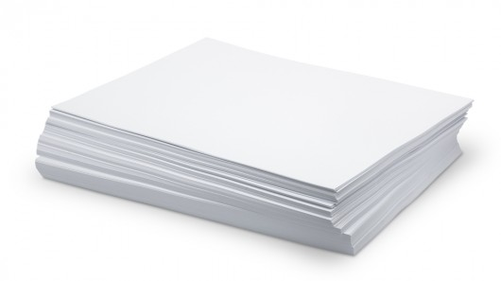
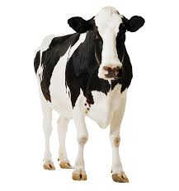
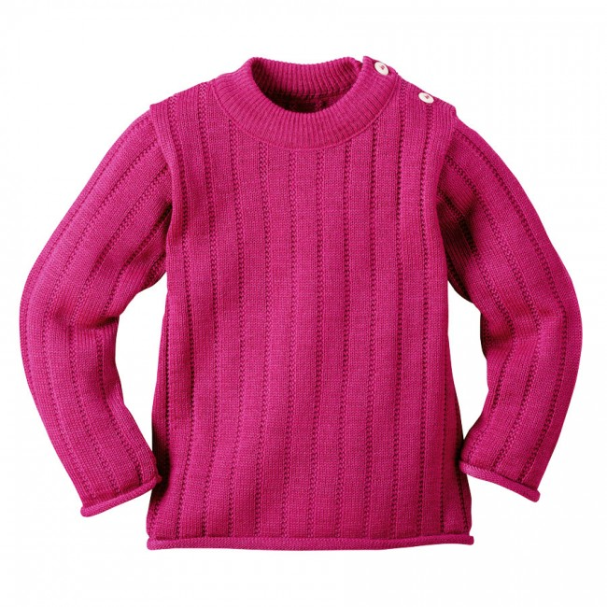
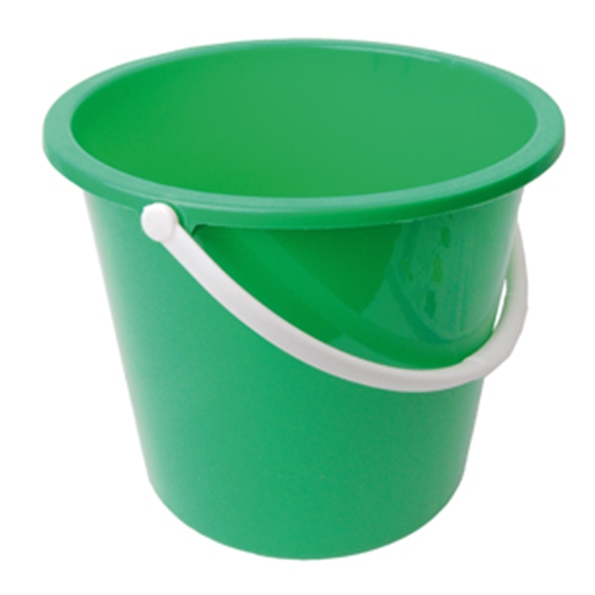
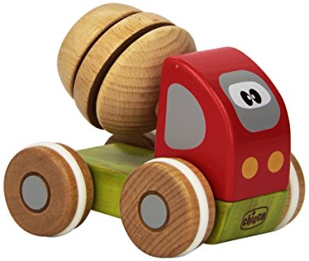
Which pictures are the odd one out and why?
Notes:
Odd one out plastic bucket and umbrella, they do not come from renewable sources

Slide 4
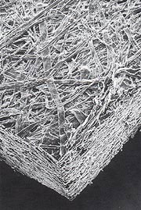
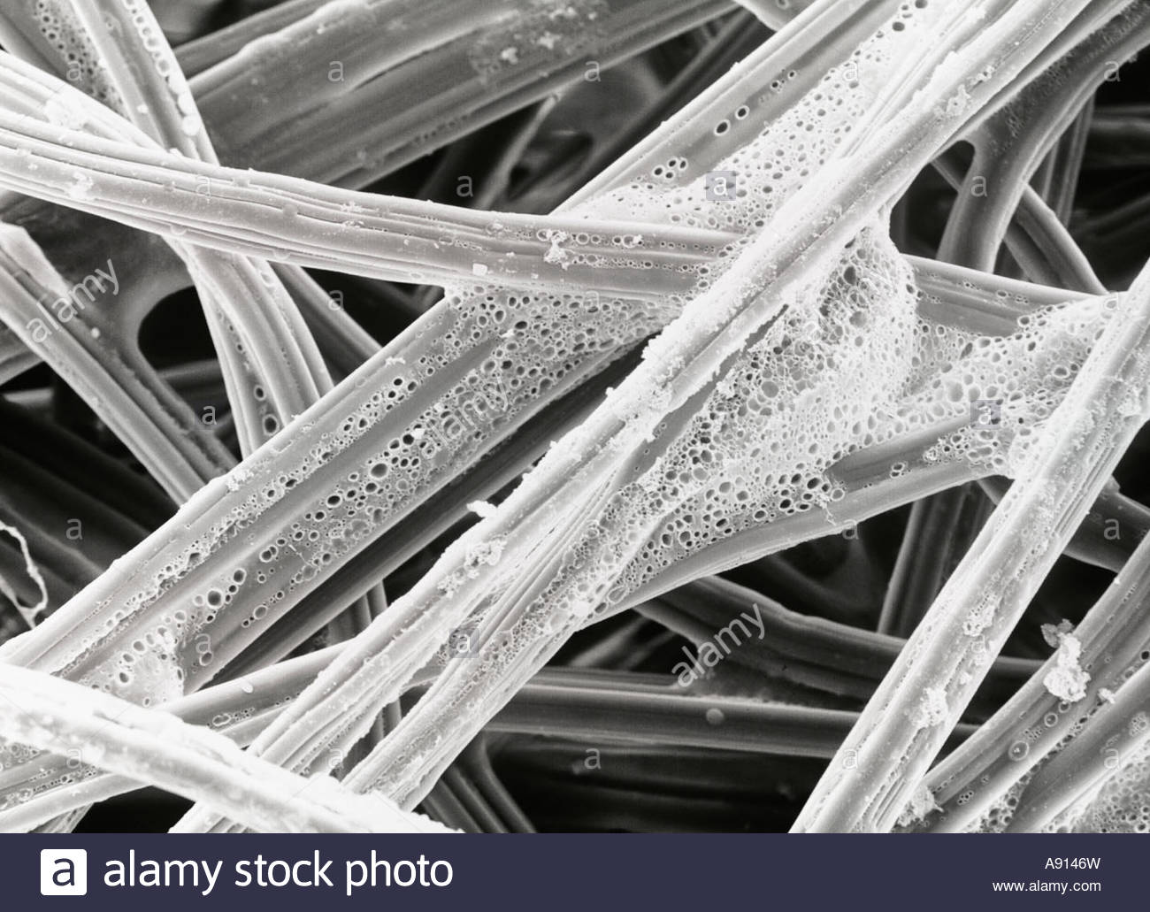
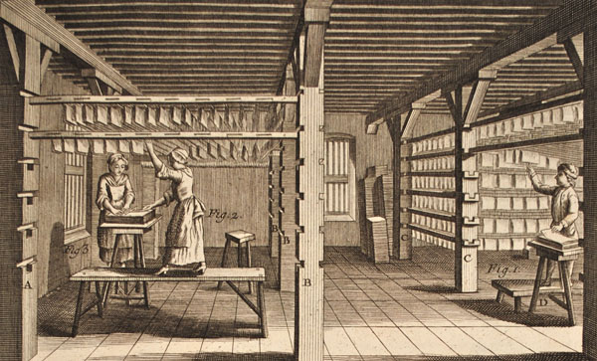
What does this picture show?
Paper under the microscope
Paper is a web like material
Paper is made from fibres
The fibres come from wood pulp
Paper making has been around for 2000 years but now it is fully automated
Notes:
Students to note key points

Slide 5
Watch the video and write down as many steps to making paper as you can

Slide 6
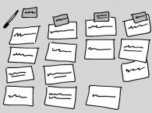
Task: Sort the cards into the correct order from the notes you have taken.
Trees are cut down
Bark is removed and cut into chippings
Wood chips are mixed with water
Boiled into a paste called wood pulp
The paper is bleached and other chemicals added to give strength
The paste is flattened out and the water is squeezed out
The flattened paste dries and becomes paper
The strips of paper are cut into smaller sheets
Notes:
Card sort activity

Slide 7
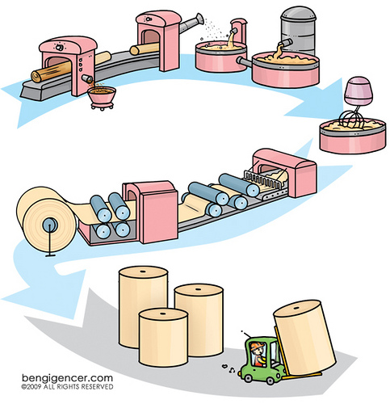
Add labels to the diagram
2) Water added
to wood chips
1) Trees cut & bark
Is removed
3)Boiled up to make wood pulp
4)The paper is bleached and chemicals added
5)The paper is flattened out
and water squeezed out
6)The flattened
Paper dries and becomes paper
7) The rolls of paper are then cut into smaller strips
Explain how old paper can be turned into paper
Notes:
Give out diagrams to students and get them to label, more able can draw a diagram if they wish

Slide 8
Paper size

Slide 10
Write down the paper type and use in your book make sure your spellings are correct.
Notes:
Ask students to try and match the correct paper types

Slide 11
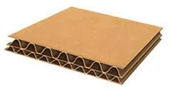
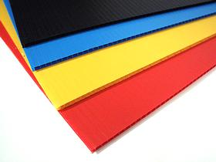
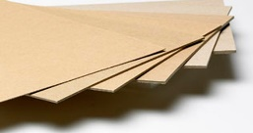
Type of Board | Use | Properties
Corrugated card | Can be made into boxes for packaging electrical goods, books etc | The wavy layer inside is called fluting which is design to absorb impact. Lightweight, can be printed on.
Mounting Board | For mounting work or for high quality models | Thick and stiff, available in a range of colours
Folding Boxboard | High quality packaging, display stands food packaging | Can be single or multi layered folds very easily can be printed on.
Corrugated Card
Mounting Board
Folding Boxboard

Slide 12
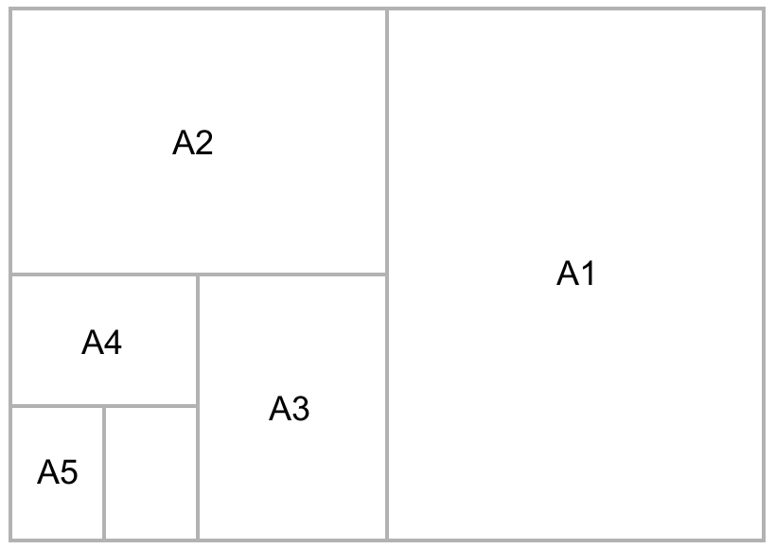
Paper size
Most materials are supplied in standard stock forms.
When specifying paper and cardboard you would choose the size (A1, A2, A3, A4 etc.)
A6 105mm x 148mm (Twice the size of A7
A5 148mm x 210mm (Twice the size of A6)
A4 210mm x 297mm (Twice the size of A5)
A3 297mm x 420mm (Twice the size of A4)
A2 420mm x 594mm (Twice the size of A3)
A1 594mm x 841mm (Twice the size of A2)
A0 841mm x 1189mm (Twice the size of A1)
The smaller the number the bigger the size of paper.
Notes:
Get students to draw the paper size diagram in their books

Slide 13
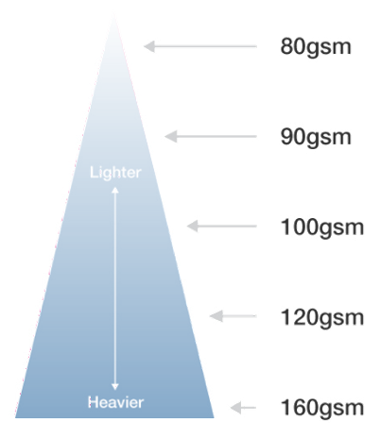
Paper Weight
Paper and card weigh is measured in g/m2 (grams per sq. metre)
The bigger the g/m2 the thicker the paper or card
When paper is over 200 gm/2 it is classed as a board
Tracing paper
Photocopier paper
Inkjet paper (special paper for printers)
Glossy paper (special paper for printers)
Recycled paper

Slide 14
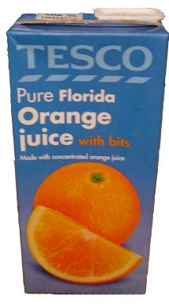
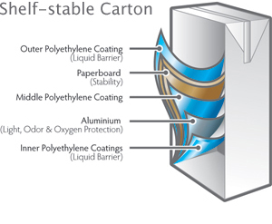
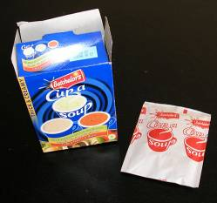
Paper & Board Composites
A composite material is defined as a material made up of two other materials with different properties.
Boards are often mixed with other materials to produce composite products with new properties.
Juice cartons are often lined with foil on the inside to make them water-tight.
Paper sachets often have a plastic lining to make them more durable.

Slide 15
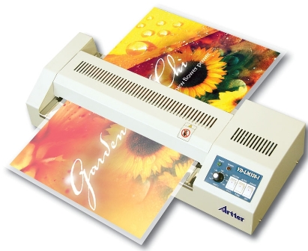
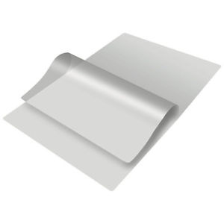
Paper Laminating
Paper can be laminated this improves its strength, finish and appearance
The paper laminating machine uses head to seal the laminated to the paper
The paper is put inside the laminates.

Slide 16
Key Points
Paper is made from pulped wood.
Paper is measured in g/m².
Thick paper is called card.
Thick card is called board and is measured in microns.
The most common paper sizes are in the ‘A series’.
Many paper based boards are composites. Board is combined with other materials to produce new properties suited to different purposes.
Paper can be laminated to improve its strength finish and appearance

Slide 17
Extension Questions
1). What does paper consist of?
Wood pulp, bleach and chemicals
2.) What is the most common material source to make paper from?
Trees with bark removed.
3.) What are the main stages involved in making paper?
Cut & remove bark, add water to wood chips, boil chips, bleach/chemicals, flatten and squeeze water out, dries, rolls cut into strips.
4) What paper size is twice the size of A4 paper?
A3
5 ) How is board different from paper?
Over 200 grams per sq metre.
6 ) What does a “composite material mean?”
Defined as a material made up of two other materials with different properties
7 ) Name a composite material and what product is could be used for.
Juice cartons are often lined with foil on the inside to make them water-tight or Paper sachets often have a plastic lining to make them more durable.

Slide 18
Facts about paper wastage you never knew
https://www.youtube.com/watch?v=N0Y4ilkA3Qw

