Slide 1
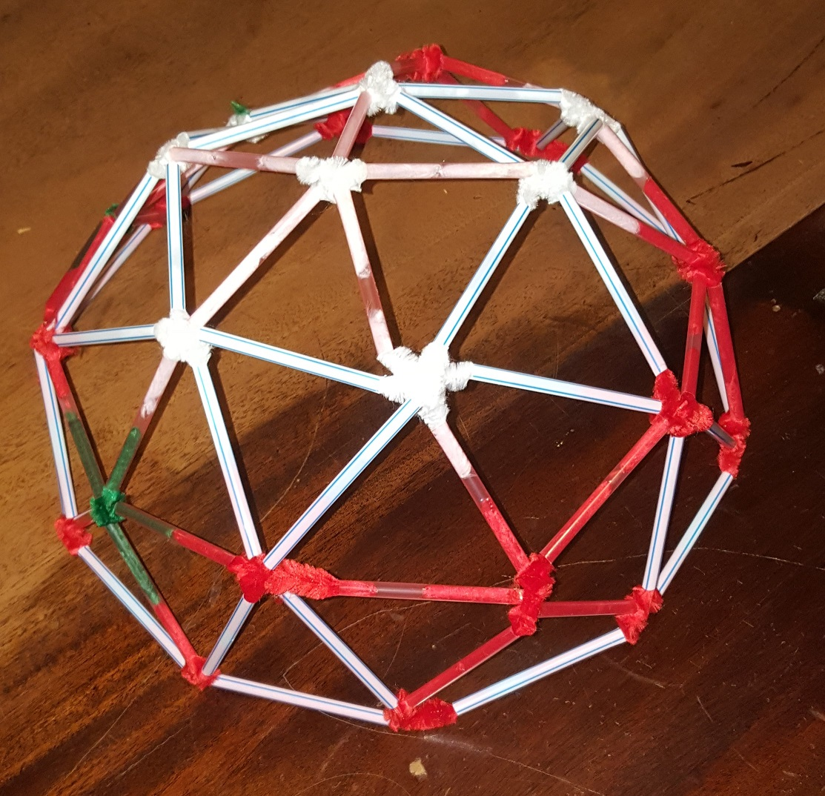
Super Structures
Making a geodesic dome
Notes:
Image is from OpenClipart.
Appreciation to Filitsa, Paola, Col and Jamie who built this example.

Slide 2
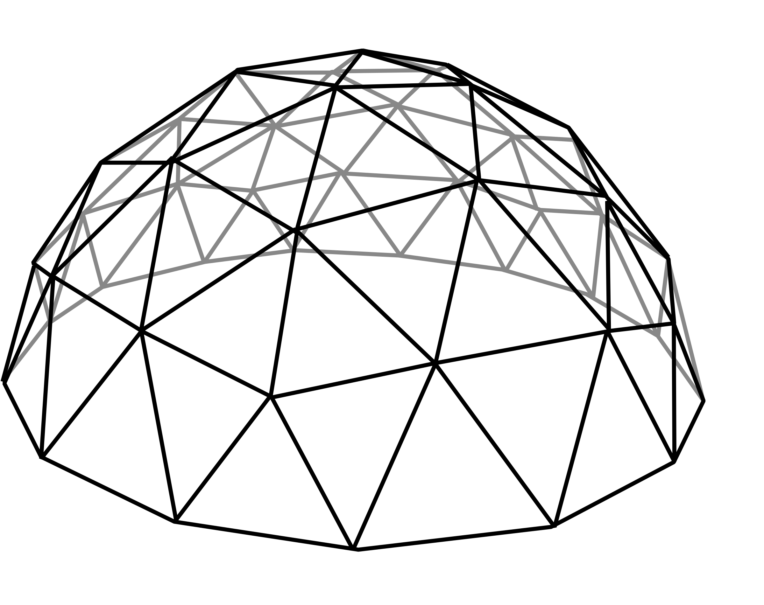
Geodesic Domes
A geodesic dome is a type of structure
It is strong (for its weight) because it is made from triangles
We are going to make a geodesic dome from straws and chenille stems
Notes:
Animated slide – click once for a small triangle, twice for a larger triangle.
This slide could be supported by showing images of geodesic domes from the additional websites listed on the lesson plan.
Chenille stems are pipe cleaners.

Slide 3
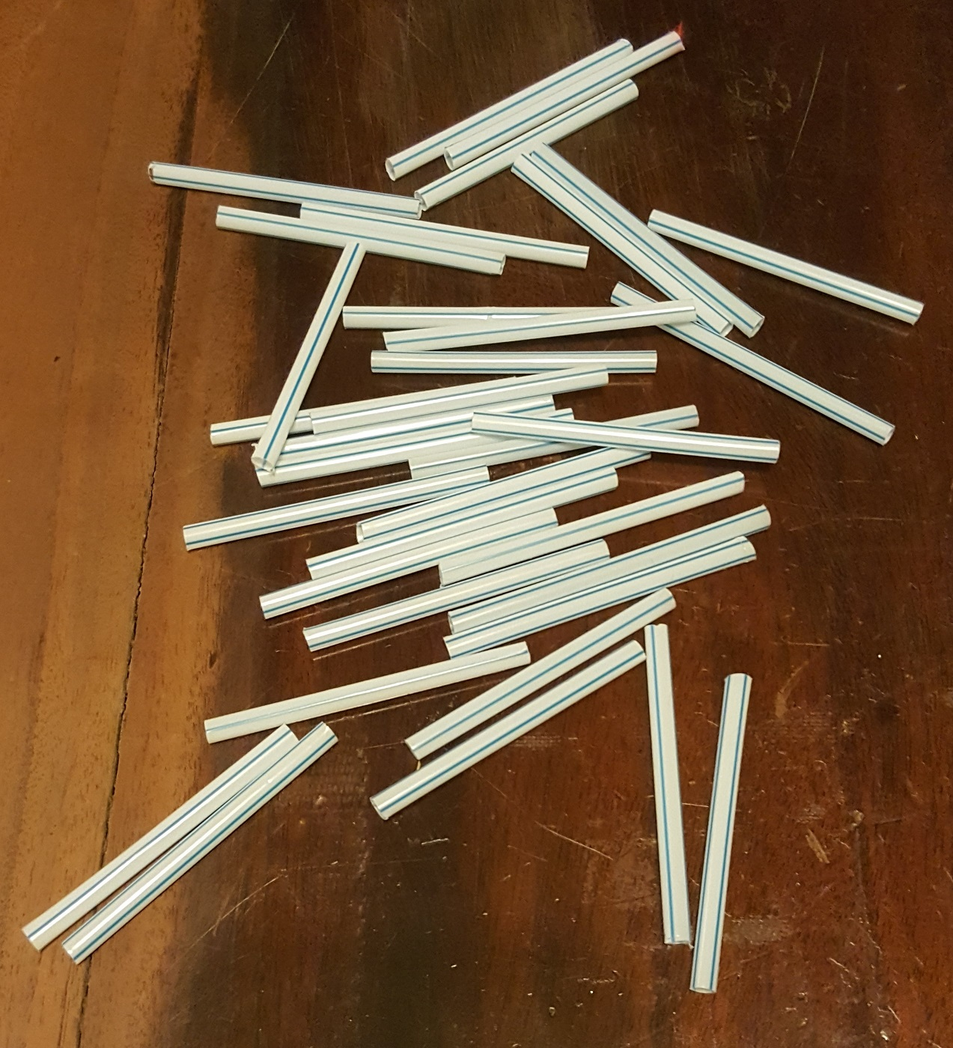
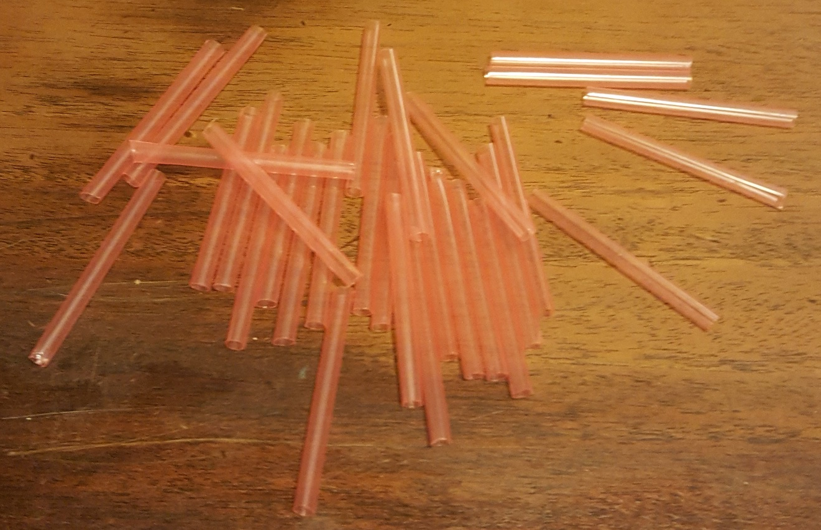
Long straws
You will need…
Item | Number needed
Long straws (6 cm) | 35
Short straws (5.3 cm) | 30
4-way connector | 10
5-way connector | 6
6-way connector | 10
To make the connectors needs a total of 68 pieces of chenille strip
Short straws
Notes:
The length of the straws is critical to success. The short straws should be 0.885 x the length of the long straws. The straws could be cut individually using scissors. If prepared in advance, the most accurate method of cutting is typically to use a guillotine with a guide/fence set to the required length. It can make it easier to distinguish the different lengths if different colours of straws are used.
Technically the straws are called members, as they are parts of a structure – however, experience shows some learners find this term confusing. Further, members that are in compression are referred to as straws and members that are in tension are referred to as ties.
Chenille strips are pipe cleaners. These pieces should each by 70-80 mm in length (e.g. cutting a standard 30 cm length into half, then half again, to make four equal parts).

Slide 4
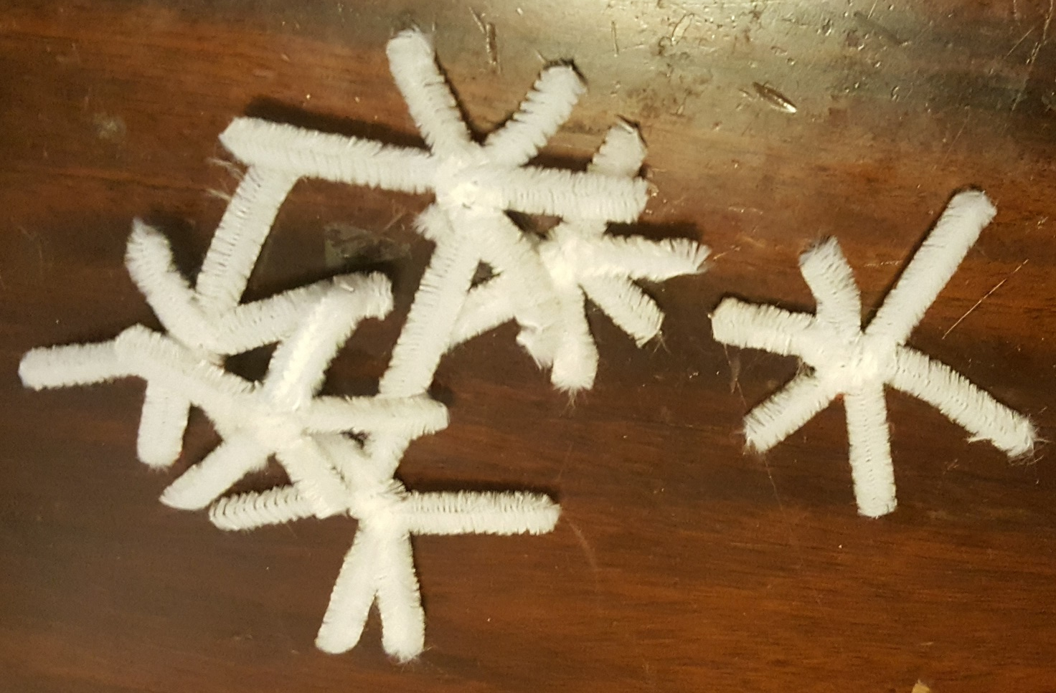
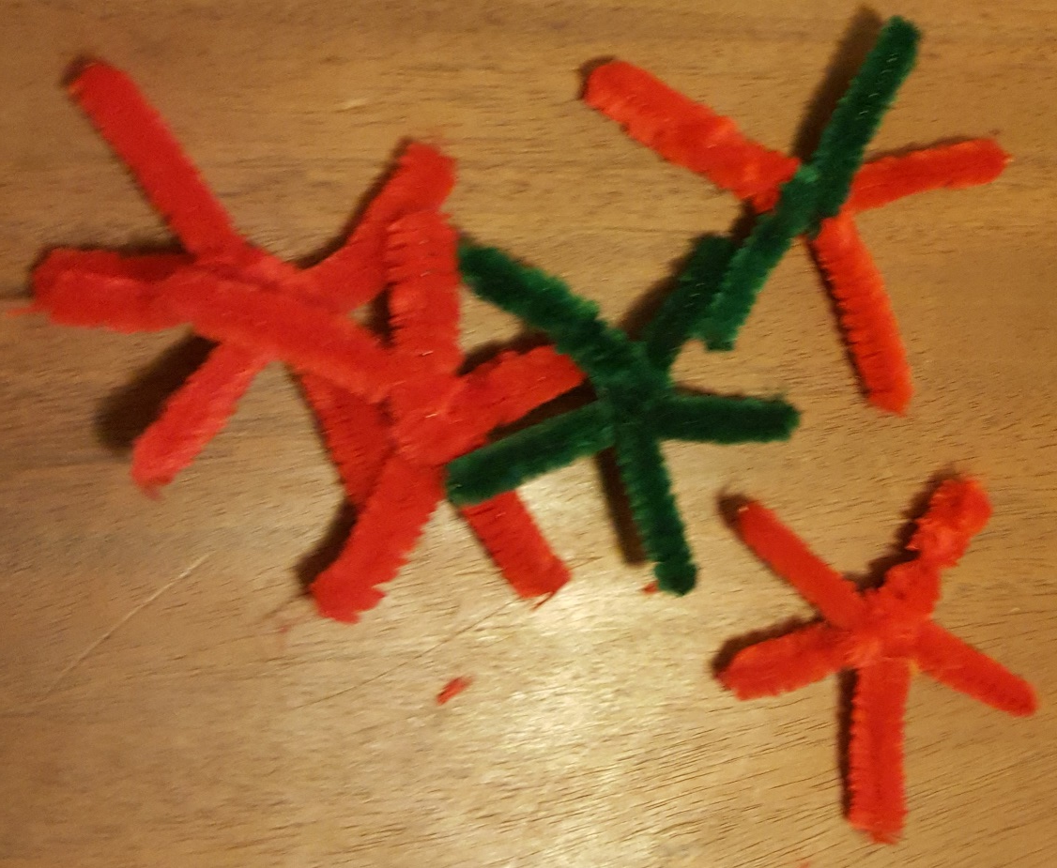
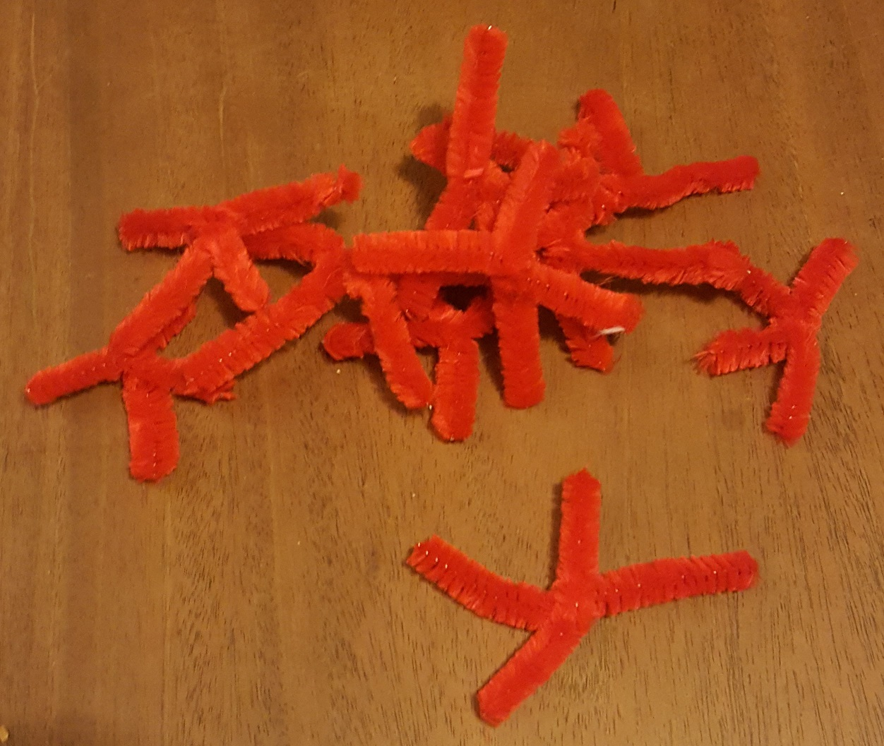
Making the connectors…
5-way connectors
Twist three chenille strips together then twist two ends into one
4-way connectors
Twist two chenille strips together
6-way connectors
Twist three chenille strips together
10 x
10 x
6 x
Notes:
Chenille strips are pipe cleaners. These pieces should each by 70-80 mm in length (e.g. cutting a standard 30 cm length into half, then half again, to make four equal parts).

Slide 5
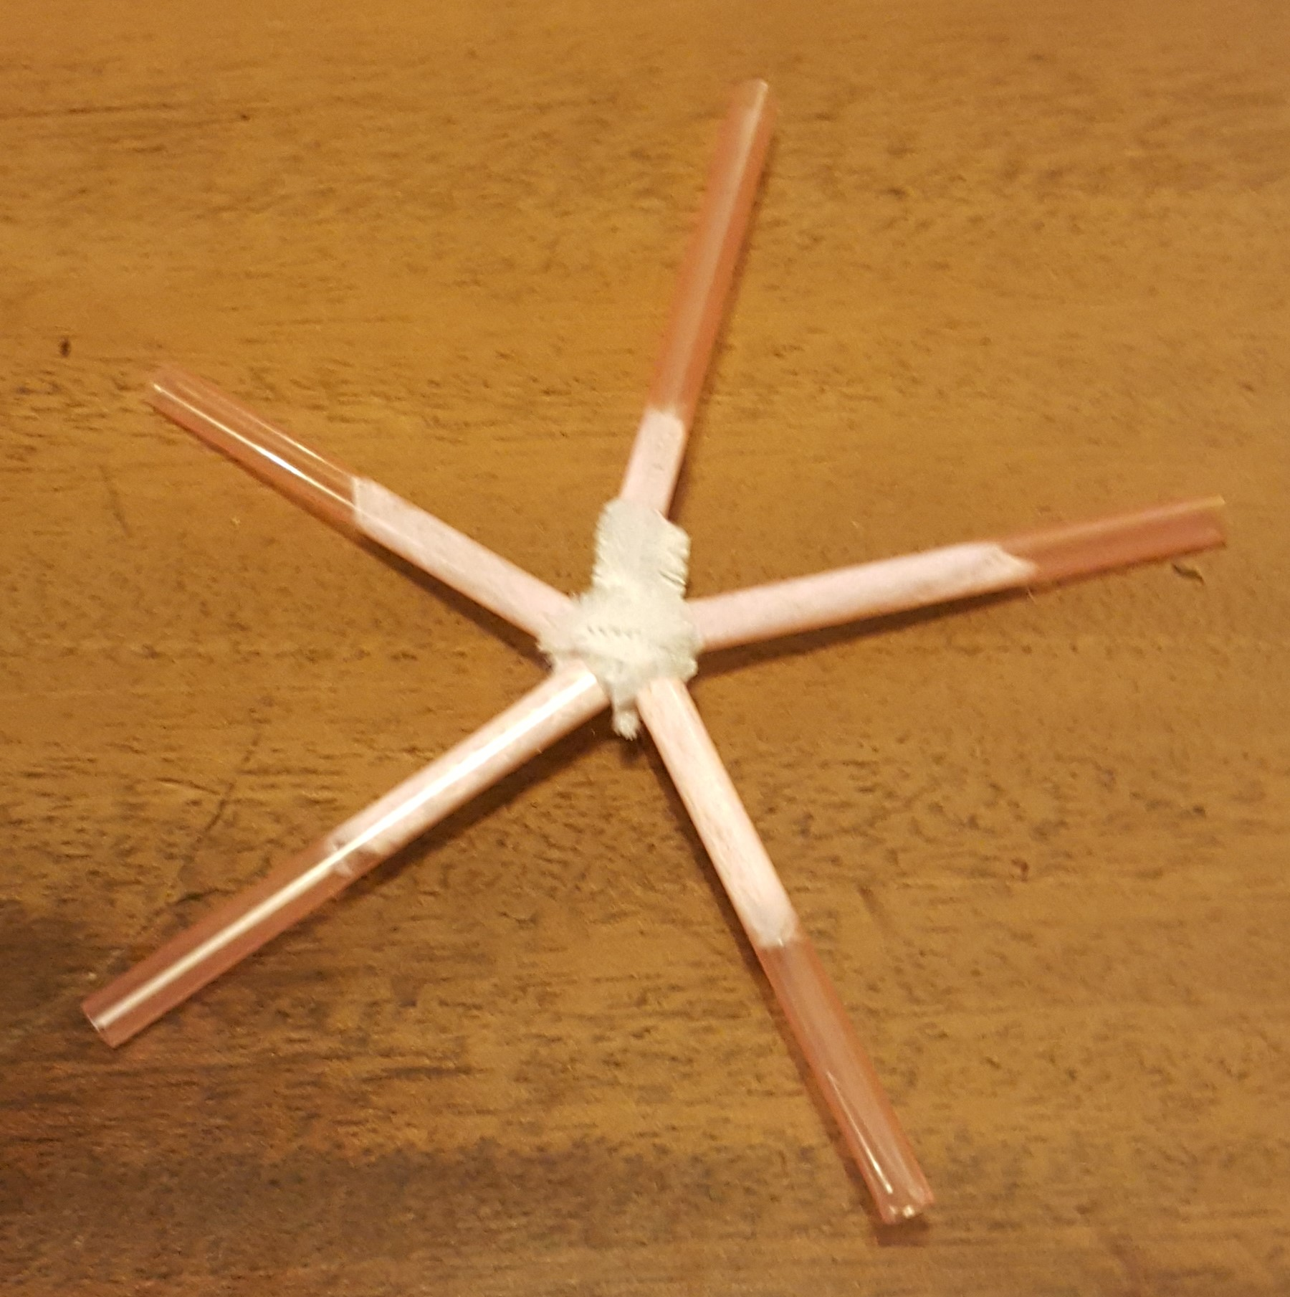
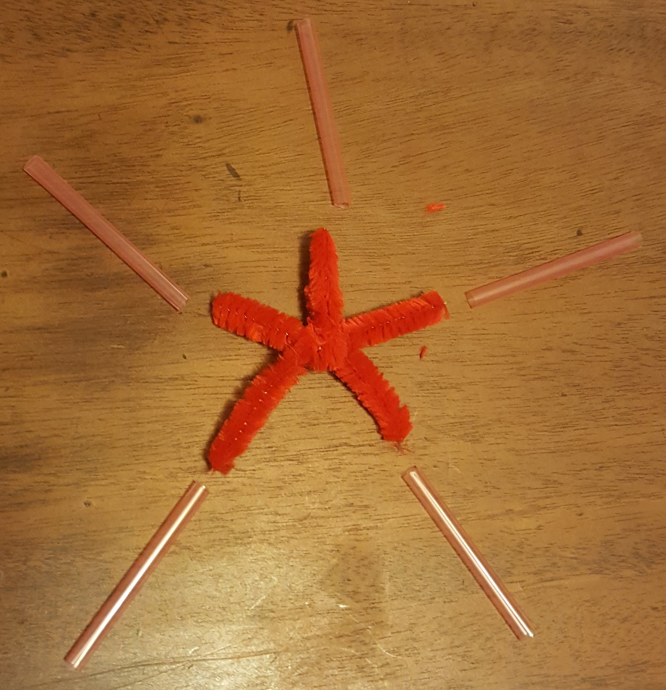
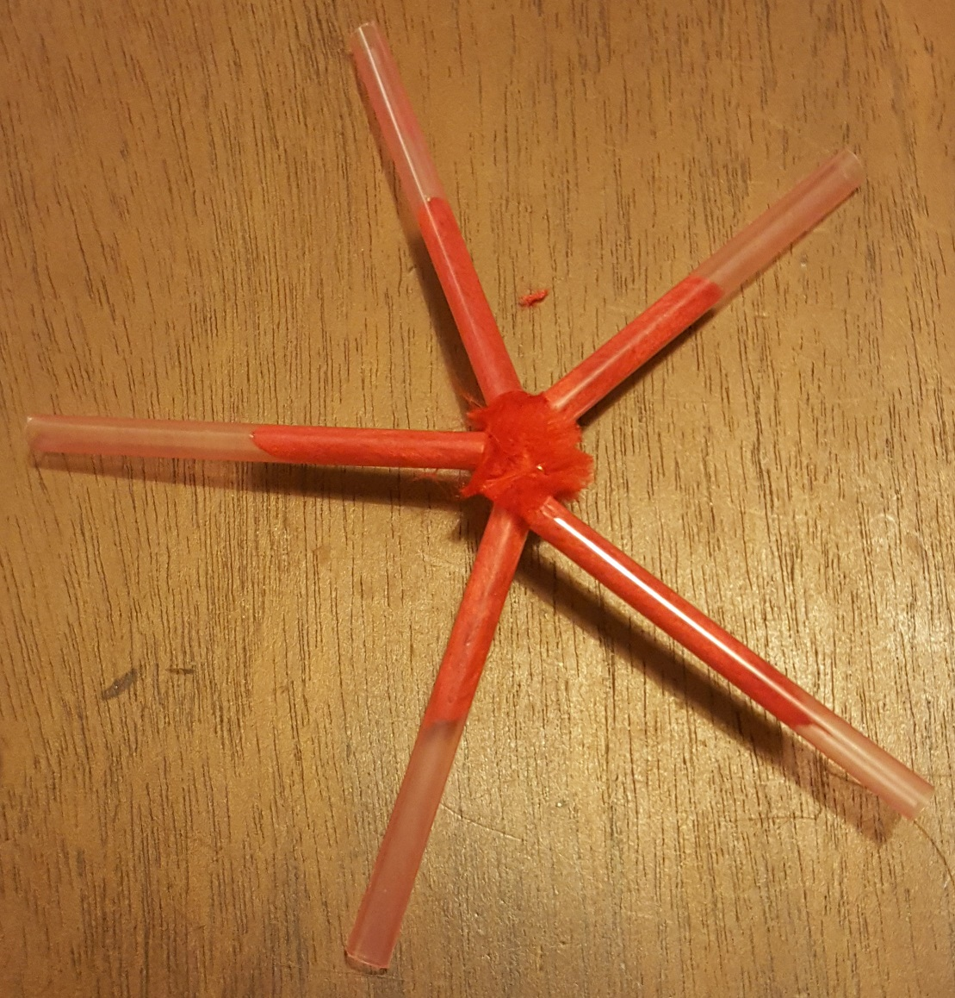
Making stars
Push 5 short straws onto the ends of a 5-way connector
Repeat this five more times (making 6 stars in total)
Notes:
The chenille strip should fit snugly into the straw. A square of sticky tape over the connector and straws can assist in holding the parts together if the fit is loose.

Slide 6
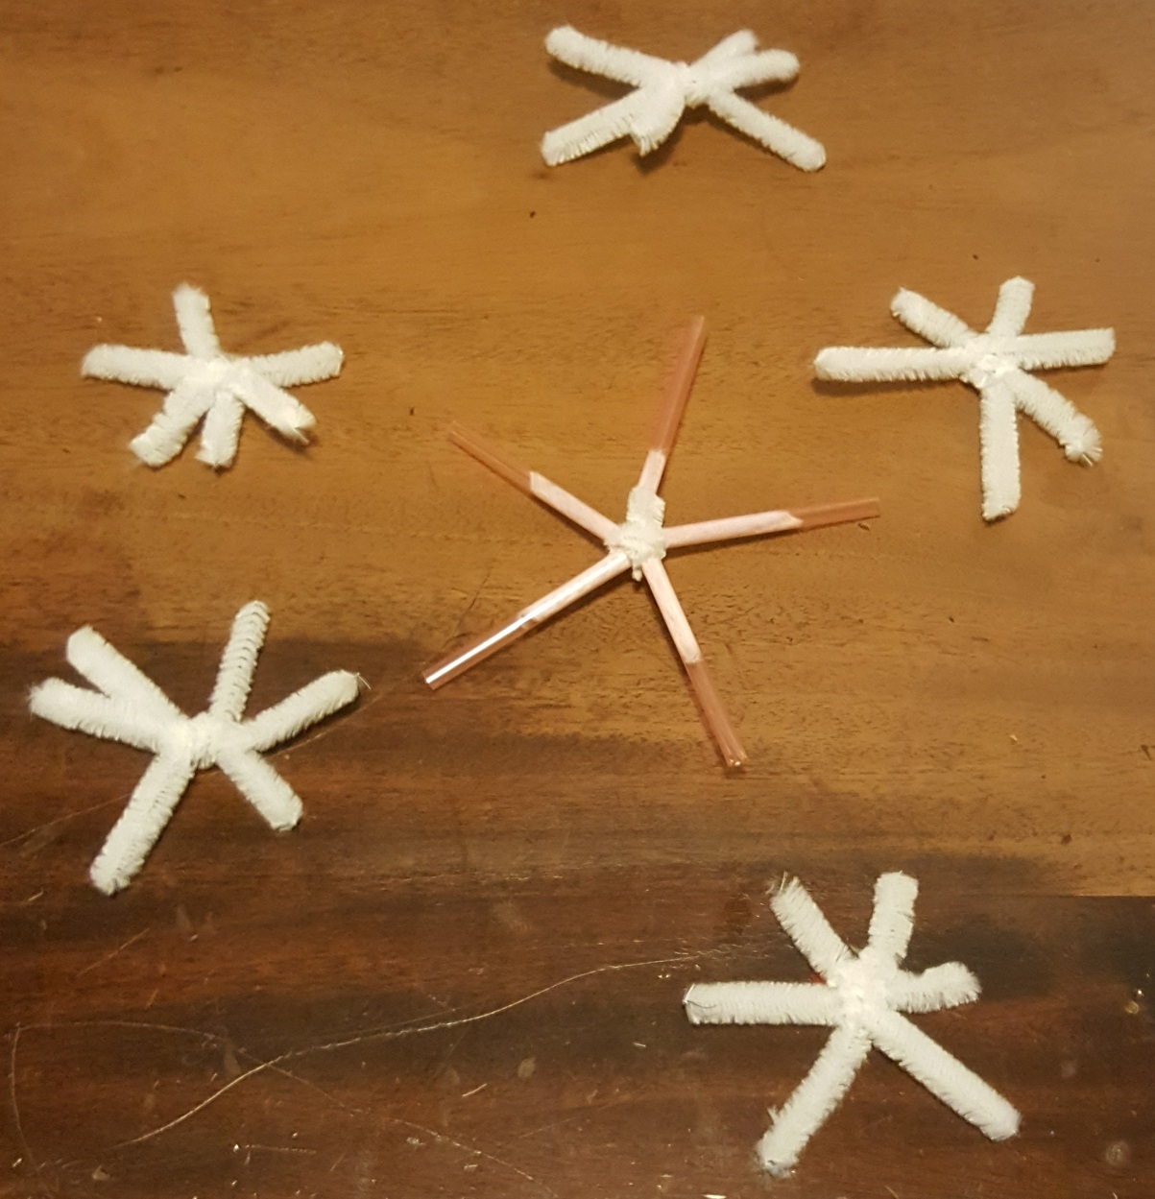
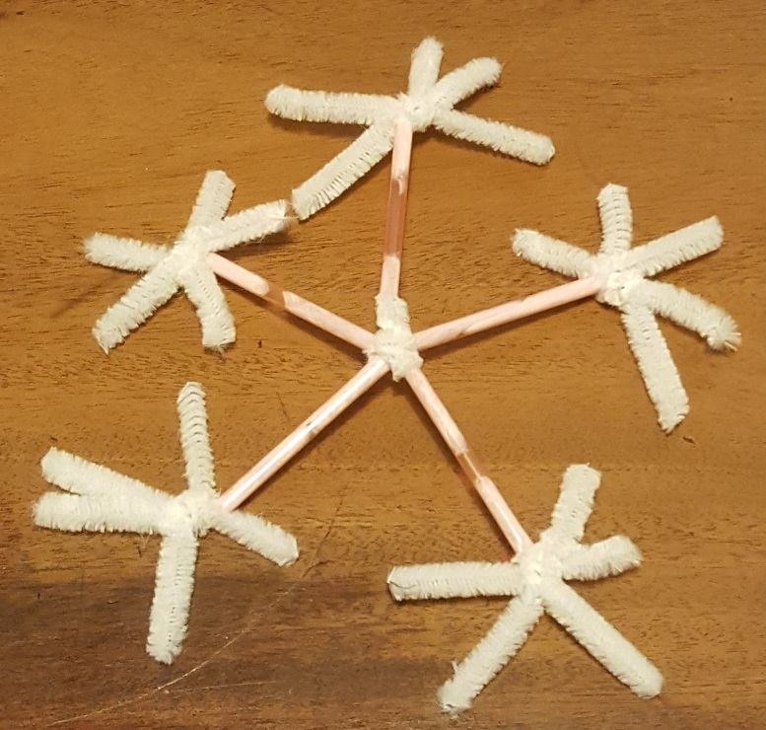
Adding connectors
Take one star - insert 6-way connectors into the outside end of each straw

Slide 7
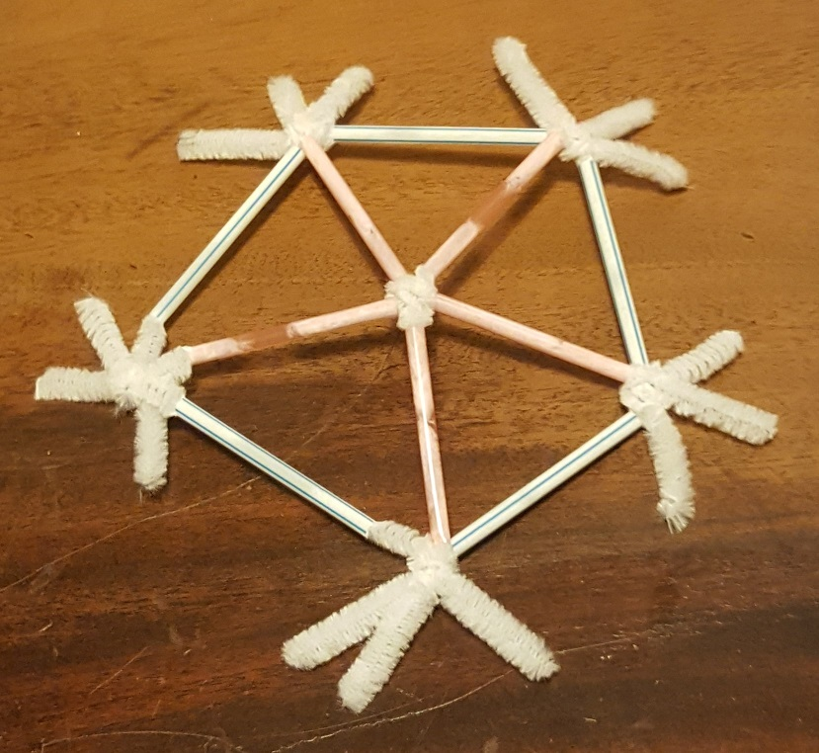
Make the first pentagon
Add long straws between the two legs of each connector nearest the star
The outline of the long straws is the shape of a pentagon
Notes:
The centre of the pentagon should be slightly raised relative to the outer shape.

Slide 8
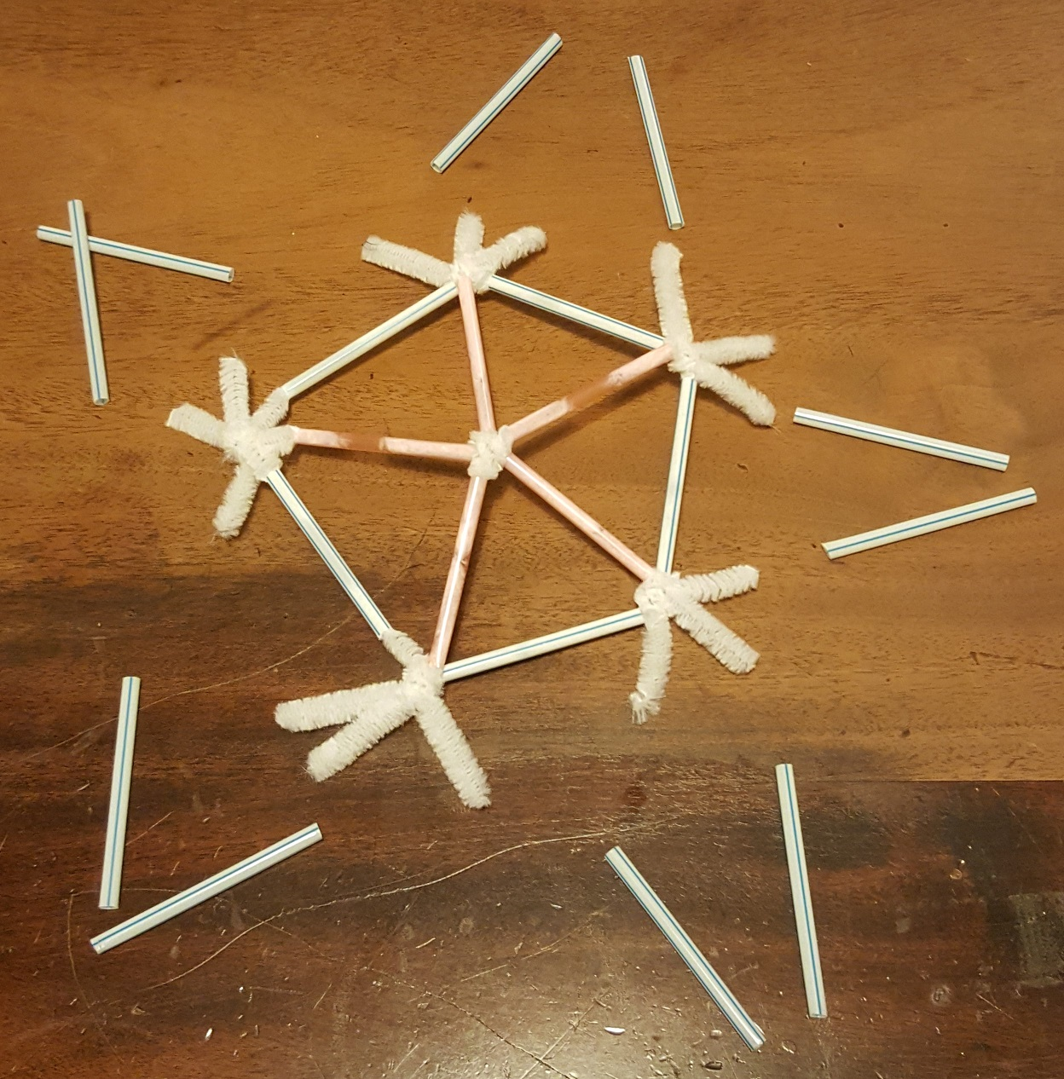
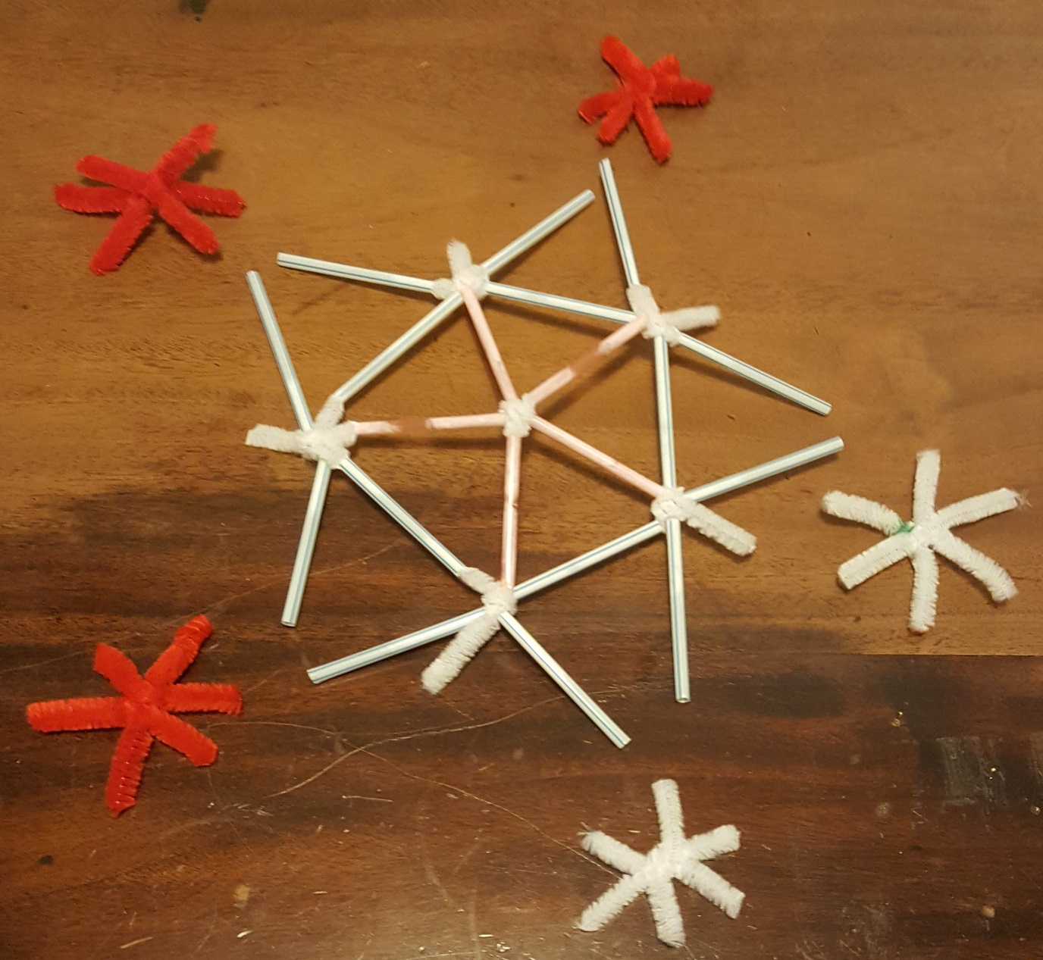
Extending the pentagon
Add long straws to the two outer legs of each connector

Slide 9
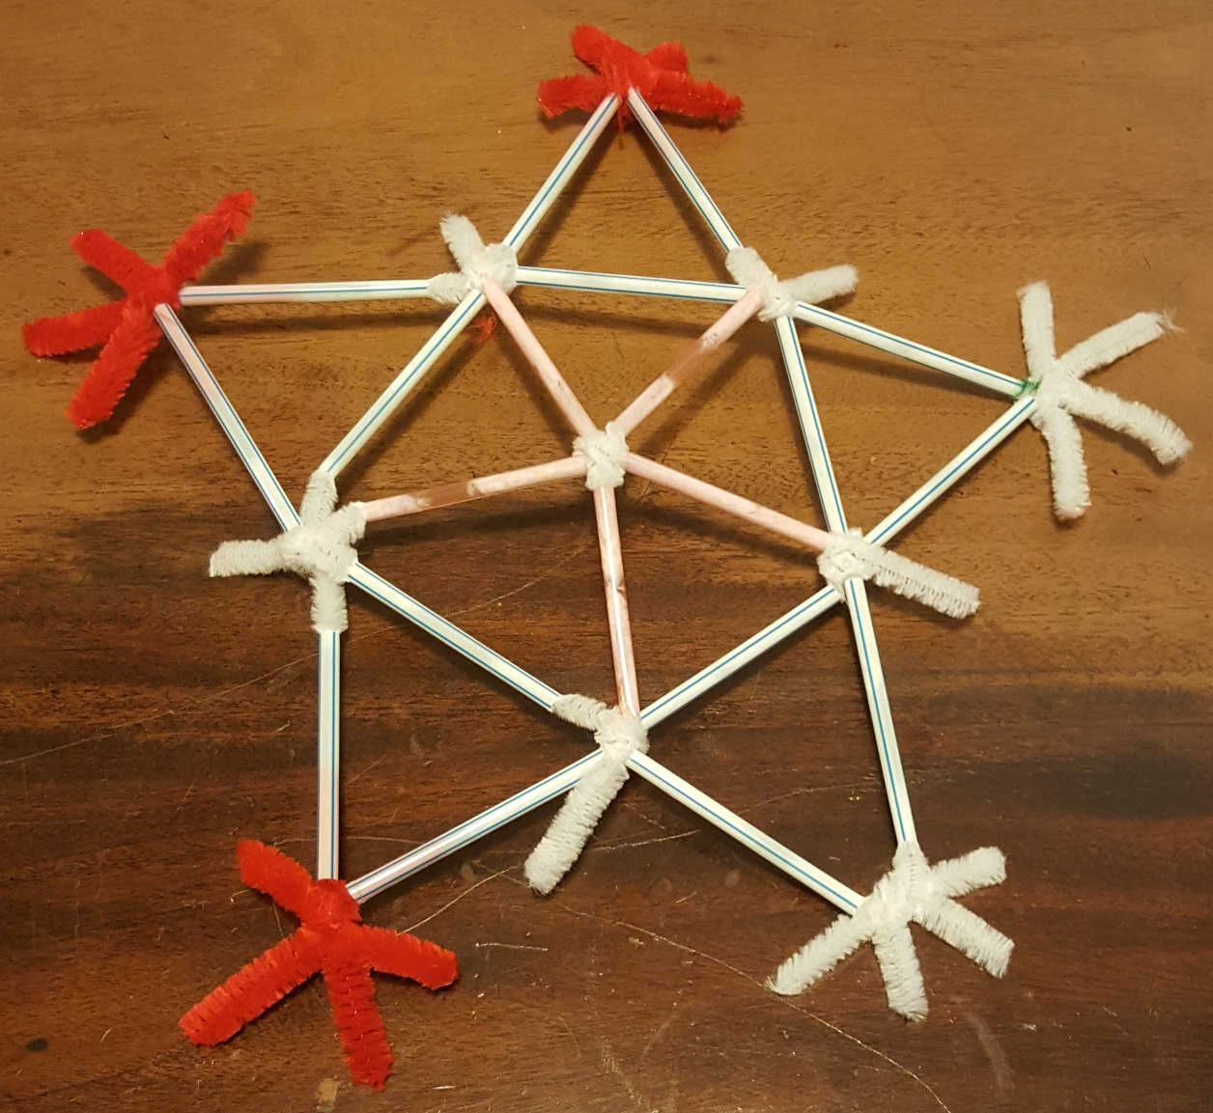
Adding connectors
Add 6-way connectors to the outer long straws (5 in total)

Slide 10
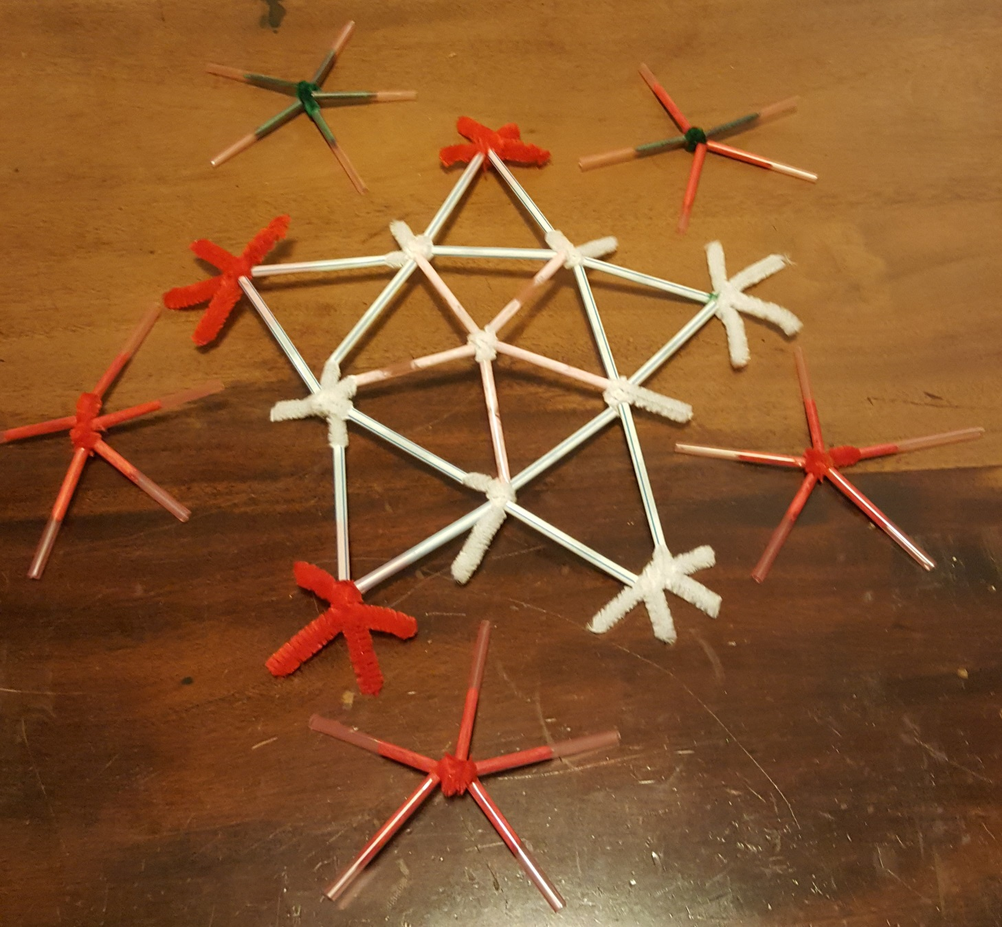
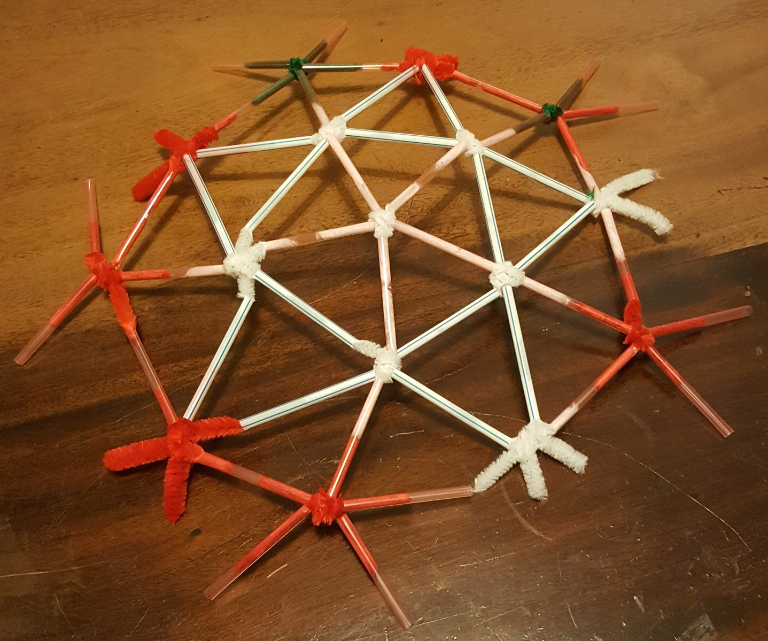
Adding the stars
Add the five other stars made at step 1. Three straws from each star should attach to connectors.
Notes:
The centre should be slightly raised relative to the outer edge – it should not be pushed down to be level. It may assist if one or two team members support the structure as another adds the triangles.

Slide 11
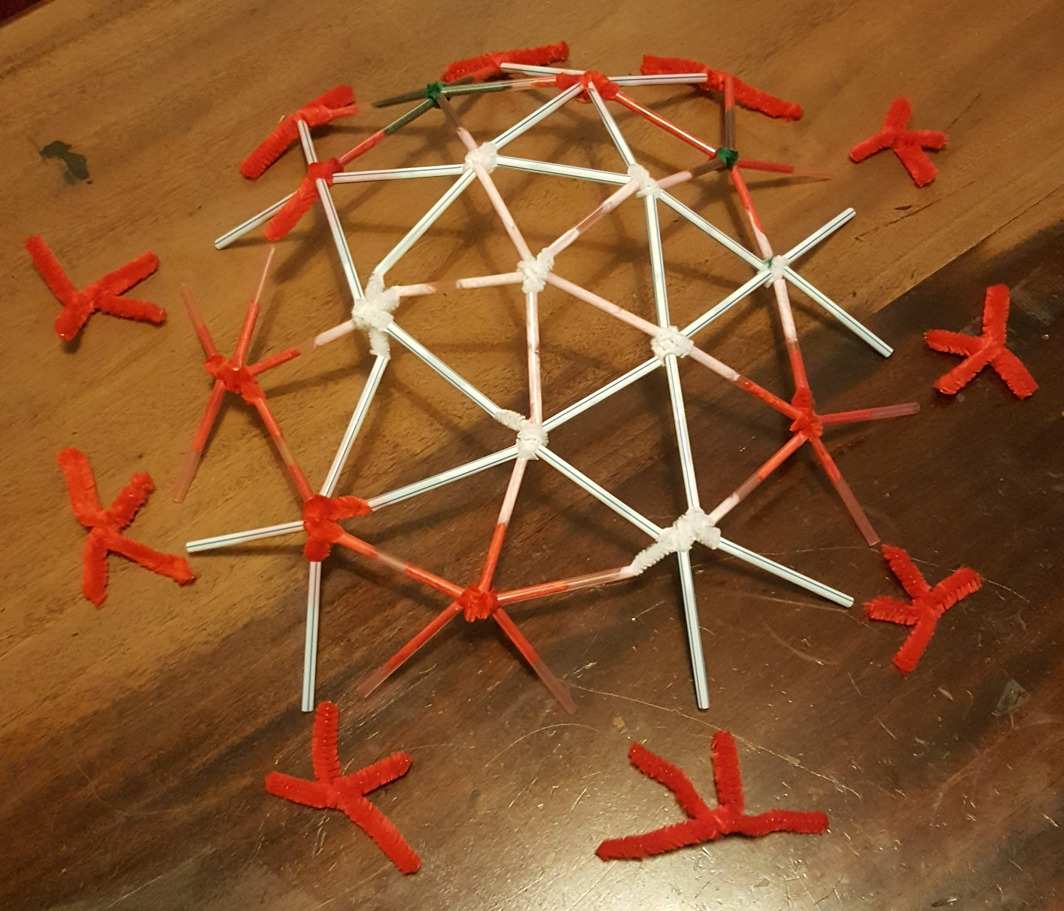
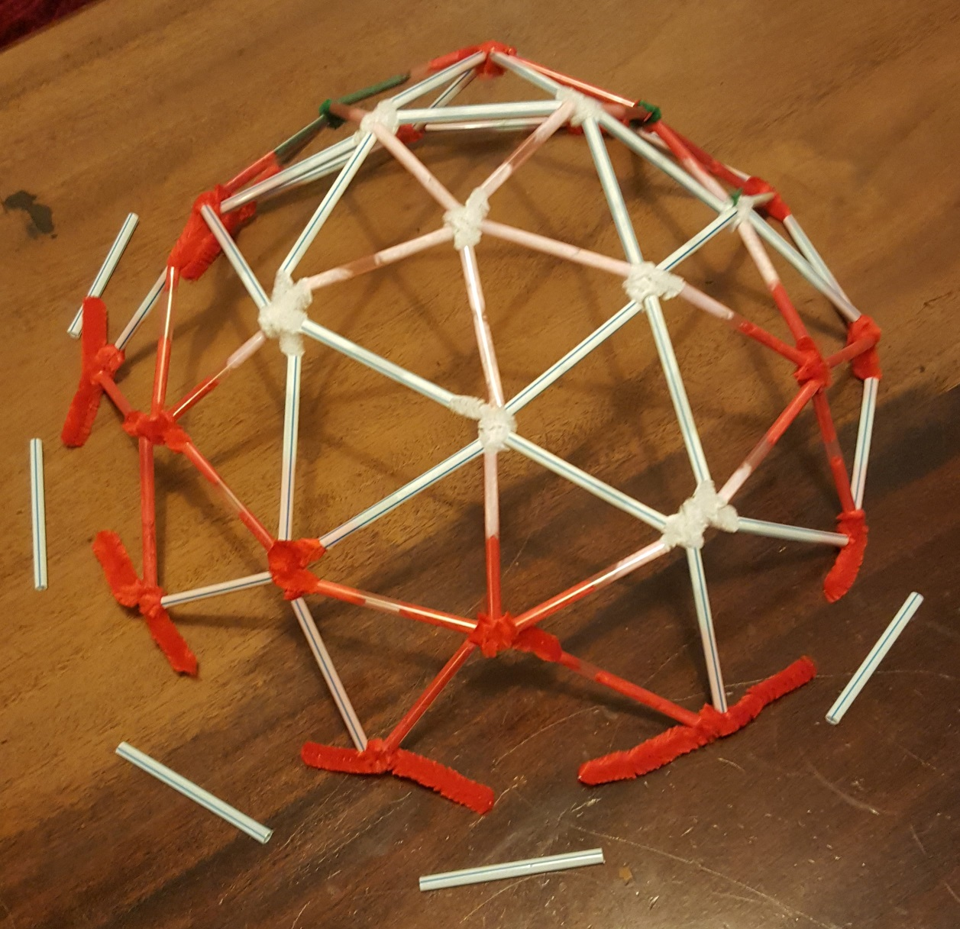
Adding the final connectors
Add 4-way connectors to the ends of all the outer straws (working round the dome)
Notes:
The centre should be raised significantly relative to the outer edge – it should not be pushed down, or this may force the connectors out. If necessary, a square of sticky tape could be placed over a connector to hold a joint secure. It may assist if one or two team members support the structure as another adds the triangles; alternatively, if a suitable sized bowl is available, this could be inverted and used to support the structure.

Slide 12
Completing the base of the dome
Add long straws between each connector…
… and congratulations, the dome is complete!
Notes:
The centre should not be pushed down, or this may force the connectors out. If necessary, a square of sticky tape could be placed over a connector to hold a joint secure. It may assist if one or two team members support the structure as another adds the straws; alternatively, if a suitable sized bowl is available, this could be used to support the structure.

