Slide 1
Magnet Maze
Making a maze on a bottle –
then using a magnet to move an item inside the bottle around the maze

Slide 2
Magnetic materials
Magnets can stick to some metals, but not others.
Magnetic materials include iron, nickel and metals that contain them. This includes some steels.
A 1 pence coin is made from copper-plated steel.
Place a magnet next to a 1 pence coin. What happens?
Plastics are not magnetic.
Notes:
1p coins are made from copper-plated steel. This means that it is steel covered with a thin layer of copper. This is magnetic as steel contains iron (note that if a pre-1992 1p coin is used then this will not be magnetic, as these were made from copper plated bronze, so it will not work for this activity).

Slide 3
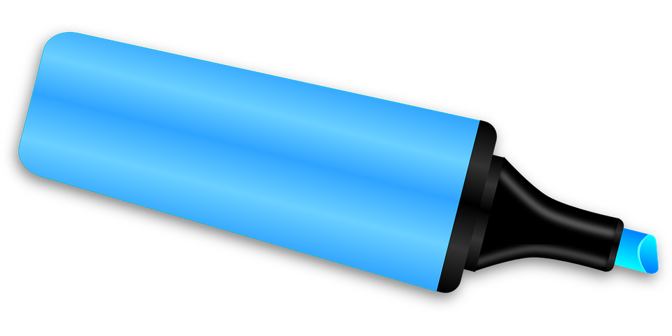
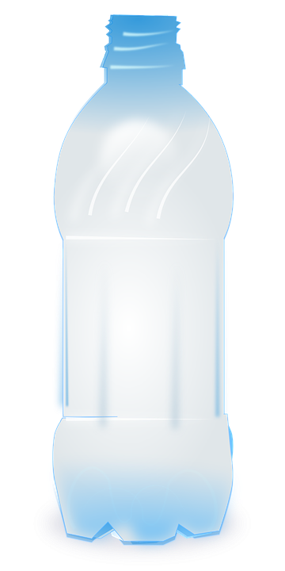
Making a magnetic maze
Use a marker pen to mark the start and finish points of your maze on the bottle.
Draw your maze or track layout linking the start and finish points.
You can use different coloured pens to make your design look more interesting.
Remember to use all sides of the bottle, going around it – make your maze as hard or easy to complete as you like!
Mark finish point
Draw maze layout
Mark start point
Notes:
Ensure bottles have been washed and are clean prior to use. All branding, labels etc. and the bottle top should be removed in advance. Different coloured marker pens can be used to add visual interest. The bottles, being plastic, are non-magnetic.
The maze should be slightly wider than a 1p coin. The finish point could be the exit/opening from the bottle.

Slide 4
Testing your maze
Place your 1 pence coin into the bottle at the start point.
Place your magnet on the outside of the bottle, also at the start – the magnet should attract the coin.
Use your magnet to guide the coin along the track to complete the maze!
Notes:
Discuss how magnetic forces can act at a distance.

Slide 5
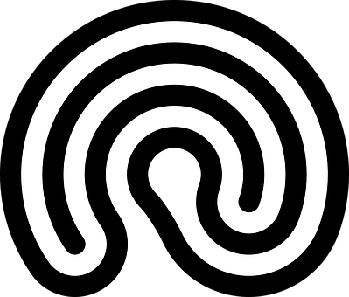
Now Try This …
Try replacing the coin with a ball bearing, a paper clip, a plastic coin and a small piece of wood.
List which ones work well and which do not. Why do you think this is?
Try drawing different maze layouts and use different sized bottles to create a range of products! Be creative!
Notes:
Teacher could also discuss sustainability – e.g. re-use of plastic bottles to save plastic waste. Ball bearings and paper clips are made from steel, so contain iron, and thus will also work. Plastic and wood are non-magnetic and so would not work. To illustrate the effect any small plastic or wood piece can be used.

