Slide 1
Lighter by Far
Measuring how the light from a torch changes with distance

Slide 2
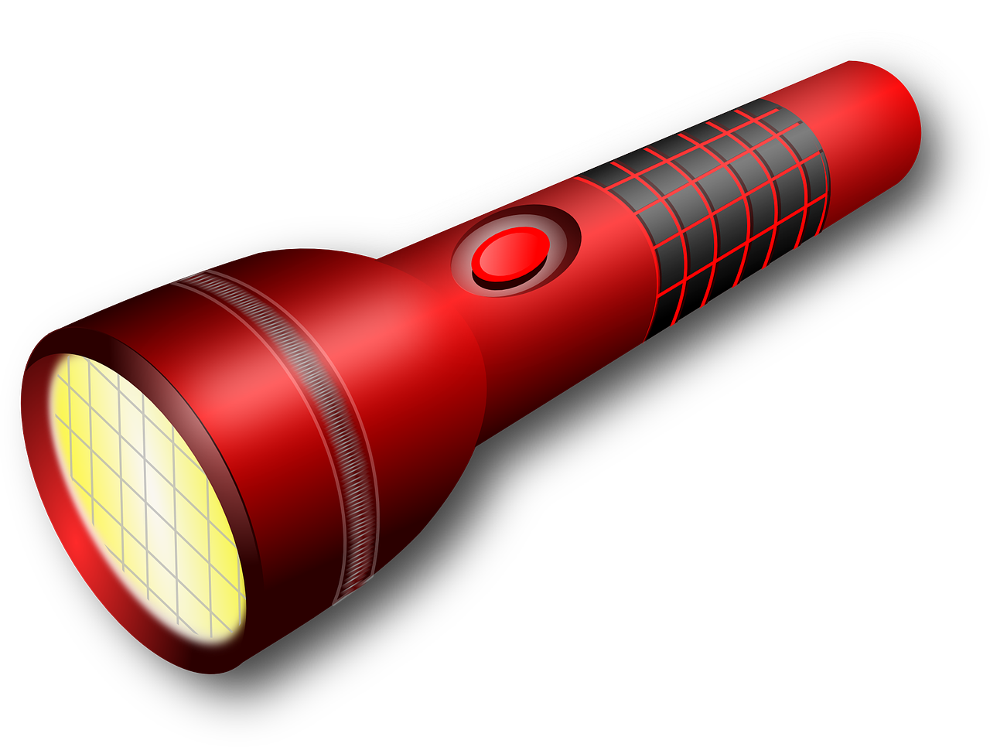
Preparation
Attach a sheet of graph paper to the wall so it’s centre is 0.6 meter up from the floor. (That’s the height of a desk).
Measure distances of 0.5 m, 1 m, 1.5 m, 2 m, 2.5 m and 3 m in a straight line from the graph paper. Mark each distance with a piece of masking tape.
Standing at the first piece of tape, hold the torch so it is pointed at the graph paper and held at a height of 0.6 m.
Notes:
The height of the graph paper and holding the torch is based on the height of school desks for 7-9 year olds specified in BS EN 1729 (0.59 m) with a small allowance, as the torch could be positioned on the table top. This value will need to be adjusted if desks are used and they are of a different size are used.

Slide 3
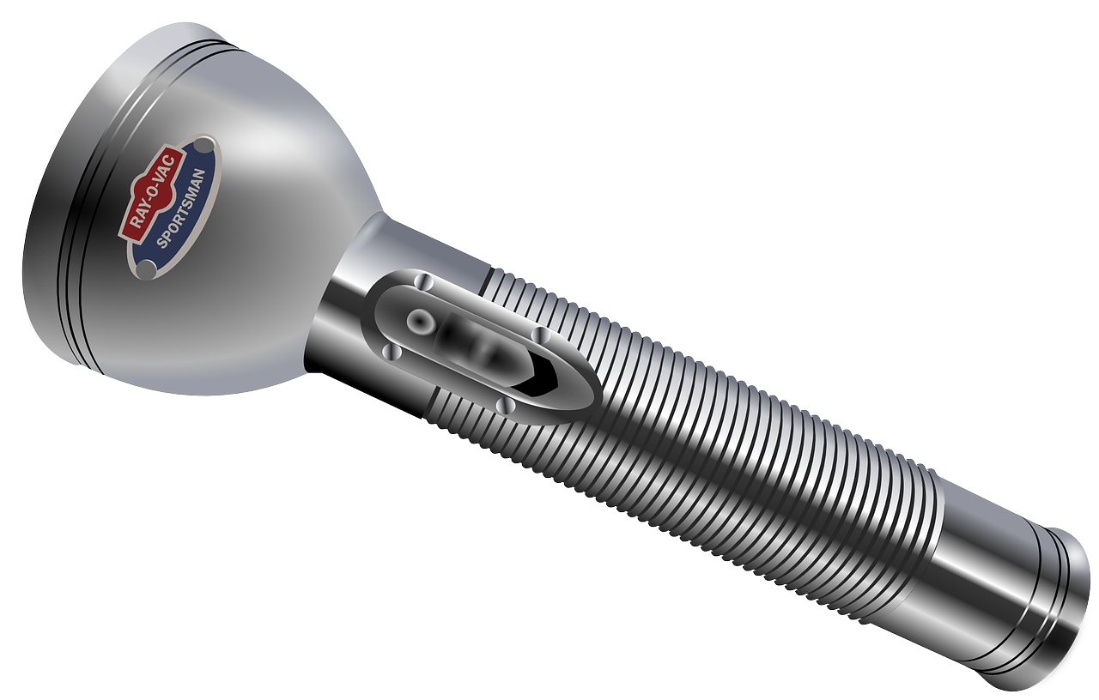
Measurement
Turn on the torch.
Turn off the lights.
Measure the light on the graph paper by counting the squares that are illuminated.

Slide 4
Recording and Presenting Results
Record your result in a table.
Repeat steps 3-6 standing at the next piece of tape, 0.5 m back each time.
Plot a graph showing your results. What does this show? What is the reason for this?
Distance, m | 0.5 | 1.0 | 1.5 | 2.0 | 2.5 | 3.0
Number of squares
Notes:
The table could be adjusted for increased lengths if necessary.

Slide 5
Now try this…
Place the torch at 3 m from the wall.
Hold up a shape 2.5 m from the wall (0.5 m from the torch), so that the torch casts it’s shadow.
Measure the size of the shadow.
Move the shape towards the wall in steps of 0.5 m, measuring the shadow each time.
Record your results in a table and plot them in a graph.
What does this show? What is the reason for this? Was there anything else you observed about the shadow?

