Slide 1
Investigating Electricity
Investigating how lamp brightness changes with different voltages

Slide 2
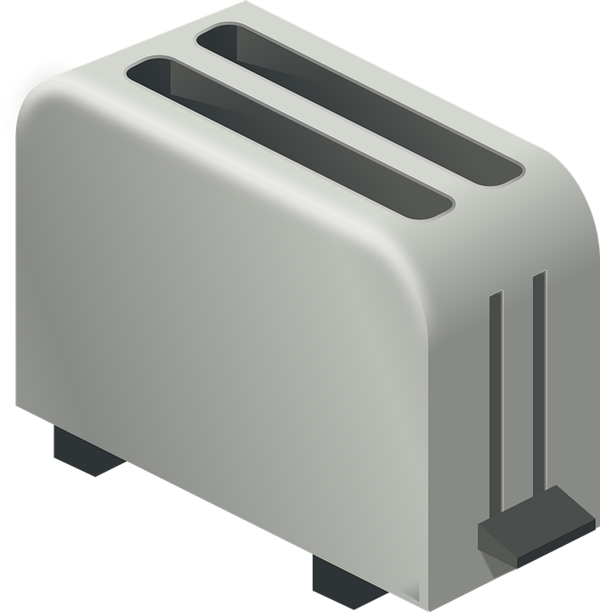
What is electricity?
Electricity can be used to power different products, such as kettles, toasters and lamps.
Current is the flow of electricity round a circuit. It is measured in amps.
Voltage is the pushing of electricity round a circuit. It is measured in volts.
The more push, the more current can flow - the bigger the voltage, the bigger the current.
Notes:
Show examples of and ask learners to give examples of devices that are powered by electricity. This slide can be used or adapted depending on prior knowledge of learners.

Slide 3
Circuit 1
Connect one end of a black crocodile clip to the black wire of the battery holder. Connect the other end to any contact on the lamp holder.
Connect one end of a red crocodile clip to the red wire of the battery holder. Connect the other end to the remaining contact on the lamp holder.
Build the circuit shown below.
+
AA battery 1
Lamp (in holder)
What happens when the battery is connected to the lamp?
Why does this happen?
Notes:
Crocodile clips should be used to assemble the circuits. The battery should be placed in a battery holder and the lamp in a lamp holder for ease of connection. Learners should see that the lamp shows a low level of brightness.

Slide 4
Circuit 2
You can do this by changing Circuit 1.
Unclip the end of the red crocodile clip that is connected to the lamp holder. Connect this end to the black wire of battery clip 2.
Connect one end of a second red crocodile clip to the red wire of battery holder 2. Connect the other end to the free contact on the lamp holder.
Build the circuit shown below.
+
+
AA battery 1
AA battery 2
lamp (in holder)
What happens to the lamp now?
Why does this happen?
Notes:
Crocodile clips should be used to assemble the circuits. The batteries should be placed in a battery holder and the lamp in a lamp holder for ease of connection. Learners should see that the lamp shows an increased level of brightness from circuit 1, but not full brightness.

Slide 5
Circuit 3
You can do this by changing Circuit 2.
Unclip the end of the red crocodile clip that is connected to the lamp holder. Connect this end to the black wire of battery clip 3.
Connect one end of a third red crocodile clip to the red wire of battery holder 3. Connect the other end to the free contact of the lamp holder.
Build the circuit shown below.
+
+
+
AA battery 1
AA battery 2
AA battery 3
lamp (in holder)
What happens to the lamp now?
Why does this happen?
Notes:
Crocodile clips should be used to assemble the circuits. The batteries should be placed in a battery holder and the lamp in a lamp holder for ease of connection. Learners should see that the lamp shows an increased level of brightness from circuit 2 – full brightness for the lamp.

