Slide 1

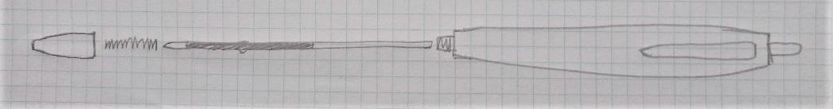
Exploded Views
How to Draw an Exploded View

Slide 2
Exploded Views
An exploded view is a type of drawing. It can be 2D or 3D.
It shows the parts of a product taken apart and laid out along a line.
Exploded views are used by people who are putting products together or who are repairing products.
They are often found in instruction booklets.
They were first used over 500 years ago!
We are going to draw an exploded view of a pen…
Notes:
Exploded views can be drawn as 2D (two dimensional) by taking a view from one direction; they can also be drawn as 3D (three dimensional) by using drawing techniques such as isometric.

Slide 3
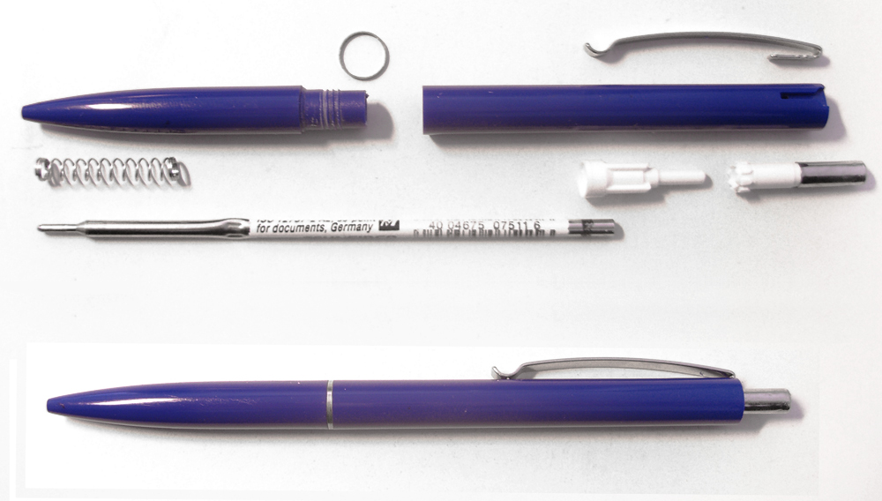
What would an exploded drawing of this pen
look like if it was a photograph?
Notes:
This is an edited version of a file from Wikipedia commons

Slide 4
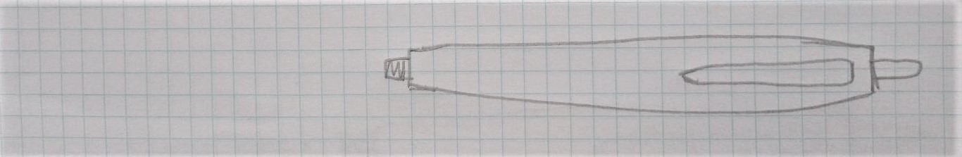
Drawing a Pen - Start
The drawing used in these examples is for a different pen. It was drawn by a Year 5 called Ben. It shows the drawing method but it has an error – see if you can spot it. We will point it out at the end.
Centre line
Case
Draw a centre line.
Draw the outline of the case of the pen, so the centre line runs along it.
Notes:
This drawing was produced by Ben, aged 9, and is used with permission.

Slide 5
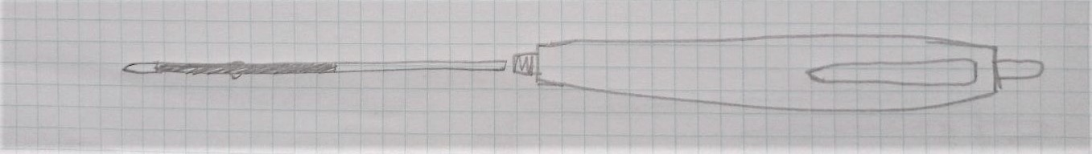
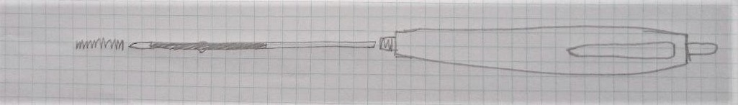
Drawing a Pen – Lining up the Parts
Add the inside parts to the drawing. Arrange these in order along the centre line.
Plastic tube holding ink
Plastic tube holding ink
Case
Case
Spring

Slide 6
Drawing a Pen – Finishing the drawing
Add the remaining parts to the drawing.
Label all the parts.
Plastic tube holding ink
Spring
Case
End cap

Slide 7
Did you Spot the Error in Bens drawing?
The push button at the end should also have been placed along the line, not as part of the case.
Plastic tube holding ink
Case
Spring
End cap
Push button
Notes:
The pocket clip shown on Bens drawing was part of the same moulding as the case – if this had been a separate part/detachable, it could have been represented by placing it on a further ‘centre line’, at right angles to the original centre line.

Slide 8
Notes:
The image is the IET Primary poster ‘Exploded Views’, available for free download from the IET Faraday primary website

