Slide 1

Exciting Electricity
Making a simple steady hand game

Slide 2
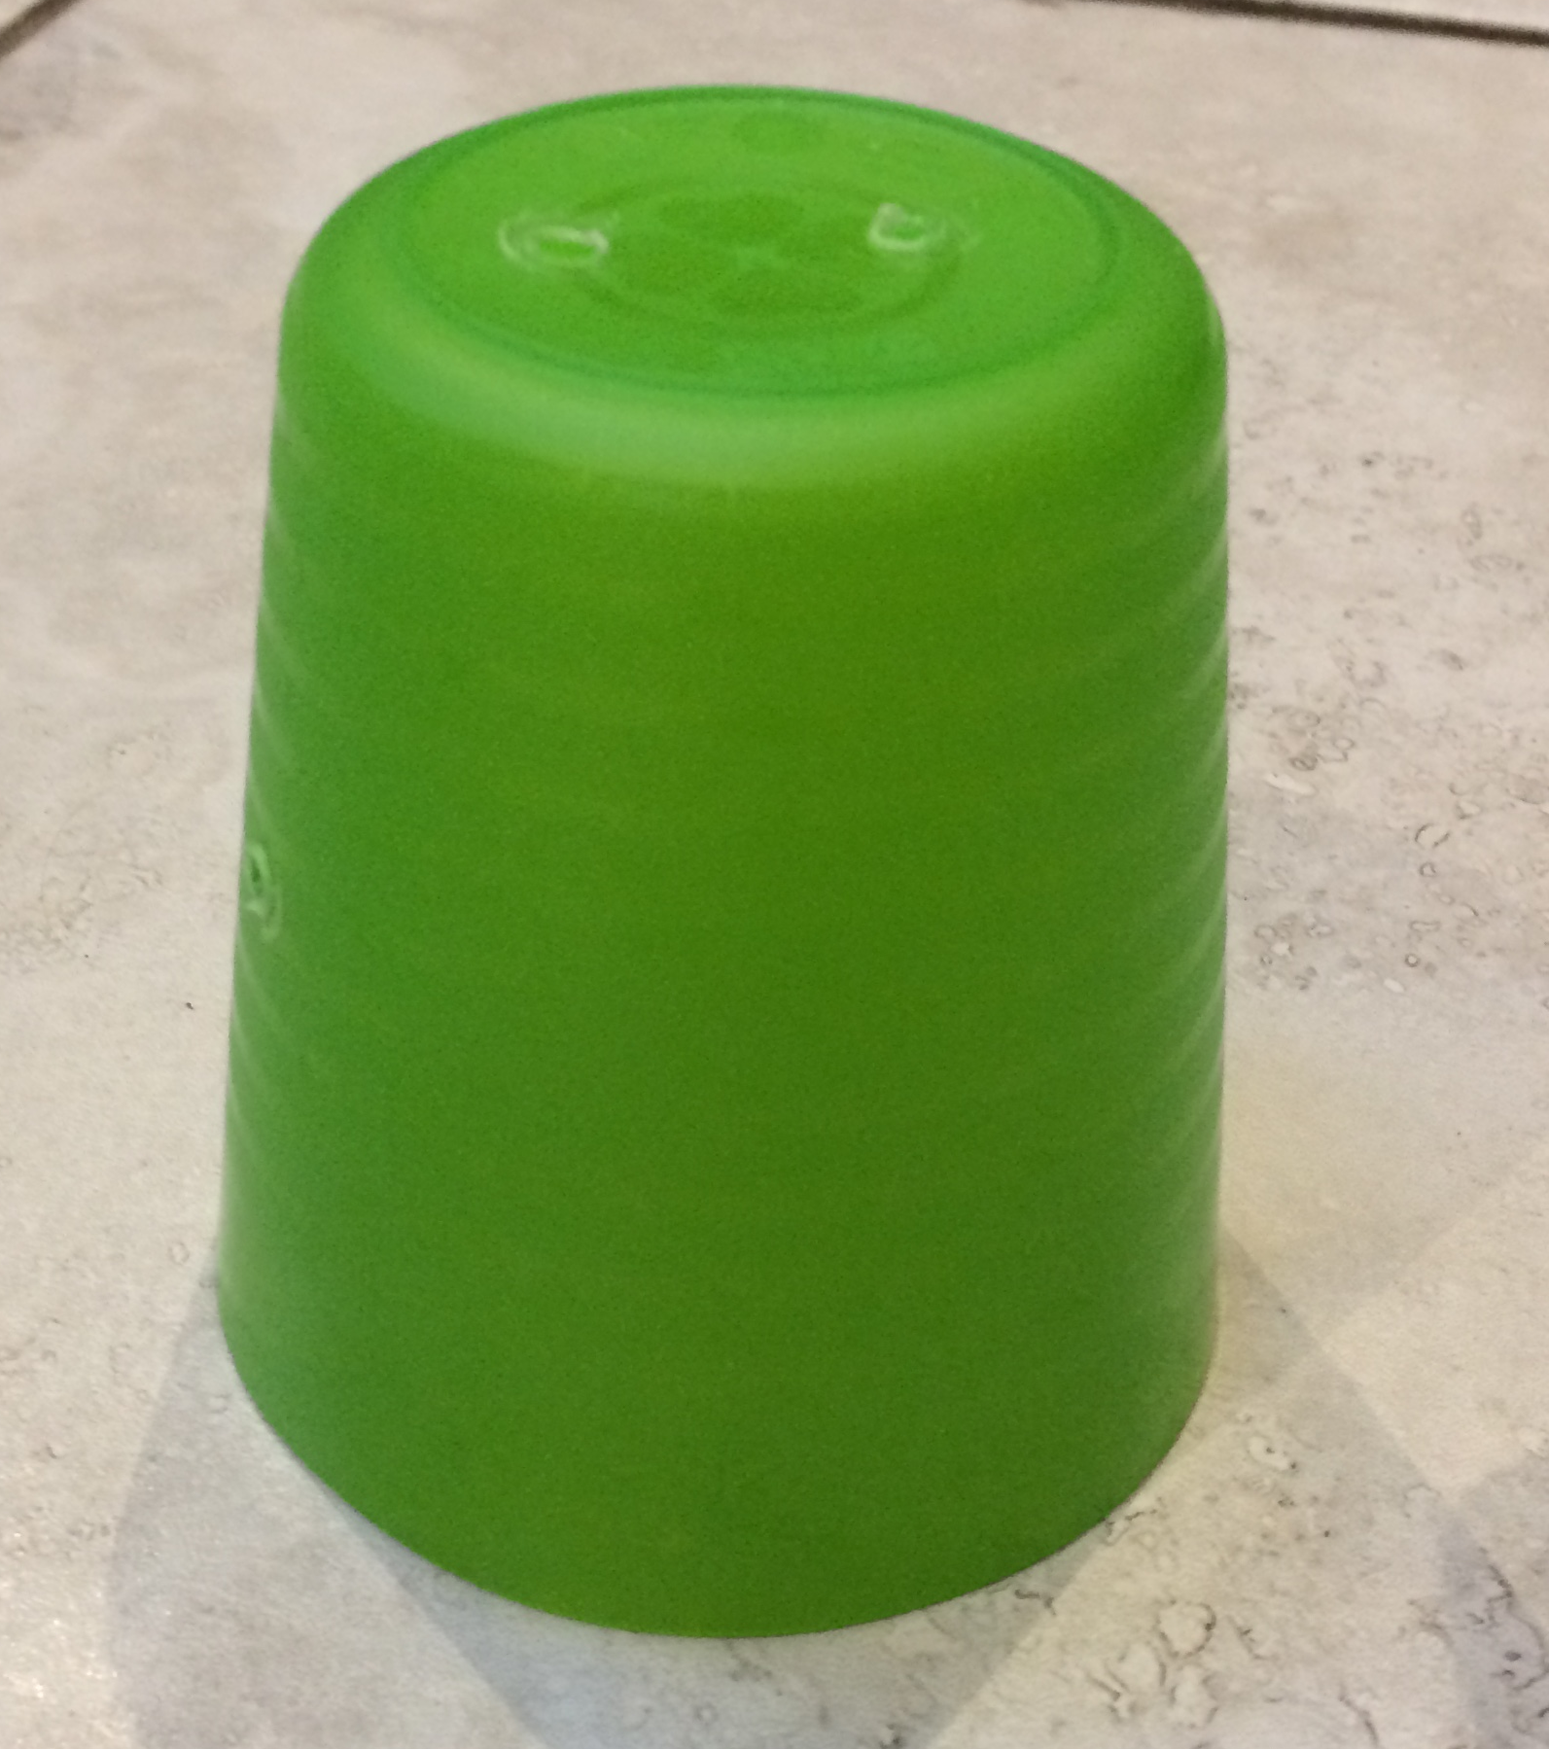
Step 1 - Prepare the base
Holes for maze wire
Turn your plastic cup upside down and secure it in a drill vice.
Place the vice on the pillar drill table and drill two 2 mm holes in the top of the cup for the wire maze.
Remove the cup from the vice, turn it on its side and re-secure in the vice.
Drill another hole in the side for the wand wire.
Hole for wand wire
Notes:
If a pillar drill is available then learners could complete these steps themselves. If only hand drills are available then these steps could be completed in advance by the teacher. All steps should be demonstrated in advance by the teacher.

Slide 3
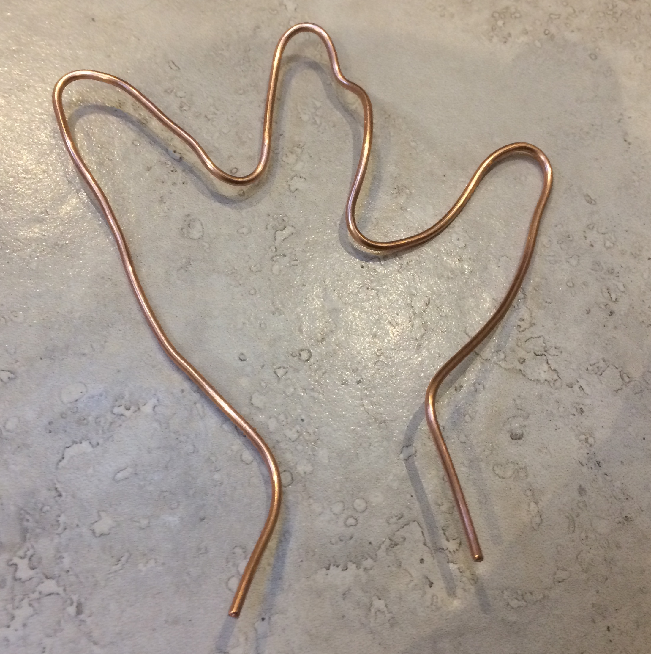
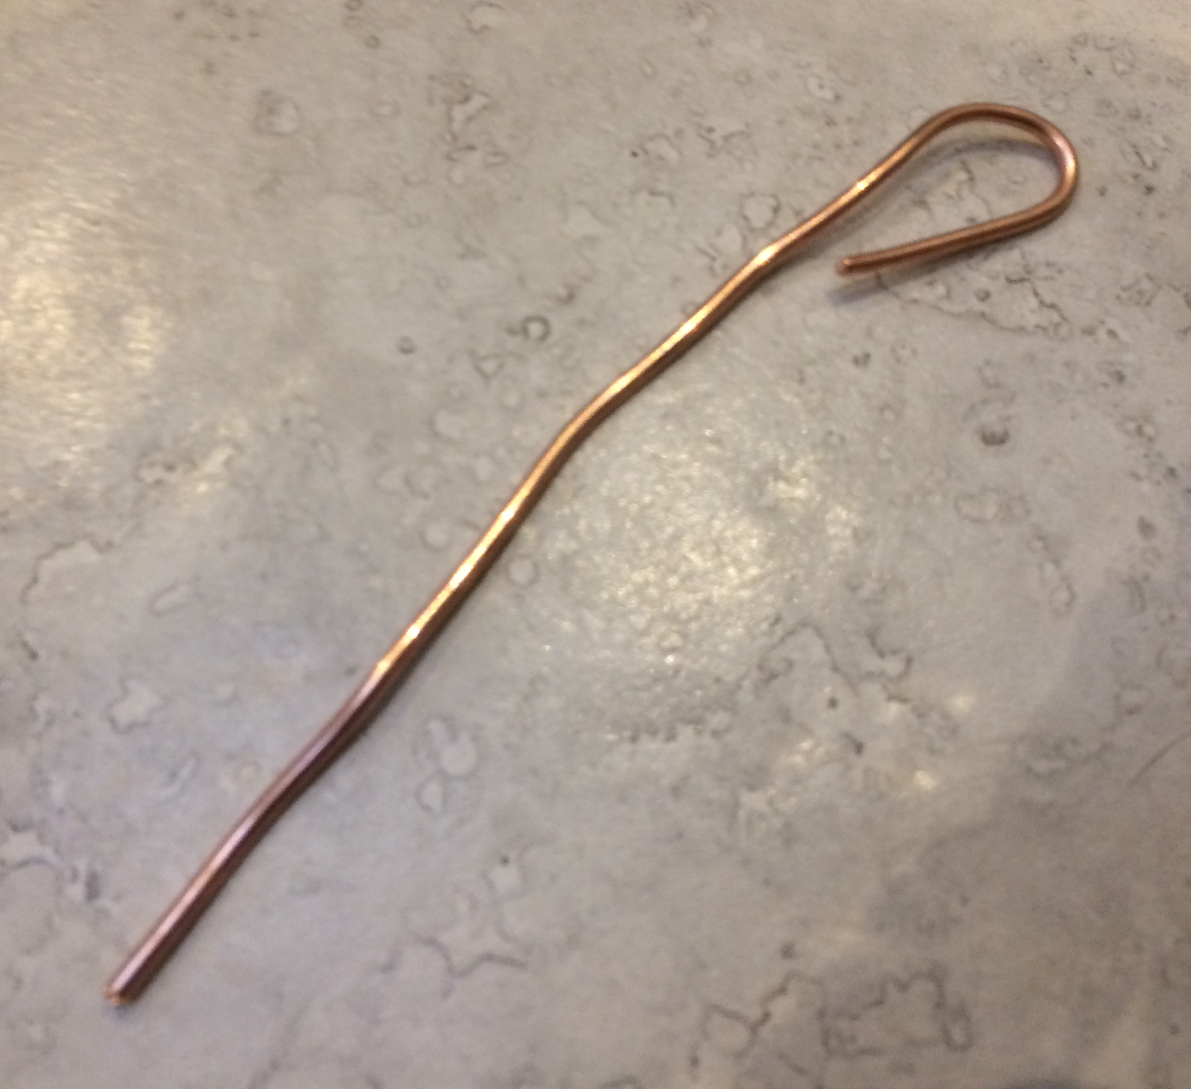
Step 2 – Create the maze and wand
Cut one 350 mm length of 2 mm diameter copper wire with wire cutters. Bend this to create the maze shape. Be creative!
Cut one 150 mm length of 2 mm diameter copper wire. Bend the top of this to create the wand, leaving a slight gap as shown.
1)
2)
Notes:
Learners could cut the lengths of wire using wire cutters, or the teacher could prepare in advance. The small gap is so the wand will fit over the maze wire.

Slide 4
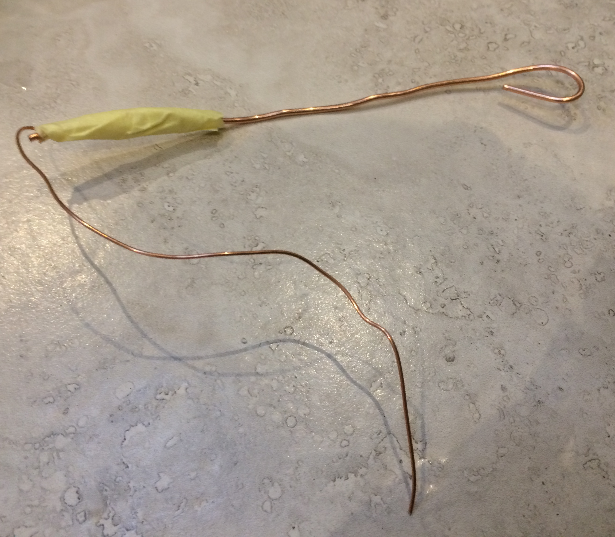
Step 3 – Create the handle
Cut one 150 mm length of 1 mm diameter copper wire and join to the wand: strip the wire ends if needed and twist one end around the bottom end of the wand, making sure it is fully wrapped around the metal.
Wrap tape around the join to create an insulated handle.
Push the maze and wand wires through the holes in the base.
Notes:
Learners could cut the lengths of wire using wire cutters, or the teacher could prepare in advance. When joining wires, learners could either wrap the wire and place the tape over the top to secure, or use soldering equipment to create a permanent joint. The handle tape should be wrapped around the joint sufficiently so that the user will not touch any exposed wire when playing. All steps should be demonstrated in advance by the teacher.

Slide 5
Step 4 – Assemble the circuit
Buzzer
Connect the red wire of the battery clip to the wand wire.
Connect the red wire of the buzzer to any end of the wire maze.
Connect the black wire of the buzzer to the black wire of the battery clip.
Ensure all components are held tightly inside the base.
To wire maze
To wand wire
+
-
9V battery and clip
Notes:
A battery clip could be used for ease of connecting. Connections could be made using soldering equipment if available, wrap around connections or crocodile clips if not. Double sided sticky pads could be used to secure the buzzer and battery to the inside of the base. If it is decided to use a buzzer without wires then the PowerPoint would needed to be amend to make it clear which connection is which.

Slide 6
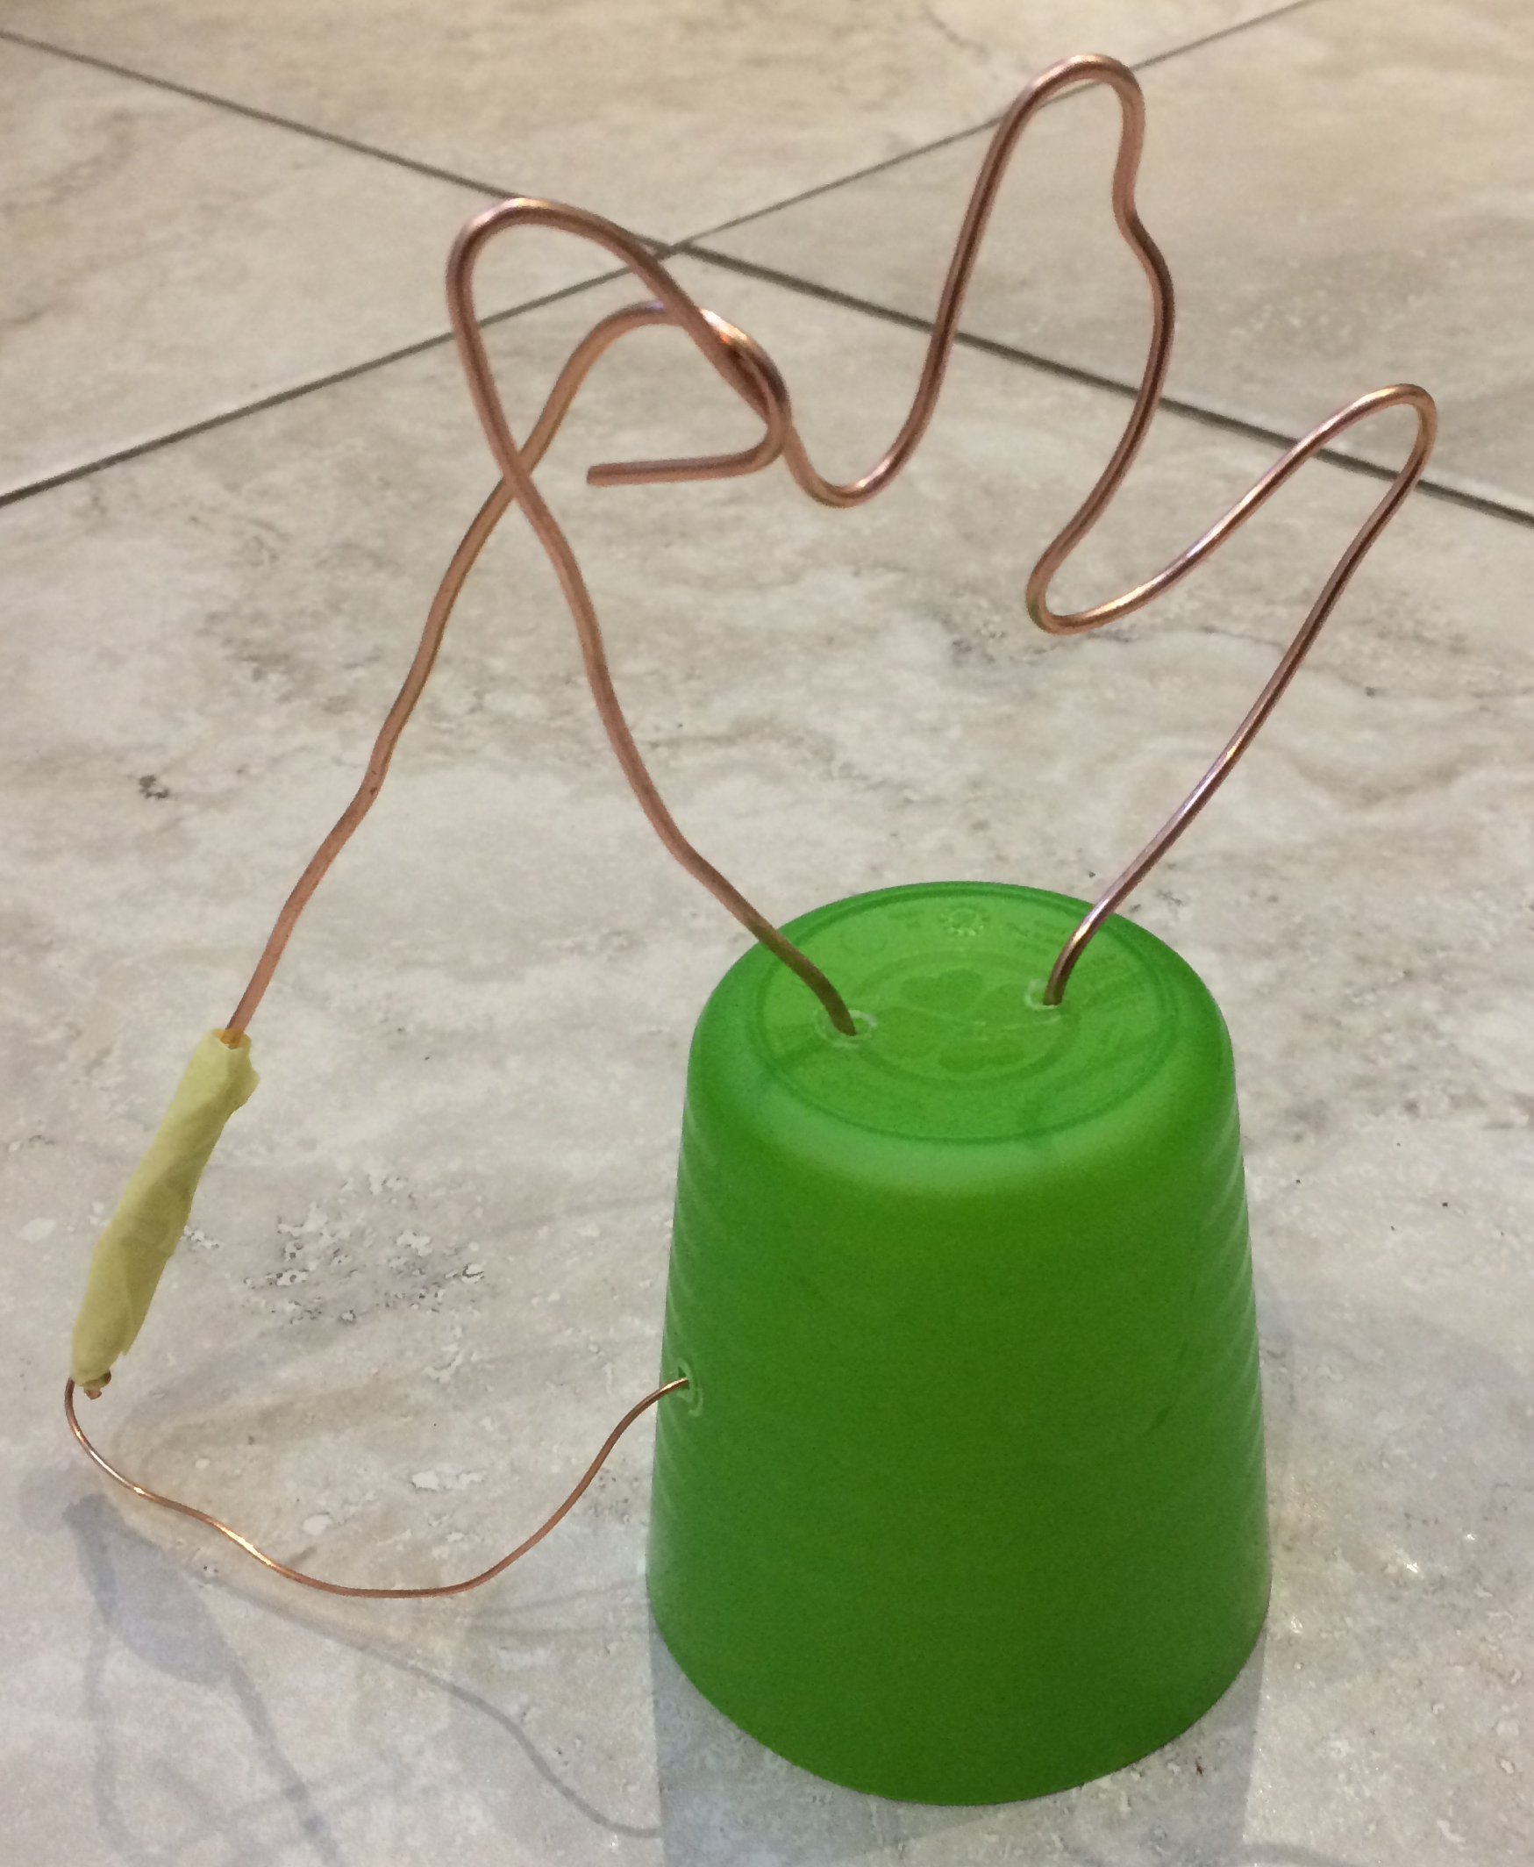
Finished steady hand game – can you complete the maze?!
Why does the buzzer sound when the wand and maze wires touch?
How could your product be improved?
Notes:
Example steady hand game. Instead of a plastic cup, learners could vacuum form a base if appropriate equipment is available. Additional sound holes could be drilled for the buzzer if needed.

Slide 7
Notes:
Example steady hand game. Instead of a plastic cup, learners could vacuum form a base if appropriate equipment is available. Additional sound holes could be drilled for the buzzer if needed.

