Slide 1
Polar Explorer Programme Transition project
Setting the Scene
1

Slide 2
Project Aims
Pupils will:
Learn about the design, construction, and subsequent research activities of the RRS Sir David Attenborough, and its auto long range submersible, Boaty McBoatface
Plan and carry out a scientific investigation at the secondary school
Analyse, evaluate and present their investigation at their primary school
2

Slide 3
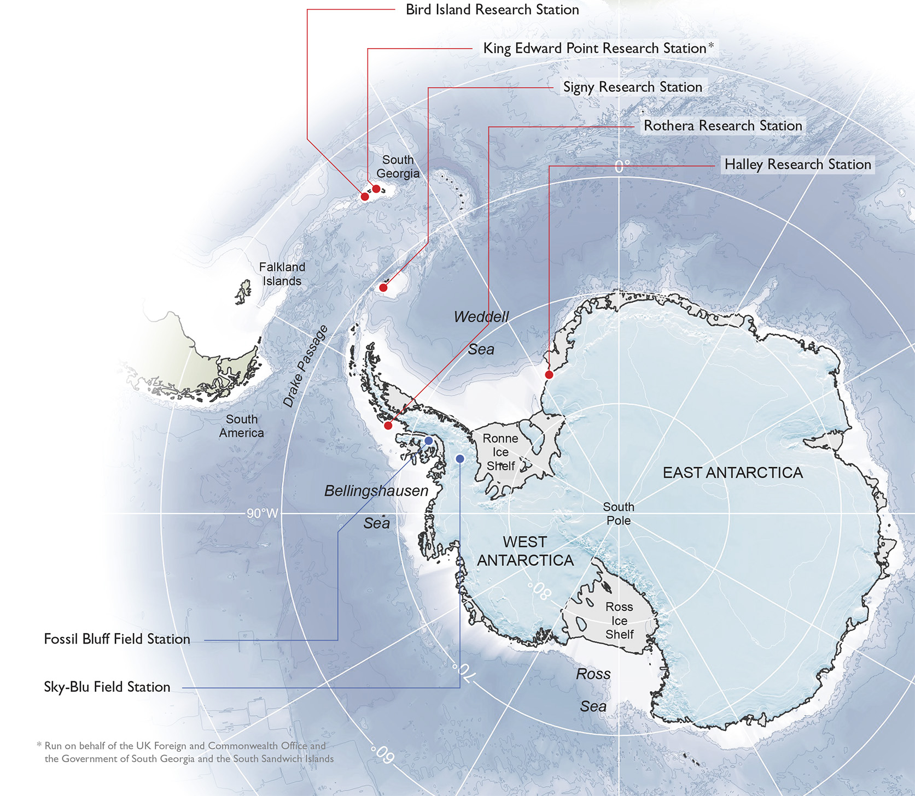
British Antarctic Survey
Antarctic Research Stations
3

Slide 4

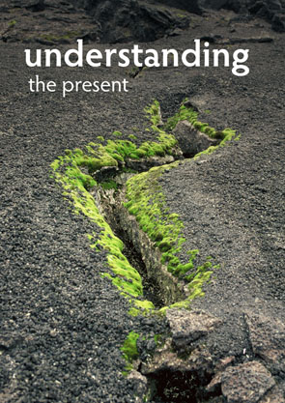


Modern BAS science
  Polar Science for Planet Earth (PSPE) is BAS’s current strategic science programme
  Concentrates on key questions of global or fundamental importance
  Dominated by environmental change
4

Slide 5
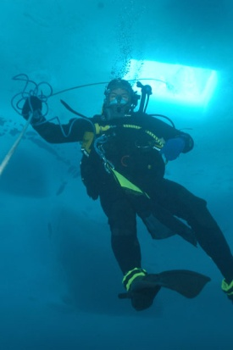
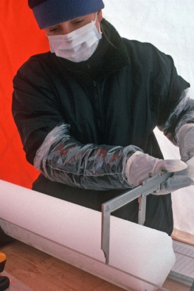
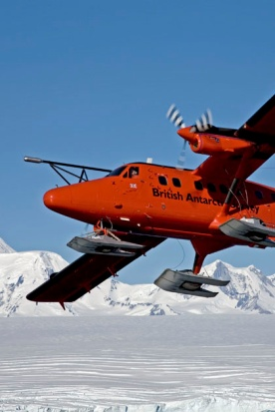
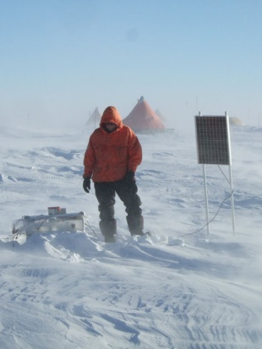
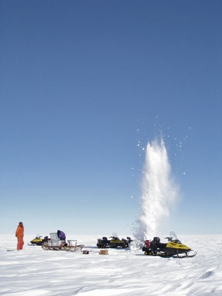
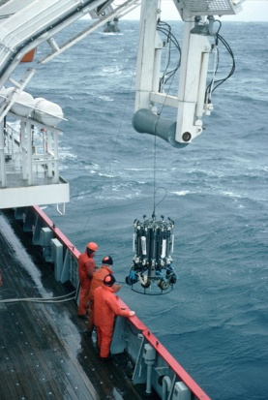
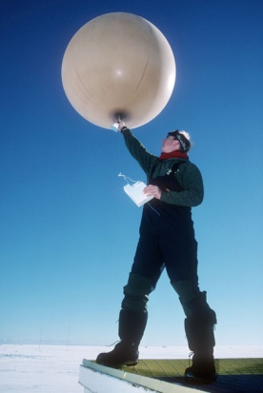
Modern BAS science
  BAS collects data from land, ice, sea, air and even from the edge of space
  Data are collected from our research stations, aircraft, ships and field parties, and from autonomous vehicles and instrument platforms
  Satellite data is increasingly important
  We use state-of-the-art drilling, satellite, surveying, monitoring, fieldwork and laboratory technology
5

Slide 6
Why does polar science matter?
  People live in the polar regions
  Many complex and unique ecosystems
  The polar regions hold clues to the past, which help us understand the present
  …and help to predict the future
  Maintain Britain as a world leader in polar science
  Keep the UK as one of the best places in the world to do science
6

Slide 7
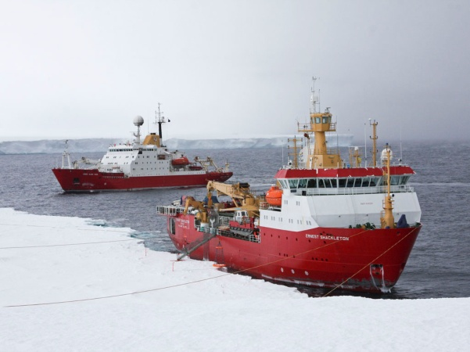
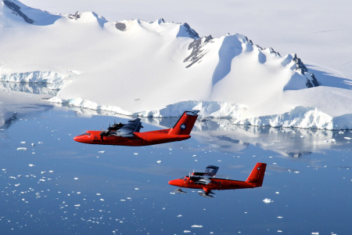
British Antarctic Survey
400 people
2 Royal Research Ships
5 aircraft
5 research stations in and around Antarctica
1 Arctic research station – managed on behalf of NERC
Not just scientists – employ carpenters, electricians, plumbers, mechanics, engineers, mountain guides, builders, chefs, support staff and more
Most scientists go south each ‘summer’ season between November and February
Support staff often go for longer
Winterers go for minimum of 18 months, potentially two and a half years
7

Slide 8
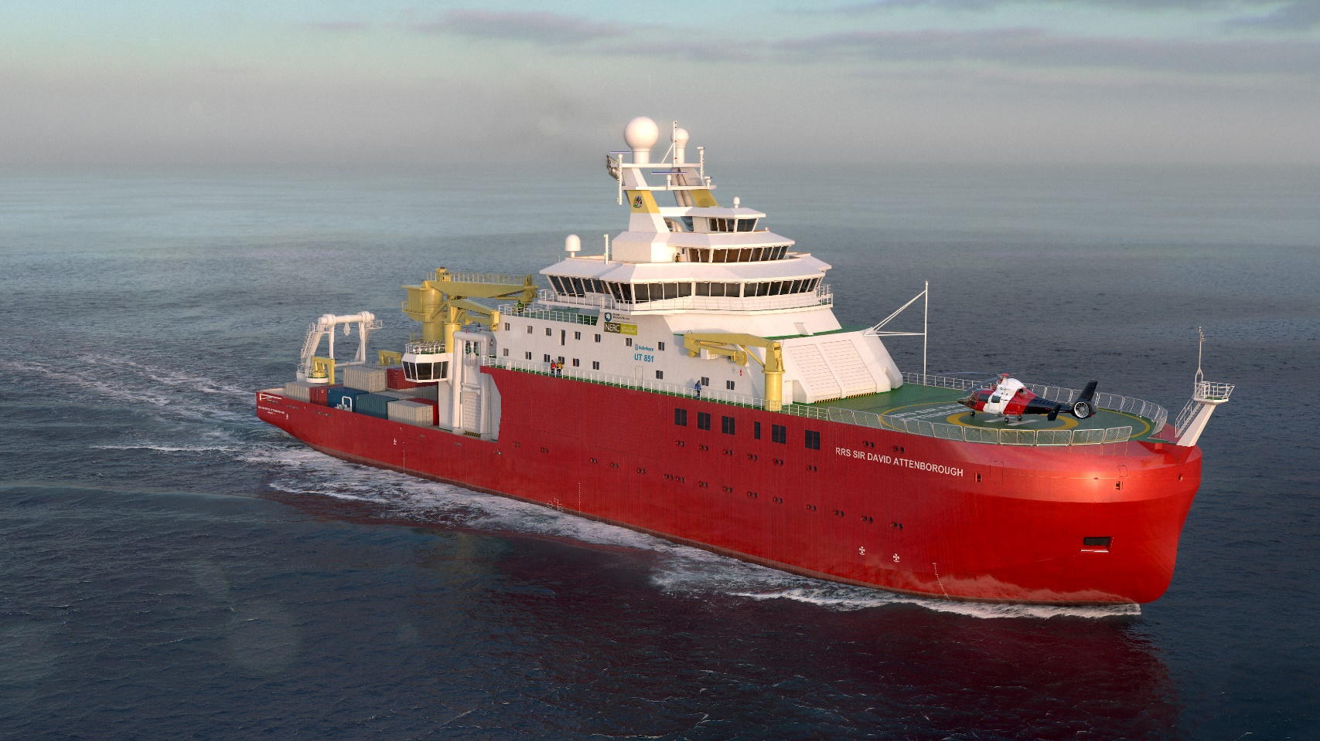
RRS Sir David Attenborough
8

Slide 9
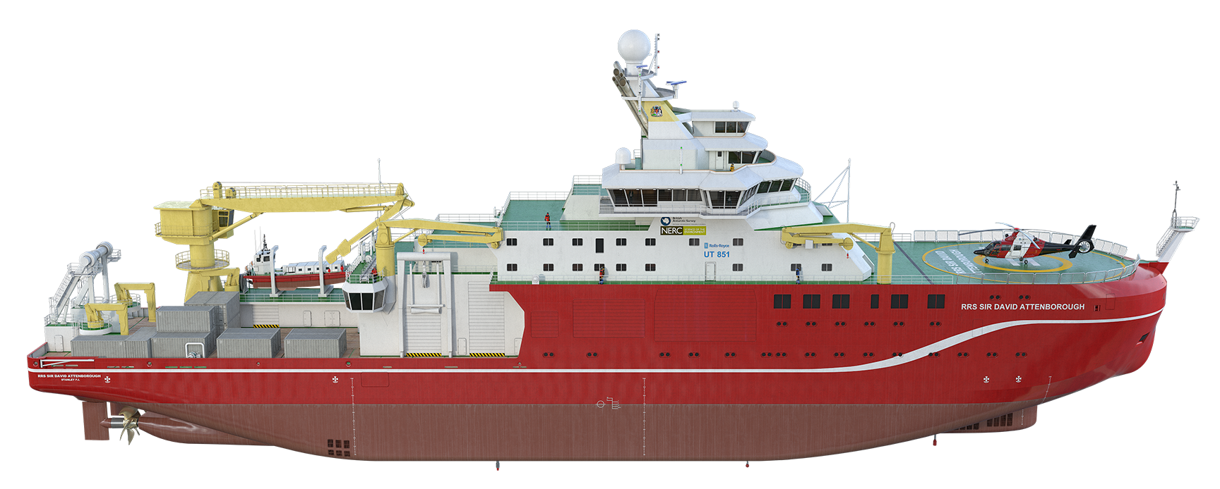
RRS Sir David Attenborough
  New state-of-the-art platform for multidisciplinary polar science
  Polar logistics
  Built at Cammell Laird shipyard in Birkenhead
  Early 2018: launch into the Mersey, harbour testing, local sea trials
  Summer 2018: planned delivery to BAS/NERC
  One year shakedown: deep-water trials, ice trials, testing of science & logistics equipment
  First full season in 2019/20
9

Slide 10
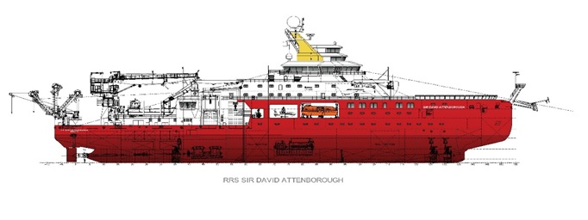
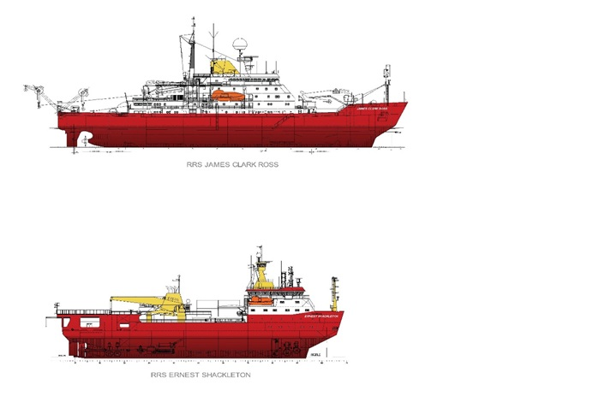
RRS Sir David Attenborough
Length: 128m
Beam: 24m
Draft: 7.0m
RRS James Clark Ross (Science)
Length: 99m
Beam: 19m
Draft:6.4m
RRS Ernest Shackleton (Logistics)
Length: 80m
Beam: 17m
Draft: 6.2m
10

Slide 11
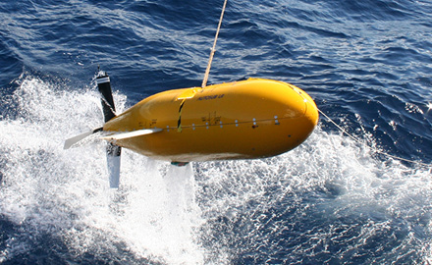
Boaty McBoatface
11

Slide 12
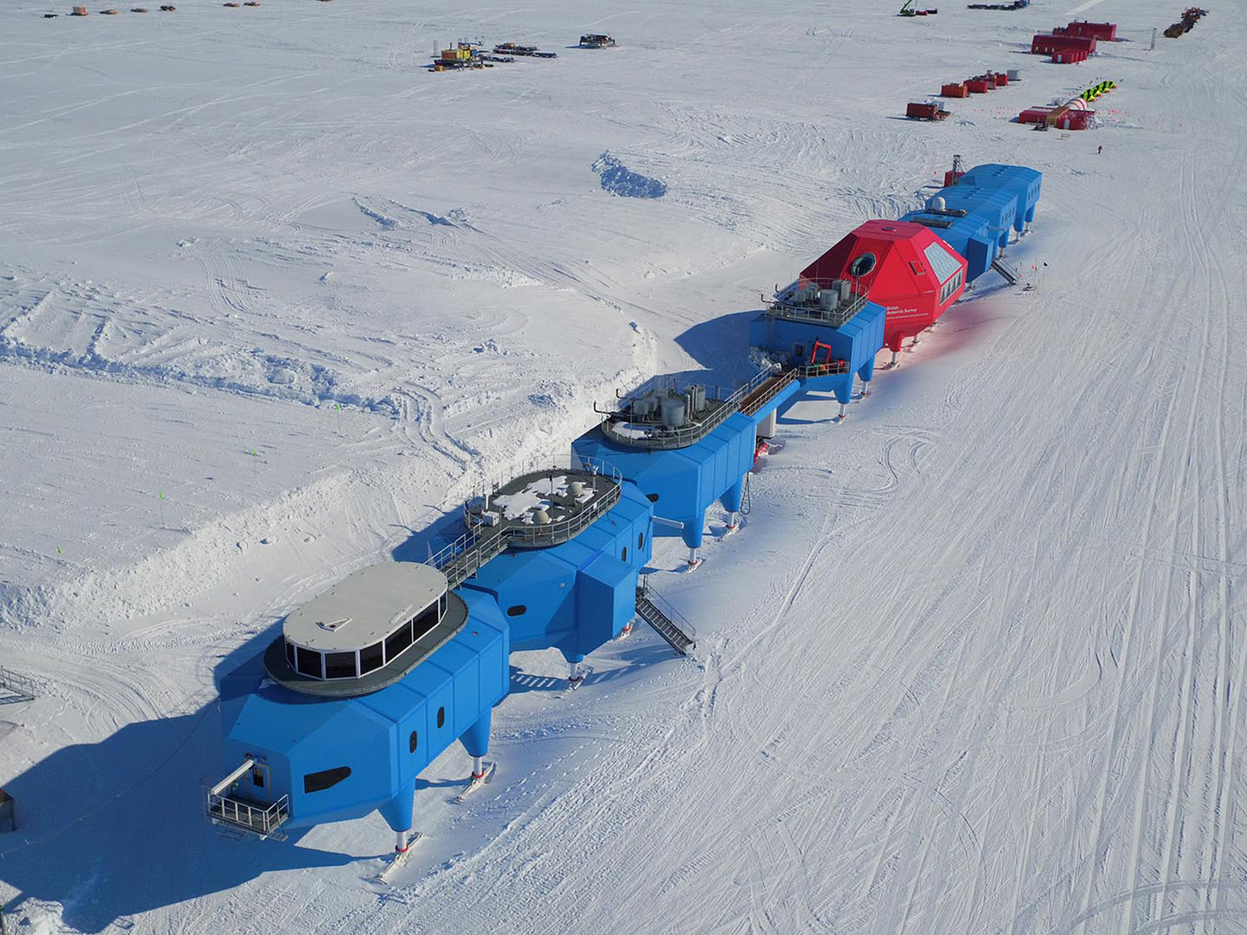
12

Slide 13
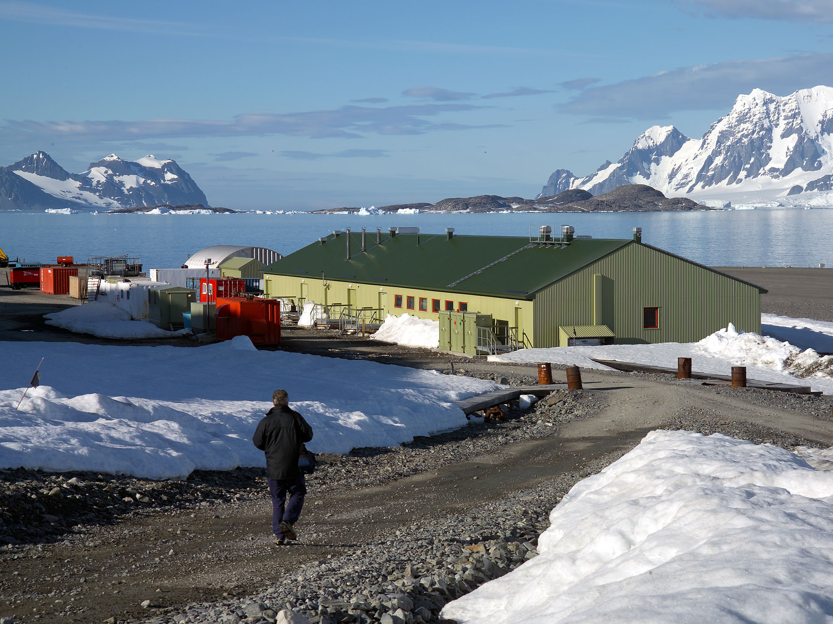
13

Slide 14
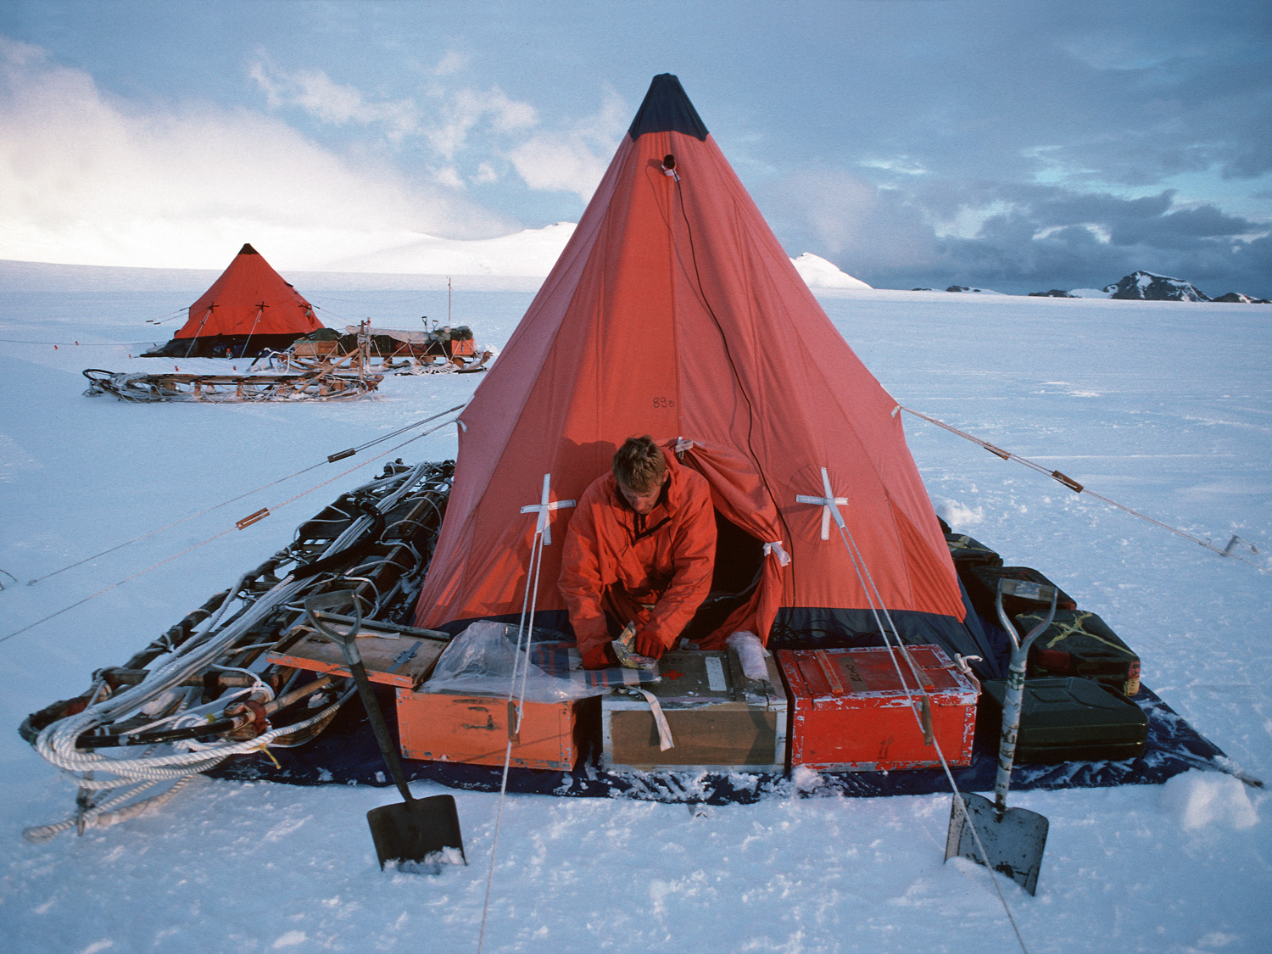
14

Slide 15
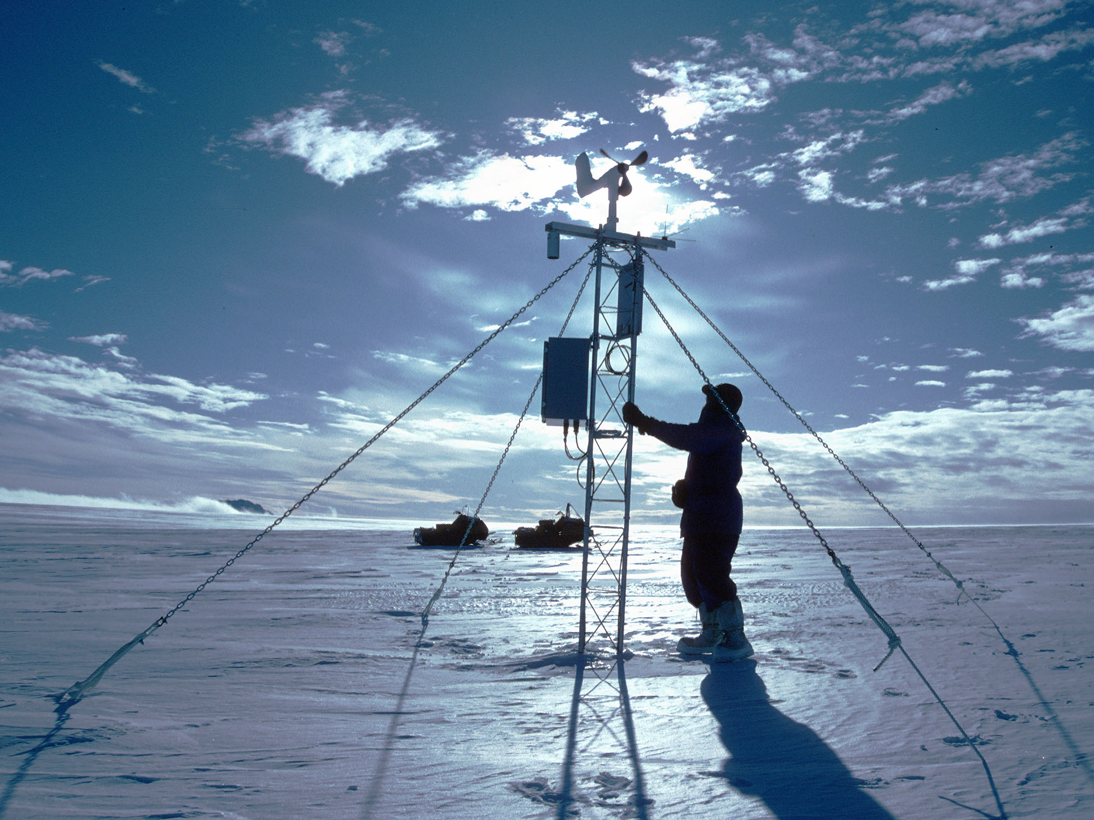
15

Slide 16
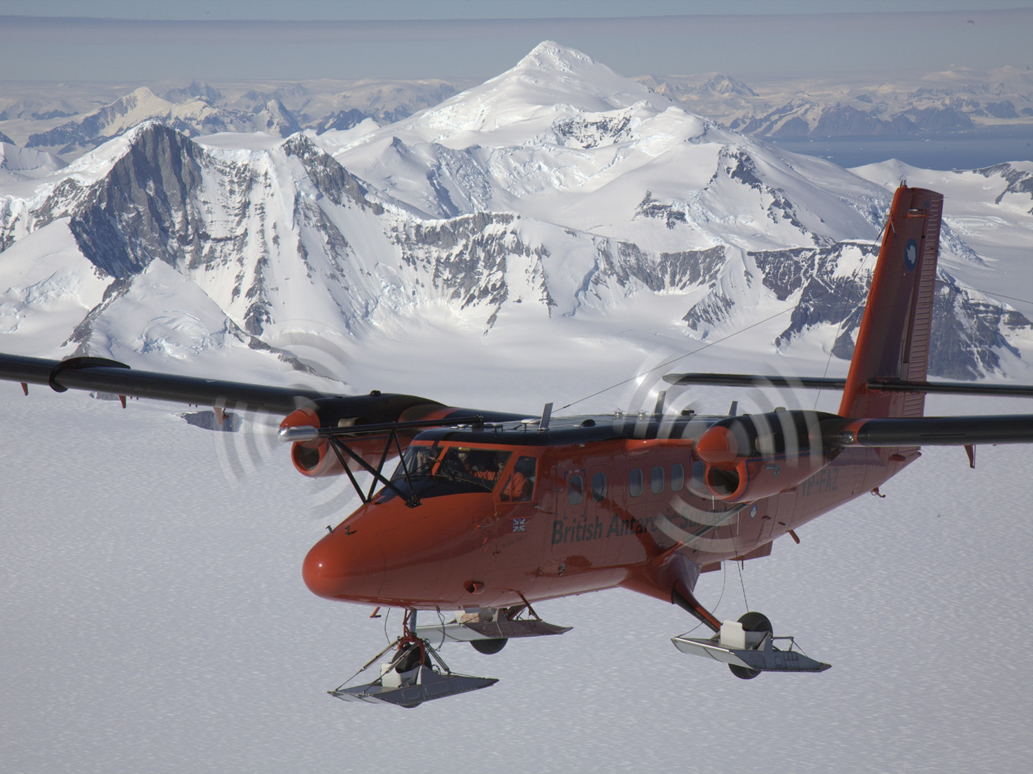
16

Slide 17
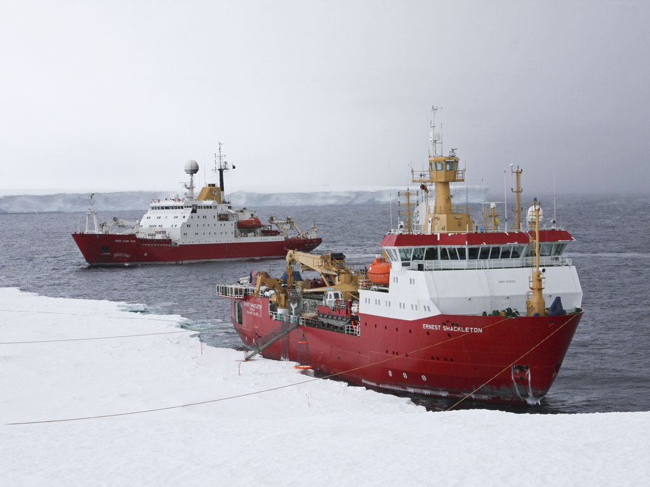
17

Slide 18
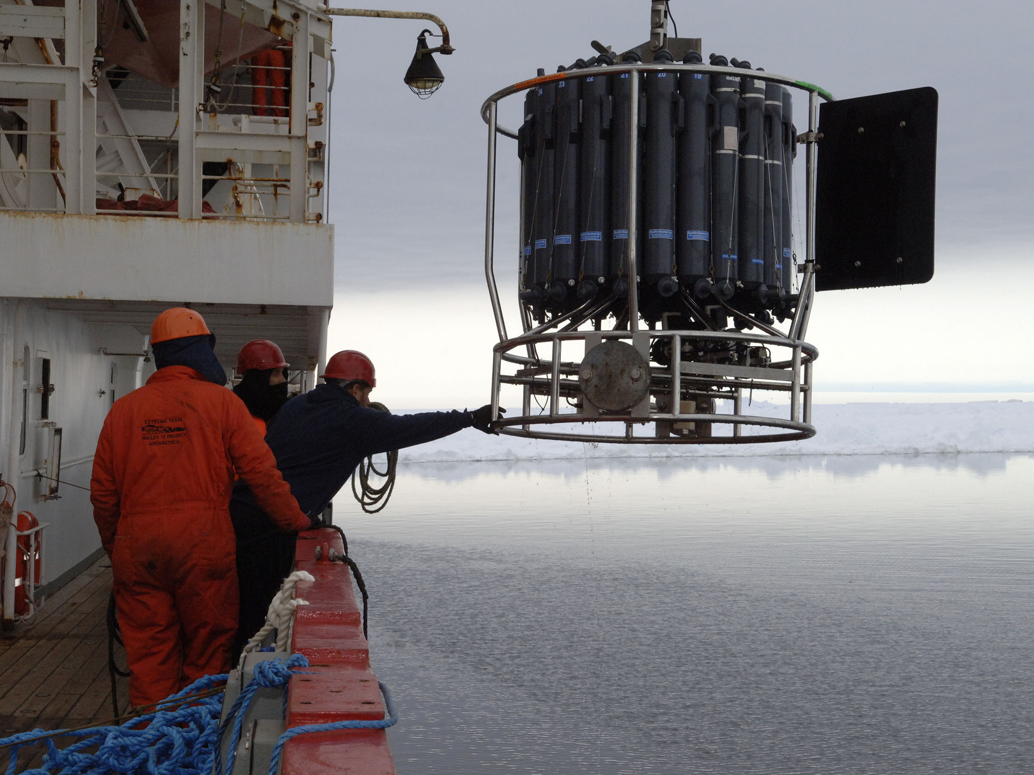
18

Slide 19
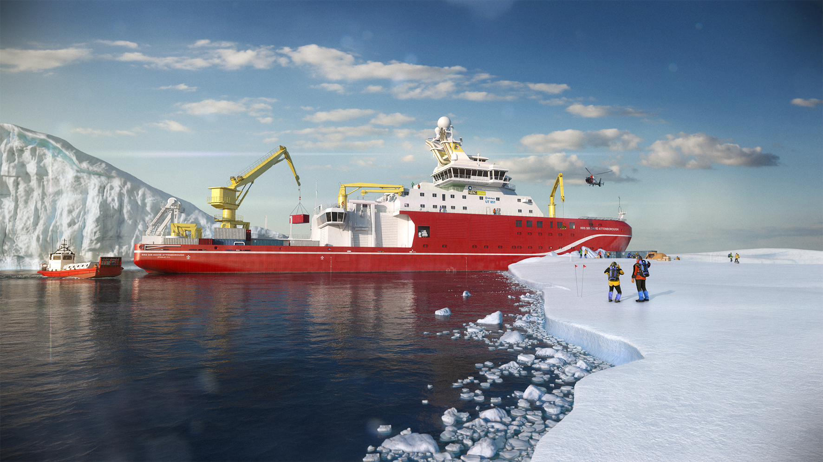
19

Slide 20
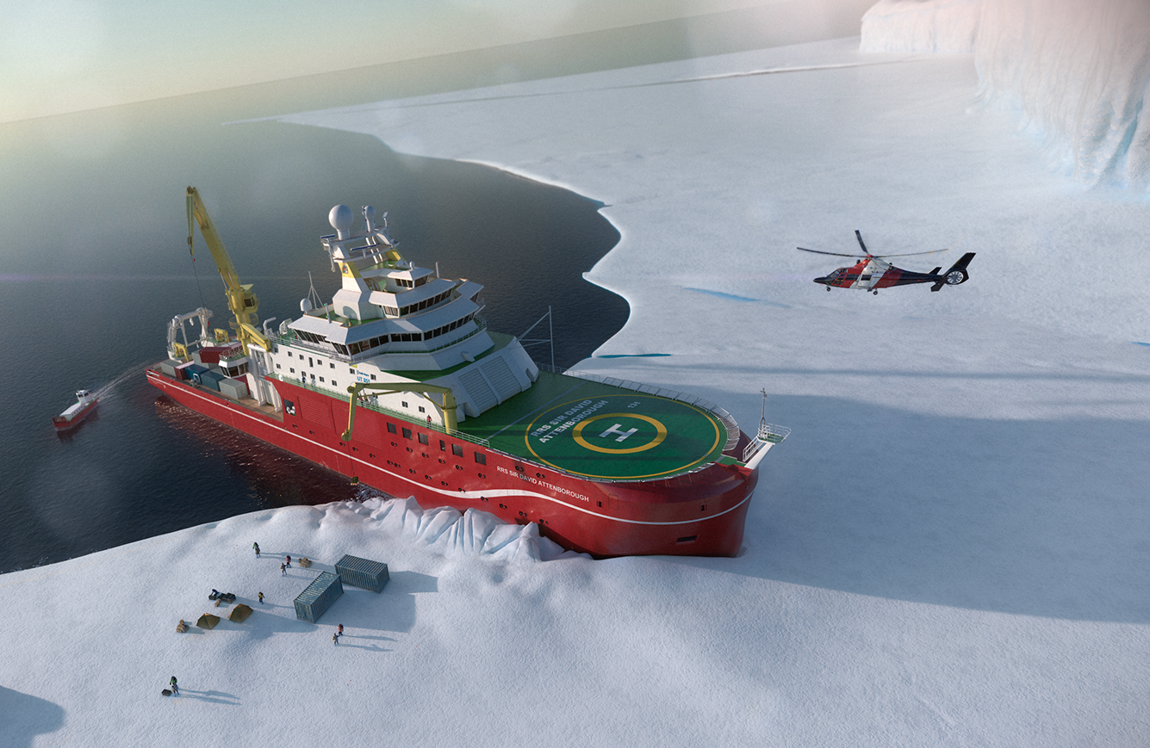
20

Slide 21

21

Slide 22
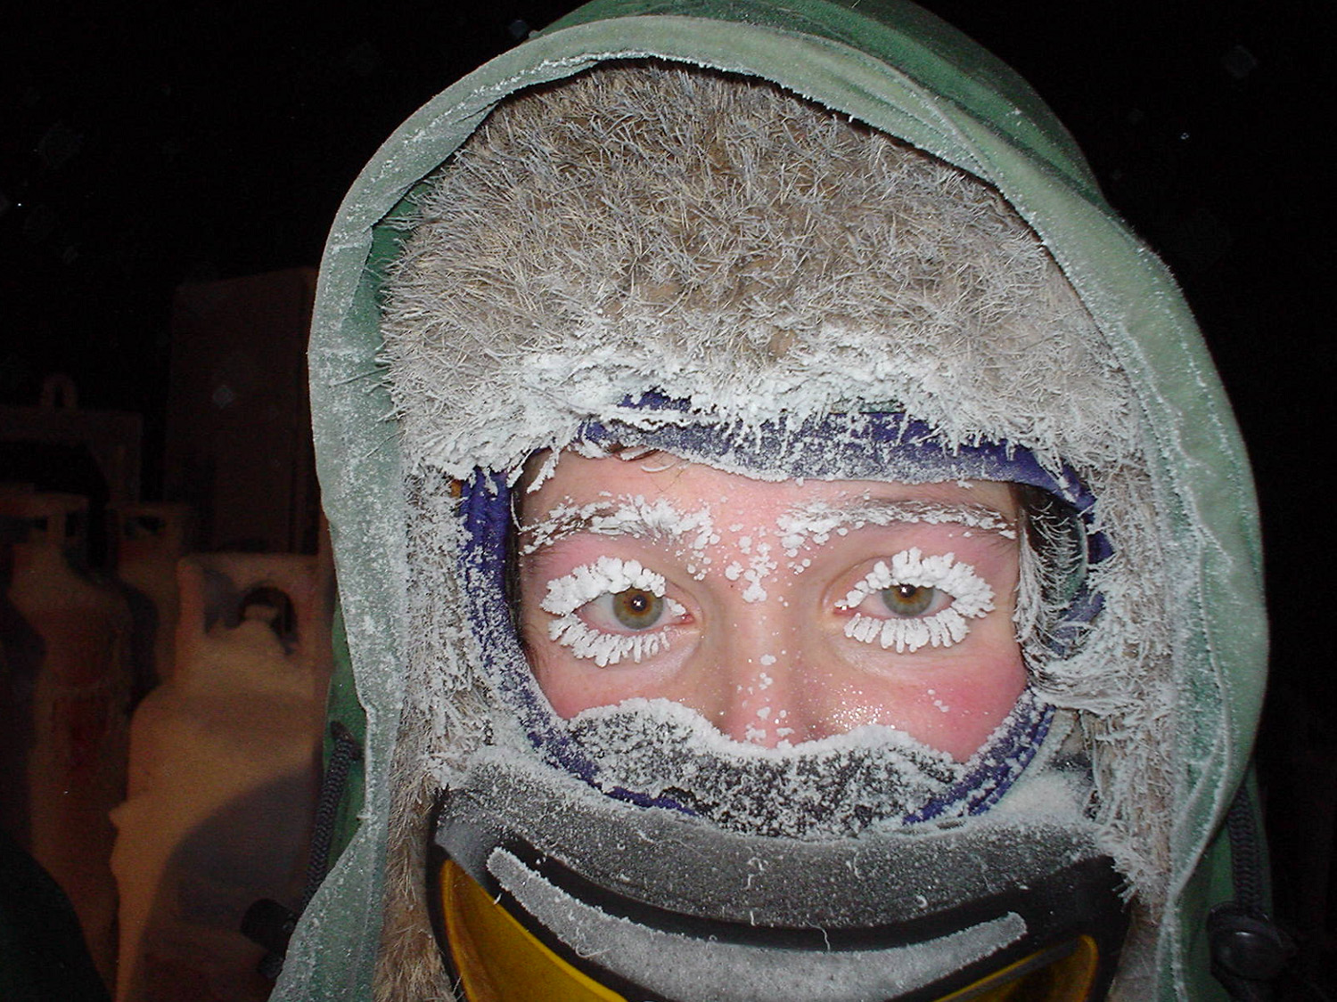
22

Slide 23
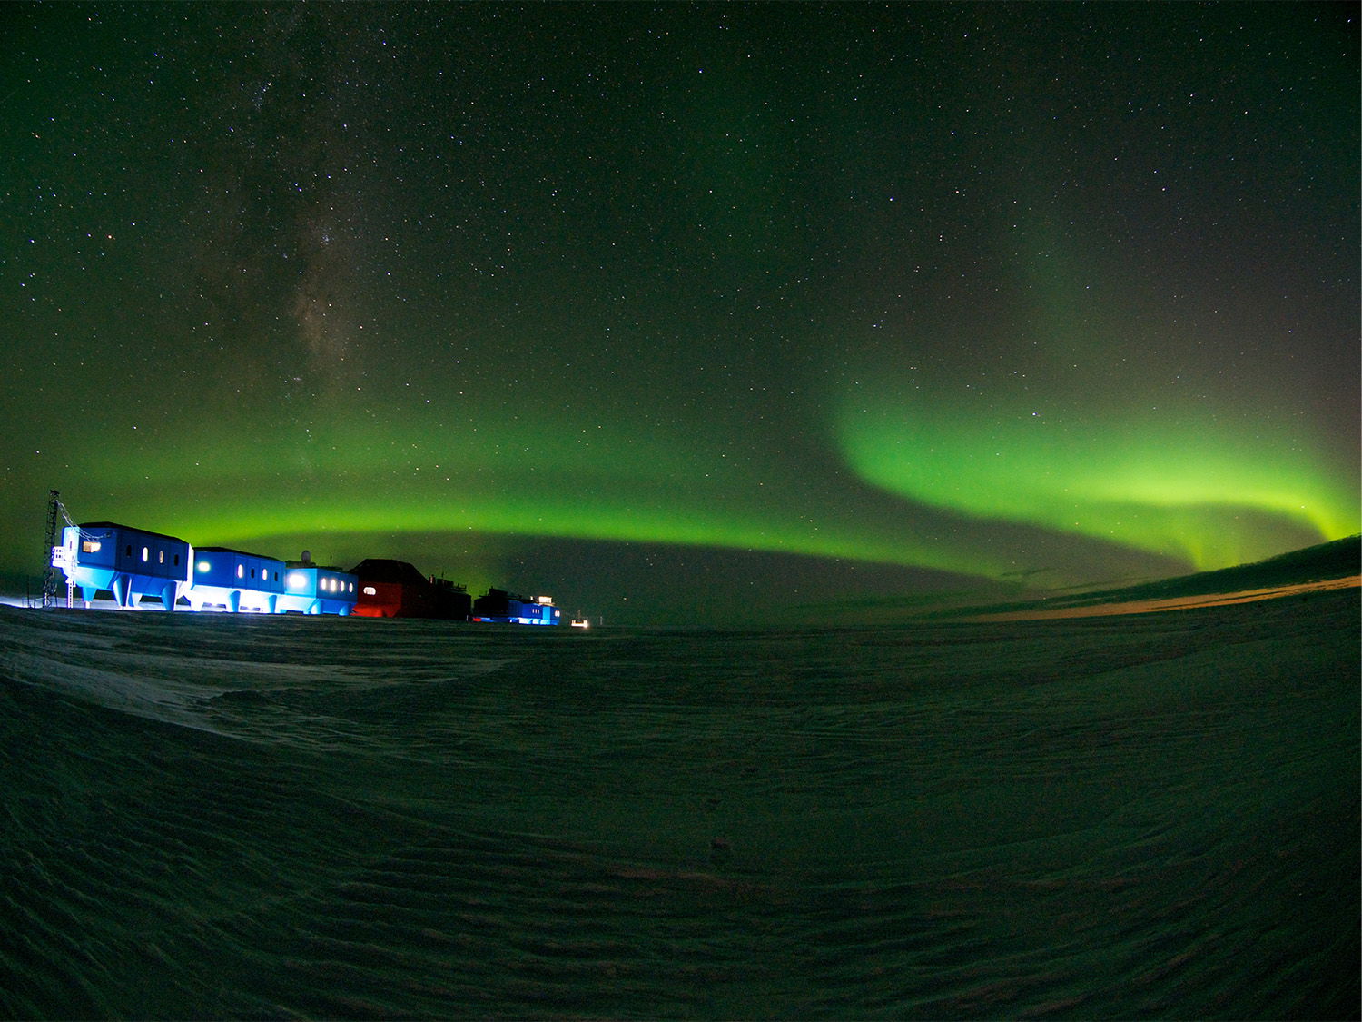
23

Slide 24
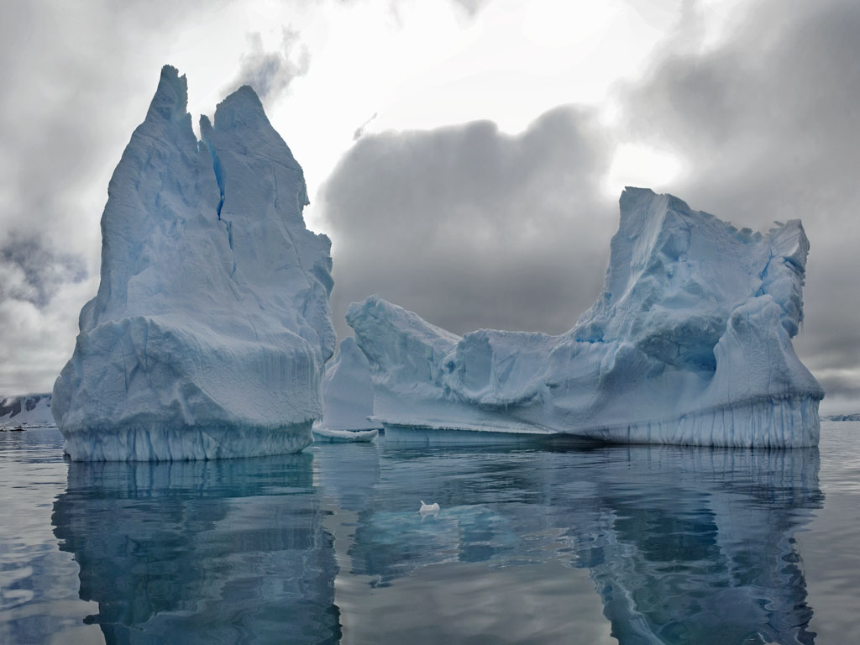
24

Slide 25
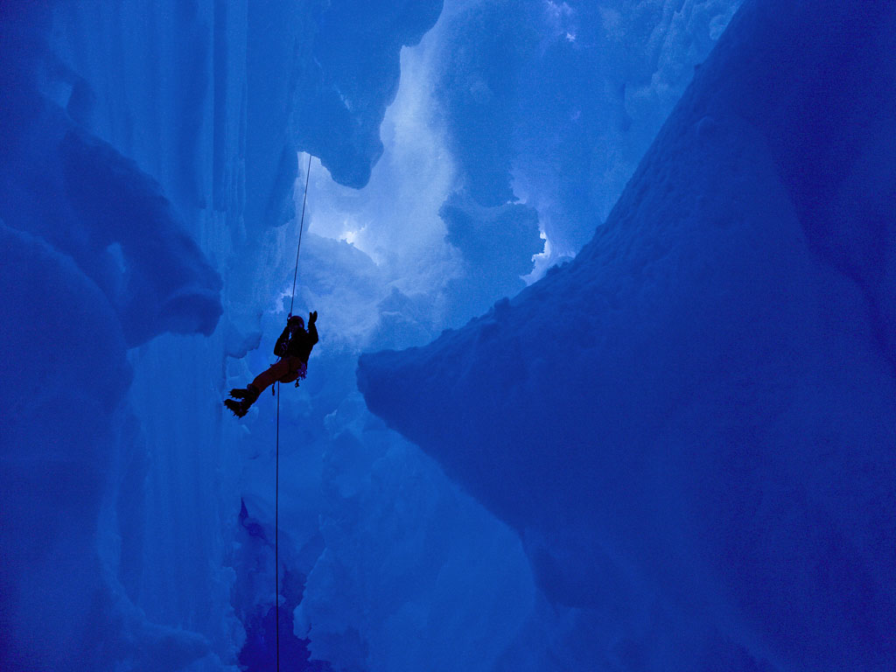
25

Slide 26
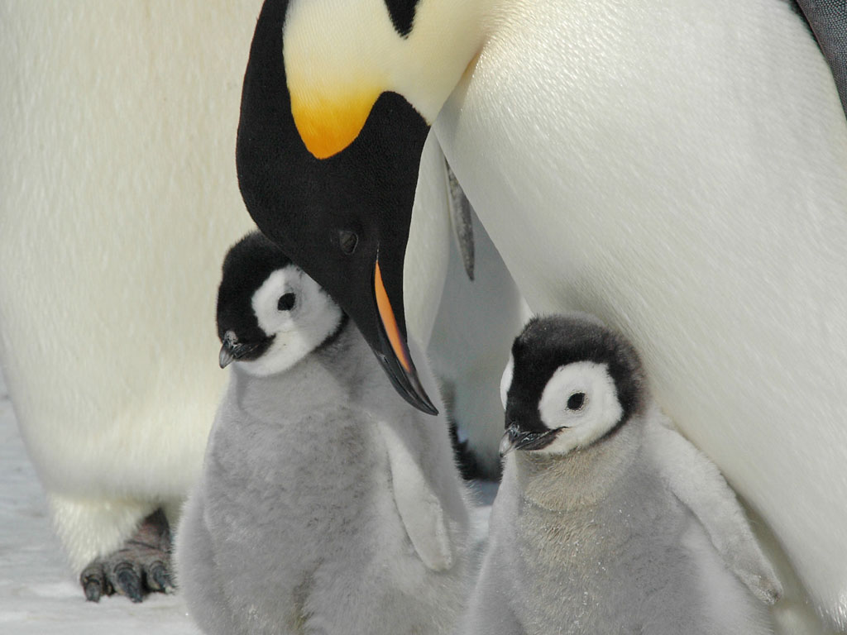
World Penguin Day 25th April
(6 types of Antarctic penguins, of which only 2 are truly Antarctic as others breed in the sub-Antarctic islands)
(These are the most well-known – Emperors)
26

Slide 27
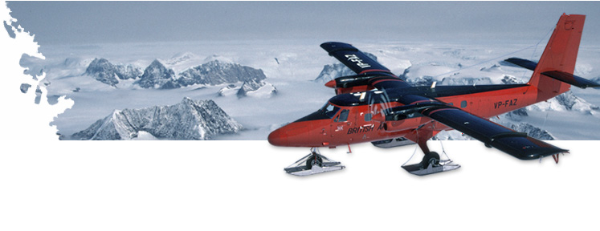
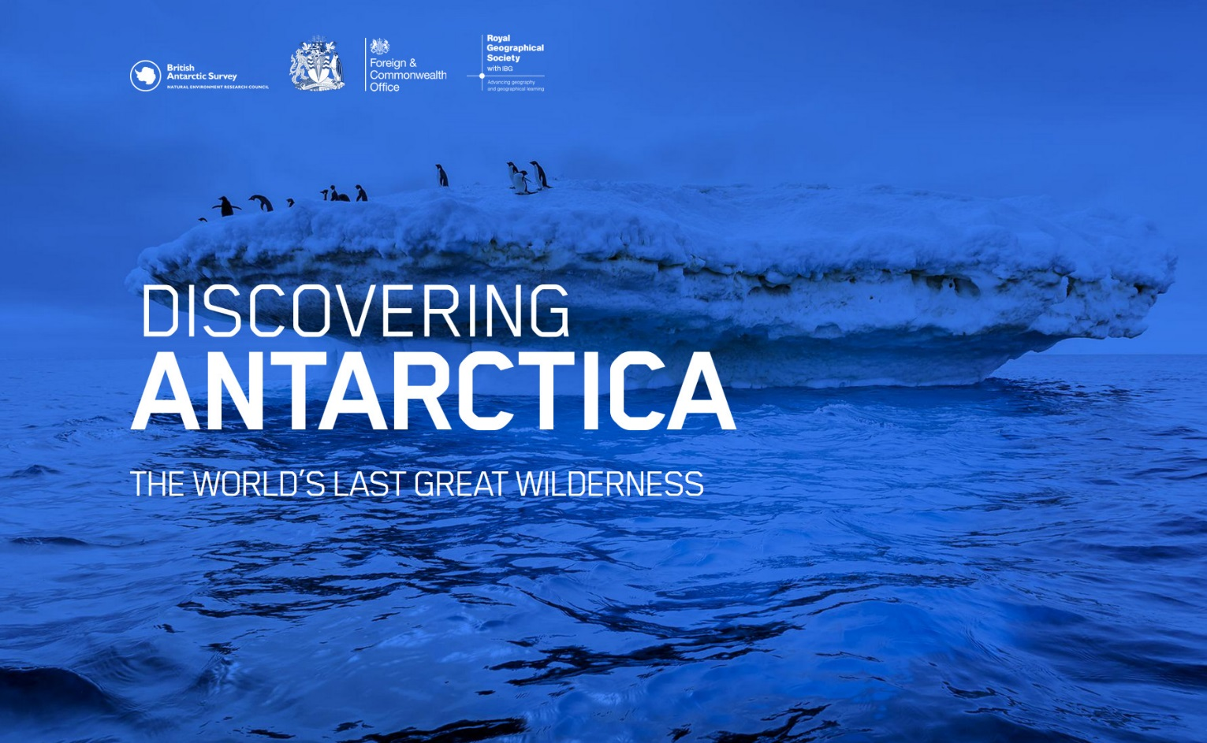


Discovering Antarctica
  You are now going to carry out your own research
  Find out more about life in Antarctia
  Discover why Britain wants a new research vessel
27
Notes:
www.discoveringantarctica.org.uk
www.discoveringthearctic.org.uk
Pupil handouts:
Research Antarctica pupil prompt sheet
Putting together a PEP presentation

