Slide 1
Scientific posters
1

Slide 2
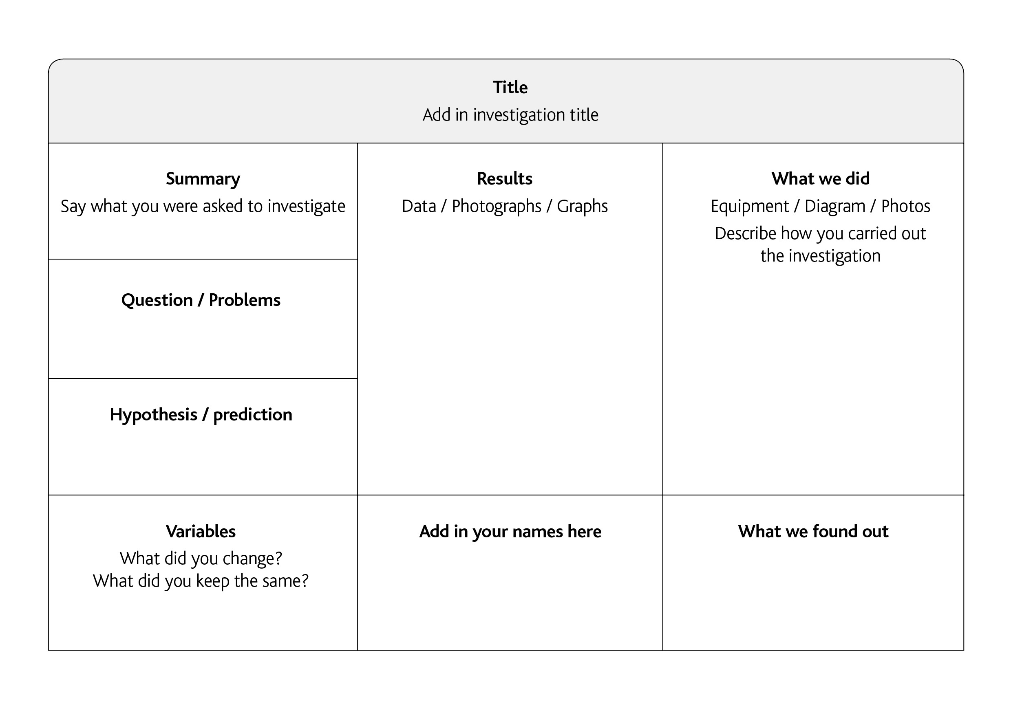
Scientific Poster layout 1
It’s ordered
Easy to follow
Has lots of detail
2

Slide 3
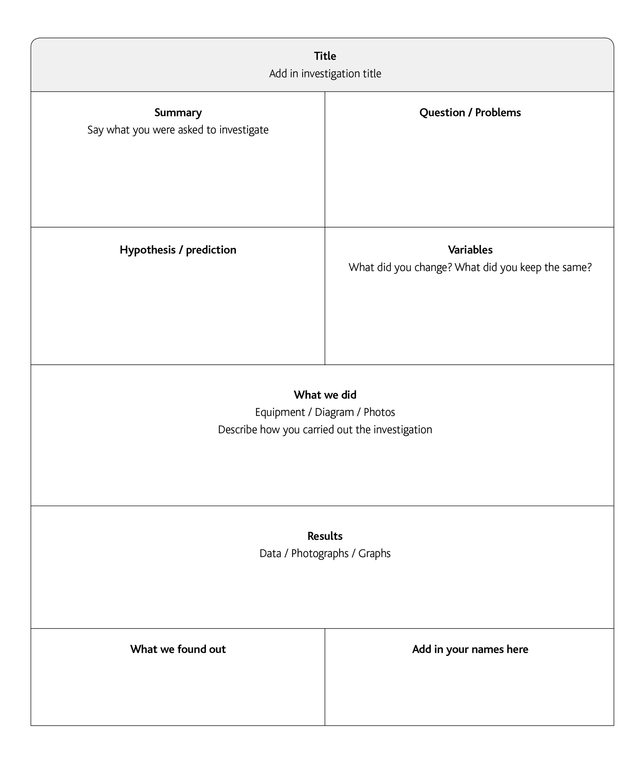
Scientific Poster layout 2
3

