Slide 1
Team Expedition Antarctica Introduction

Slide 2
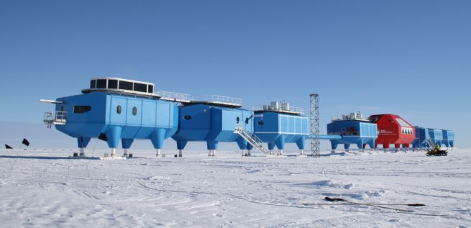
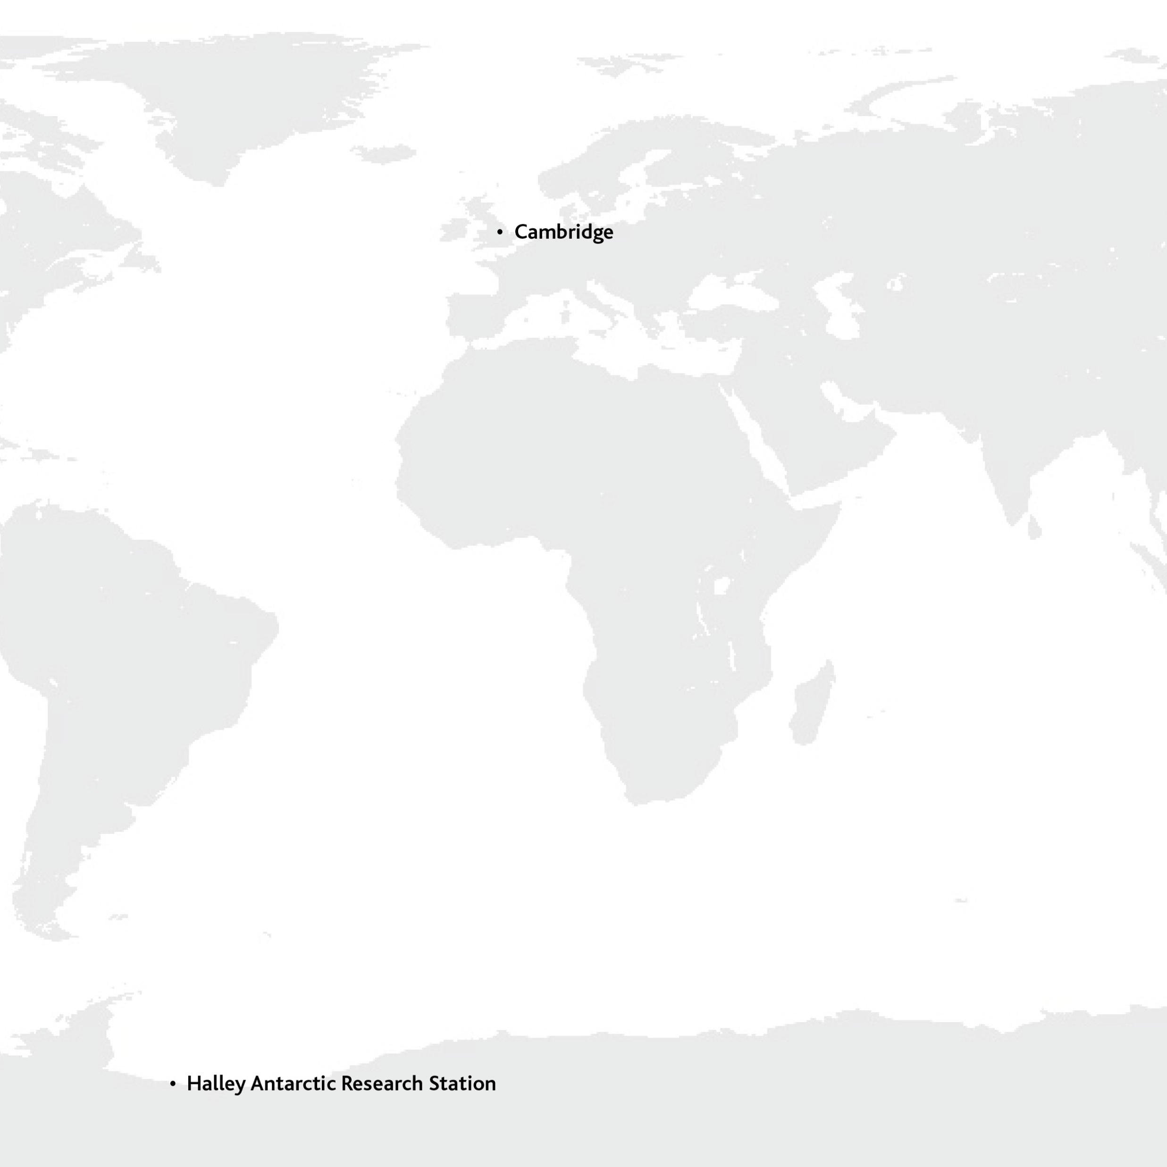
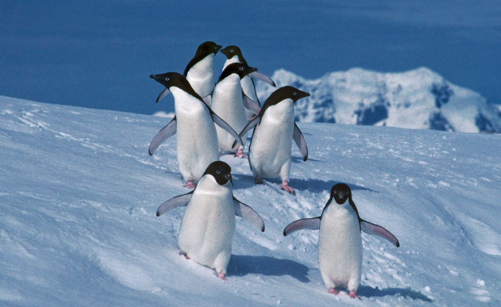
Halley Antarctic Research Station
What would it be like?
Images from British Antarctic Survey

Slide 3
Do you think there are any animals in the Antarctic?

Slide 4
I don’t think anything can live in the Antarctic.
It is just too cold.

Slide 5
How could we find out?
We could go on an expedition and explore the Antarctic.

Slide 6
Team Expedition Antarctica
Who would be in your team? What skills would they need? What jobs would they do?
How could you study living things in the Antarctic? What might you see?
How can your expedition be represented on a flag?

Slide 7
Expedition flags and badges
Isaac Newton
Rocket
Gravity
United Kingdom
Image: European Space Agency

