Slide 1
Activity 1B Menu planning

Slide 2
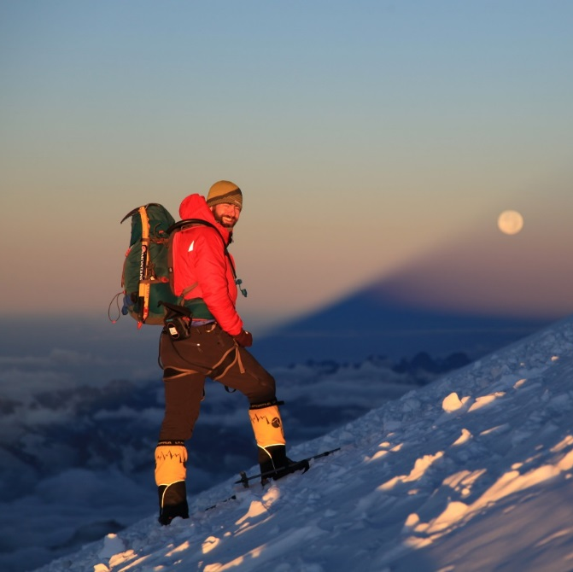
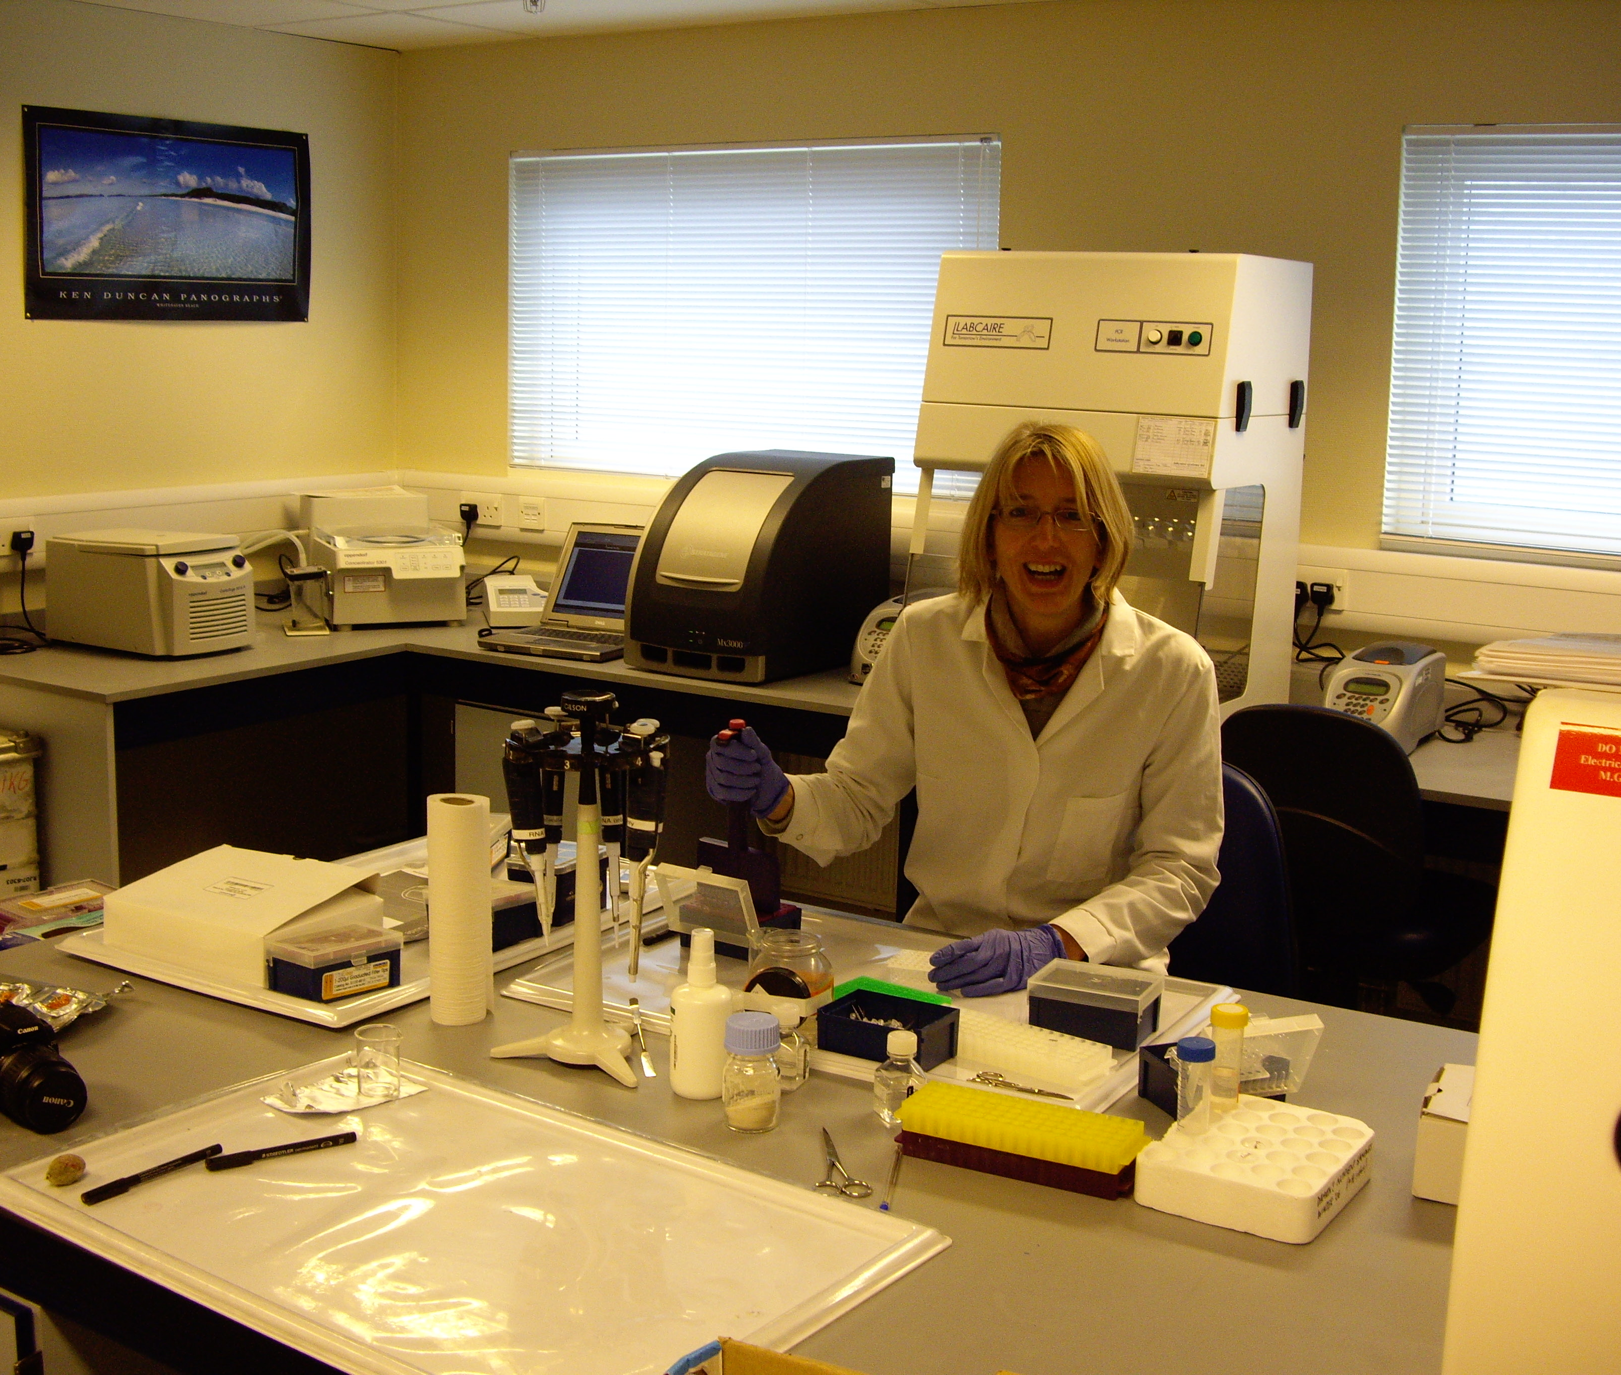
Meet the STEM Professionals
Ibrar Ali Ex-Army Officer, Charity Ambassador and Adventurer.
Ricky Munday Former Head of Corporate Services at British Antarctic Survey (BAS), Polar Ambassador and Founding Director of Inspire Alpine.
Professor Melody Clark Project leader and Molecular Biologist at British Antarctic Survey (BAS).

Slide 3
Objectives
To assemble and compare two meals for two different STEM professionals with differing roles and dietary requirements.

Slide 4
Introduction
Read Melody’s profile
Read Ricky or Ibrar’s profile
What did you eat last night?
What does a Polar explorer eat?

Slide 5
Background information
Melody is based in the lab at Rothera research base in Antarctica and needs your help to design her a meal so she can concentrate on her research looking at adaptations of animals to climate change.
Ricky has been planning his next exploration following his successful ascent of Mount Everest. He wants your help with some meal planning ideas so he doesn’t get bored.
Ibrar is planning his next charity expedition to the North Pole following his successful expedition to the South Pole with Prince Harry.
Did you know?
The average adult needs 2,250 calories a day.
Evening meal should contain 700 – 800 calories
Whilst in the field, an adult needs 3,350 calories a day
Evening meal should contain 1000 – 1200 calories

Slide 6
Activity
Work in pairs or threes
Plan your meals
Compare the two meals
Present your meals and the key differences to another team

Slide 7
Links
Ben Shepperd talks about food planning for an 1,800 mile journey in Antarctica
Find out about Sarah Outen, a round the world traveller
Learn about Aaron Linsdau’s Polar Expedition food
This company makes and sells food for exploration directly to explorers
More information about food in Antarctica

