Slide 1
Activity 5A Food Transport

Slide 2
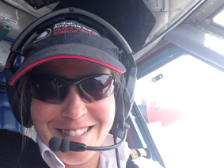
Meet the STEM Professional
Victoria Auld British Antarctic Survey

Slide 3
Objectives
To evaluate the best method for transporting food safely in the Polar regions.

Slide 4
Introduction
How do you think food is transported in the Arctic and Antarctic?
How do you think this was done in the past?
Find out more here

Slide 5
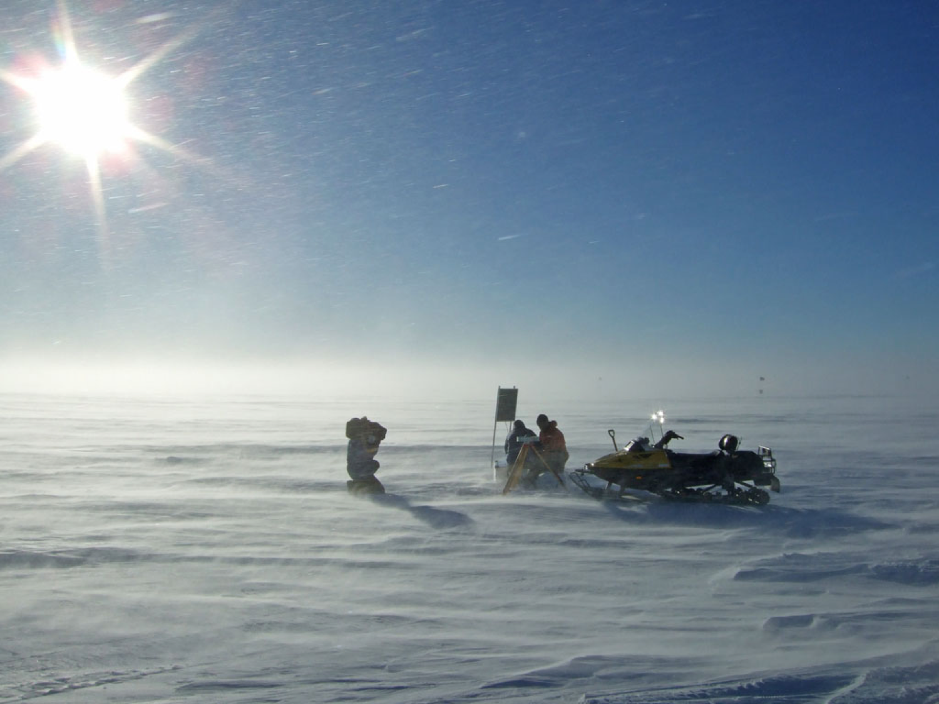
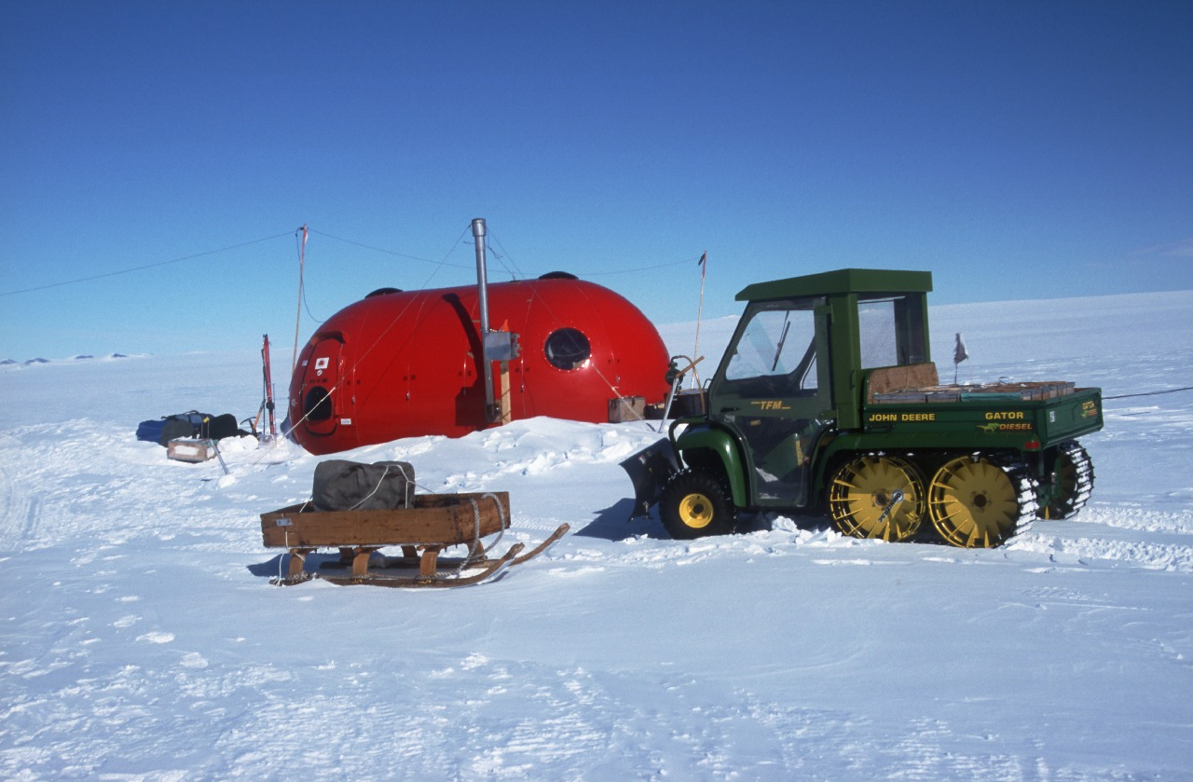
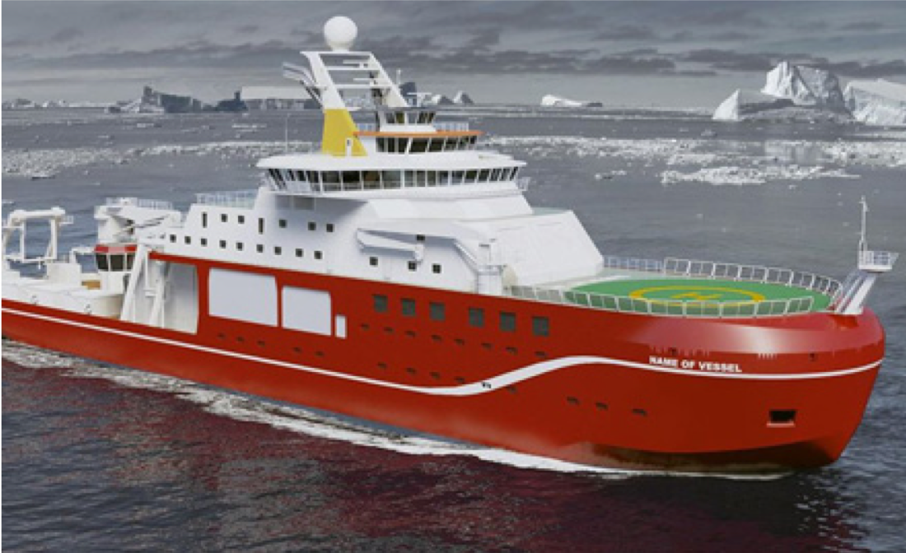
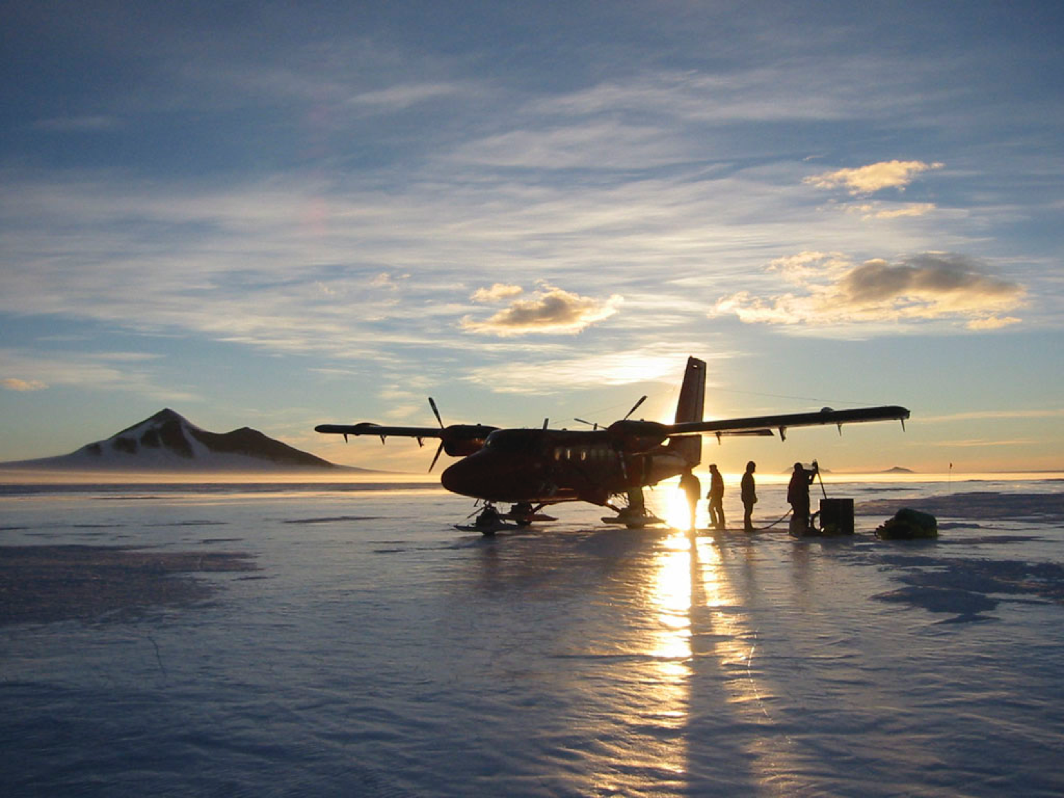
Transport in the Polar regions

Slide 6
Background
Pilots, like Victoria, spend their time transporting people, food and other supplies around the polar regions.
Modern day explorers and scientists also use snowmobiles and other vehicles.
In the past, animals were often used to pull sleds, but much of the work was done by men hauling their supplies.

Slide 7
Activity
Victoria has some food to transport from one base to another and has had to land the plane further away from the research base than planned due to lack of fuel.
How could the food be transported from the plane to the base?
Can you plan an investigation to find out which method of transport would get the food to the polar scientists quickly and safely?

Slide 8
Activity
Set up a circuit to represent a journey in the Arctic. You will need to include obstacles.
Evaluate different ways of transporting food around the circuit:
On a sledge
In a rucksack
In a carrier bag or box
Can you think of any more methods?
How will you ensure that it is a comparative test? How will you measure success?

Slide 9
Links
Watch this clip about Scott’s journey to the South Pole
Learn more about Scott’s journey
Compare transport in the polar regions today with transport in the past
Watch the RRS Sir David Attenborough being launched
Learn more about the RRS Sir David Attenborough

