Slide 1
Activity 4A Food Storage

Slide 2
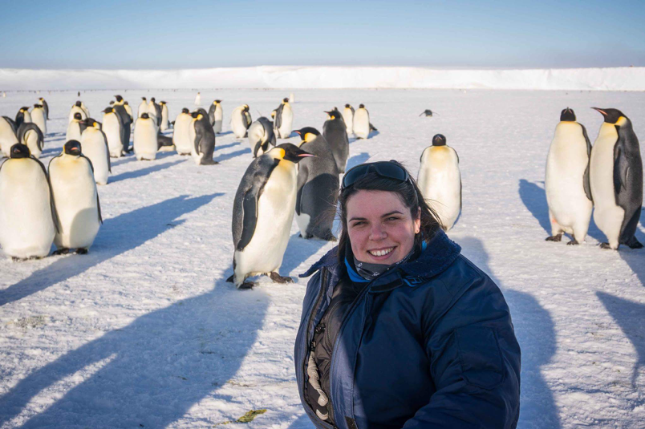
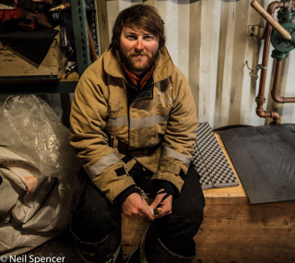
Meet the STEM Professionals
Dr Jess Walkup Rothera Station Leader
Richard Warren Halley Station Leader

Slide 3
Objectives
To compare and contrast different approaches to storing and protecting food.
To collect data to illustrate which approach to storing and protecting food would be ‘best’.

Slide 4
Introduction
How many different ways of packaging food can you think of?
What makes the ‘best’ food packaging?
Test out some ideas with an egg drop

Slide 5
Background
Station Leaders, like Jess and Richard, are responsible for ensuring that food is stored and packaged safely and sensibly on Research Stations.
Did you know that food is sometimes stored in an ice cave? Find out more here!

Slide 6
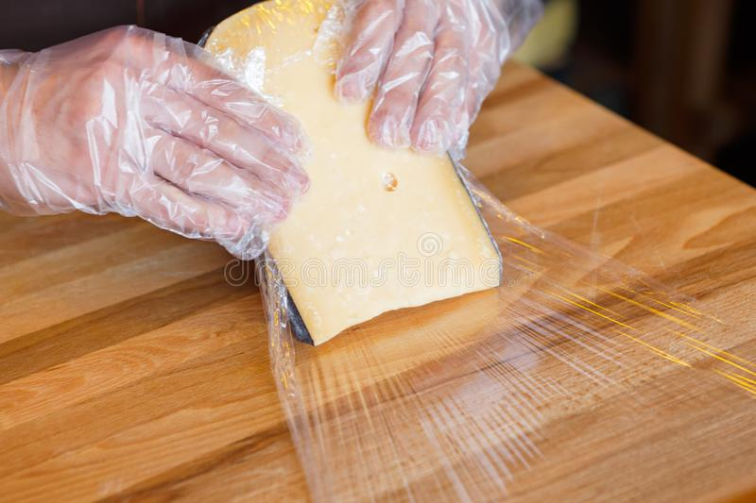
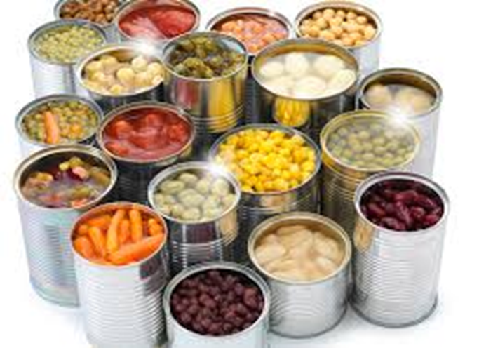
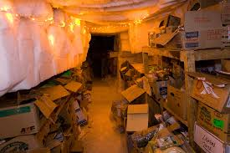
Ways to preserve food
Can you remember how you preserved food? How does that link to storing food?

Slide 7
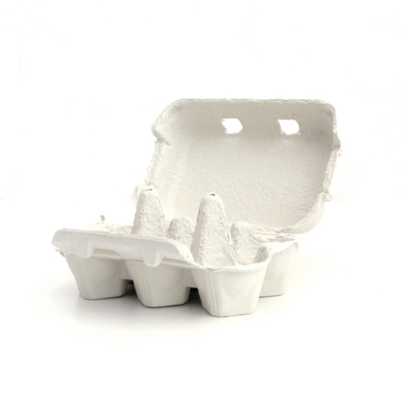
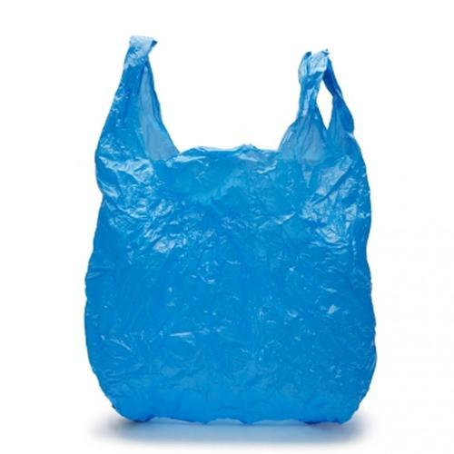
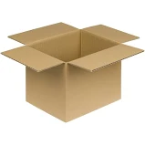
More ways to store food

Slide 8
Activity
Jess and Richard need your help as the recent batches of bread being made keep getting squashed at the Rothera and Halley Stations.
Can you plan an investigation to find out which food packaging would be most effective and why?
Write to either Richard or Jess telling them what you have found out.

Slide 9
Links
Learn how some foods are packaged with gases
Take part in the Squashed Tomato Challenge!

