Slide 1
Activity 3A Food Preservation

Slide 2
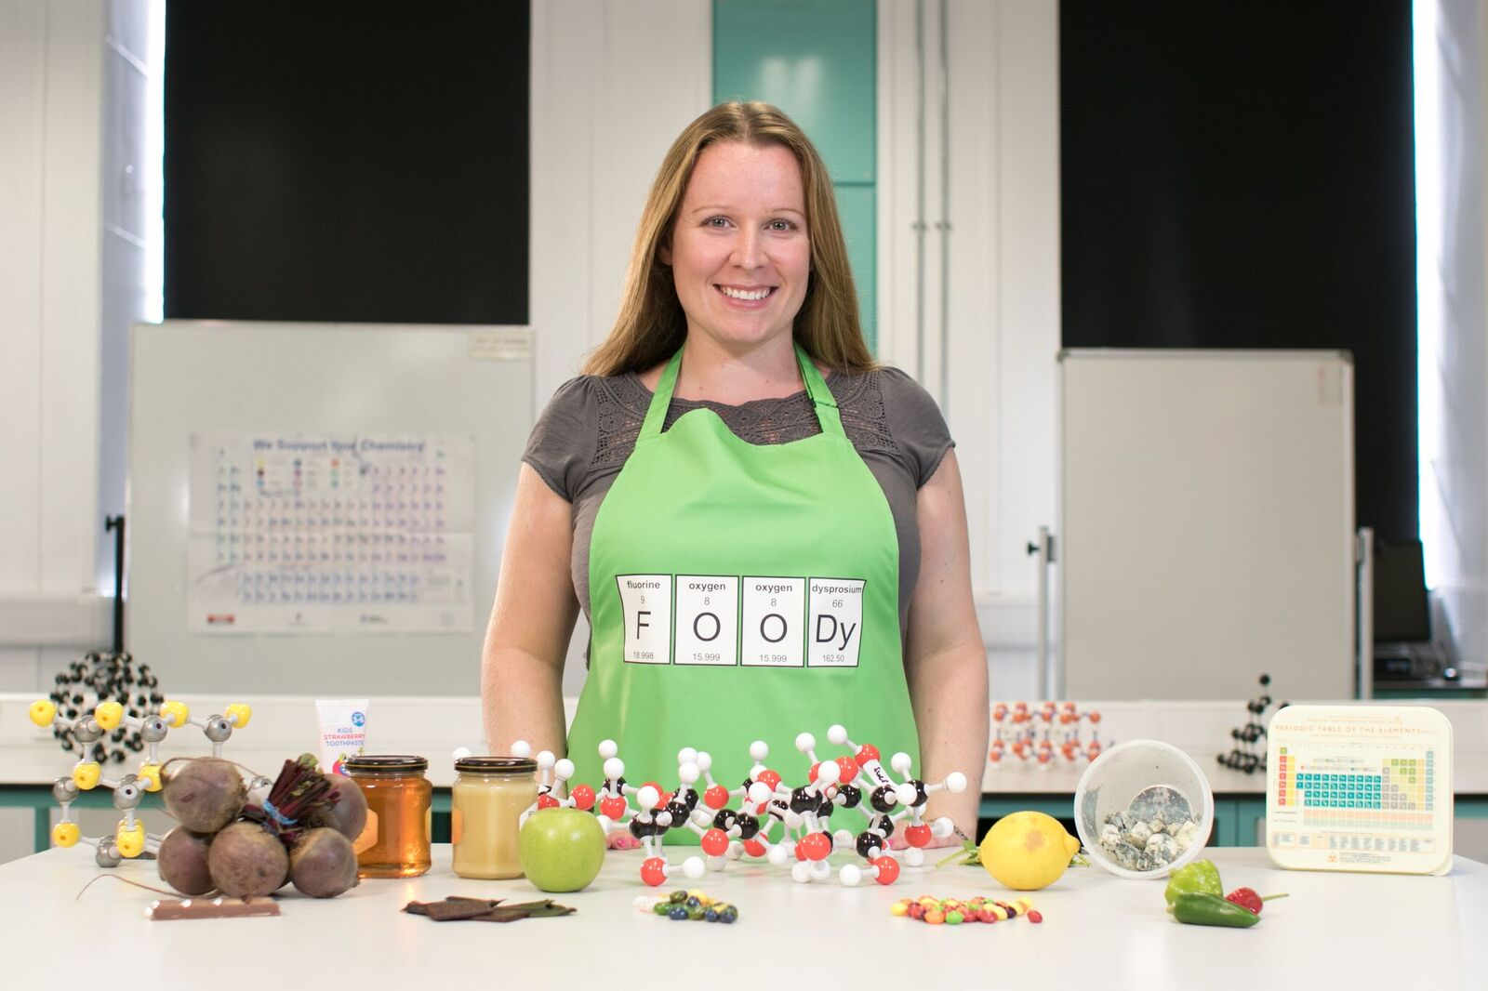
Meet the STEM Professional
Dr Joanna Buckley Chemical Scientist, University of Sheffield

Slide 3
Objectives
To evaluate different ways of preserving food in preparation for an expedition.

Slide 4
Introduction
Read Joanna’s profile
How can you prevent an Apple from going brown?

Slide 5
Background information
Preserving food enables it to be edible for longer.
Lots of different methods were used before fridges were invented.
Historical expeditions to the polar regions took lots of food with them. Why not compare this to the food that people take on expeditions today?

Slide 6
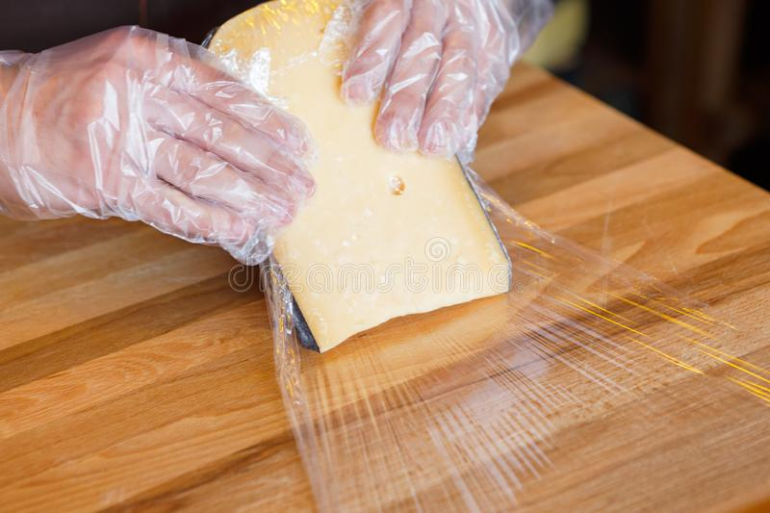
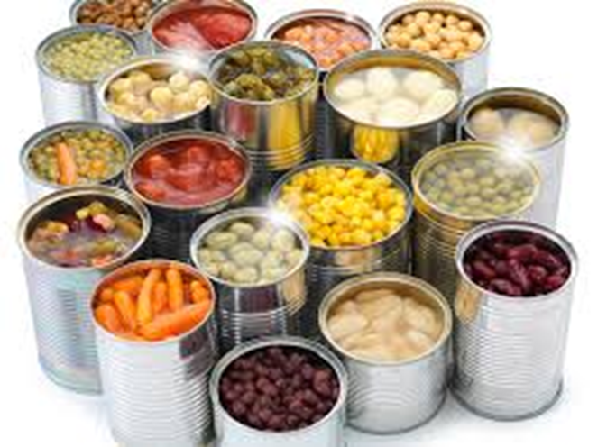
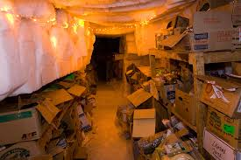
Ways to preserve food

Slide 7
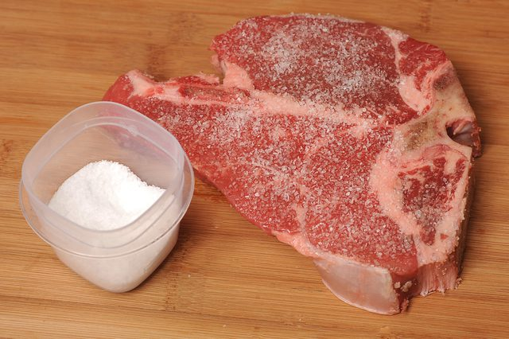
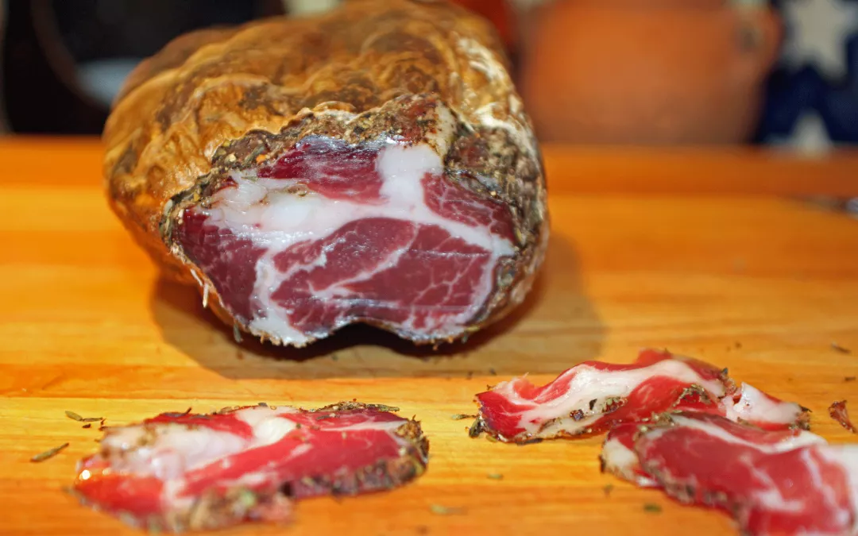
Ways to preserve food

Slide 8
Activity
Work in pairs or threes
Plan an investigation to preserve the bread you made in activity 3
Have you got a control? What will you record? How often will you inspect your samples?
Present pictorial evidence for Joanna to explain what you have found out

Slide 9
Links
Read about Shackleton’s hut found with all the food still preserved 100 years later!
Find out how a chef in the Antarctic caters for staff at the Halley Station
Listen to this clip which explains more about food preservation
Find out more about how food can be preserved

