Slide 1
Activity 2A Recipes

Slide 2
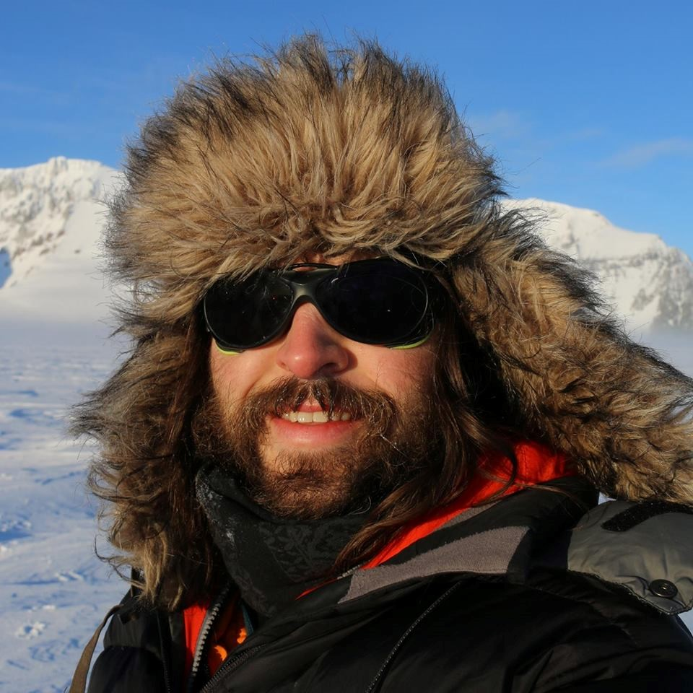
Meet the STEM Professional
Lewis Georgiades Chef at Rothera Reasearch Station, Antarctic

Slide 3
Objectives
To measure ingredients and use a recipe to make some food typically eaten in the Antarctic now and compare them to food eaten historically.

Slide 4
Introduction
Read Lewis’ profile
Try some different foods
What notes should you take to help you compare them?

Slide 5
Background information
Lewis is trying new bread recipes and wants your help in testing one out.
He also wants you to make a recipe from an old cookbook he has come across online.
Did you know:
fresh fruit and vegetables are rarely seen in the polar regions as there is nowhere to grow them and they can’t be stored for very long.
BAS Research stations employ a team of chefs to prepare the food for everyone living and working there.

Slide 6
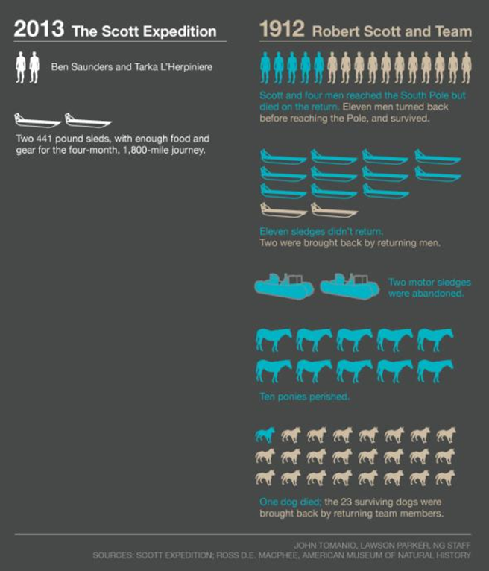
Terra Nova 2013 Vs Robert Scott 1911

Slide 7
Activity
Try some different foods used today
Work in small groups
Use the recipes
Compare the two foods.
Write a report to Lewis about what you found out

Slide 8
Links
More recipes here!
Compare Scott’s journey with a modern expedition
Catering for the team at the Halley Station

