Slide 1
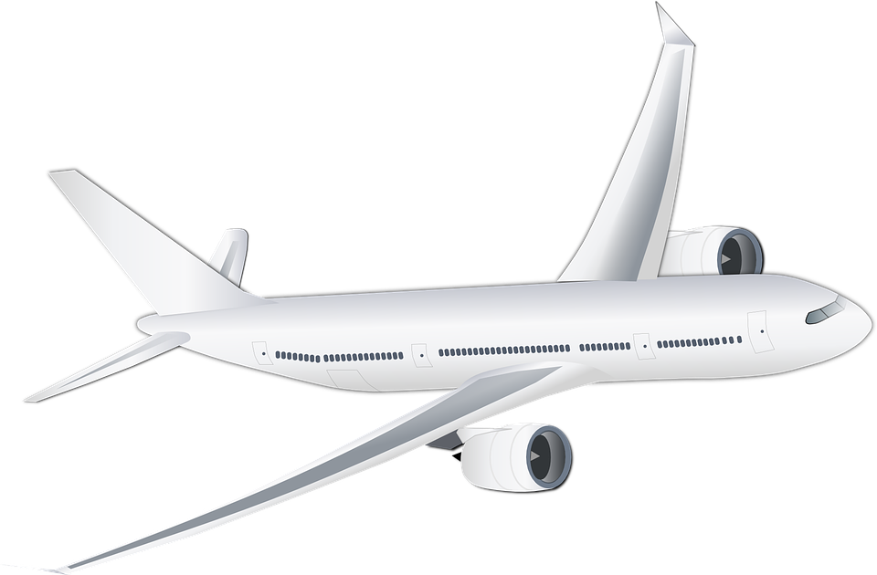
Aircraft of the future
Designing a sustainably powered aircraft

Slide 2
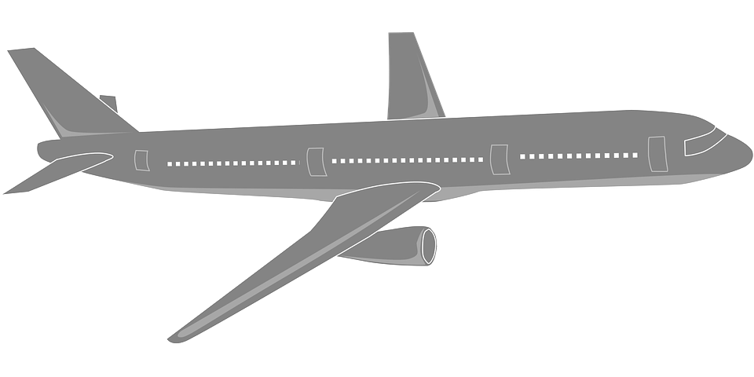
Design brief
Situation
Petrochemicals are likely to become more scarce in the future as the world’s oil resources are used up. This will affect the design of aircraft and how they are powered.
Brief
Design a passenger aircraft that could operate without the use of petrochemicals.
Notes:
Discuss the brief and design criteria with learners.

Slide 3
Design criteria
The aircraft must:
Use a sustainable alternative to petrochemicals to provide the thrust needed for flight.
Make use of appropriate new and/or modern materials.
Be aesthetically appealing.
Notes:
Discuss the brief and design criteria with learners.

Slide 4
Aircraft of the future designs
Use this space to sketch three ideas for your ‘aircraft of the future’.
Don’t forget to annotate your designs to show how they meet the design criteria!
Notes about design:
Notes:
Learners can use this sheet to present their ideas, annotations and supporting notes.

Slide 5
Final design
Select your best idea.
Produce a presentation drawing of the design that you have chosen.
Justify your choice.

