Slide 1
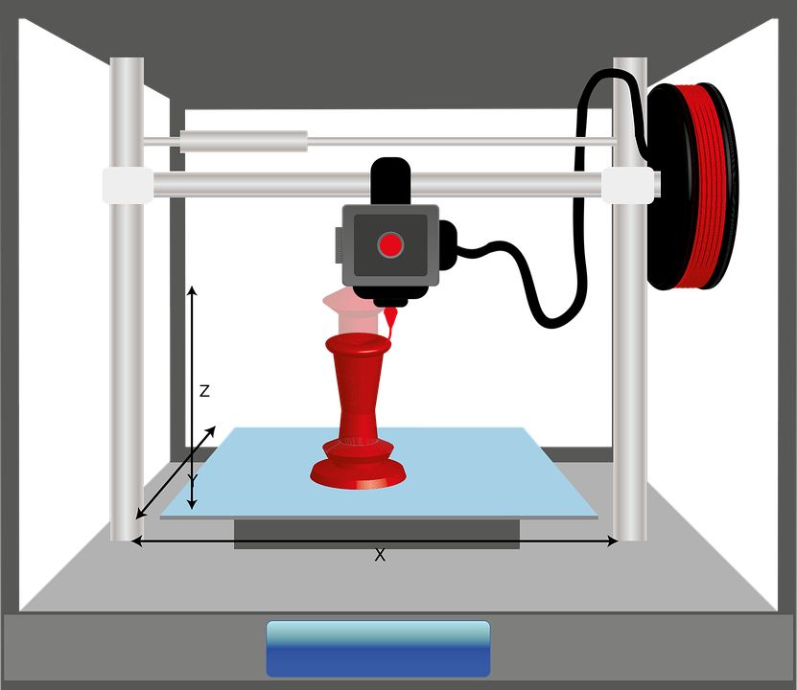
Starter
Recalling what you learnt last lesson write down how a 3D printer works.

Slide 2
Objectives
To understand the 3D printing process
To review different uses of 3D printing

Slide 3
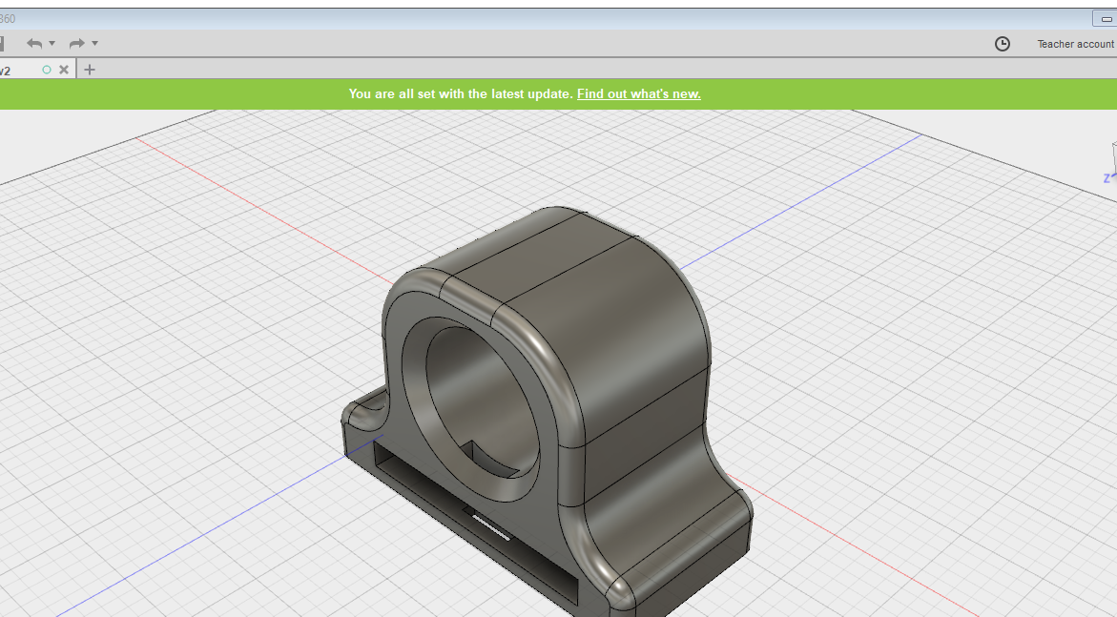
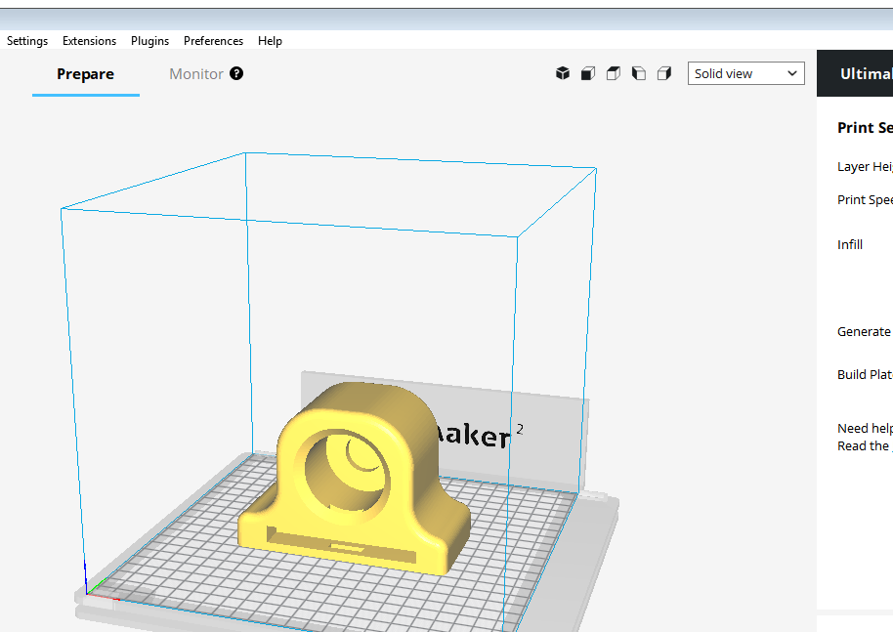
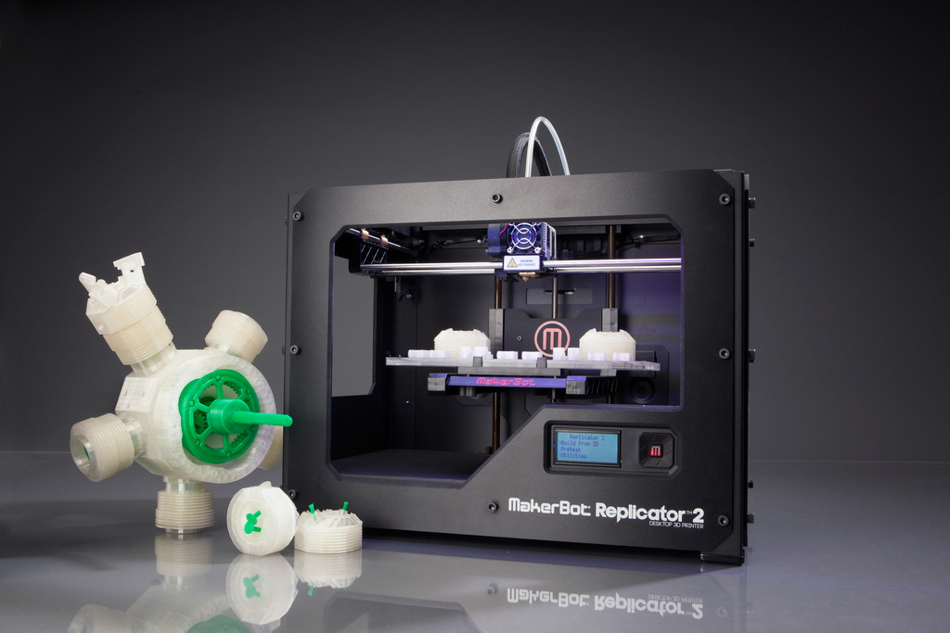
How to create a model to print
1. Design on CAD
01
2. Slice model
02
3. 3D print model
03

Slide 4
Designing on CAD
1. Models are designed using 3D CAD packages such as Fusion 360.
2. The models are designed in 3D and then exported as an STL file.
3. The STL files are sliced into layers and sent/uploaded to a 3D printer.
4. The printer then prints the STL files in layers.

Slide 5
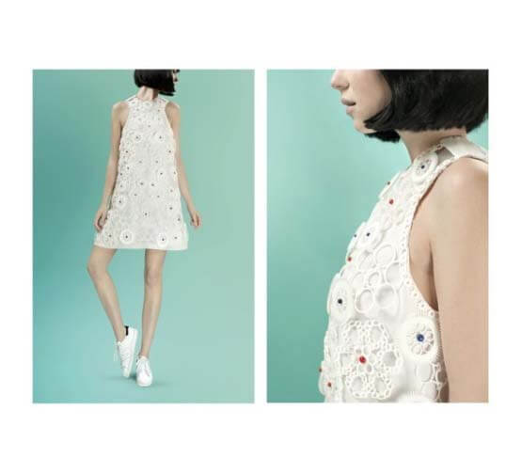
3D printing and Fashion
3D printing is being used in the fashion industry.
Customised garments can be made that are unique to a customers sizing.
New materials and printing techniques allows for more creative designs.
https://www.sculpteo.com/en/applications/textile-industry/

Slide 6
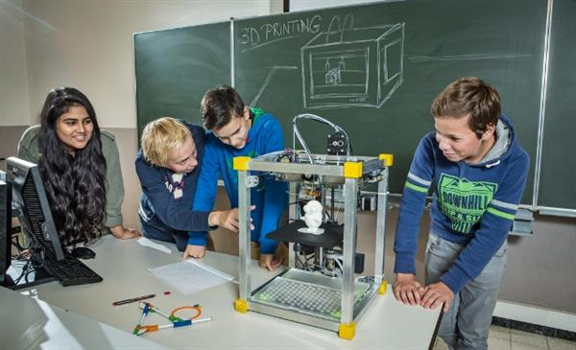
3D printing in education
Schools around the world are embracing 3D printing to teach students how to create designs.
With 3D printing going to have such a huge impact upon how things are made, education is key to driving it forward.
3D printing is seen as a STEM subject as it uses Maths and Science principles
http://www.3ders.org/

Slide 7
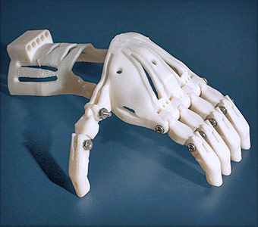
3D printing in medicine
3D printing is revolutionising the Medical industry. From 3D printed mechanical arms to Bio 3D printing. Medicine is set to benefit hugely from the growth of 3D printing.
Mechanical arms can be 3D printed at a much lower cost than normal metal produced arms.
As children grow, they can just print a new arm in a matter of hours.
https://www.asme.org/engineering-topics/articles/manufacturing-design/top-5-ways-3d-printing-changing-medical-field

Slide 8
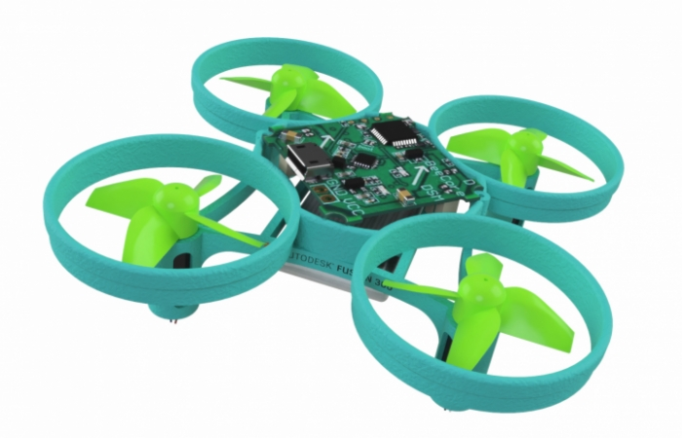
3D printing and Drones
3D printing has allowed for new and emerging technology such as drones to be accessible for all.
They can be printed quickly and cheaply and used as a learning tool.
Previously expensive – now 3D printing and drones are common education projects.
https://academy.autodesk.com/curriculum/airgineers-micro-drone

Slide 9
Plenary
Complete the plenary questions on your student worksheet.

