Slide 1
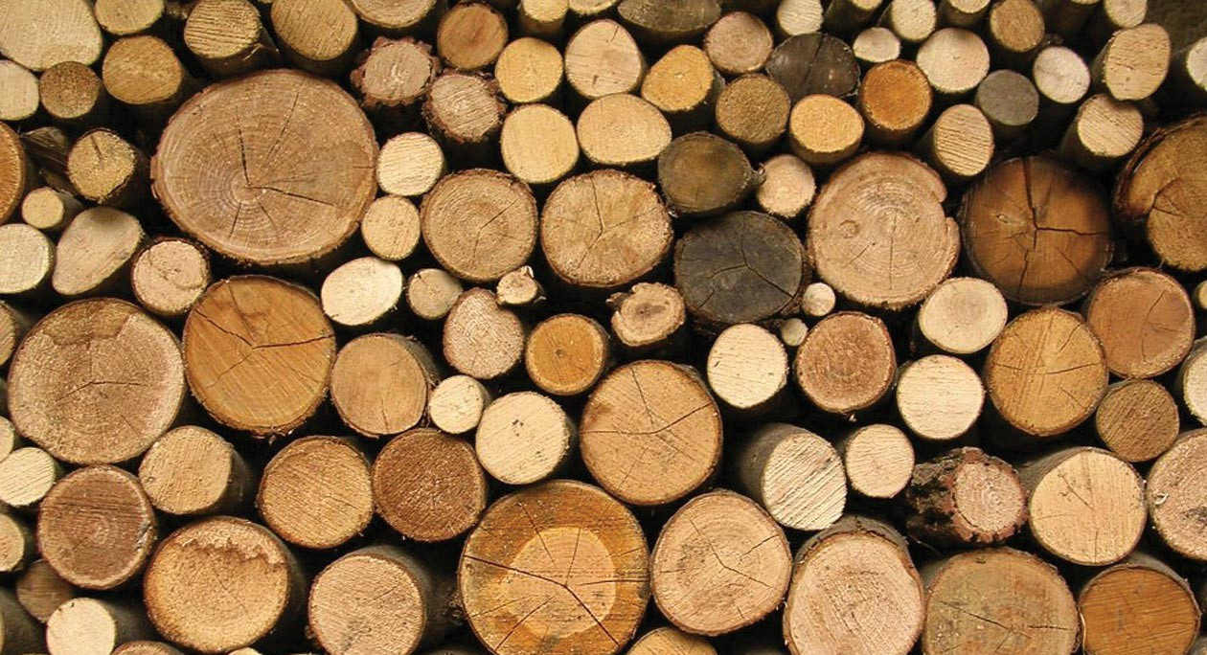
LESSON 3/5
Material Properties – Natural & Manufactured Boards
Within this lesson you will cover:
To gain an understanding of timber seasoning (both naturally and artificially) to help reduce the moisture content.
Develop an understanding of the process of converting a log into lumber.
Develop an understanding of timber conversion and apply to an exam style question.

Slide 2
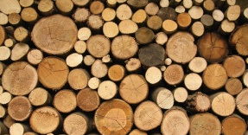
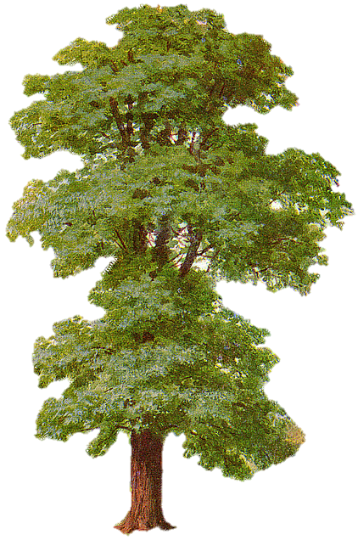
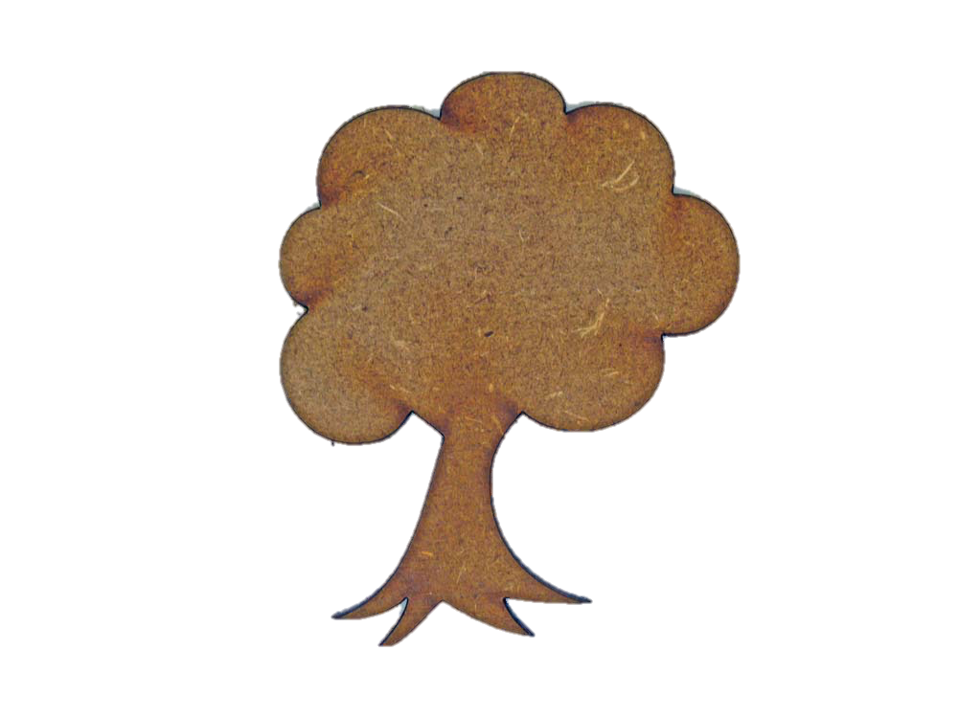
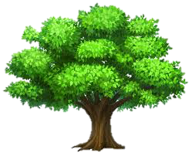
Objective - Learner will gain knowledge and understanding of timber seasoning to help reduce the moisture content.
DO NOW ACTIVITY
Can you match the types of Woods and Trees?
BEECH TREE
PLYWOOD
BALSA WOOD
MAHOGHANY
CHIP BOARD
MDF TREE
OAK TREE
MDF
PINE

Slide 3
Can you match the types of Woods and Trees?
BEECH TREE
PLYWOOD
BALSA WOOD
MAHOGHANY
CHIP BOARD
MDF TREE
OAK TREE
MDF
PINE
Notes:
Worksheet to print or complete on an interactive whiteboard

Slide 4
Objective - Learner will gain knowledge and understanding of timber seasoning to help reduce the moisture content.
DO NOW ACTIVITY
PLYWOOD
BEECH TREE
PINE
MDF
BALSA WOOD
MAHOGHANY
OAK TREE
CHIP BOARD
MDF TREE

Slide 5


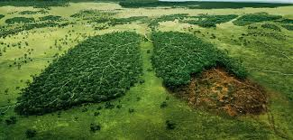

Objective - Learner will gain knowledge and understanding of timber seasoning to help reduce the moisture content.
TIMBERS & SUSTAINABILITY
Timbers & sustainability
The FSC (Forest Stewardship Council)
Briefly describe to your neighbour their role.
What is the potential impact of deforestation?

Slide 6
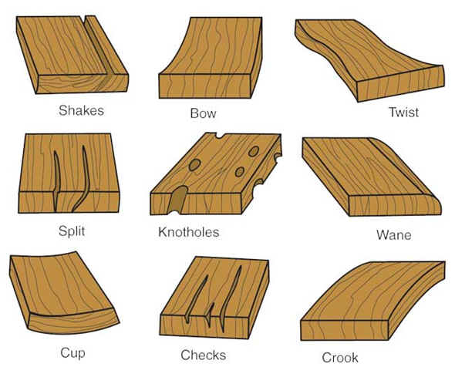
Objective - Learner will gain knowledge and understanding of timber seasoning to help reduce the moisture content.
TIMBER SEASONING
Processing felled timber : Seasoning
Seasoning of timber is the process by which moisture content in the timber is reduced to required level. By reducing moisture content, the strength, elasticity and durability properties are developed. A well-seasoned timber has 15% moisture content in it.
There are two methods of Seasoning of timber which are:
Natural seasoning
Artificial seasoning
“Green” wood contains over 50% moisture. Seasoning reduces the moisture content and prevents common faults.

Slide 7
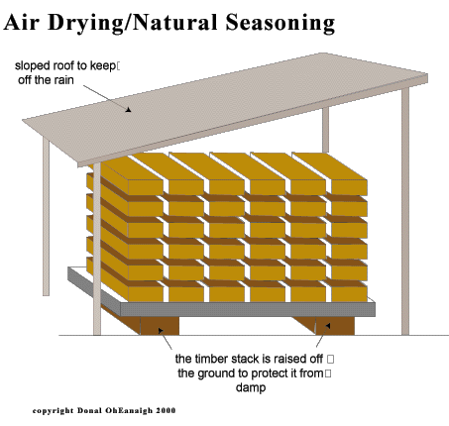

Objective - Learner will gain knowledge and understanding of timber seasoning to help reduce the moisture content.
TIMBER SEASONING
Processing felled timber : Seasoning
Natural seasoning - is the process in which timber is seasoned by subjecting it to the natural elements such as air or water. Natural seasoning may be water seasoning or air seasoning.
Air seasoning:
Slower (1 year per 25mm)
Higher moisture-content
Needs more space
https://www.youtube.com/watch?v=Qn68NTlULws

Slide 8
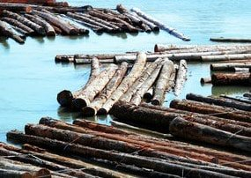
Objective - Learner will gain knowledge and understanding of timber seasoning to help reduce the moisture content.
TIMBER SEASONING
Processing felled timber : Seasoning
Water Seasoning
Water seasoning is the process in which timber is immersed in water flow which helps to remove the sap present in the timber. It will take 2 to 4 weeks of time and after that the timber is allowed to dry. Well-seasoned timber is ready to use.

Slide 9
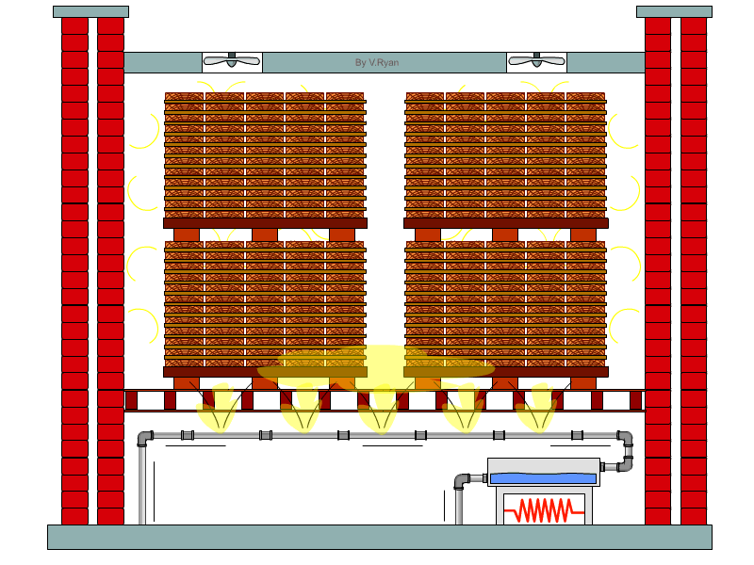
Objective - Learner will gain knowledge and understanding of timber seasoning to help reduce the moisture content.
ARTIFICIAL SEASONING
Seasoning by Boiling - Chemical seasoning - Kiln seasoning - Electrical seasoning
Artificial Seasoning of Timber
Seasoning by Boiling
Seasoning of timber is also achieved by boiling it in water for 3-4 hours. After boiling timber is allowed to drying. For large quantity of timber boiling is difficult so, sometimes hot steam is passed through timber logs in enclosed room. It also gives good results. The boiling or steaming process develops the strength & elasticity of timber but economically it is of heavier cost.

Slide 10
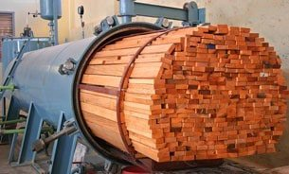
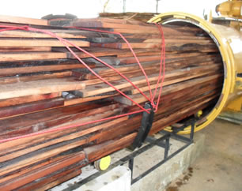
Objective - Learner will gain knowledge and understanding of timber seasoning to help reduce the moisture content.
ARTIFICIAL SEASONING
Seasoning by Boiling - Chemical seasoning - Kiln seasoning - Electrical seasoning
Artificial Seasoning of Timber
Seasoning by chemicals
In case of chemical seasoning, timber is stored in suitable salt solution for some time. The salt solution used has the tendency to absorb water from the timber. So, the moisture content is removed and then timber is allowed to drying. It affects the strength of the timber.

Slide 11
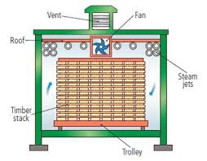
Objective - Learner will gain knowledge and understanding of timber seasoning to help reduce the moisture content.
ARTIFICIAL SEASONING
Seasoning by Boiling - Chemical seasoning - Kiln seasoning - Electrical seasoning
Artificial Seasoning of Timber
Natural seasoning gives good results but takes more time. So, artificial seasoning of timber is developed nowadays. By artificial seasoning, timber is seasoned with in 4-5 days.
Kiln drying:
Faster
Lower moisture-content
More expensive
Kills bugs
https://www.youtube.com/watch?v=oxNBJv7_Kvg

Slide 12
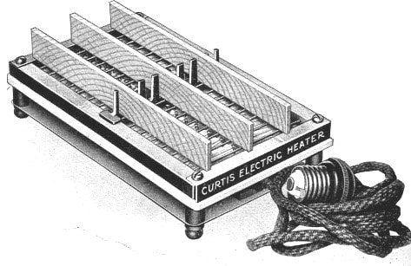
Objective - Learner will gain knowledge and understanding of timber seasoning to help reduce the moisture content.
ARTIFICIAL SEASONING
Seasoning by Boiling - Chemical seasoning - Kiln seasoning - Electrical seasoning
Artificial Seasoning of Timber
Electrical Seasoning
In the method of electrical seasoning timber is subjected to high frequency alternating currents. The resistance of timber against electricity is measured at every interval of time.
When the required resistance is reached seasoning, process is stopped because resistance of timber increases by reducing moisture content in it. It is also called as rapid seasoning and it is uneconomical.

Slide 13
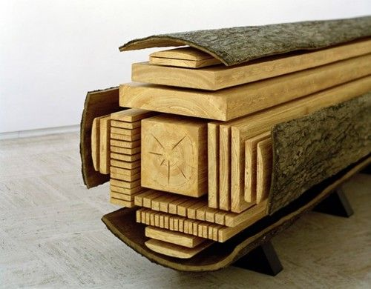
Objective - Learner will gain knowledge and understanding of timber seasoning to help reduce the moisture content.
LOGS TO LUMBER
https://www.youtube.com/watch?v=NvbgwdTGoyo#

Slide 14
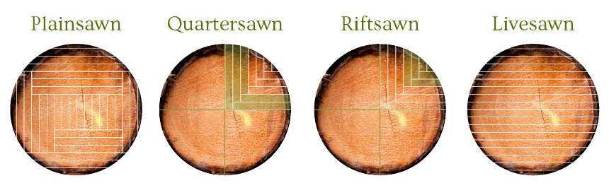
Objective - Learner will gain knowledge and understanding of timber seasoning to help reduce the moisture content.
TIMBER CONVERSION
Conversion is the term used when sawing a tree trunk into useable pieces of timber.
There are two basic forms of conversion, slab sawn and quarter sawn.
As well as cutting the timber into useable pieces, the choice of conversion method can also enhance the grain and help make the materials more stable.
https://www.youtube.com/watch?v=VvUPJPFg4wM

Slide 15
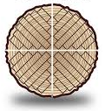
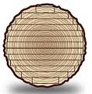
Objective - Learner will gain knowledge and understanding of timber seasoning to help reduce the moisture content.
TIMBER CONVERSION
Apply what you have learnt to an exam question.

Slide 16
Notes:
Worksheet to print

Slide 17

Objective - Learner will gain knowledge and understanding of timber seasoning to help reduce the moisture content.
PLENARY
Using the Twitter slip write a 140 character Tweet which summarises what you have learnt during todays lesson.

Slide 18
Notes:
Plenary tweet ‘twitter’ sheets to print and cut out

