Slide 1
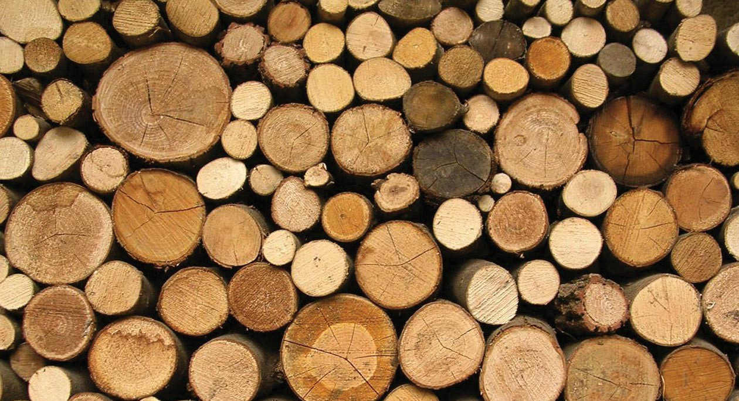
LESSON 1/5
Material Properties – Natural & Manufactured Boards
Within this lesson you will cover:
To gain an understanding of the properties of hardwood and softwood timbers.
Names of different hardwoods & softwoods.
Understand the different timber types and their uses.
Apply learning to a homework worksheet.

Slide 2
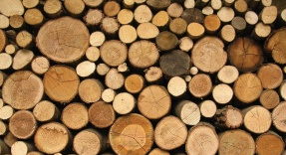
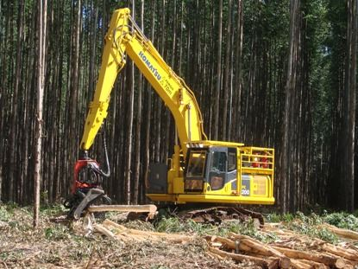
Objective - Learner will gain knowledge and understanding of the properties of hardwood and softwood timbers
DO NOW ACTIVITY
Timber Production and Types
Study the image and using the 5W’s & How write a question you would like to know the answer to.
Where?
When?
What?
How?
Who?
Why?

Slide 3
Objective - Learner will gain knowledge and understanding of the properties of hardwood and softwood timbers
SUCCESS CRITERIA
Who | Description
All Students | Describe with the use of images the lifecycle of Timber, including the type of trees different timbers come from.
Most Students | Explain the different types of timber- Softwoods, Hardwoods and Manufactured boards.
Some Students | Explain how sustainable forests are having a positive environmental impact.
Lets watch a short video about the differences of hardwood & softwood.
https://www.youtube.com/watch?v=CI39sMIy6mE

Slide 4
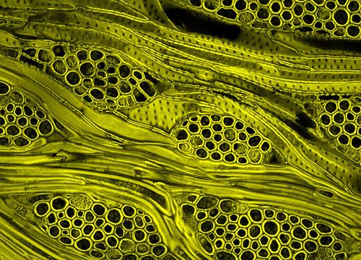
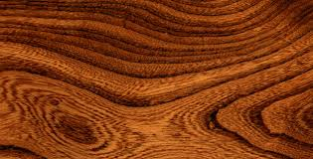
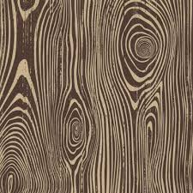
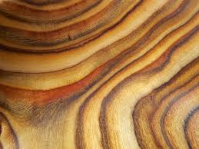
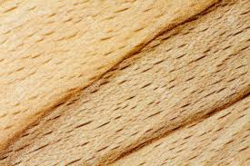
Objective - Learner will gain knowledge and understanding of the properties of hardwood and softwood timbers
TIMBERS – WHAT ARE THEY?
Wood comes from trees and is one of our oldest natural resources. It has many useful properties and many uses. The wood we use comes from many different types of trees and each one is different, both in colour and pattern (grain).
Wood can be found all over the world with different species found in different areas.
Cellulose fibres
Lignin resin
Approximately 80% of the UK wood needs are supplied by other countries.

Slide 5
Objective - Learner will gain knowledge and understanding of the properties of hardwood and softwood timbers
TIMBER LOCATION MAP

Slide 6
Objective - Learner will gain knowledge and understanding of the properties of hardwood and softwood timbers
TIMBER PREPERATION

Slide 7
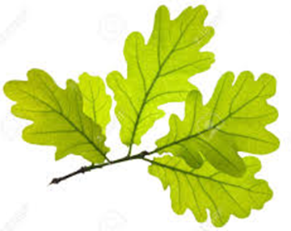
Objective - Learner will gain knowledge and understanding of the properties of hardwood and softwood timbers
HARDWOODS
Hardwoods
Hardwood trees are usually deciduous with broad leaves.
They grow best in warm, wet (tropical)areas.
They include the densest, strongest and most durable timbers.
But NOT all hardwoods are hard, e.g. balsa wood.
The cheaper hardwoods are approximately equal in cost to expensive softwoods.
Hardwood List: Ash, Beech, Elm, Mahogany, Chestnut, Maple, Teak, Walnut & Oak.
To name but a few

Slide 8
Objective - Learner will gain knowledge and understanding of the properties of hardwood and softwood timbers
HARDWOODS

Slide 9
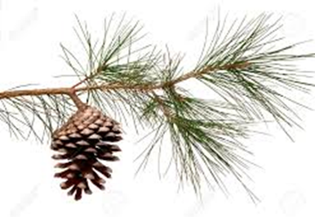
Objective - Learner will gain knowledge and understanding of the properties of hardwood and softwood timbers
SOFTWOODS
Softwoods
Softwood trees are evergreen with pine needles and cones.
They grow best in cold, dry climates.
They are NOT all soft, e.g. yew.
Softwoods comprise about 75% of timber used in the UK.
Softwood List: Cedar, Douglas Fir, Larch, Pine, Yew & European Redwood
Remember there are LESS softwoods than hardwoods.

Slide 10
Objective - Learner will gain knowledge and understanding of the properties of hardwood and softwood timbers
SOFTWOODS

Slide 11
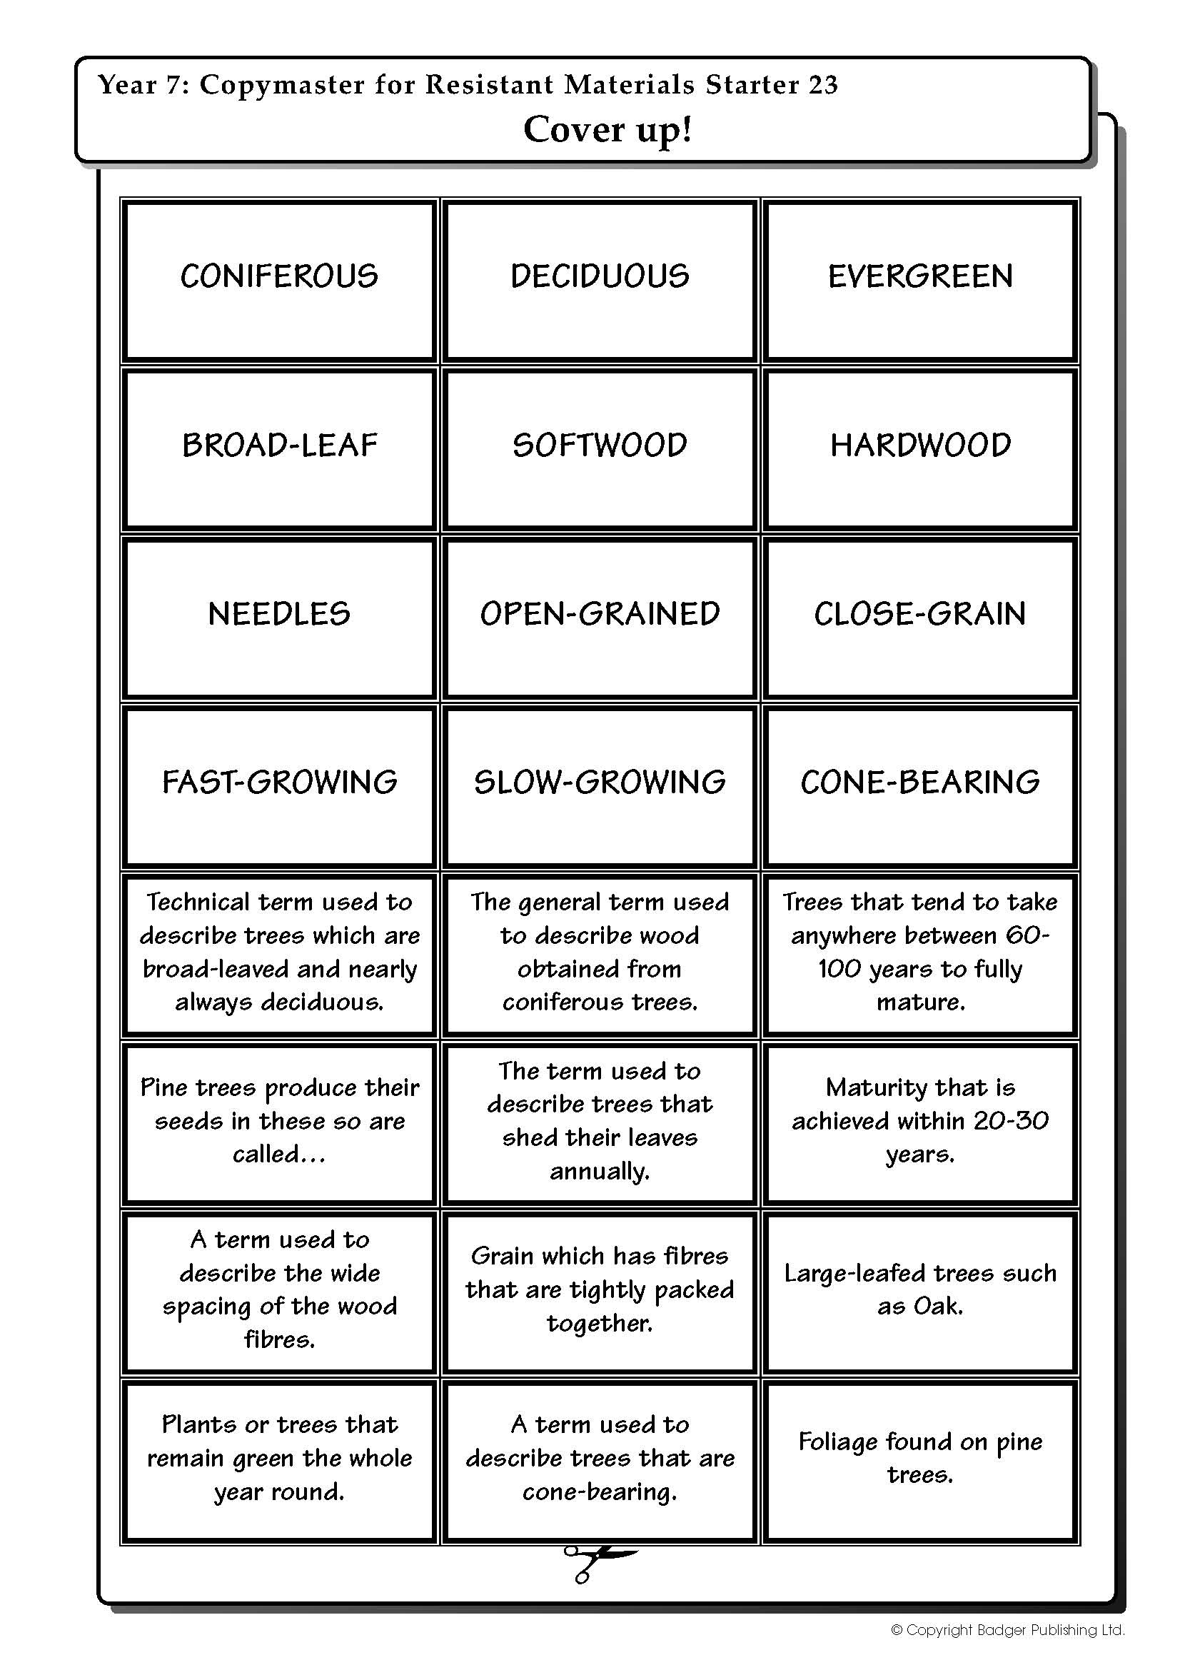
Objective - Learner will gain knowledge and understanding of the properties of hardwood and softwood timbers
TIMBER ACTIVITY
Cut out the boxes
Match up the key words with the definitions
Do not stick anything yet!

Slide 12
Notes:
WORKSHEET TO PRINT

Slide 13
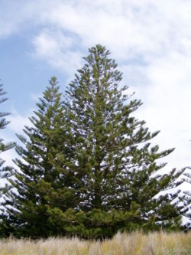
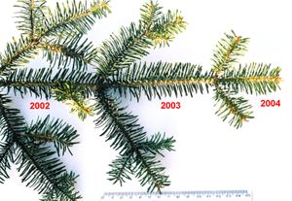
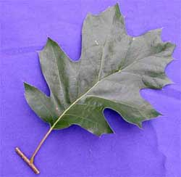
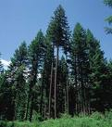
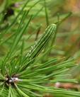
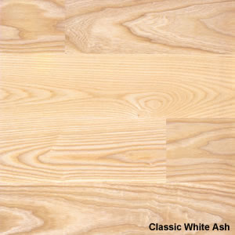
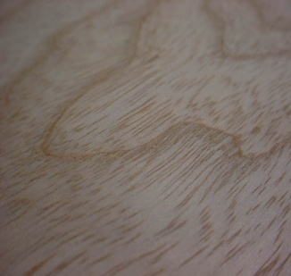
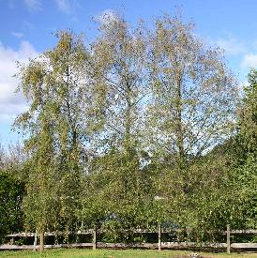
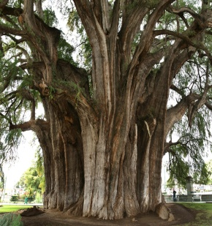
Objective - Learner will gain knowledge and understanding of the properties of hardwood and softwood timbers
TIMBER ACTIVITY:ANSWERS
Now you have placed it into the correct order, glue the matching cards into your exercise book.

Slide 14
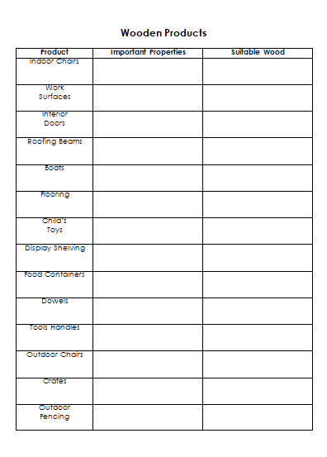
Objective - Learner will gain knowledge and understanding of the properties of hardwood and softwood timbers
HOMEWORK TASK
On the worksheet provided write which wood is suitable for each product & the important properties to consider.
Properties: Hardness, Strength etc.

