Slide 1
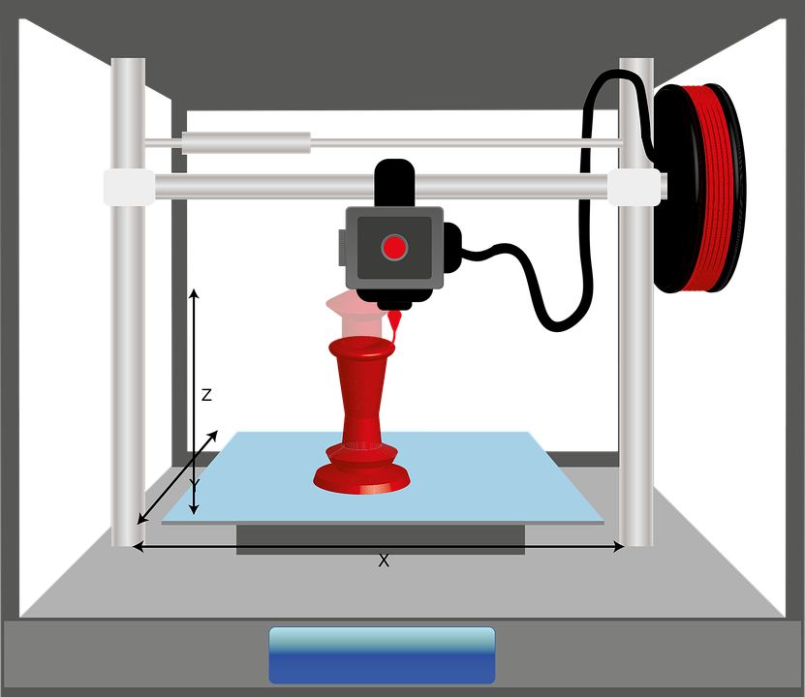
Objectives
To model a small device for keeping food packets closed.
To work independently to design and then prepare our model for 3D printing

Slide 2
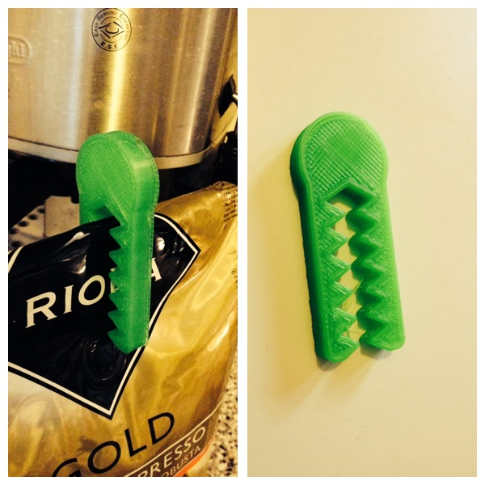
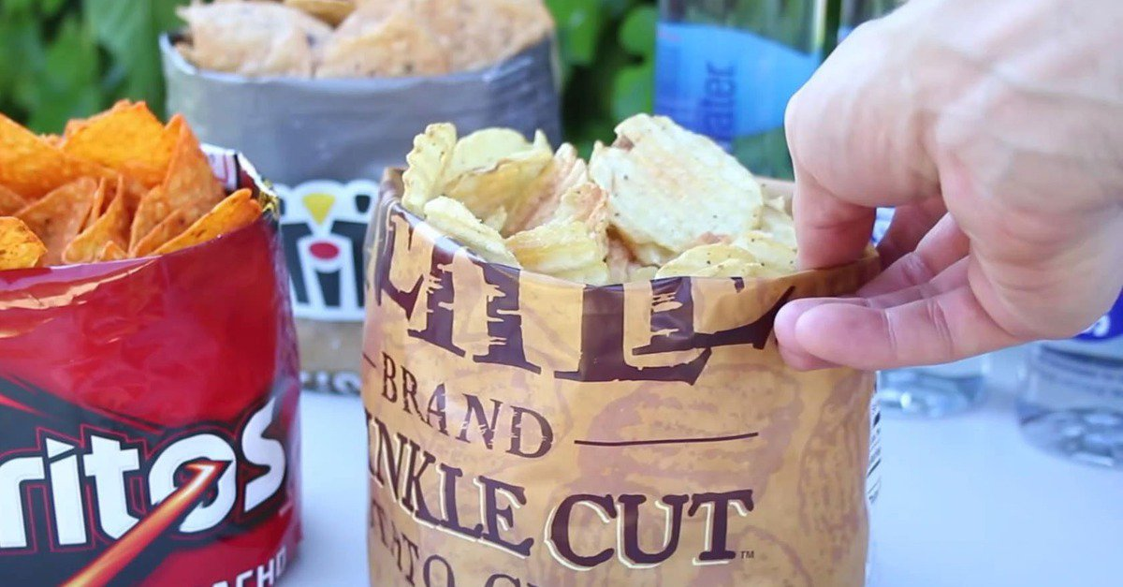
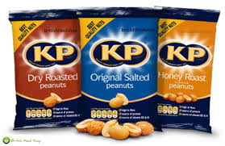
Problem
Open food packets can cause unnecessary food wastage and increase costs as food can perish faster.
Design a device that can be printed in under an hour to keep food packets closed

Slide 3
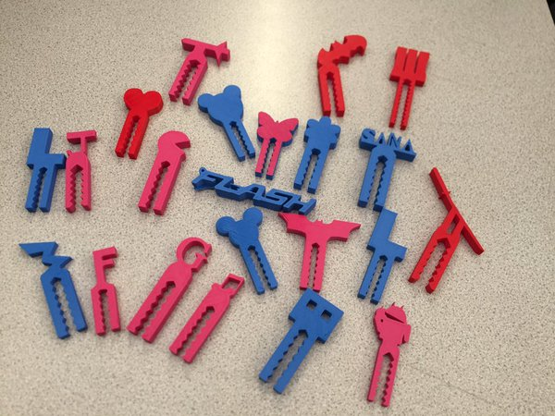
Examples of outcomes.

Slide 4
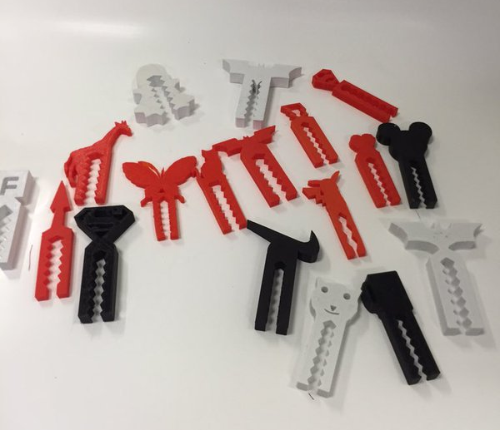

Slide 5
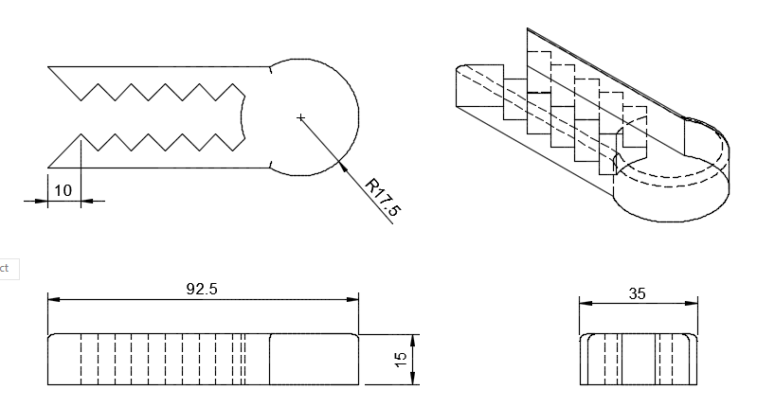
Technical drawings
Use the sizes as a reference when designing your own clip.
Dimension in mm.
Plan View
Side View
End View

Slide 6
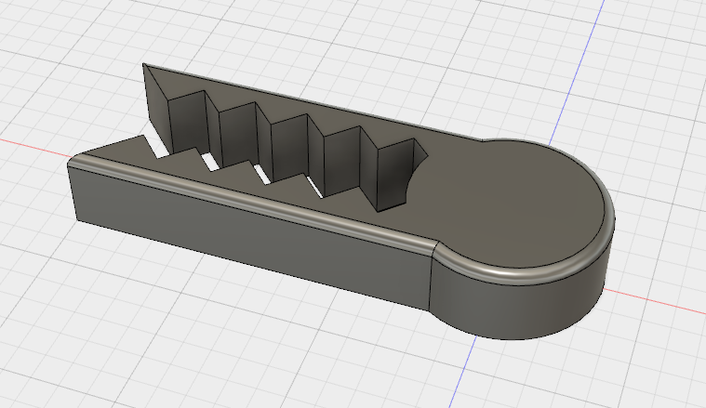
Design requirements
Sizes must be no bigger than the example in the tech drawing.
Must be able to be 3D printed in under an hour.
Slice and prepare your model by the end of the lesson.

Slide 7
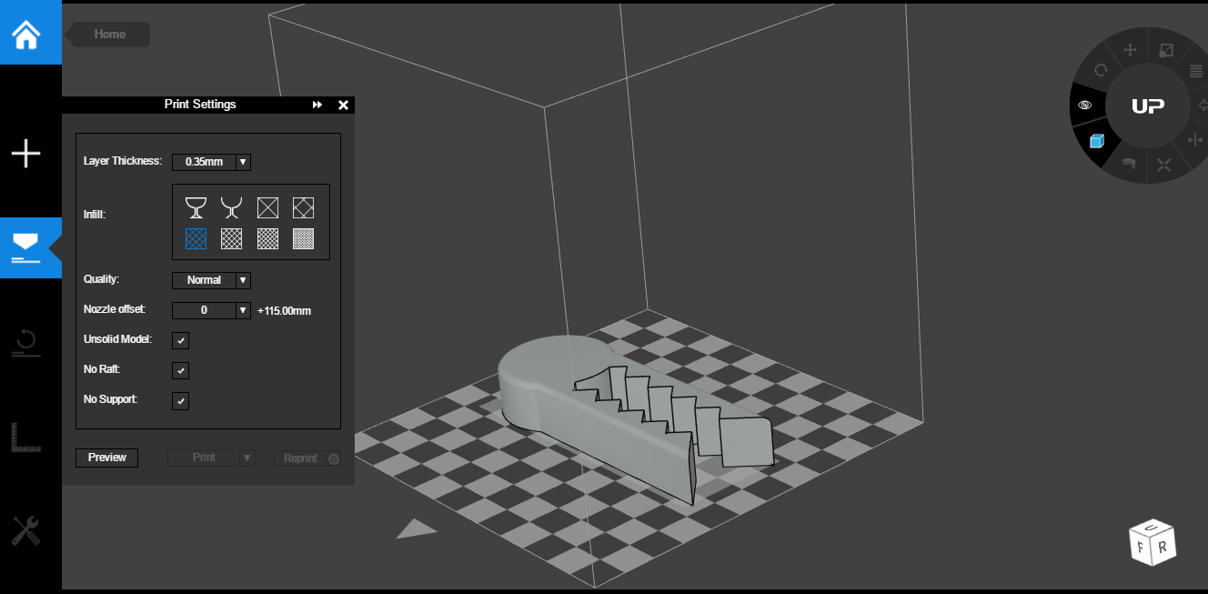
Slicing settings
Thicker layer height
Minimum density
This will being the print time under an hour

Slide 8
Plenary
Reflecting back on the series of lessons, explain three of the most important things that you have learned during the series of lessons.
1)…………………………………
2)………………………………...
3)………………………………...

