Slide 1
NEA MINI ASSESSMENT
Lesson 8/10
DESIGN FOR SOCIETY
“Understanding how design can have a positive impact on others”.
Learning Aims:
Apply previous lessons learning of inclusive design to a mini NEA design brief.
Learn about anthropometrics & collect appropriate data.
Use data to produce a developed design solution applying SCAMPER.

Slide 2
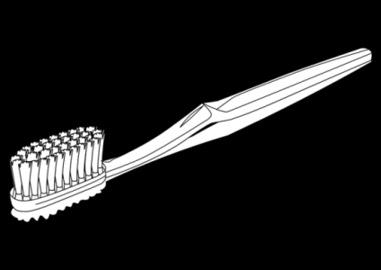
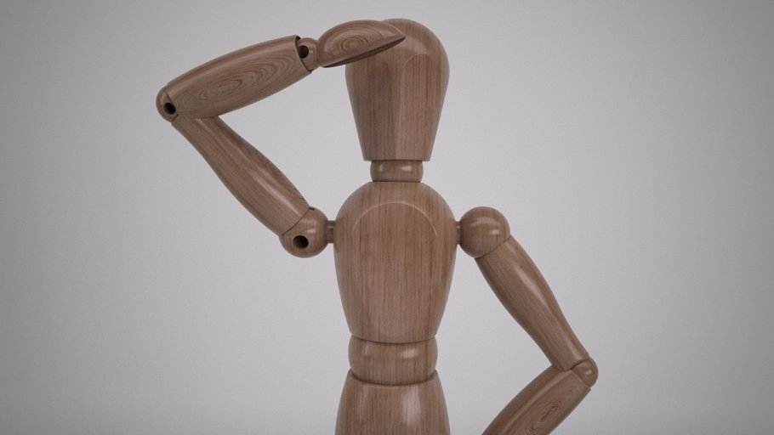
GCSE Design Technology – Toothbrush redesign for an elderly person
5W’S & HOW QUESTION
DO NOW ACTIVITY
Who?
Where?
If
Why?
How?
When?
What?
Using the post it note provided study the above image of an Ergonome and write a discussion questions. Once written stick your post it note on the board for discussion.

Slide 3
GCSE Design Technology – Toothbrush redesign for an elderly person
I am known as an ergonome.
I am used to work out the correct movement and size of the human body.
Often this can be called the 5th – 50th – 95th percentile.
I am also used to see how I fit in the relationship to the product I will be using.
Most products use the MEAN data to ensure ALL users can use it.

Slide 4
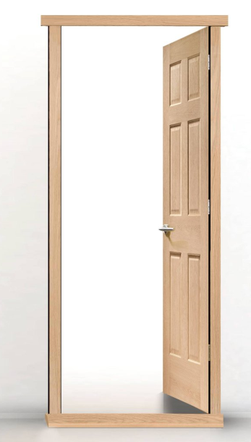
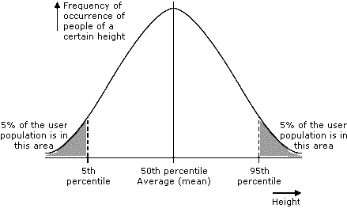
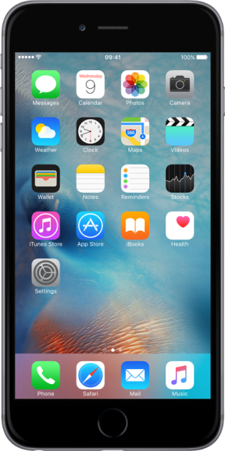
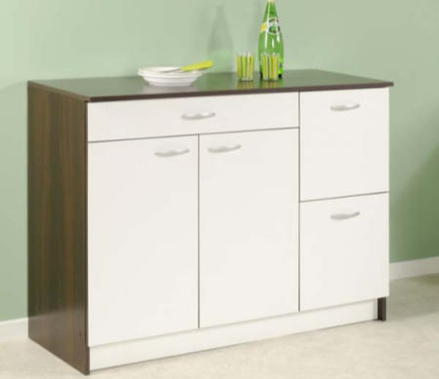
GCSE Design Technology – Toothbrush redesign for an elderly person
This is anthropometric percentile graph which helps determines the measurements products should be produced. Most products use the mean data or the 50th percentile which means that it will suit MOST people.
Guess the percentile.

Slide 5
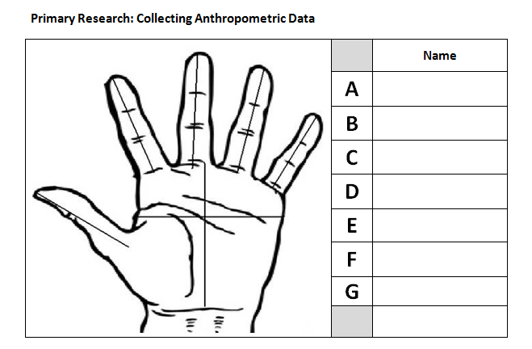
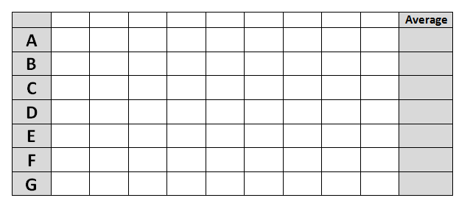
GCSE Design Technology – Toothbrush redesign for an elderly person
Collect anthropometric data from your own hand.
Label the palm A-G with your measurement.
Measurements ONLY in (mm).
Once you have you’re A-G measurements write in one column your data.
Go around the classroom and collect the data from others, until your table is FULL.
Add up all of the measurements and divide by 9 to get the mean (AVERAGE)

Slide 6
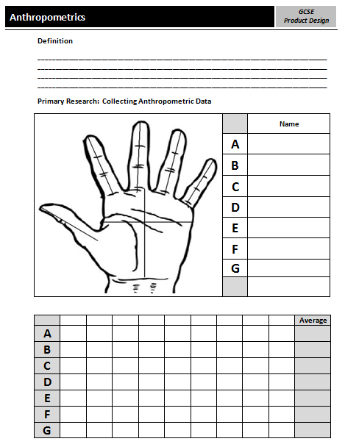
Anthropometric Worksheet
GCSE Design Technology – Toothbrush redesign for an elderly person
You have 30 minutes to complete this worksheet.
You need to firstly write a definition of what the term anthropometrics means.
Collect the data of your palm, labelling what measurements A-G are.
Write your measurements in the below table.
Collect 8 more results from your peers.
Add all together and divide by 9 to collect the mean, average result.
Now that you have collected average hand sizes you will be able to apply these measurements to your model.

Slide 7
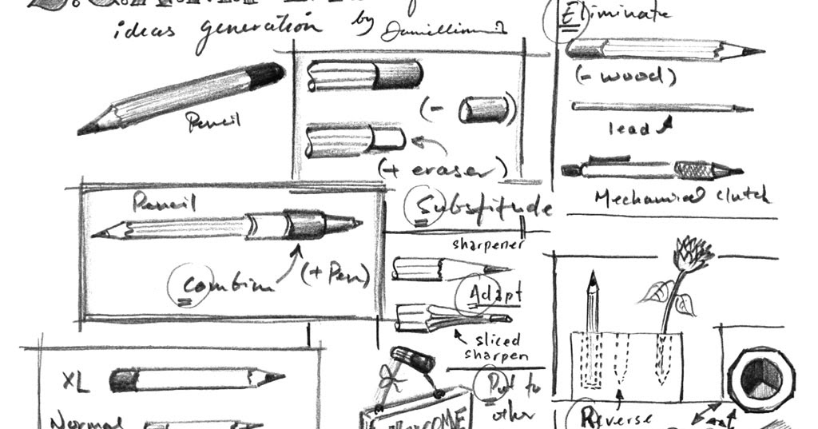
Design development using SCAMPER
GCSE Design Technology – Toothbrush redesign for an elderly person
An excellent method of developing your initial ideas into a final one is to use the SCAMPER method. Making small changes can lead to a BIG one.
https://www.youtube.com/watch?v=ru9-74qLXAo&t=99s

Slide 8
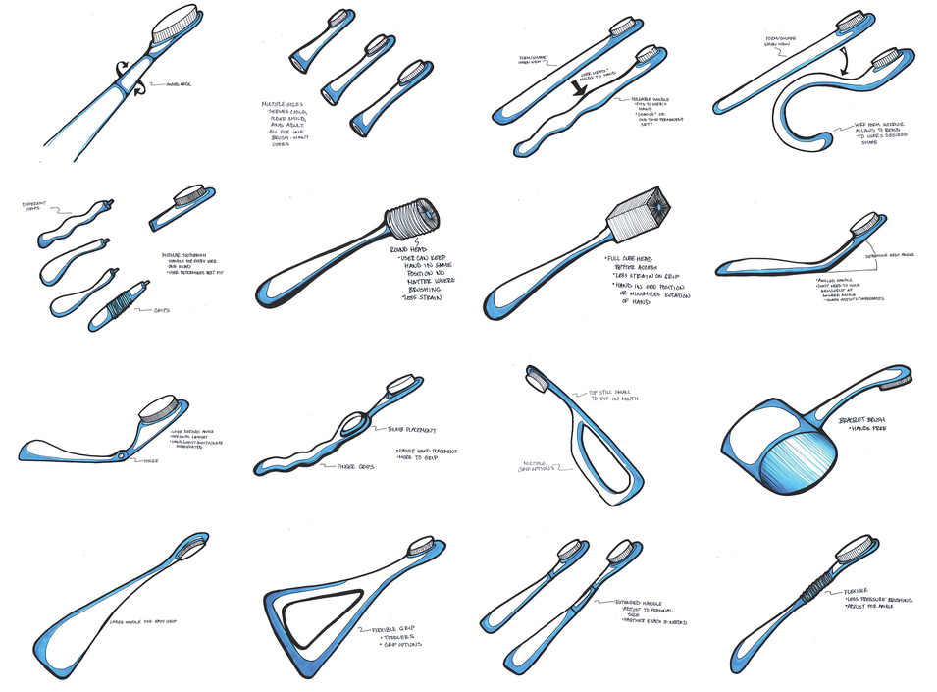
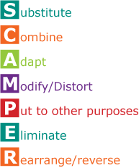
Design development using SCAMPER
GCSE Design Technology – Toothbrush redesign for an elderly person
Now you have knowledge of SCAMPER apply it to your initial ideas. Look back at these and picking one idea apply some of the letters of SCAMPER to make small changes, leading to a final idea you can model next lesson.
Start your SCAMPER developments this lesson and take away to complete for home learning.

