Slide 1
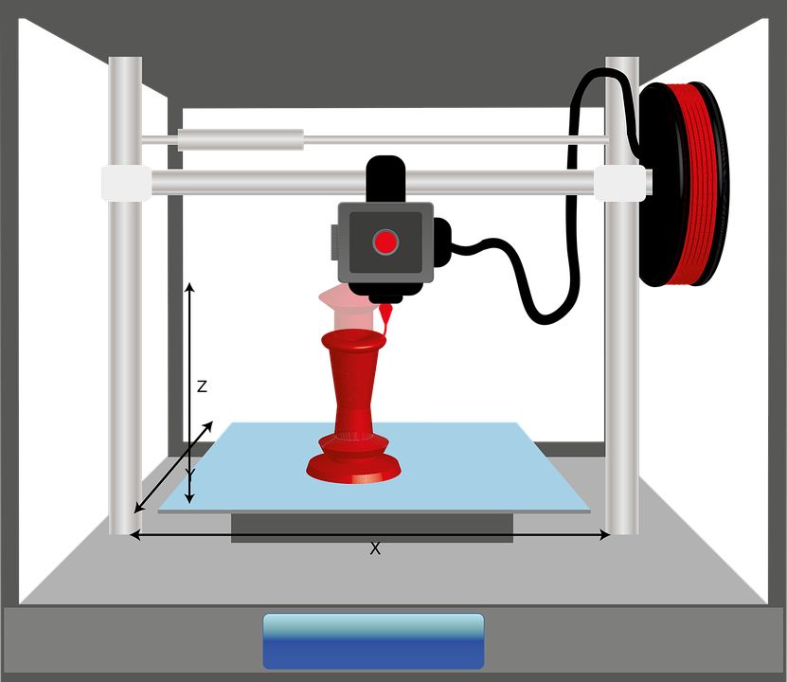
Starter
Thinking back to the earlier lessons what are the three main parts to the 3D printing process?

Slide 2
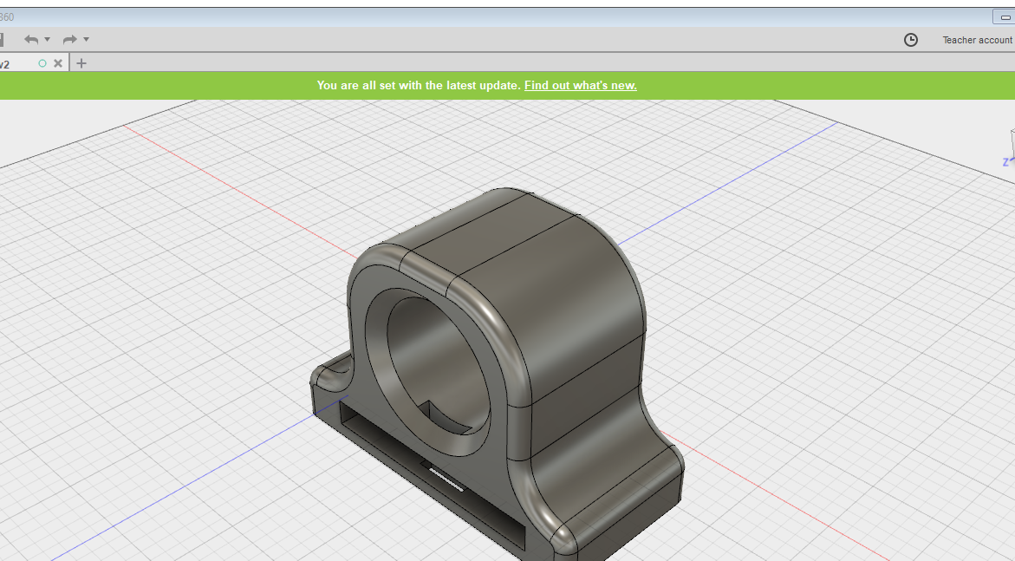
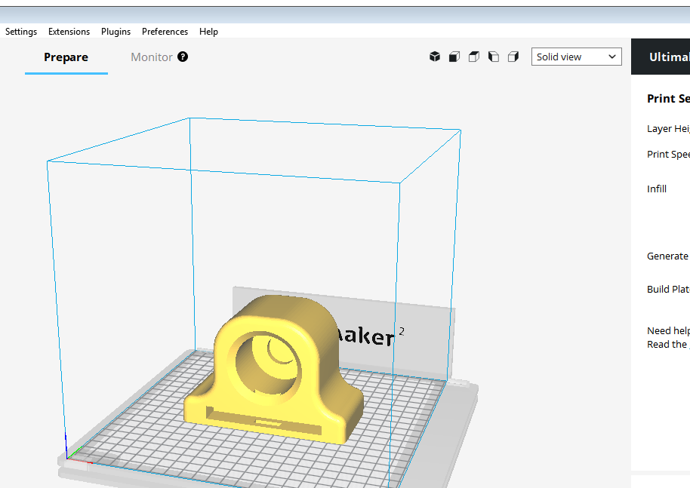
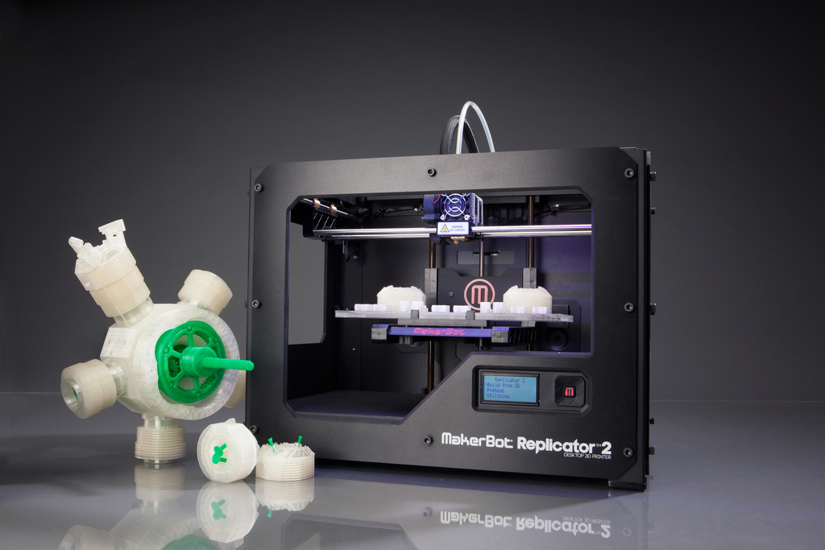
The 3D printing process
Design on CAD
Export STL file and slice
3D print the model
Stage 1 Stage 2 Stage 3

Slide 3
Objectives
To understand the concept of slicing.
To be able to slice models ready for 3D printing.

Slide 4
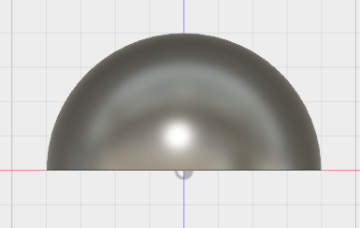
What is stage 2 – Slicing an STL file?
https://support.3dverkstan.se/article/30-getting-better-prints
Slicing a model means converting the STL file that you export from a 3D CAD package and converting it into a file that can be printed in layers.
This is commonly called a gcode. The file contains thousands of co-ordinates (X,Y and Z) that the 3D printer follows when extruding out plastic.
Once the printer has printed a layer in the X and Y direction, the print head/bed moves in the Z direction to start a new layer.

Slide 5
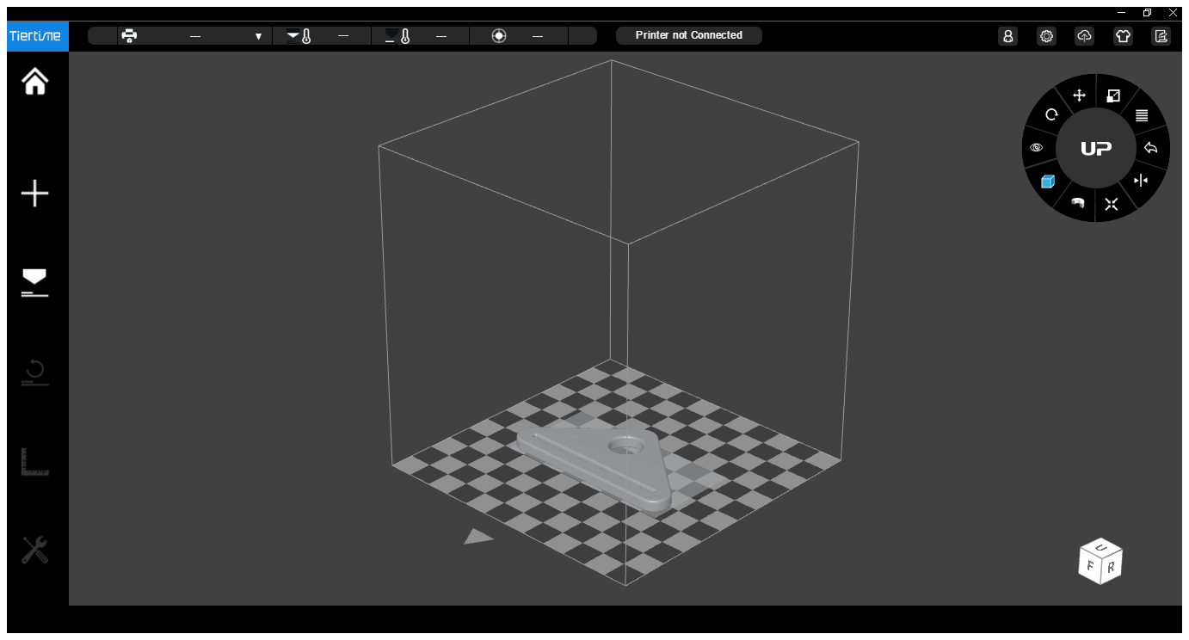
How to slice an STL file.
To slice an STL file you need to use specific software that can work with your 3D printer.
You import the STL into the software. (ensure that the software is correctly configured to your 3D printer size).

Slide 6
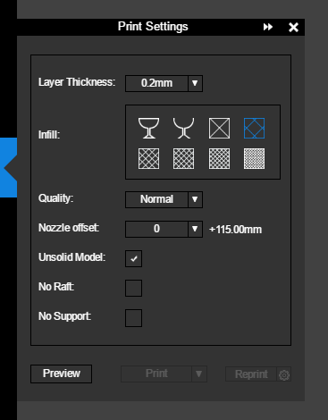
Slicer settings – Layer height
https://support.3dverkstan.se/article/30-getting-better-prints
In the software you have to decide on the layer height. As shown above you can have different layer heights.
A thicker layer height will print fast but will be lesson detailed. A thinner layer height will take longer to print but will appear smoother and the layers might be less visible.

Slide 7
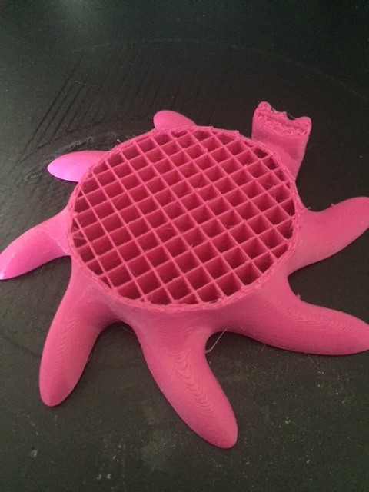
Infill setting - Density
The infill density determines how strong you want the model to be.
A denser model printed with more infill will use more material and take longer to 3D print. It will also be heavier.
A less dense model will print quicker and be lighter, but it will be weaker in strength.
You have to decide on what will work for your model.

Slide 8
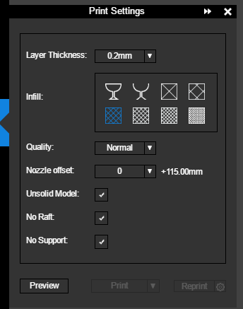
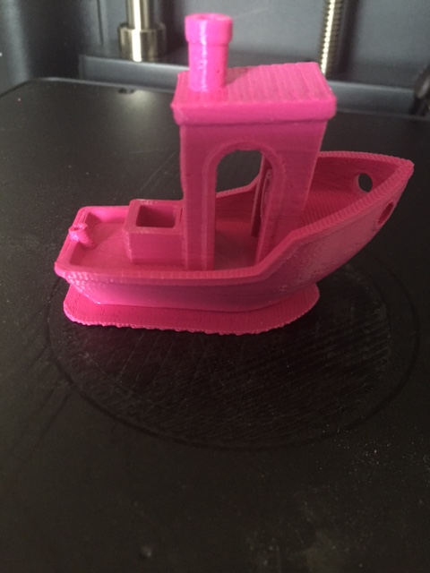
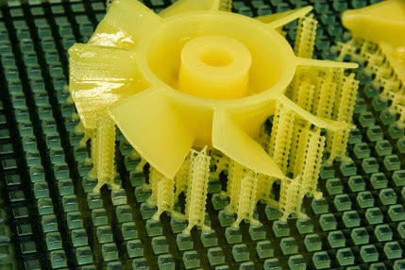
Supports and rafts
Rafts help with ensuring the part sticks to the bed, but they use more material and take longer to print.
Supports help with over hangs on models that are over 45degrees. They act as scaffolding to ensure the model prints.
http://3dprintingninja.blogspot.com/2012/10/tricks-every-new-3d-printer-owner.html

Slide 9
Slicing simulation
Press the play button below to show the slicing process.
Once the process has been tested send the model to the 3D printer, press the print button.

Slide 10
Plenary
How does the layer height effect the time of a print?
What’s the critical angle that a model will need support?

