Slide 1
NEA MINI ASSESSMENT
Lesson 7/10
DESIGN FOR SOCIETY
“Understanding how design can have a positive impact on others”.
Learning Aims:
Apply previous lessons learning of inclusive design to a mini NEA design brief.
Use product analysis & clients problem from the previous lesson to generate a range of design ideas.
Develop confidence in drawing quick, thumbnail sketches which demonstrate solutions to the problem with annotation.

Slide 2
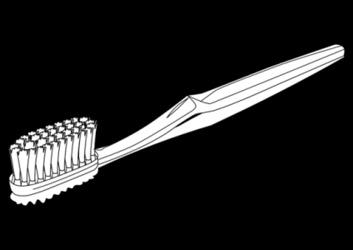
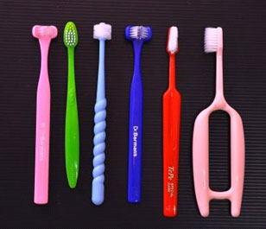
GCSE Design Technology – Toothbrush redesign for an elderly person
DO NOW ACTIVITY
THINK – PAIR – SHARE
WHAT I THINK
AFTER SHARING WITH MY PARTNER
AFTER SHARING WITH MY CLASS
Study the above image of adapted toothbrushes which assist elderly/disabled users.

Slide 3
THINK – PAIR – SHARE
THINK – PAIR – SHARE
WHAT I THINK
WHAT I THINK
AFTER SHARING WITH MY PARTNER
AFTER SHARING WITH MY PARTNER
AFTER SHARING WITH MY CLASS
AFTER SHARING WITH MY CLASS
Notes:
WORKSHEET TO PRINT

Slide 4
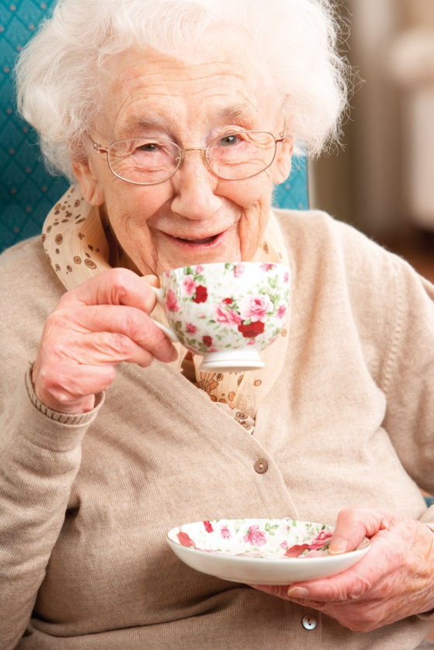
GCSE Design Technology – Toothbrush redesign for an elderly person
Your client – Ethel, aged 82.
Ethel has arthritis and this means her joints (in particular in her hands) are weakened. She suffers from joint pain and stiffness (especially at the beginning and end of the day).
This typically will be when she brushes her teeth.
She has reduced range of motions and this affects her joints and can often lead to swelling.
Re-read the clients brief.
What are the key words/information? What will you need to consider the MOST?

Slide 5
GCSE Design Technology – Toothbrush redesign for an elderly person
Your client – Ethel, aged 82.
Ethel has ARTHRITIS and this means her JOINTS (in particular in HER HANDS) are WEAKENED. She suffers from JOINT PAIN and STIFFNESS (especially at the BEGINNING and END of the day).
This typically will be when she brushes her teeth.
She has REDUCED RANGE OF MOTIONS and this affects her joints and can often LEAD TO SWELLING.
To be successful in producing a solution you will need to meet these NEEDS.

Slide 6
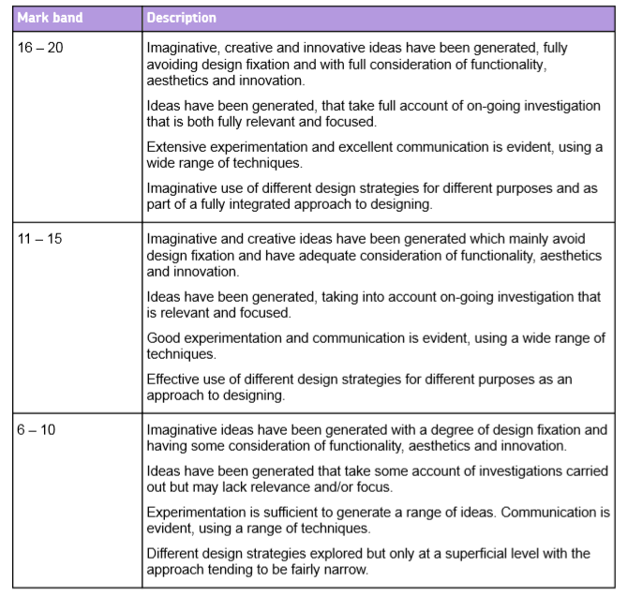
GCSE Design Technology – Toothbrush redesign for an elderly person
Your main task today is to produce a wide range of THUMBNAIL, CONCEPT sketches.
These should be:
Imaginative
Creative
Innovative *not a direct copy of an existing design
Focus on the clients needs
Don’t forget your ANNOTATION – EXPLAIN & SELL YOUR IDEA.
Notes:
Criteria used is for AQA. Can be adapted to other exam boards.

Slide 7
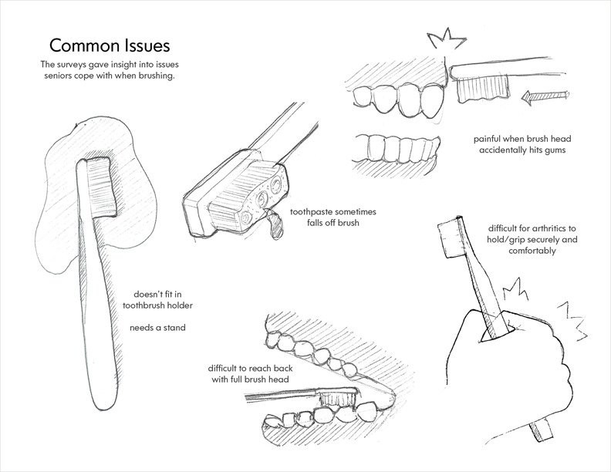
GCSE Design Technology – Toothbrush redesign for an elderly person
Quick concept sketches with annotated notes.
These show the problem and highlights what you need to improve.
In your sketch book produce a series of sketches (2 pages) of problems Ethel may face with her toothbrush.
Remember Ethel's issues.

Slide 8
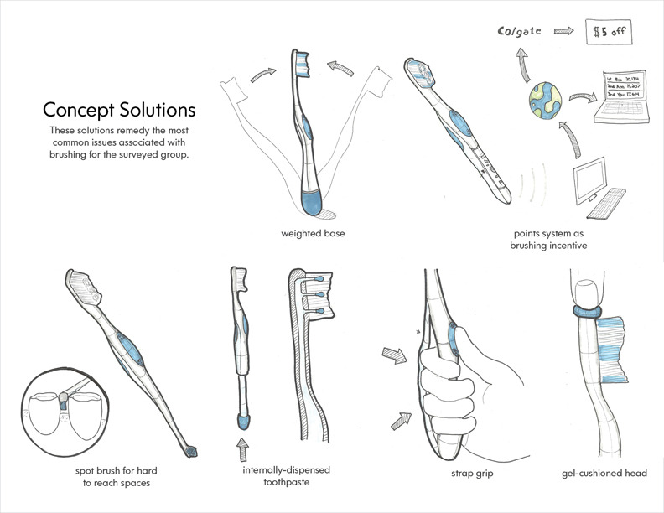
GCSE Design Technology – Toothbrush redesign for an elderly person
An idea/new thought
Do these concept solutions resolve Ethel's problem?

Slide 9
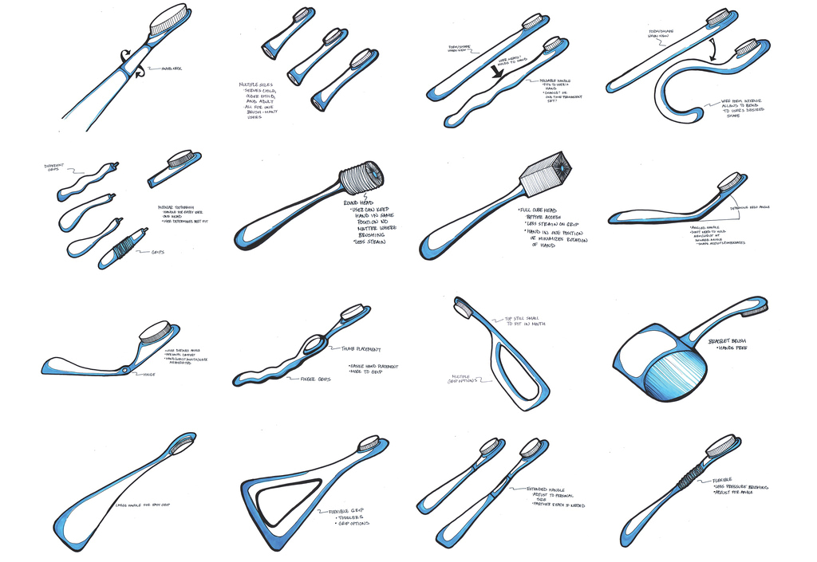
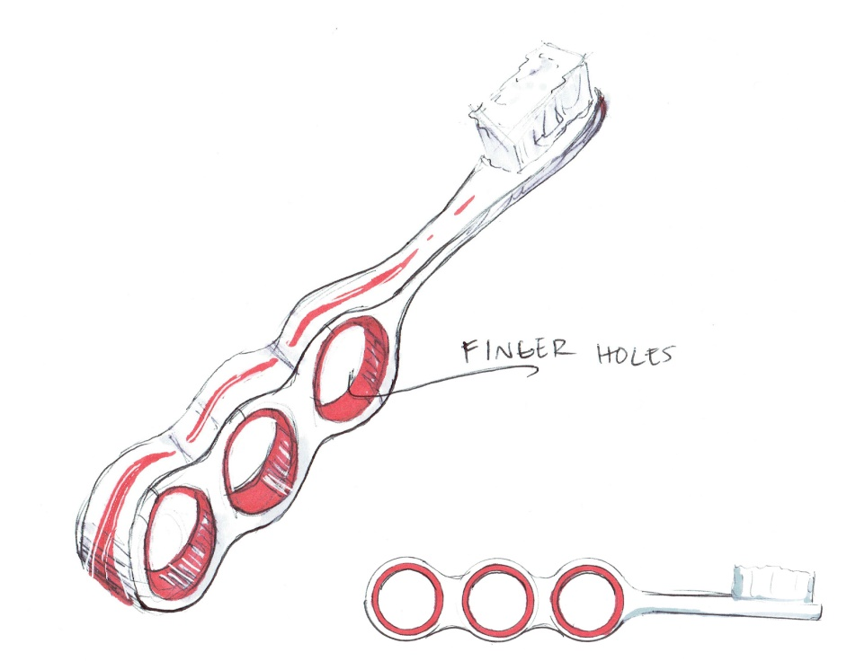
GCSE Design Technology – Toothbrush redesign for an elderly person
Developing sketching – sketching = no rulers!
You should aim for 2-3 pages of sketches.
All ideas should be different in their design and show that they resolve the clients problem.
Colour should be applied to show shade/tone.
Annotation should be added to explain the idea/materials/how it will be used.
Black fine liners can be borrowed to add THICK and thin lines.

