Slide 1
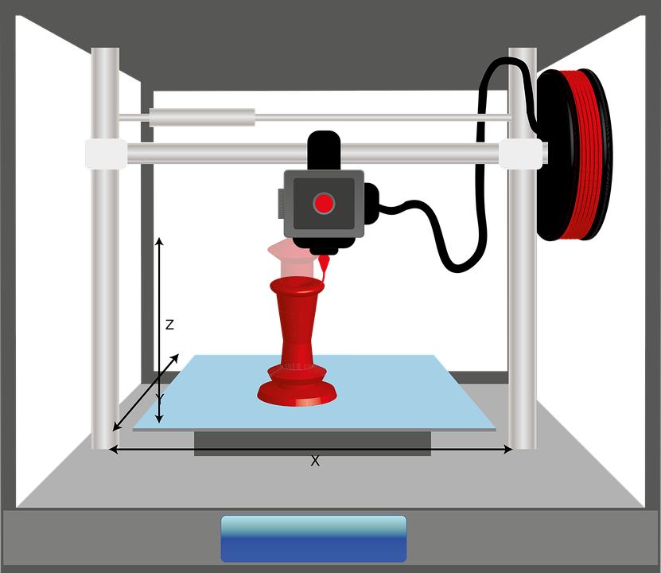
Objectives
How to create a revolve in Fusion 360.
To design a cable tidy using Fusion 360.

Slide 2
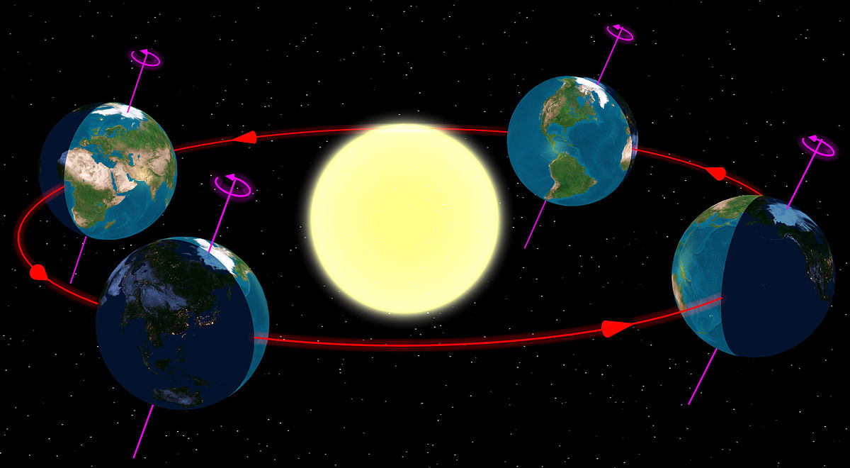
Key question?
What does the word ‘revolve’ mean?
https://en.wikipedia.org/wiki/Earth%27s_orbit

Slide 3
Revolve
To turn around a centre axis e.g. the earth revolves around it’s axis.
A revolving door turns around an axis.

Slide 4
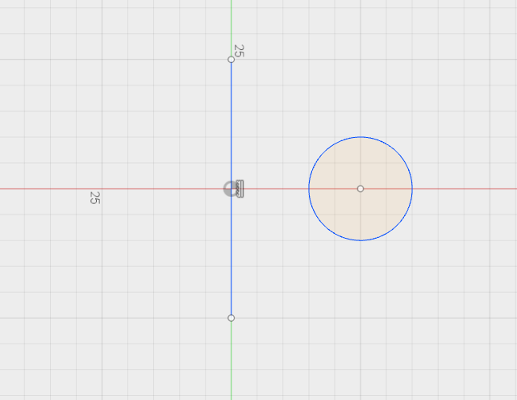
Objective 1 – How to create a revolve
Start a new sketch and select a work plane.
Sketch a centre line and then a circle to the right of the line.

Slide 5
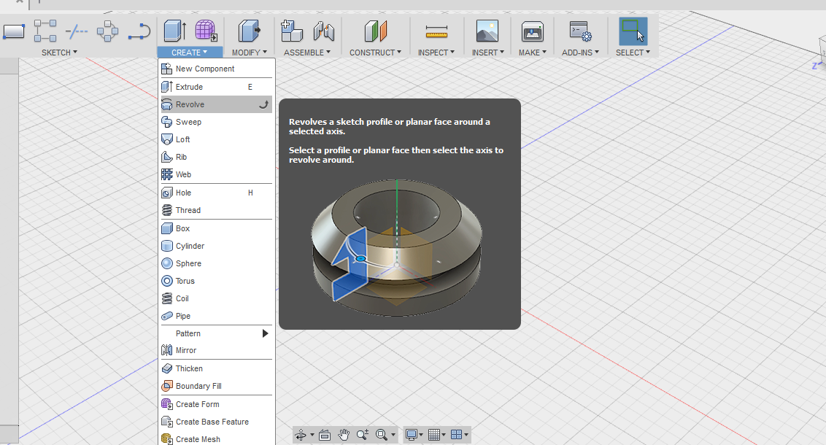
Click stop sketch and then ‘create’ and ‘revolve’

Slide 6
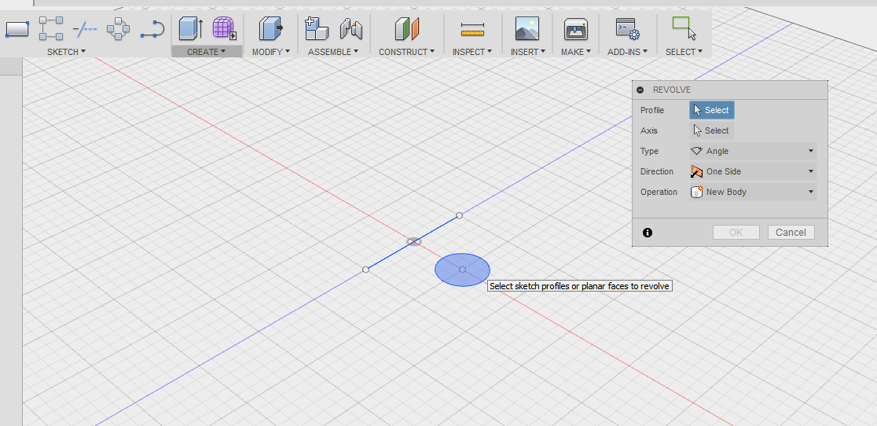
Select the profile (click the circle) then click the select button to the right of the word ‘axis’ in the dialogue box. Then click the centre line.

Slide 7
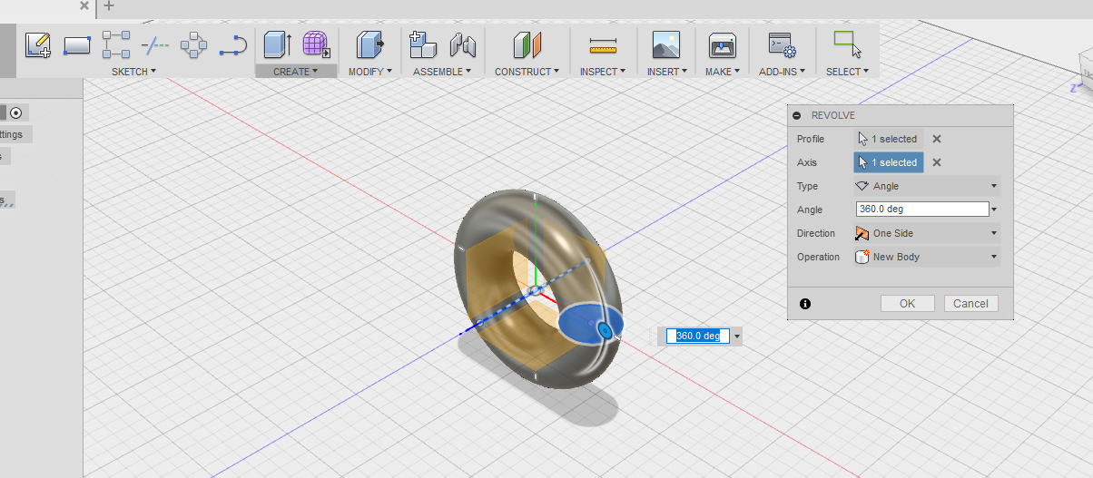
This will revolve the circle 360 degrees around the centre line (axis) that you have just drawn. The default angle is 360 degrees, but you can alter this.
Press ok and you have a revolve.

Slide 8
Student task – 10 minutes
Using fusion 360 experiment and create a series of revolves.

Slide 9
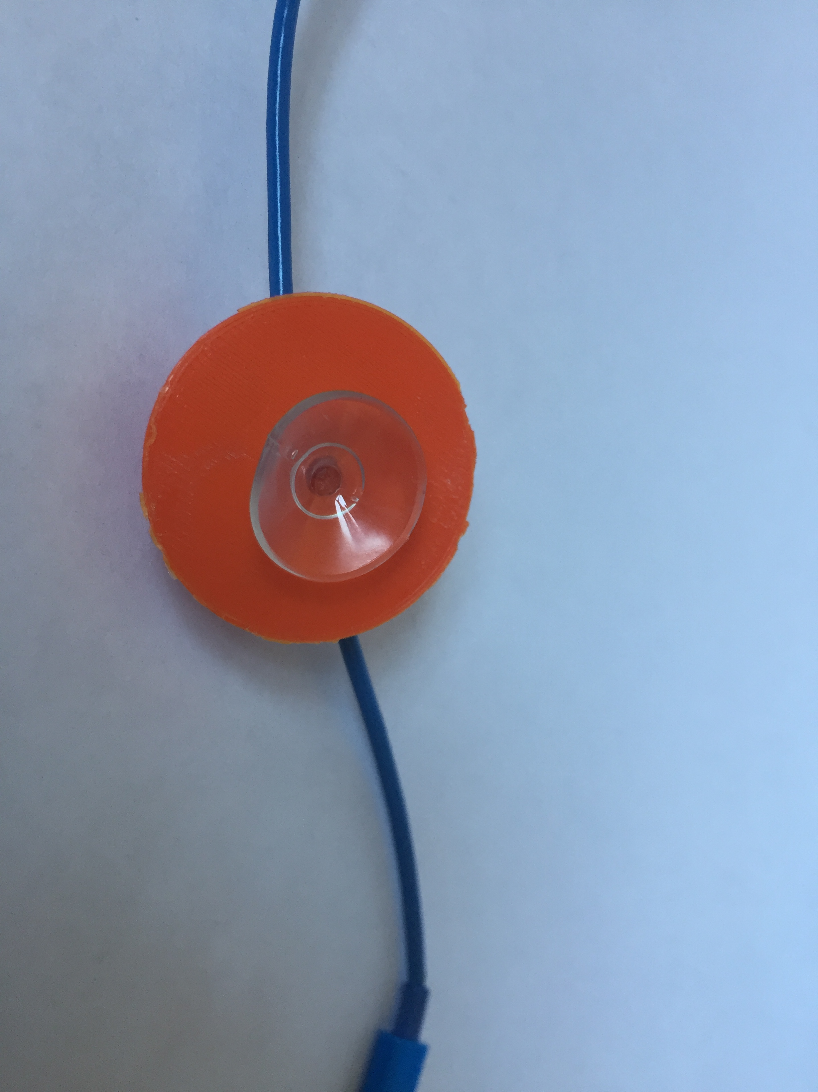
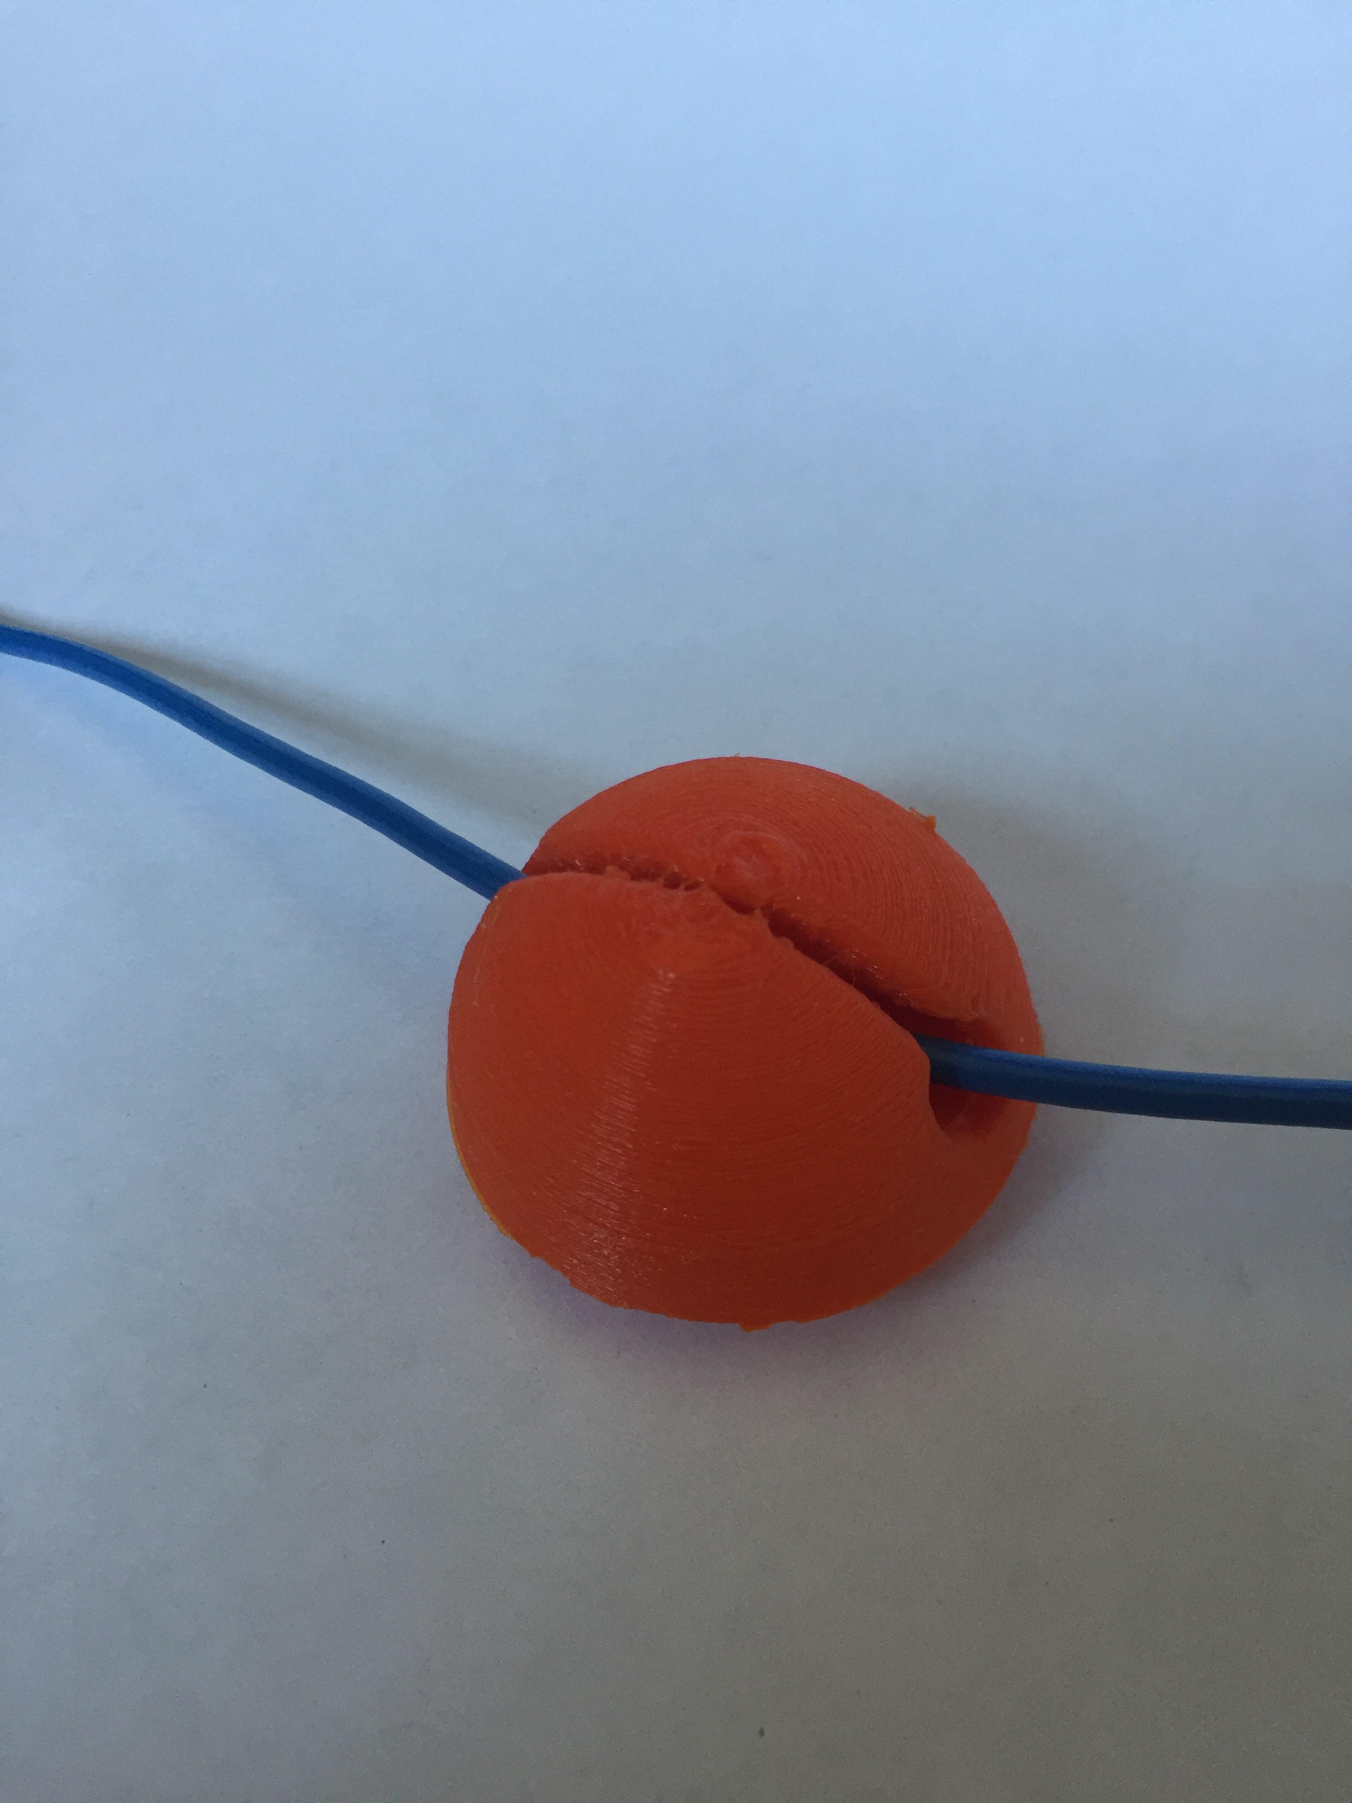
How to design a cable tidy

Slide 10
Step 1 – draw this sketch

Slide 11
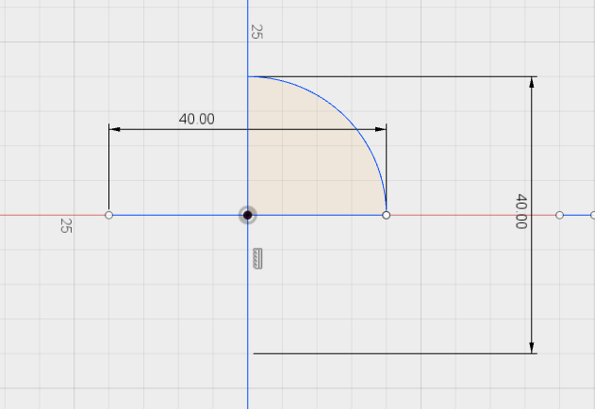
Step 2 – Trim it down and press stop sketch and then revolve the sketch.

Slide 12
Step 3 – revolve the sketch and press ok.

Slide 13
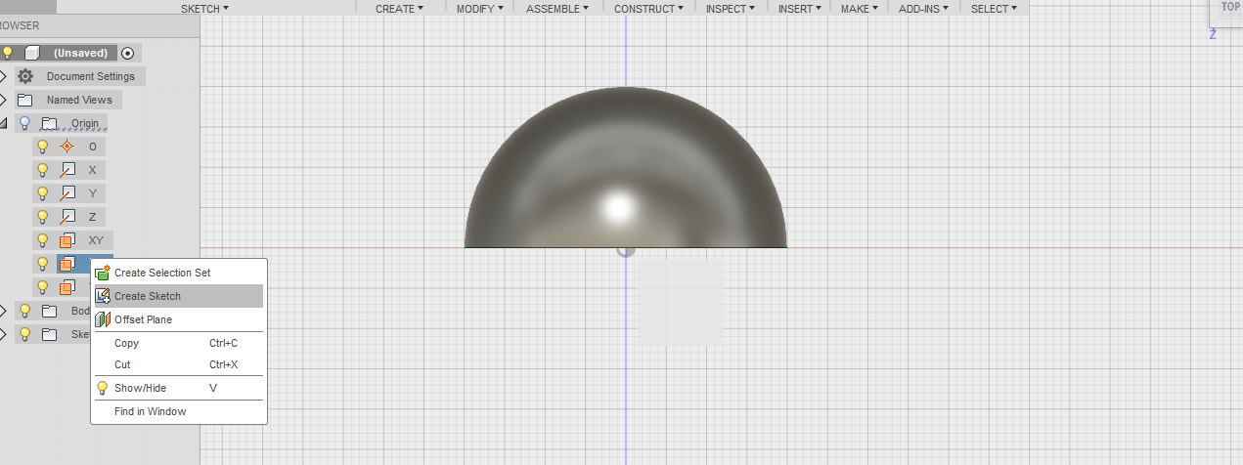
Step 4 – offset a workplane
Click on origin – right click on XZ workplane and select ‘create sketch’.

Slide 14
Rotate and check the plane is selected.

Slide 15
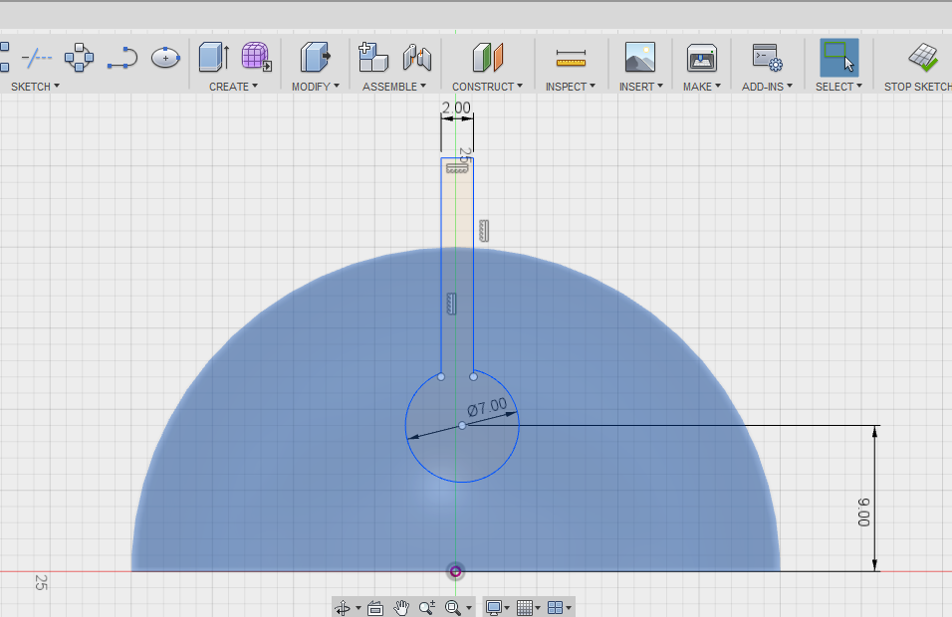
Step 5. Click on the workplane, right click and ‘create sketch’ and draw this shape below.

Slide 16
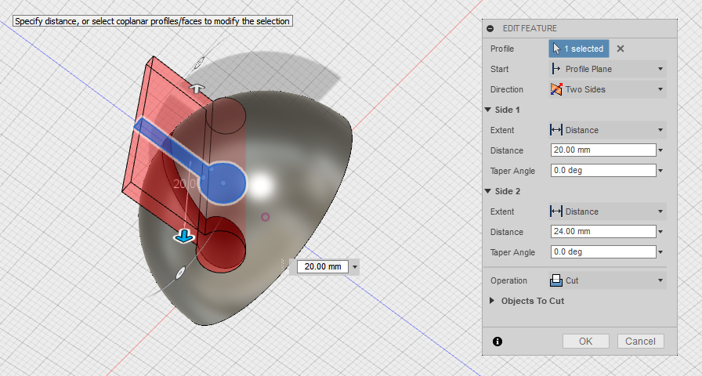
Step 6 – Stop the sketch and extrude, select two sides and under the operation drop down tap select cut.

Slide 17
Step 7 – Add a 1.0mm chamfer to the edge of the slot. This will help the iphone cable slot in.

Slide 18
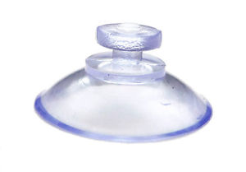
Step 8 – Add a cavity for a 20mm suction button cup.

Slide 19
Step 9 – Draw an ellipse and a centre line and trim the left part.

Slide 20
Step 10 – revolve as a cut to make it hollow.

Slide 21
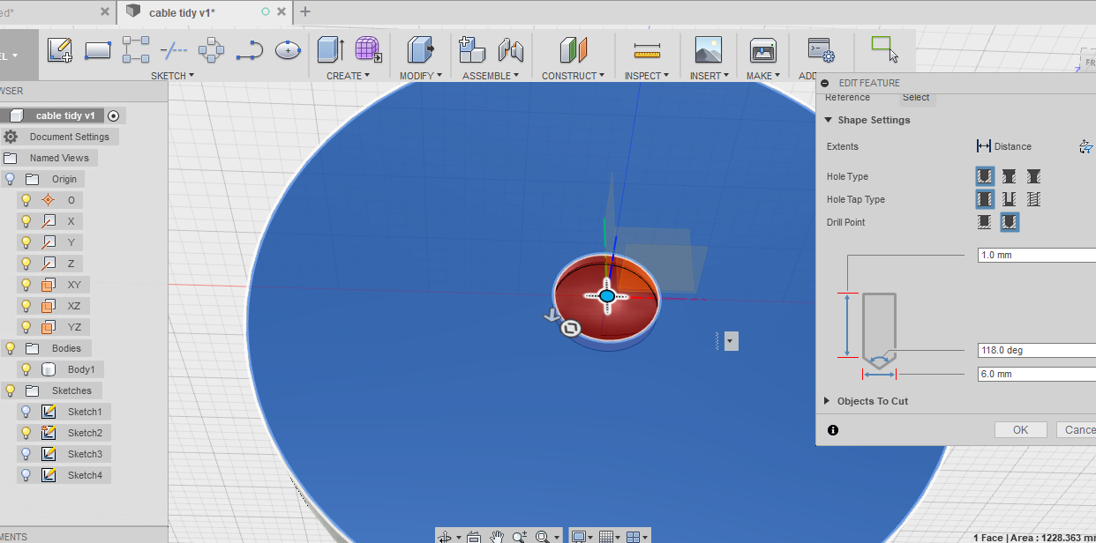
Step 10 – Add a hole so the suction cup can be pushed in.
Make the depth 1.0mm and the diameter 6.00mm.

Slide 22
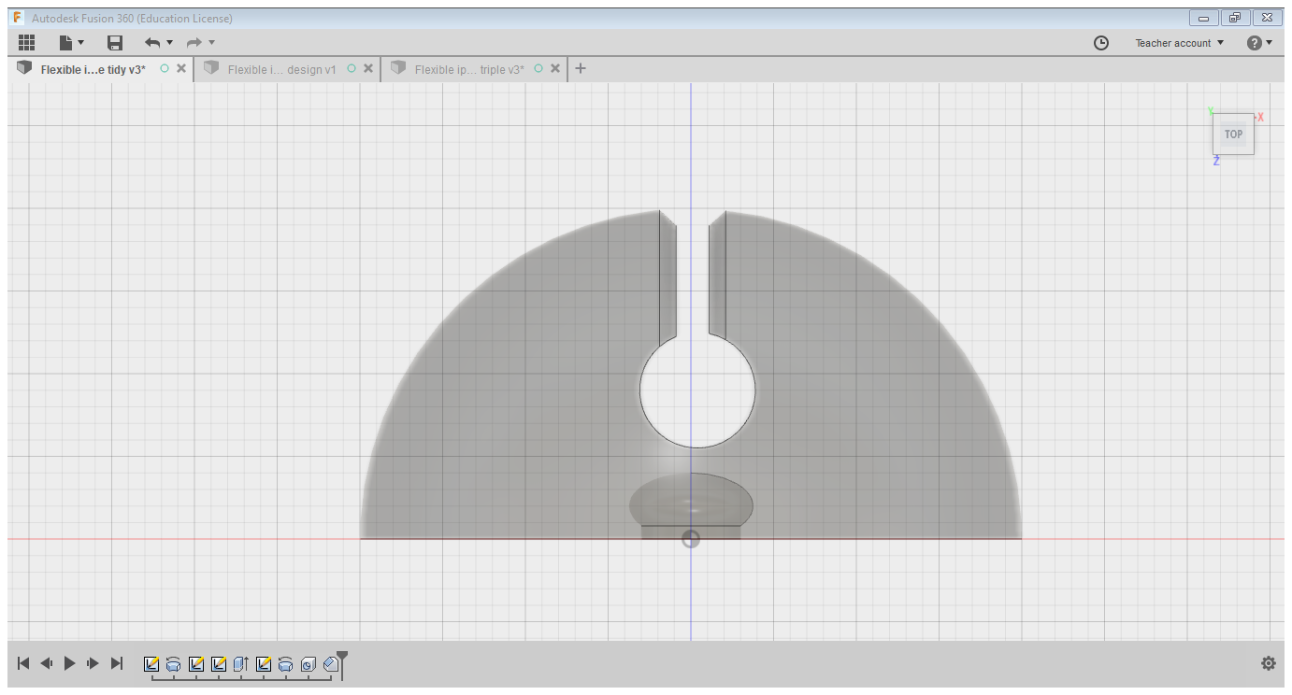
It should look like this below
Slot for the cable
Cut out for the suction cup

Slide 23
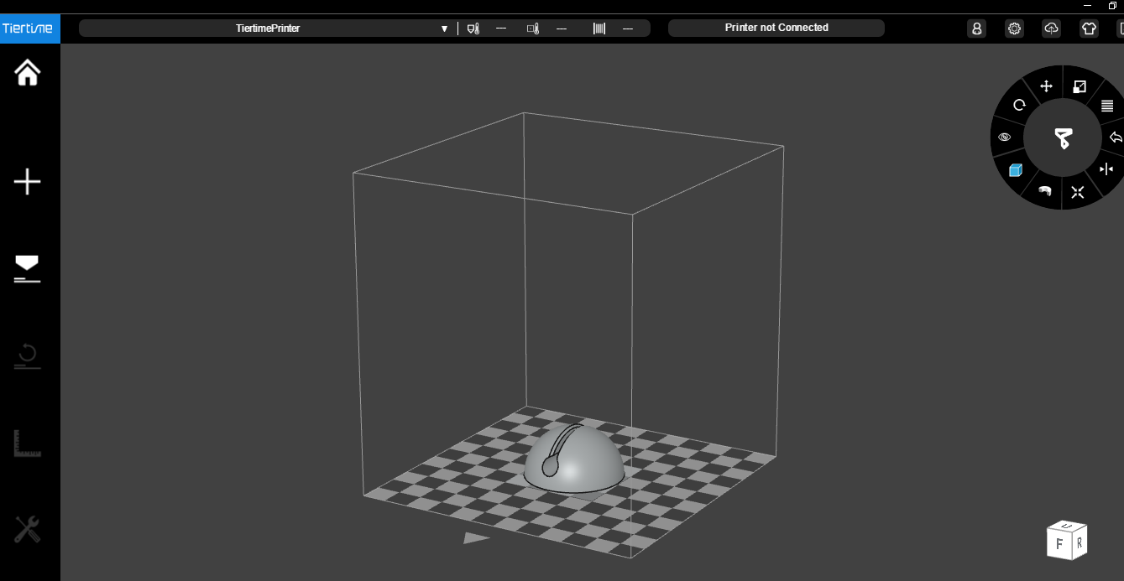
Step 11 – Export as an STL file, slice and 3D print.

Slide 24
Plenary
Can you describe what a revolve is?
How is a revolve different from an extrude? Explain.

