Slide 1
NEA MINI ASSESSMENT
Lesson 6/10
DESIGN FOR SOCIETY
“Understanding how design can have a positive impact on others”.
Learning Aims:
Apply previous lessons learning of inclusive design to a mini NEA design brief.
Understand and discuss the difference between product form and function.
Complete product analysis study of elderly aid products.

Slide 2
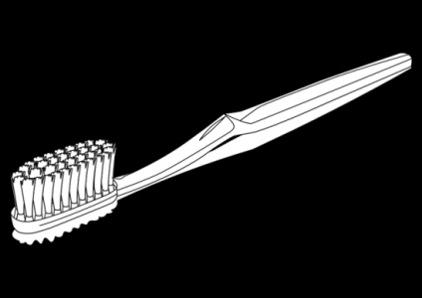
GCSE Design Technology – Toothbrush redesign for an elderly person
A Better Toothbrush is an exercise in research, concept sketching, and foam modelling, with the goal of improving the brushing experience for the elderly.
For the NEA (50% of your final mark) sat in year 11 you will need to choose a brief from AQA and solve the problem through modelling.
This means you need to develop your problem solving skills and ability to come up with a range of ideas which solve a real-life problem being faced by a client.
The NEA requires:
Research
Design ideas
Refinement through development
Modelling and manufacturing a solution

Slide 3
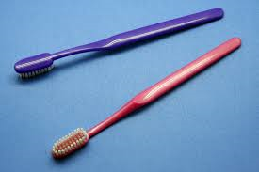
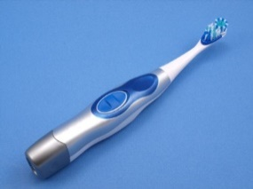
GCSE Design Technology – Toothbrush redesign for an elderly person
FORM VS FUNCTION. Which one is better?
How it looks against how it works.
Cheap toothbrush Vs expensive.
FORM
FUNCTION
WRITE
RESPONSE
ON
YOUR
V’S
THE
PROVIDED
POST IT NOTE
Notes:
Do now – Students to write their response on a provided post it note and place it on the board for further discussion

Slide 4
GCSE Design Technology – Toothbrush redesign for an elderly person
Cheap toothbrush Vs expensive.
FORM VS FUNCTION. Which one is better?
How it looks against how it works.
FORM
FUNCTION
V’S
Notes:
Leave on the screen for students to place their written post it notes on.

Slide 5
GCSE Design Technology – Toothbrush redesign for an elderly person
Your client – Ethel, aged 82.
Ethel has arthritis and this means her joints (in particular in her hands) are weakened. She suffers from joint pain and stiffness (especially at the beginning and end of the day).
This typically will be when she brushes her teeth.
She has reduced range of motions and this affects her joints and can often lead to swelling.
Your challenge is to research the problem, look at existing products, produce a range of sketches, develop these and model a solution for Ethel to use.

Slide 6
GCSE Design Technology – Toothbrush redesign for an elderly person
User group research
Five seniors (65 years+) were surveyed. This provided subjective and objective insight into their lives and specifically their brushing experience.
For seniors, brushing should be about: Comfort convenience and fun.

Slide 7
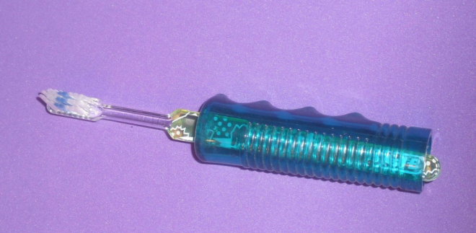
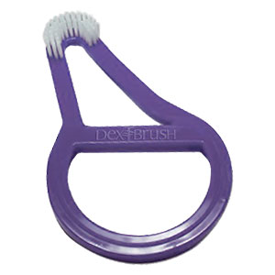
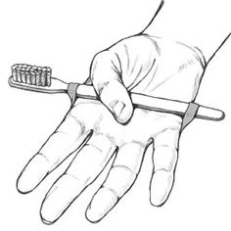
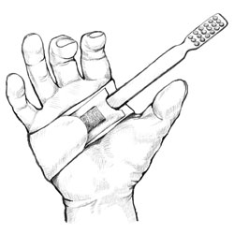
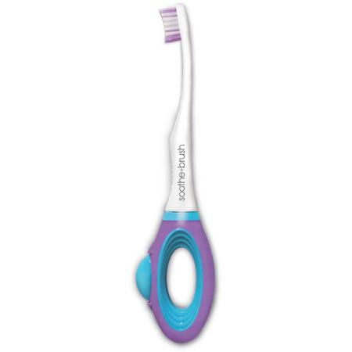
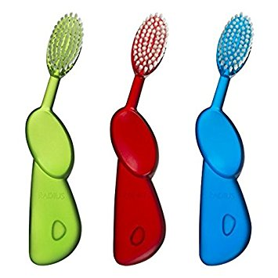
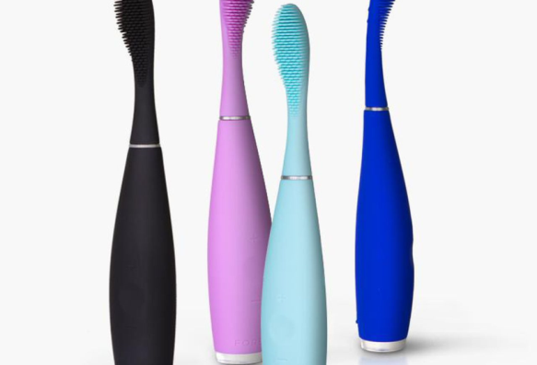
GCSE Design Technology – Toothbrush redesign for an elderly person
Existing products – elderly aids.
WHAT ARE YOUR INITIAL OPINONS ON THESE PRODUCTS?
HANDS UP DON’T SHOUT OUT.

Slide 8
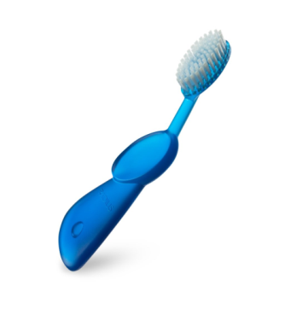
GCSE Design Technology – Toothbrush redesign for an elderly person
Product analysis is a vital research tool to enable you to analyse and describe areas of existing products.
Task: Product analysis a series of toothbrush elderly aids.
Using the letters of ACCESS FM write notes which describe these existing products.

Slide 9
Product analysis is a vital research tool to enable you to analyse and describe areas of existing products.
Aesthetics: Describe how the product looks. Shape/size/ intended use.
Cost: Cost to make the product? Materials costs? Cost if sold in a shop?
Consumer: who do you think the intended user is and why? Explain.
Ergonomics: Discuss the shape of the product/handle & how it helps the user.
Size: Discuss the products size in relation to its use & users needs
Safety: Is it safe for the intended user? Why? Any issues?
Function: How does it work? What features help it work? How is it used?
Manufacture: How is the product made? Materials used? Why are these materials chosen?
Name:
Product analysis using ACCESS FM.
Notes:
Teacher note – Instead of analysing the provided images students could look at actual products (if sourced)
Worksheet to print

Slide 10
Product analysis is a vital research tool to enable you to analyse and describe areas of existing products.
Aesthetics: Describe how the product looks. Shape/size/ intended use.
Cost: Cost to make the product? Materials costs? Cost if sold in a shop?
Consumer: who do you think the intended user is and why? Explain.
Ergonomics: Discuss the shape of the product/handle & how it helps the user.
Size: Discuss the products size in relation to its use & users needs
Safety: Is it safe for the intended user? Why? Any issues?
Function: How does it work? What features help it work? How is it used?
Manufacture: How is the product made? Materials used? Why are these materials chosen?
Name:
Product analysis using ACCESS FM.
Notes:
Worksheet to print

