Slide 1
MINI ASSESSMENT
OUTCOME
CONCLUSIONS
Lesson 5/10
DESIGN FOR SOCIETY
“Understanding how design can have a positive impact on others”.
Learning Aims:
What inclusive design is
Why it is important for a designer to include for ALL and ensure products fit ALL needs.
Complete a series of activities where your abilities are impaired by completing an everyday activity.

Slide 2
DO NOW ACTIVITY – PRODUCT PAIRS
Objective - Learner will gain knowledge and understanding of inclusive design & ensuring all needs are met & apply to a practical task.
Complete the product pair worksheet analysing the two inclusive products.

Slide 3
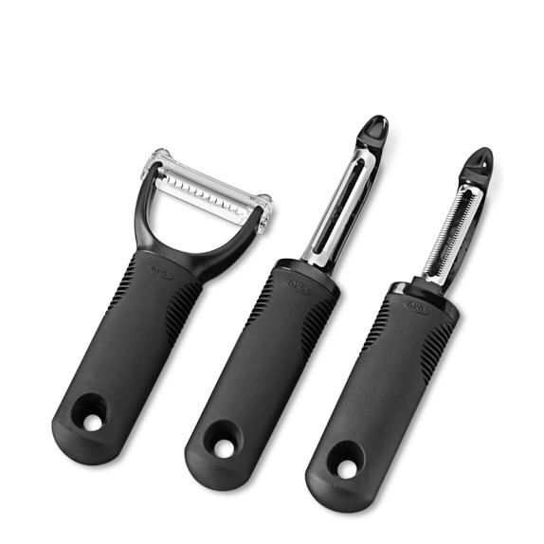
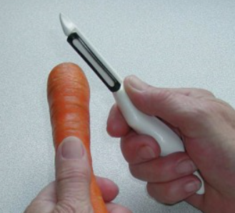
Look at these inclusive designed products. Both allow the user to peel vegetables with ease. Answer the following questions for both designs:
What is different from a standard peeler of this type?
What do the modifications do? How do they work?
Who could use them?
What needed to be considered by the designer?
What are the alternatives?
Notes:
Worksheet to print and complete

Slide 4
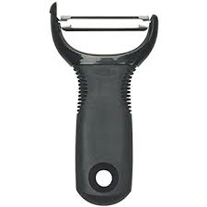
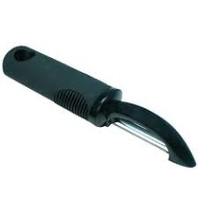
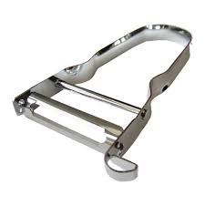
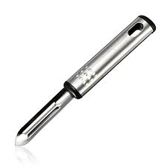
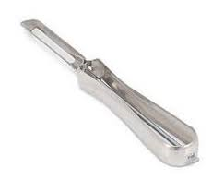
INCLUSIVE DESIGN – ACTIVITY
Objective - Learner will gain knowledge and understanding of inclusive design & ensuring all needs are met & apply to a practical task.
INCLUSIVE DESIGN WITH PEELERS
So last lesson you analysed different potato peelers where your abilities were hampered.
Today you will choose one of the analysed peelers and produce a modelled solution.

Slide 5
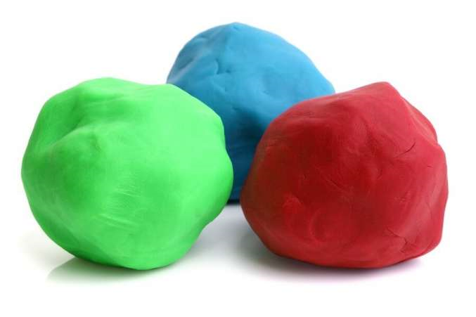
INCLUSIVE DESIGN – MODELLING ACTIVITY
Objective - Learner will gain knowledge and understanding of inclusive design & ensuring all needs are met & apply to a practical task.
Pick one of the four peelers you looked at last lesson and using the modelling clay re-design a better handle which would make it INCLUSIVE & EASIER to use.
Once modelled:
GET A PHOTO TAKEN
Draw a sketch of it in your book.
Write a paragraph explaining how the redesign has improved it.
Notes:
Peelers and modelling clay (Playdough) Required.

Slide 6
INCLUSIVE DESIGN – MODELLING EVALUATION
Objective - Learner will gain knowledge and understanding of inclusive design & ensuring all needs are met & apply to a practical task.
Pick one of the peelers and write a detailed evaluation about it using these headings/questions to help you.
The general criteria used to evaluate products is:
Performance – How the product works. Does it fulfil its purpose?
Reliability – Well made? User can depend on it?
Ease of use – Can be used by a range of people/abilities
Safety – Manufacture and use.
Aesthetics – How the product looks/shaped/layout
Materials – What its made out of/pros/cons
Construction – How its made
Cost – Of manufacture/sell/profit margin.
Ergonomics – Ease of comfort and use/appropriate shape & size for the user.
Quality – Durability & Reliability
Product – The specific features it MUST posses.
User Characteristics – Special capabilities, requirements & limitations of those that use the product.

