Slide 1
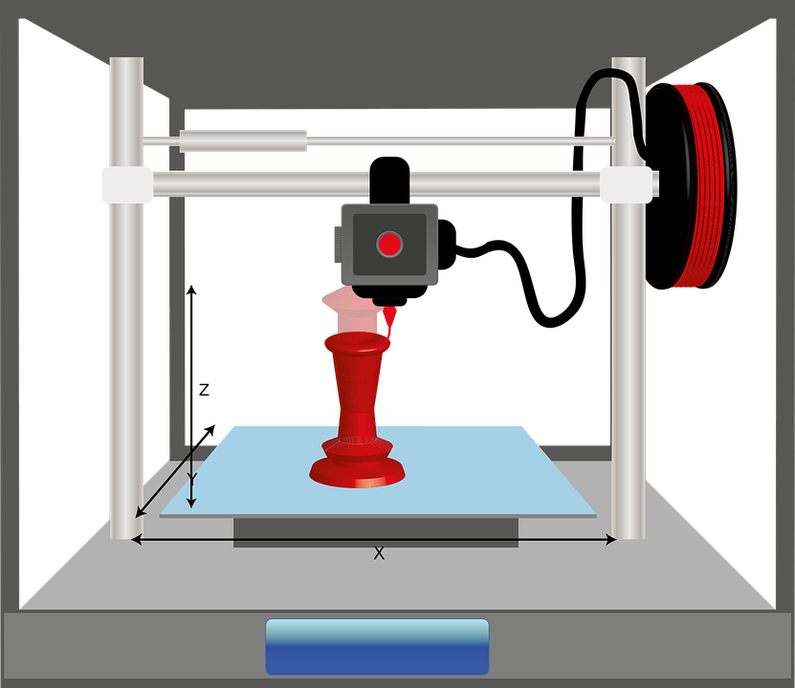
Objectives
How to trim a sketch.
How to model a mini iphone keyring stand.

Slide 2
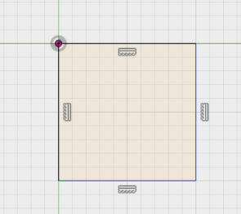
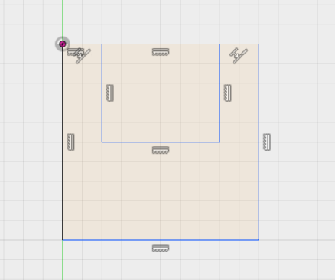
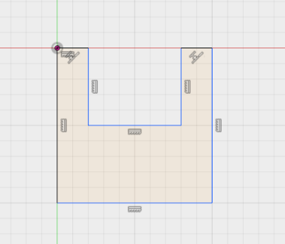
Task 1
Draw a square, then draw another square inside, as shown below. Then use the trim button and trim the top edge of the square. This will trim the shape to the one shown below

Slide 3
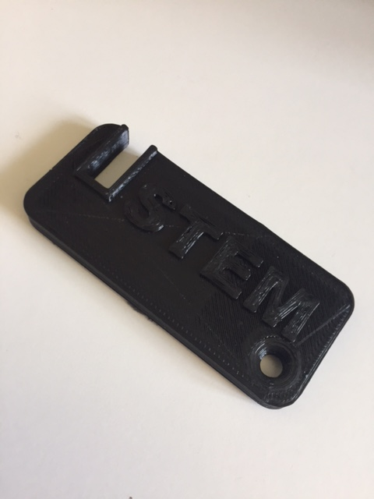
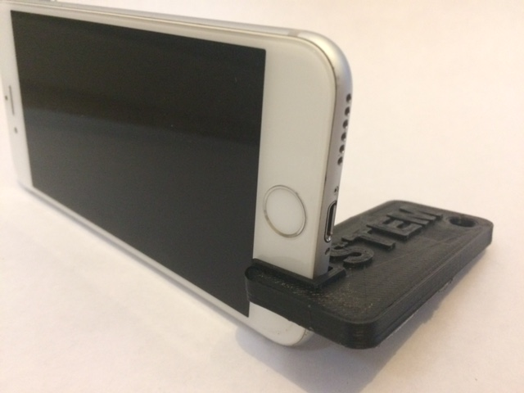
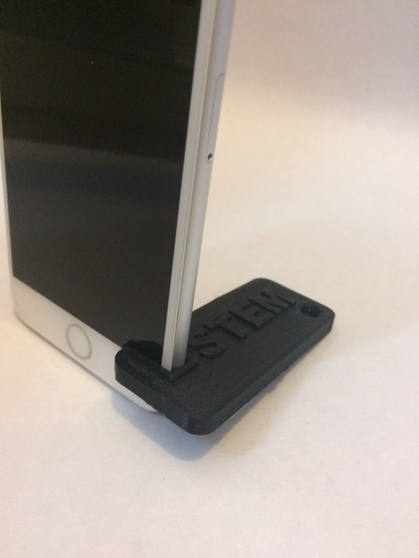
Final outcome

Slide 4
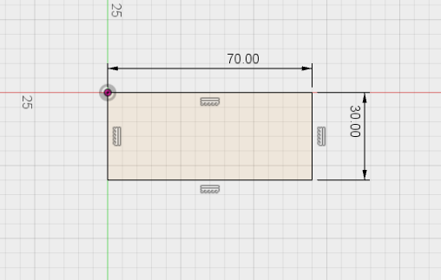
Task 2
Log onto fusion 360 and draw this shape.

Slide 5
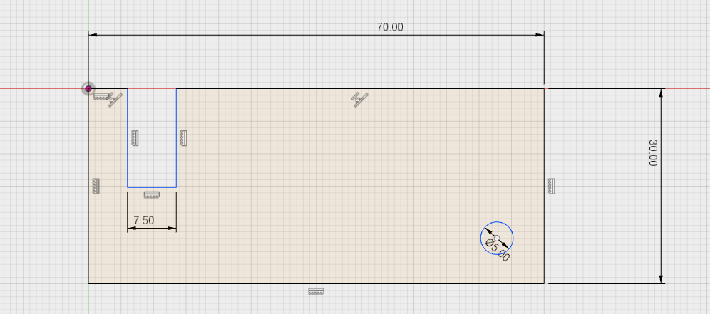
Add a rectangle that is the thickness of your smart phone. In this case an iphone 6 has a thickness of just over 7.00. It’s rounded up to 7.5mm to account for shrinkage of plastic as it cools.
Add a 5 mm hole of the key ring to go through

Slide 6
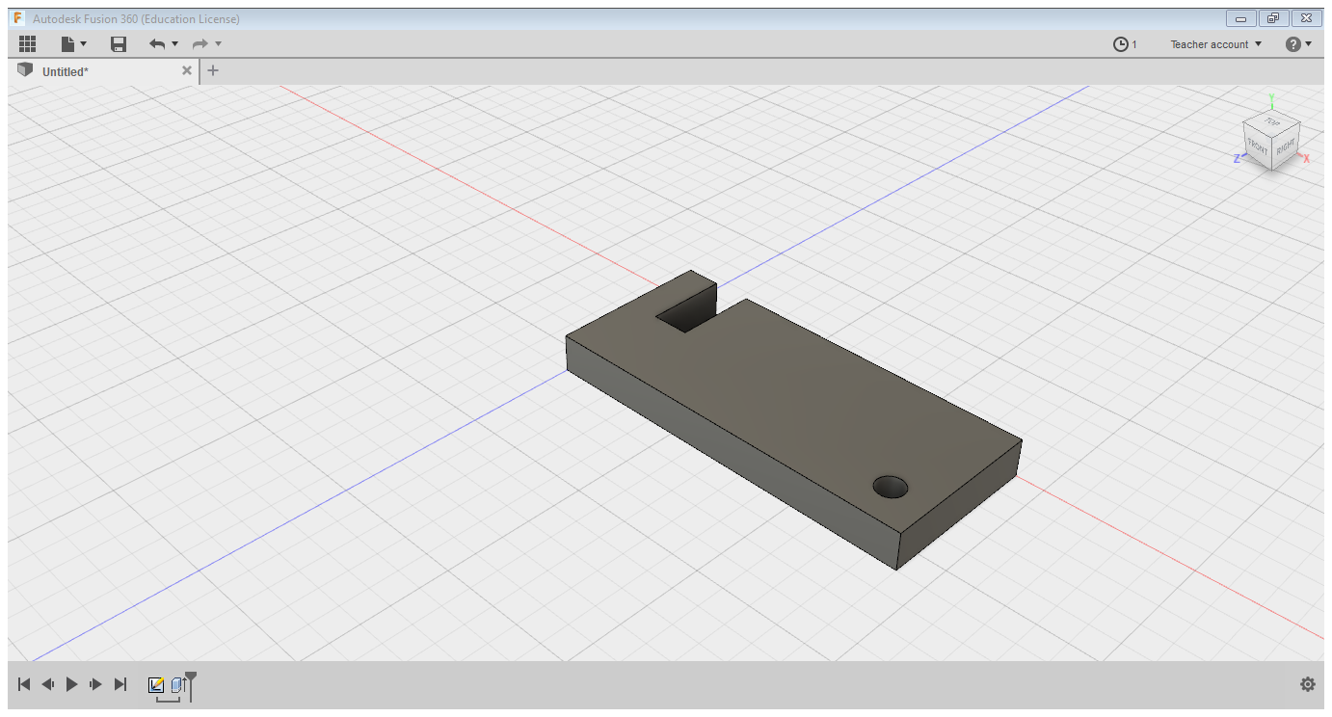
Extrude this shape by 5 mm.

Slide 7
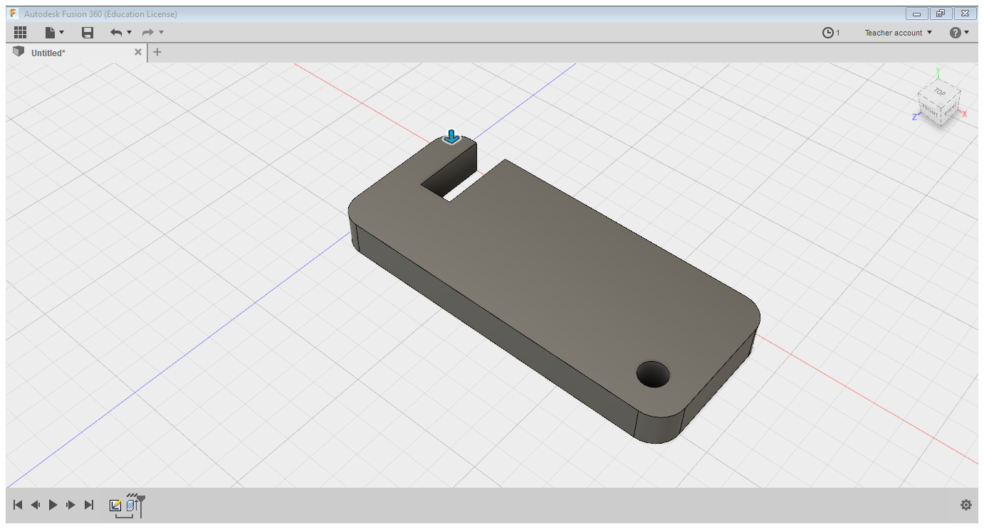
Add 5mm fillets to the edges to round the corners.

Slide 8
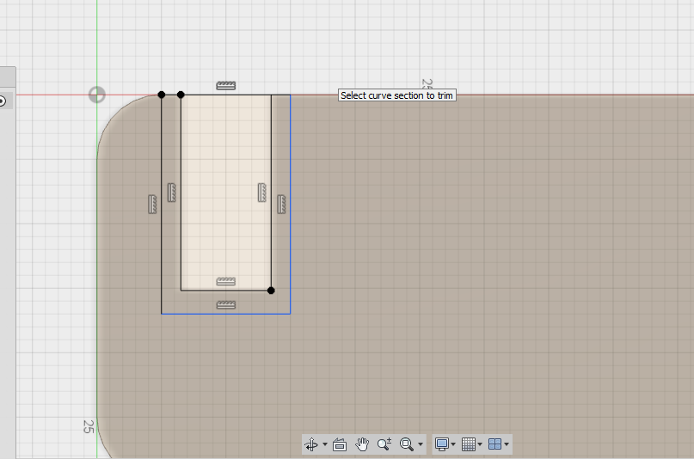
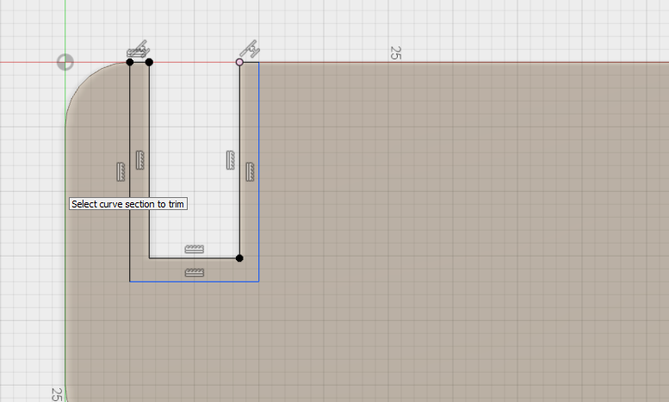
On the top surface create a new sketch and sketch the shape below and then trim it.

Slide 9
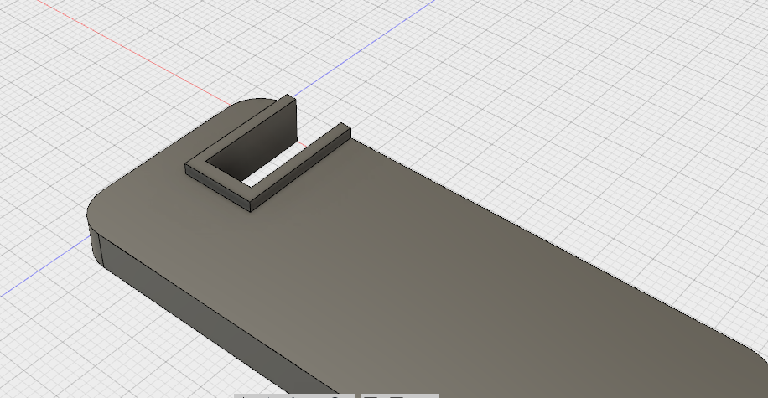
Extrude this shape by 1.5mm. This will allow more grip on the phone.

Slide 10
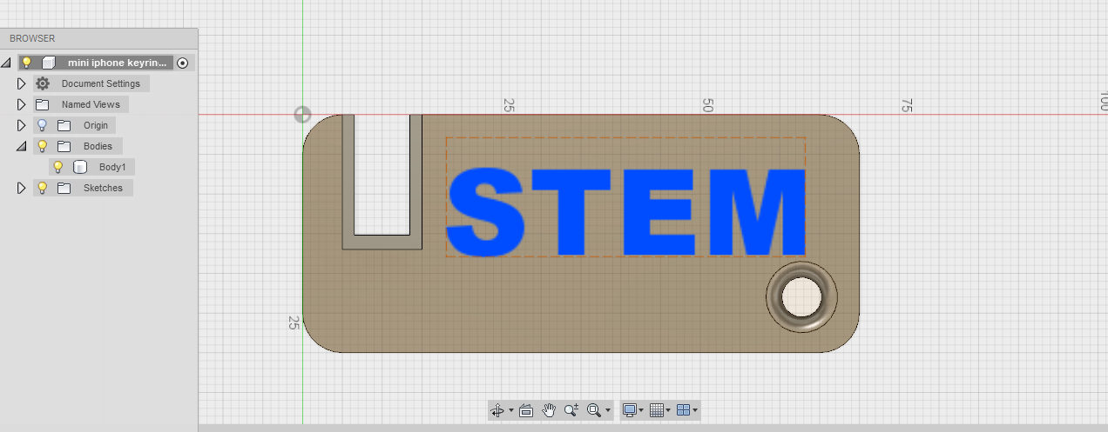
Select the top surface and create a new sketch.
Add text on to it or a pattern.
Then extrude it by 1.0mm
On the bottom keyring hole, add a fillet of 1.00.

Slide 11
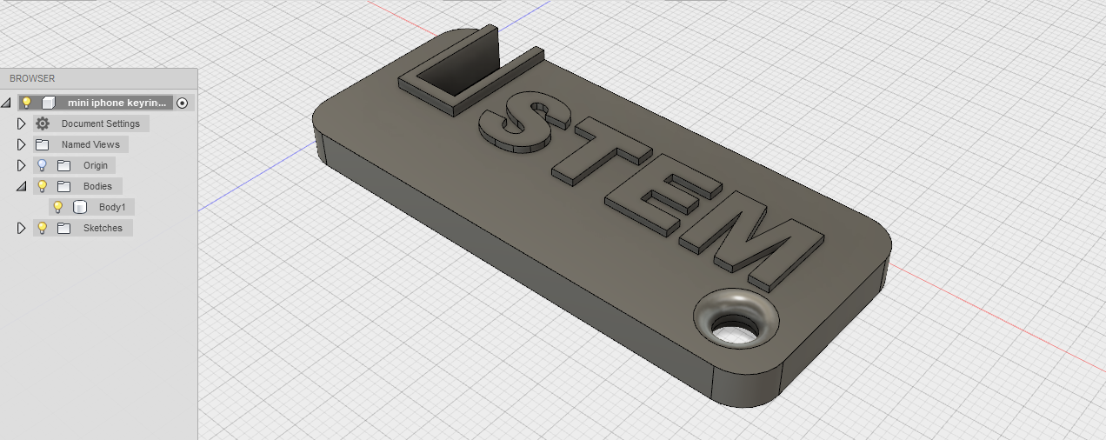
The design should look like this below.
Export it as an STL file and then 3D print it.
This should take under an hour to print if the layer height is set to 2.00 and speed at 100mm/s

Slide 12
Plenary
Explain the function of the trim feature and why you would use it?

