Slide 1
MINI ASSESSMENT
JUDGEMENTS
ANALYSIS
Lesson 4/10
DESIGN FOR SOCIETY
“Understanding how design can have a positive impact on others”.
Learning Aims:
What inclusive design is
Why it is important for a designer to include for ALL and ensure products fit ALL needs.
Complete a series of activities where your abilities are impaired by completing an everyday activity.

Slide 2
DO NOW ACTIVITY – PAST EXAM PAPER Q
Objective - Learner will gain knowledge and understanding of inclusive design & ensuring all needs are met & apply to a practical task.
A wheelchair user can find moving around their daily environment difficult.
WRITE YOUR RESPONSE IN YOUR EXERCISE BOOK.
6 MINUTES TO COMPLETE.
Suggest ways in which designers can help minimise these difficulties for wheelchair users. Give reasons in your answer. [6 MARKS]

Slide 3
DO NOW ACTIVITY – PAST EXAM PAPER Q
Objective - Learner will gain knowledge and understanding of inclusive design & ensuring all needs are met & apply to a practical task.
Suggest ways in which designers can help minimise these difficulties for wheelchair users. Give reasons in your answer. [6 MARKS]
SWAP YOUR ANSWER WITH YOUR PARTNER TO MARK.
Lightweight frame so not tiring or difficult to manoeuvre.
Ergonomically designed seat which can be adjusted so that the user is comfortable when sitting for long periods of time.
Angled wheels for greater speed and manoeuvrability.
Suspension to cushion when going over bumps.
Motorised, electric powered, folding frame, more compact frame.
Accept modifications to the environment, ramps, automatic / wider doors, lowered light switches.

Slide 4
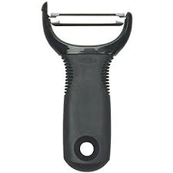
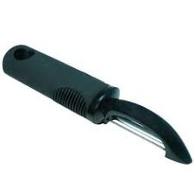
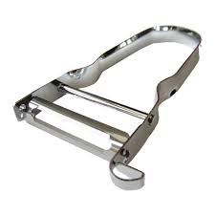
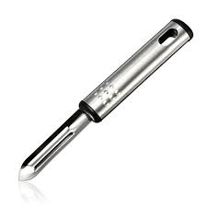
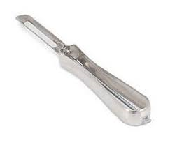
INCLUSIVE DESIGN – ACTIVITY
Objective - Learner will gain knowledge and understanding of inclusive design & ensuring all needs are met & apply to a practical task.
INCLUSIVE DESIGN WITH PEELERS
Inclusive design is where products are made to fit ALL regardless of their ABILITIES or DISABILITIES.

Slide 5
INCLUSIVE DESIGN
Objective - Learner will gain knowledge and understanding of inclusive design & ensuring all needs are met & apply to a practical task.
DATE
List all of the 5 human senses.
Stretch & challenge: How can these senses be hampered? (disadvantaged)
E.g. Sight, this can get worse with age and you need to wear glasses. Worst case scenario you could go blind and therefore can’t see at all and would need to learn how to cope and read using brail.
INCLUSIVE DESIGN
THE 5 HUMAN SENSES
1
2
3
4
5

Slide 6
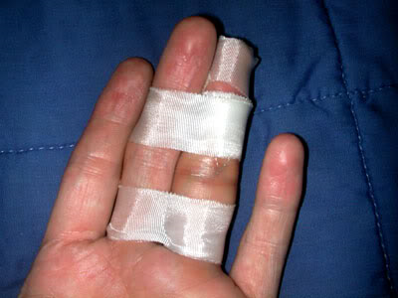
INCLUSIVE DESIGN – ACTIVITY
Objective - Learner will gain knowledge and understanding of inclusive design & ensuring all needs are met & apply to a practical task.
Today you will complete an activity where you will be completing a simple activity but your abilities will be hampered with so you can discover how difficult it can be for some.
Blindness (Loss of sight)
Partially Sighted
Broken fingers/
Poor grip
Broken arm - dominant
(use of one limb)
Use cardboard & masking tape to create a splint & cast.
Take your time!
Notes:
Task – Requires potato peelers. Food technology should be able to assist in supplying a sufficient amount of different styles.
Use cardboard and masking tape to create splints and casts. Use safety goggles with both and one lens covered with tape to black out.

Slide 7
INCLUSIVE DESIGN – ACTIVITY
Objective - Learner will gain knowledge and understanding of inclusive design & ensuring all needs are met & apply to a practical task.
INCLUSIVE DESIGN WITH PEELERS EVALUATION.
Peeler Sketch | Blind | Partially Sighted | Broken arm | Broken fingers
Peeler Summary:
Notes:
Worksheet Instructions – Students are to review four different peelers and evaluate against blind, partially sighted, broken arm and broken fingers. A sketch of the peeler reviewed needs to be produced. The task attempted and then a personal review (opinions) filled in.

Slide 8
NAME: INCLUSIVE DESIGN WITH PEELERS EVALUATION.
Peeler Sketch | Blind | Partially Sighted | Broken arm | Broken fingers
Peeler Summary:
Notes:
Worksheet to print

Slide 9
INCLUSIVE DESIGN – PEER REVIEW
Objective - Learner will gain knowledge and understanding of inclusive design & ensuring all needs are met & apply to a practical task.
Discuss with your partner which potato peeler you found the easiest and hardest to use & why?
Which disability to find the hardest & why?
Notes:
Worksheet to print

