Slide 1
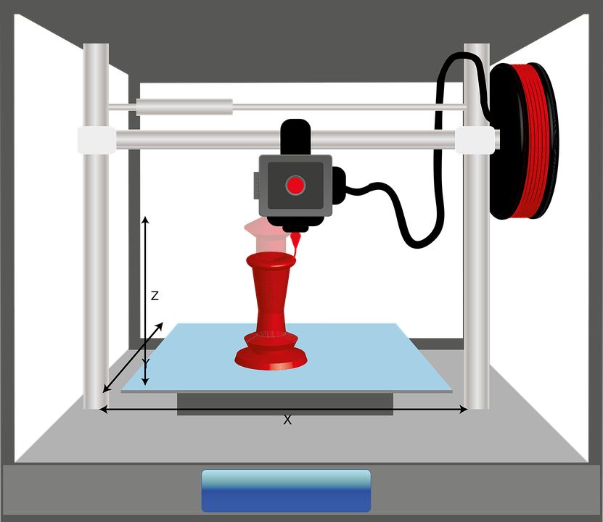
Starter
‘Log onto Fusion 360’ and open up your files from last lesson.

Slide 2
Objectives
To understand how to prepare a model for 3D printing.
To know the difference between infill, layer height, print speed and a raft.

Slide 3
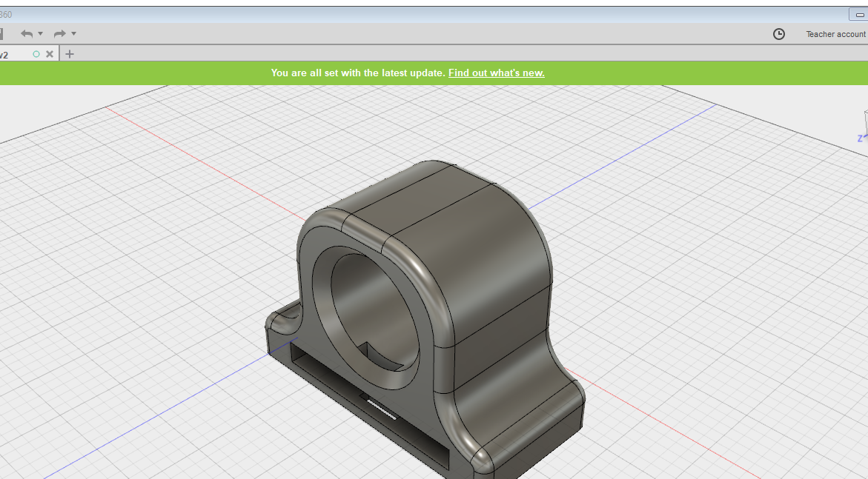
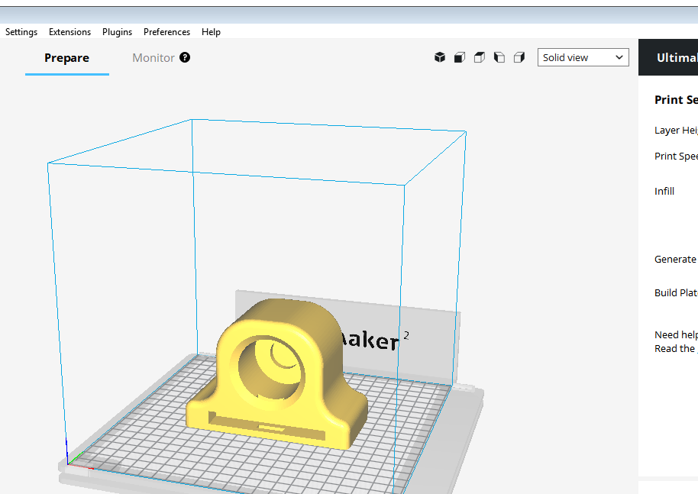
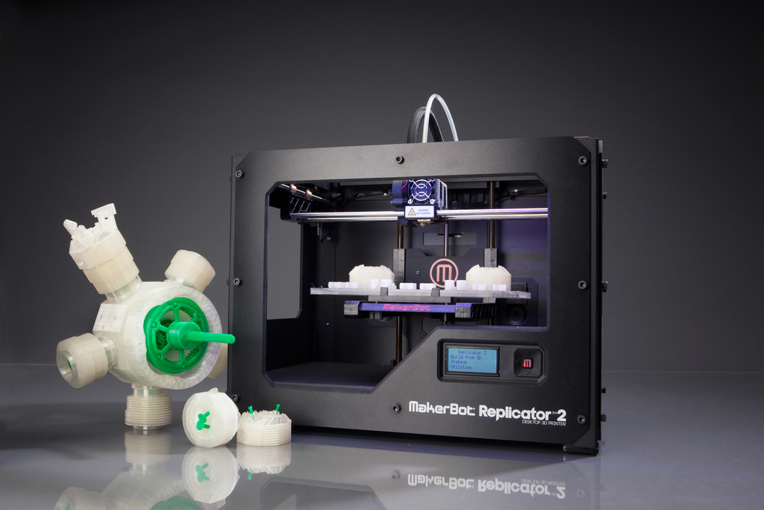
The 3D printing process
Design on CAD
Export STL file and slice
3D print the model

Slide 4
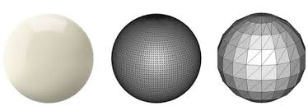
What is an STL file?
STL files are meshes of polygons that are wrapped around the 3D model.
The STL file can easily be sliced into layers using slicing software.
When the STL file is created, they are hollow on the inside. When you slice the model in slicing software you can determine the density of how much material you want on the inside.
https://all3dp.com/what-is-stl-file-format-extension-3d-printing/

Slide 5
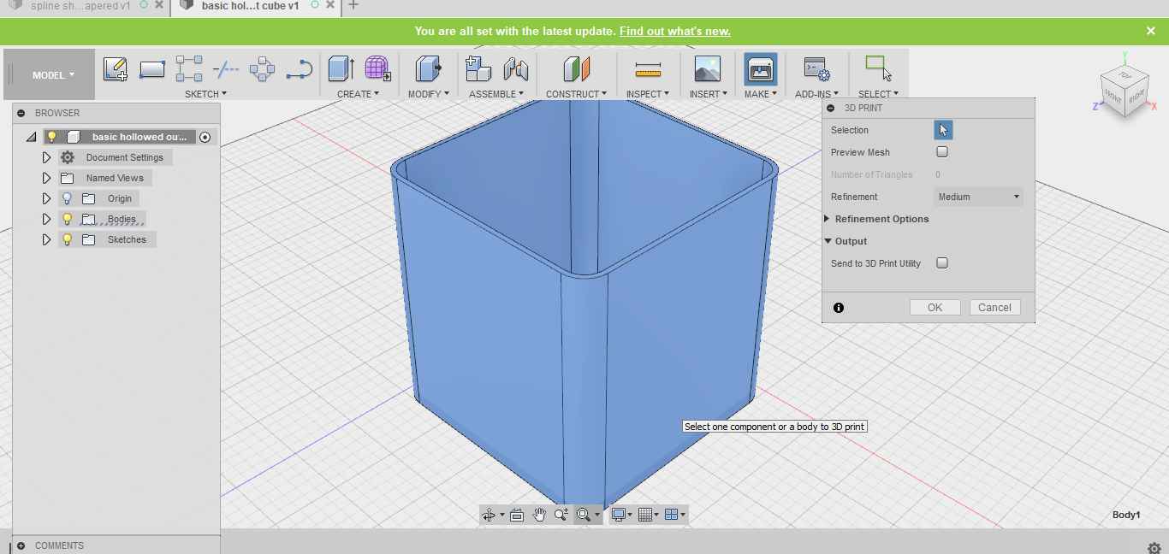
How to export an STL file from Fusion 360.
Click on ‘Make – 3D print – Click the model – (ensure send to 3D print Utility is unchecked) make sure the model is shaded blue like below. Then click ‘OK’.

Slide 6
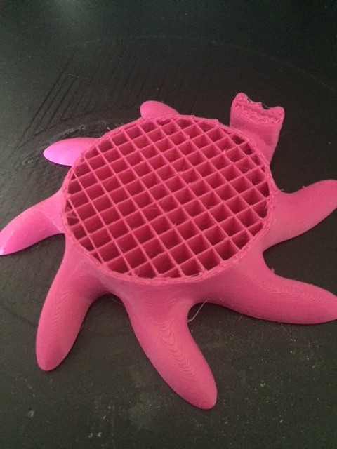
What is Infill?
Infill is the density that you want your model to print at. A more dense infill will use more material and take longer to 3D print.

Slide 7
What is layer height?
Layer height is the thickness of each layer that the 3D printer prints.
The smaller the layer height the more detailed the end result will be.
The thicker the layer height will make the part less detailed.
The thicker the layer height the faster the model will 3D print.
https://support.3dverkstan.se/article/30-getting-better-prints

Slide 8
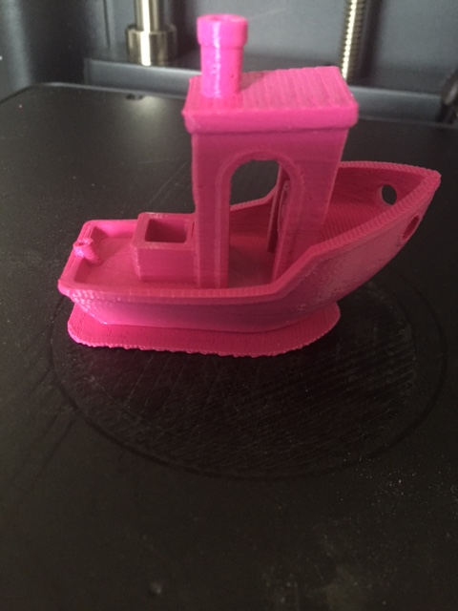
What is a Raft?
A raft is like a foundation for the 3D print. It helps stop the print from warping and is used to ensure that the print sticks to be bed.
Parts that may struggle to stick to the bed will need a raft to help them print.

Slide 9
Plenary
Can you describe what an STL file is?
What is layer height?

