Slide 1
Lesson 2/10
DESIGN FOR SOCIETY
“Understanding how design can have a positive impact on others”.
Learning Aims:
Understand how products are designed to meet a clients needs .
Explain what impact culture and society have on design.
Look at a specific product and analyse it using the information provided.

Slide 2
DO NOW ACTIVITY
Objective - Learner will gain knowledge and understanding of market pull & technology push.
In the table provided state whether the following items have been developed from either market pull or technology push. In the column provided state clearly your choice for each product.
Complete the provided worksheet to test your memory from the previous lesson.
Technology | Market pull or technology push? | Reason for your choice
Reusable shopping bag
Digital camera
3D TV
Car Airbag
Flash memory stick
Robotic vacuum cleaner
Technology Push – New technology or materials are developed & designers take the opportunity presented by this to design new products.
Market Pull – Where users want a product to be improved or redeveloped to meet their needs.

Slide 3
In the table provided state whether the following items have been developed from either market pull or technology push. In the column provided state clearly your choice for each product.
Technology | Market pull or technology push? | Reason for your choice
Reusable shopping bag
Digital camera
3D TV
Car Airbag
Flash memory stick
Robotic vacuum cleaner
Notes:
Worksheet to print

Slide 4
KEY WORDS
Objective - Learner will gain knowledge and understanding of market pull & technology push.
KEY WORDS
Society – A collective of people living together in a community (what around us) This can be friends, family, celebrities.
Culture – The values and beliefs, customs and behaviours used by groups in society.

Slide 5
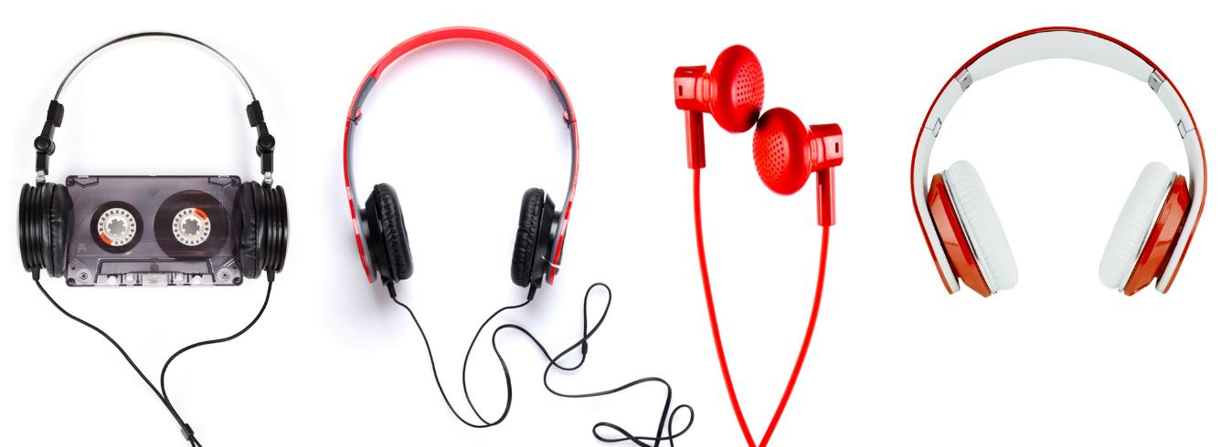
FASION & TRENDS
Objective - Learner will gain knowledge and understanding of market pull & technology push.
Evolution in the development of materials, technology and fashion has driven design trends.
Studying the above headphone images answer the following questions:
What developments in materials and technology have contributed to the design of new types of headphone?
Which of these are driven by consumers or by research?

Slide 6
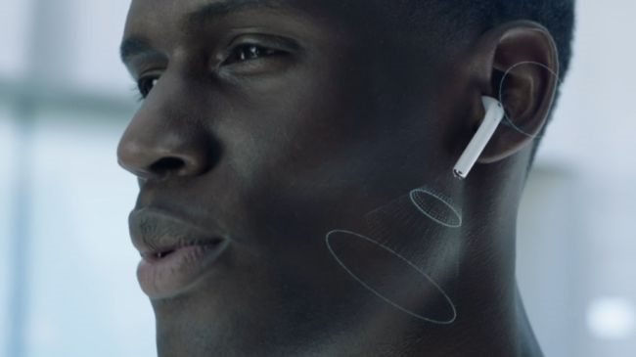
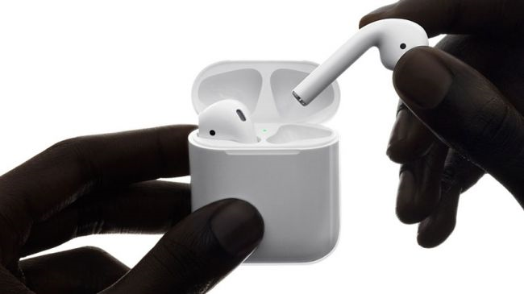
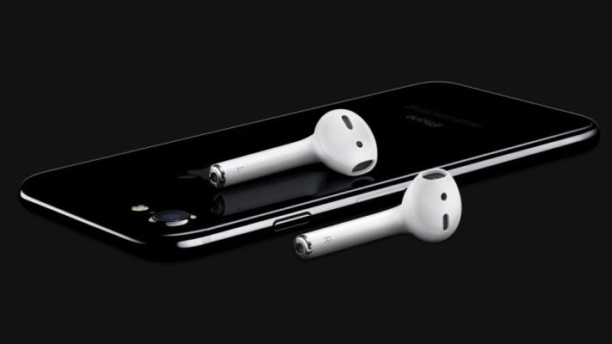
FASION & TRENDS
Objective - Learner will gain knowledge and understanding of market pull & technology push.
Evolution in the development of materials, technology and fashion has driven design trends.
This technology is still evolving. Have an IPhone 7 or more recent?
They removed the headphone jack. WHY?
Peer Review: Swap your sketches with the person sitting next to you and discuss your idea. Listen to their feedback and obtain feedback through what went well (WWW) and even better if (EBI)
Activity – You have 10 minutes to quickly sketch what headphones will look like in 10 years time.
What will we need? How will we listen? What product will it play off?

Slide 7
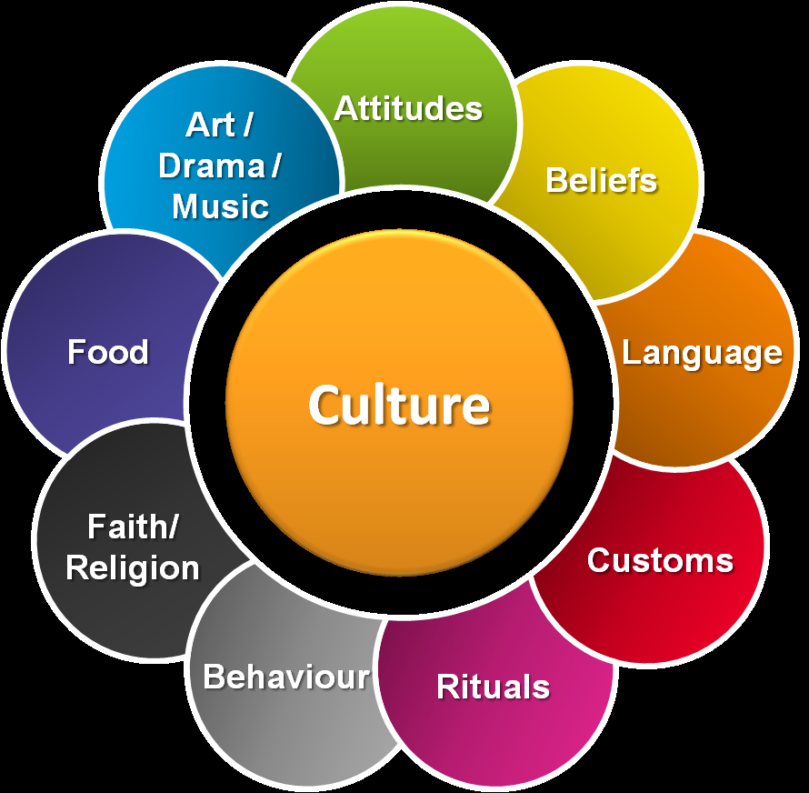
CULTURE & SOCIETY
Objective - Learner will gain knowledge and understanding of market pull & technology push.
Culture is groups within society (some we are born into and some we choose) these can be:
Ethnic
Political
Religious
Gender
Britain has become a multicultural society and from this has changed fashion, food and architecture among other outcomes.
Q) Why is it important for designers to consider different cultures in their products?

Slide 8
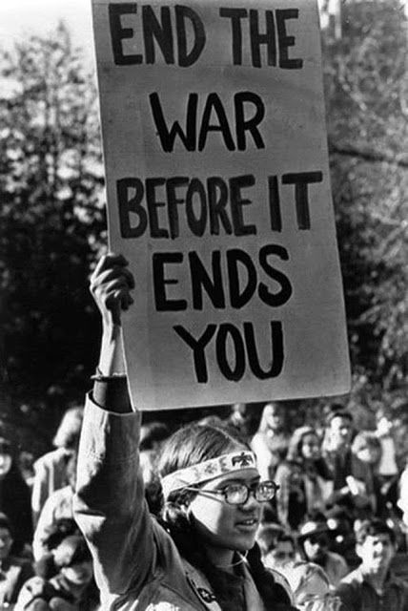
CULTURE & SOCIETY
Objective - Learner will gain knowledge and understanding of market pull & technology push.
Products can be developed by influences from society as well as different culture it can be:
War
Finances (recession)
Technology (social media)
Celebrities
Disabilities (inclusive)
Q) How does social media impact your product choices?
Q) What impact does the economy have on product designers and consumers?

Slide 9
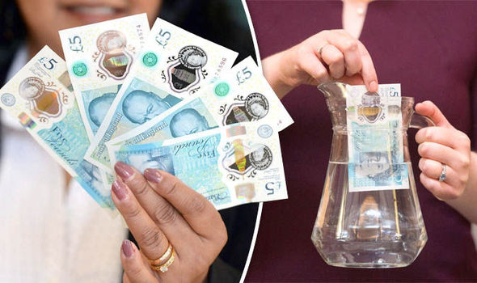
CULTURE & SOCIETY CASE STUDY
Objective - Learner will gain knowledge and understanding of market pull & technology push.
Case study Polymer £5 notes
The new UK £5 note contains a small amount of tallow in the polymer pellets used to make the notes
Tallow is a substance derived from animal fat
This has upset a large community of Hindus, Sikhs, Jains, vegetarians and vegans living in the UK.
Watch the clip discussion to follow.
https://www.youtube.com/watch?v=IK96PJStI90
Q) What are the potential consequences for the Bank of England?
Q) Why did they change the material?

Slide 10
CULTURE & SOCIETY – COLOURS
Objective - Learner will gain knowledge and understanding of market pull & technology push.
The meaning of colour
Does red mean STOP, DANGER?
Or WEALTH, LUCK and HAPPINESS?
In Asia red is a POSITIVE colour. But in Russia it represents COMMUNISM.
It is often regarded as a negative/danger symbol in most products.
Icons Task
What cultural assumptions lie behind these icons?
Sketch the icon and label it

Slide 11
MARKET RESEARCH
Objective - Learner will gain knowledge and understanding of market pull & technology push.
Understanding the market is one of the most challenging aspects for designers and manufacturers.
What works for one person, will not necessarily work for another
How do mobile phone companies tailor their products to best suit as many people as possible?
Remember an IPhone could be used by a teenager (YOU) through to an old lady.
What makes you decide to purchase a product? Is this the same for everyone?
https://www.youtube.com/watch?v=xmQW6hoNGhk
Watch the clip. What was the point of the research & did they listen?

Slide 12
HOME LEARNING
Objective - Learner will gain knowledge and understanding of market pull & technology push.
Write an article that describes how multicultural Britain has had an impact on the design and development of products. Use examples of products in your article.

