Slide 1
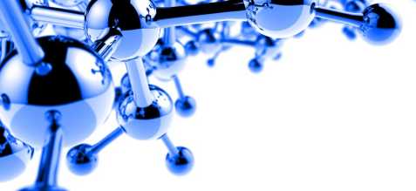
GCSE Design Technology
MATERIAL PROPERTIES
LESSON 5
Plastics & Polymers
Todays learning objectives:
Understand what biodegradable plastics are & their purpose for reducing plastic waste.
Be able to identify different biodegradable polymers, describe different applications for these polymers and analyse why this type of polymer has been used for a particular product.

Slide 2
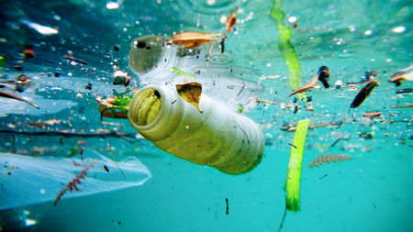
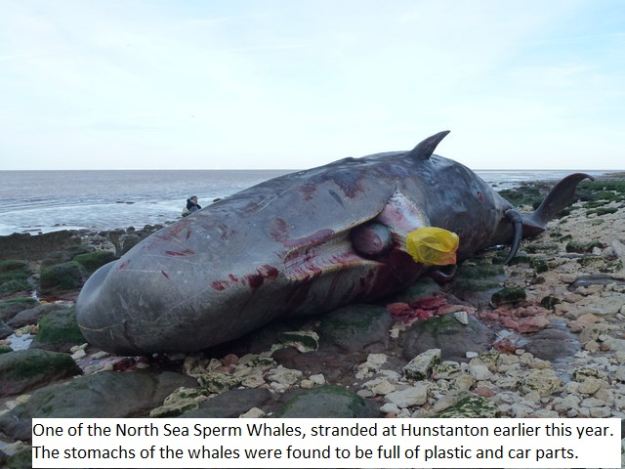
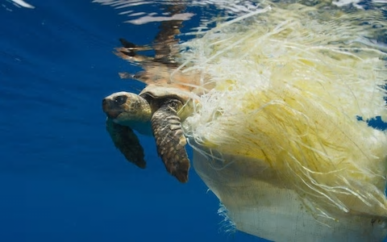
GCSE Design Technology
MATERIAL PROPERTIES
LESSON 5
Plastics & Polymers
Thinking Task – How do you feel seeing this image?
Respond on your post it note.

Slide 3
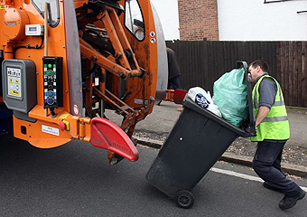
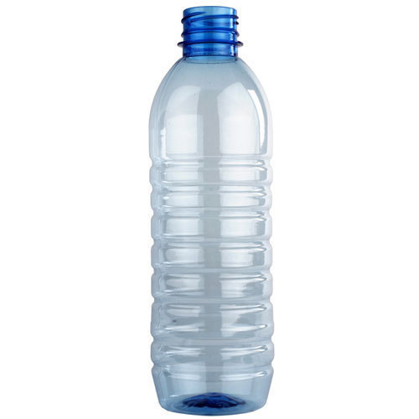
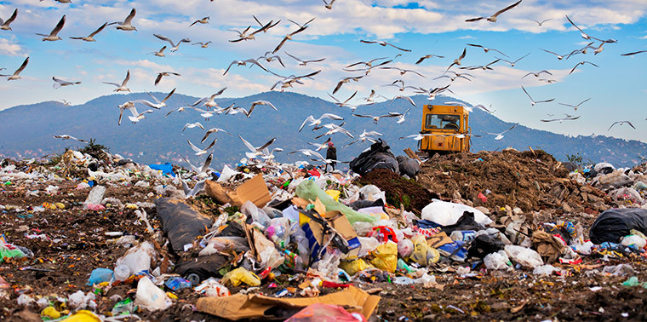
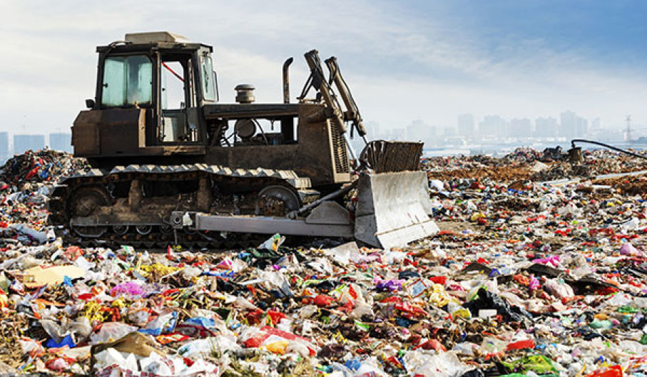
GCSE Design Technology
MATERIAL PROPERTIES
LESSON 5
Plastics & Polymers
Each week your rubbish (whether its recyclable or other) is collected by the dustman but where does it go? HANDS UP!
PLASTIC BOTTLES LETS WATCH A VIDEO OF THE BOTTLES LIFE. https://www.youtube.com/watch?v=_6xlNyWPpB8
Did you spot the amount of POLYMERS in the landfill sites? What do you use/maybe now made of polymer?

Slide 4
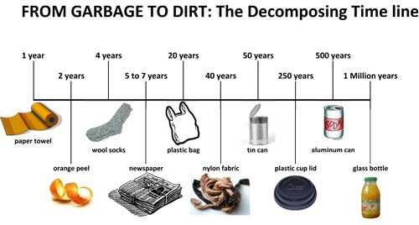
GCSE Design Technology
MATERIAL PROPERTIES
LESSON 5
Plastics & Polymers
Time Line Activity – Guess the years to decay.
It isn’t just POLYMERS in our landfill sites.
?
?
?
?
?
?
?
?
?
?

Slide 5
Notes:
Sheet to print

Slide 6
GCSE Design Technology
MATERIAL PROPERTIES
LESSON 5
Plastics & Polymers
Time Line Activity – Guess the years to decay.
It isn’t just POLYMERS in our landfill sites.
?
?
?
?
?
?
?
?
?
?
Are you shocked? Surprised? Briefly discuss with your neighbour.

Slide 7
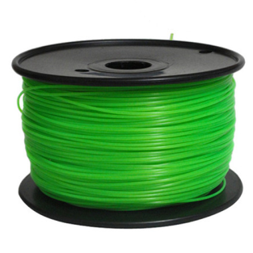
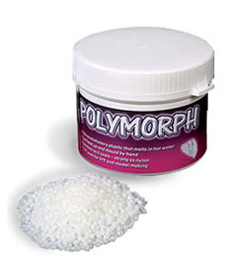
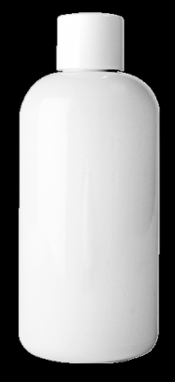
GCSE Design Technology
MATERIAL PROPERTIES
LESSON 5
Plastics & Polymers
Biodegradable plastics - Some of the newer plastics are made from vegetable starches and are fully biodegradable if composted. The natural bacteria in the soil breaks down the plastic very quickly, largely owing to being exposed to moisture and high temperatures.
Name | Appearance | Image | Characteristics | Uses
Polylactic Acid [PLA] | Smooth, can be textured finish |  | Non toxic, easy to mould & 100% biodegradable | Bottles, disposable containers
Polycaprolactone [PCL] | Off-white colour, translucent & shaped by hand |  | Easy to mould in hot water, non-toxic & 100% biodegradable | Prototyping & modelling
Polyhydroxybutyrate [PHB] | Smooth & textured finish & colour can be applied. |  | Non-toxic, brittle with limited chemical resistance, easy to mould. | Bottles, pots, disposable food containers.

Slide 8
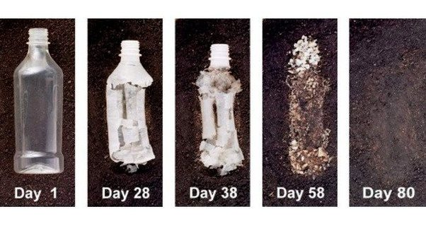
GCSE Design Technology
MATERIAL PROPERTIES
LESSON 5
Plastics & Polymers
The above image demonstrates the process of a plastic bottle biodegrading over a period of time.

Slide 9
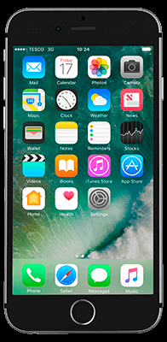
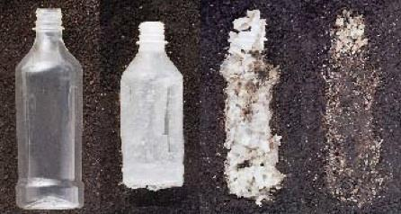
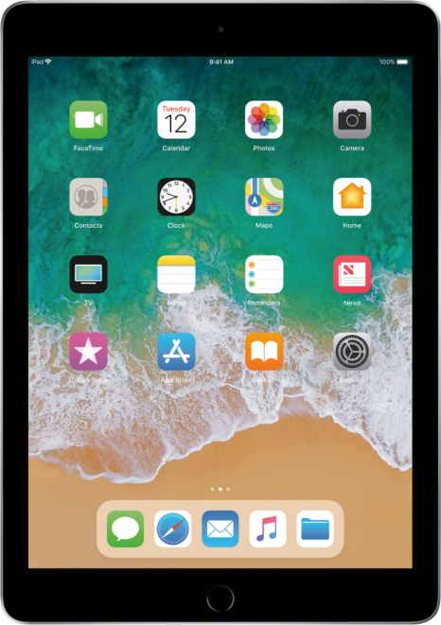
GCSE Design Technology
MATERIAL PROPERTIES
LESSON 5
Plastics & Polymers
Using the internet research below.
In teams:
List the advantages and disadvantages of using biodegradable polymers
List the raw materials that biodegradable polymers are made from
What are the 4 main types of degradable polymers?
Discuss and share information with the class.

Slide 10
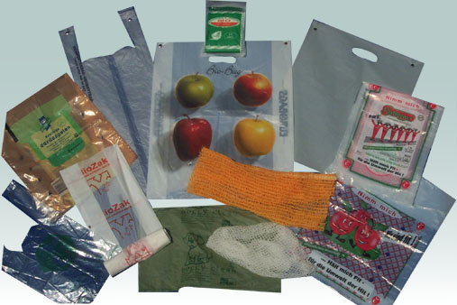
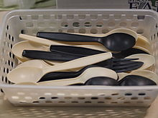
GCSE Design Technology
MATERIAL PROPERTIES
LESSON 5
Plastics & Polymers
Using the internet research below.
Research:
How many different products can you find that use biodegradable polymers? List them.
Can you suggest additional applications for biodegradable polymers

Slide 11
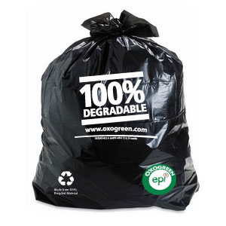
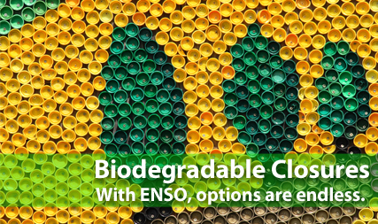
GCSE Design Technology
MATERIAL PROPERTIES
LESSON 5
Plastics & Polymers
Watch closely the clip on biodegradable polymers
https://www.youtube.com/watch?v=OZTEfYb0wQU
Discussion to follow.

Slide 12
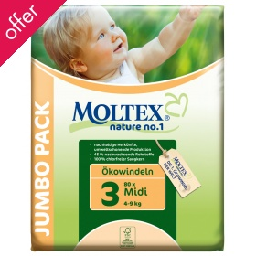
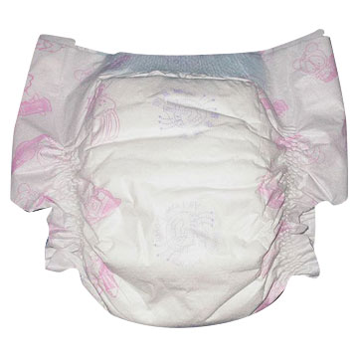
GCSE Design Technology
MATERIAL PROPERTIES
LESSON 5
Plastics & Polymers
Written Task: Compare and analyse a product that has traditionally been manufactured from a non degradable polymer and is now manufactured using a biodegradable polymers.
Your answer should include the advantages and disadvantages of using each type of polymer.

Slide 13
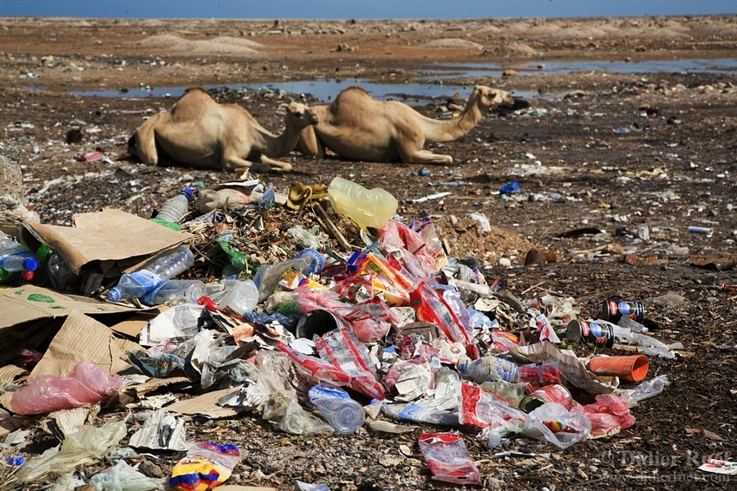
GCSE Design Technology
MATERIAL PROPERTIES
LESSON 5
Plastics & Polymers
Plenary Activity – Recapping learnt knowledge
From what you have learnt today, list what you now know about biodegradable polymers.

