Slide 1
GCSE Design Technology
MATERIAL PROPERTIES
LESSON 1
Plastics & Polymers
Todays learning objectives:
Understand the classifications of plastics & polymers.
Develop familiarity of a range of thermoforming polymers.
Apply taught knowledge to a revision worksheet.

Slide 2
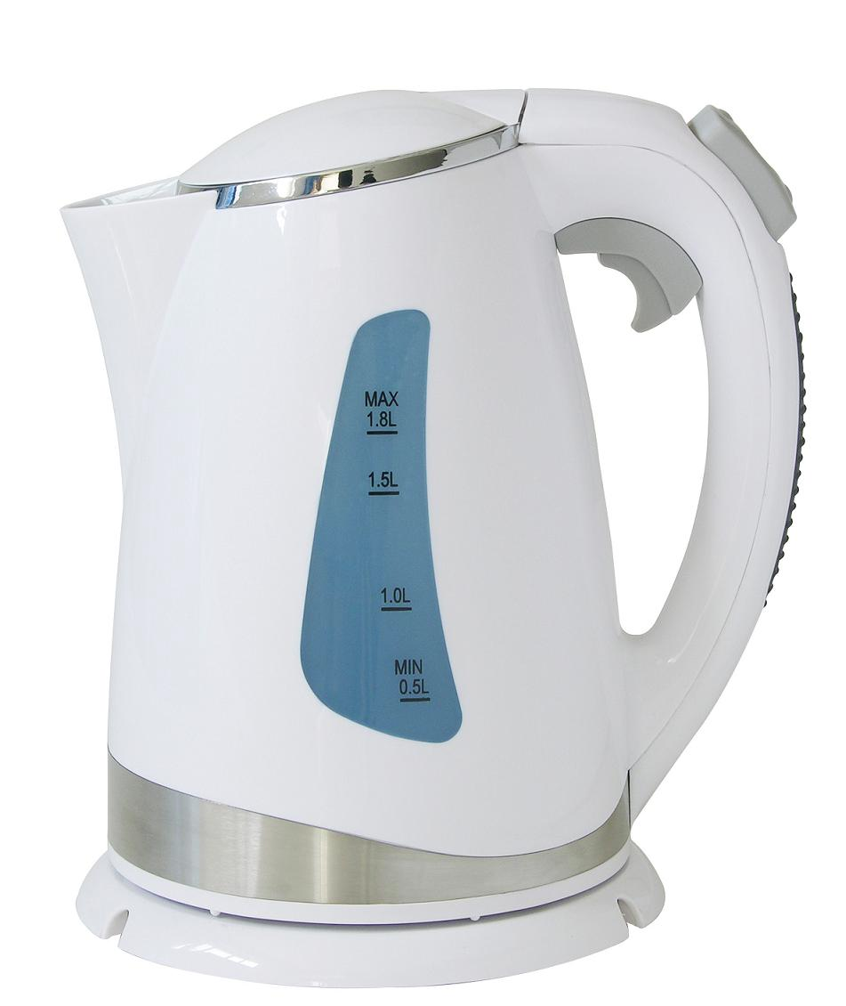
GCSE Design Technology
MATERIAL PROPERTIES
LESSON 1
Plastics & Polymers
DO Now Starter:
Discuss in pairs why this kettle is made from polymers? Write your response on the post it note provided.
Plastics & polymers is an area which you will have some prior knowledge from key stage 3.
At GCSE you will recover this area in more detail.

Slide 3
GCSE Design Technology
MATERIAL PROPERTIES
LESSON 1
Plastics & Polymers
Materials widely available
Easy to manufacture
price
Lightweight
Electrical insulator
Thermal insulator
Colorful, where necessary

Slide 4
GCSE Design Technology
MATERIAL PROPERTIES
LESSON 1
Plastics & Polymers
What are polymers?
Polymers have become increasingly popular since their usage of consumer products back in the 1950s. As they are versatile and can be coloured, shaped, moulded; as well as being affordable they are used widely in all day to day products.
Most polymers are manufactured using crude oil which is non-renewable. This means it is not sustainable. The increase of use means that chemical engineers are looking for alternatives.
Polymers are split into two categories:
Thermoforming
Thermosetting
Today we will be learning about the properties of thermoforming polymers & named examples with principal uses.

Slide 5
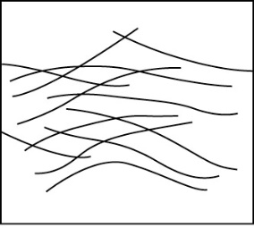
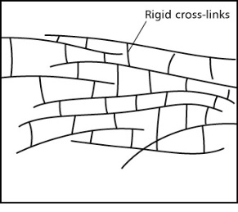
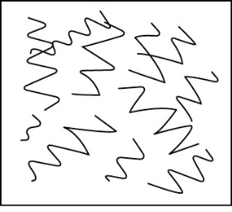
Key words
Thermosets - Thermosetting – Elastomers – long chain molecules – polymers – plastics – rigid cross links – inorganic - synthetic
Notes:
WORKSHEET TO PRINT (Per student)

Slide 6
Polymers Note sheet. Write personal notes during the lesson. Purple indicates todays tasks
Key words
Thermosets - Thermosetting – Elastomers – long chain molecules – polymers – plastics – rigid cross links – inorganic - synthetic

Slide 7
GCSE Design Technology
MATERIAL PROPERTIES
LESSON 1
Thermoforming
Thermoforming polymers
Name | Properties | Principal uses
Polyamide (Nylon) | Creamy colour, tough, fairly hard, resists wear, self-lubricating, good resistance to chemicals | Bearings, gear wheels, casings for power tools, hinges for small cupboards, curtain rail fittings and clothing
Polymethyl methacrylate (Acrylic) | Stiff, hard but scratches easily, durable, brittle in small sections, good electrical insulator, machines and polishes well | Signs, covers of storage boxes, aircraft canopies and windows, covers for car lights, wash basins and baths
Polypropylene | Light, hard but scratches easily, tough, good resistance to chemicals, resists work fatigue | Medical equipment, containers with built-in hinges, 'plastic' seats, string, rope, kitchen equipment
Polystyrene | Light, hard, stiff, transparent, brittle, with good water resistance | Toys, especially model kits, packaging, 'plastic' boxes and containers
Low density polythene (LDPE) | Tough, good resistance to chemicals, flexible, fairly soft, good electrical insulator | Packaging, especially bottles, toys, packaging film and bags
High density polythene (HDPE) | Hard, stiff, able to be sterilised | Plastic bottles, tubing, household equipment

Slide 8
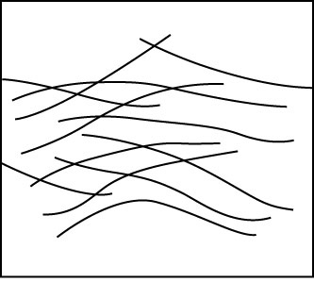
GCSE Design Technology
MATERIAL PROPERTIES
LESSON 1
Plastics & Polymers
Thermoforming
Long chain molecules held together by strong electrostatic forces called (van der Waals bonds).
These bonds can be released by applying heat allowing the material to be reshaped.

Slide 9
GCSE Design Technology
MATERIAL PROPERTIES
LESSON 1
Plastics & Polymers
How many of the polymer names do you know from the symbol alone?
Discuss in pairs.
P.S. These materials are the ones commonly found at home for packaging. There are more which we will use in the workshop.

Slide 10
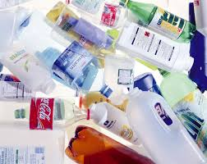
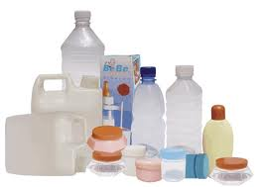
GCSE Design Technology
MATERIAL PROPERTIES
LESSON 1
Plastics & Polymers
PLENARY: What have you learnt so far this lesson?
Write a paragraph, or use diagrams to describe, what we have learnt about polymers today.
Key words
Thermosets - Thermosetting – Elastomers – long chain molecules – polymers – plastics – rigid cross links – Packaging symbols

