Slide 1
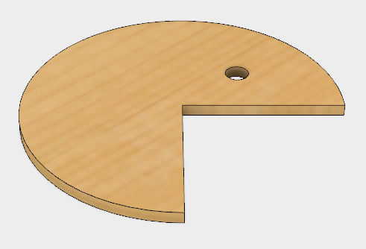
Fusion 360 Pac Man Tutorial

Slide 2
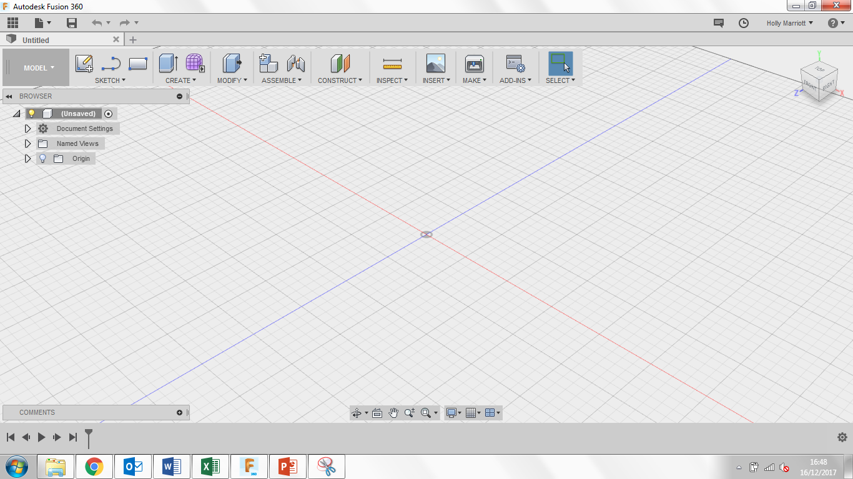
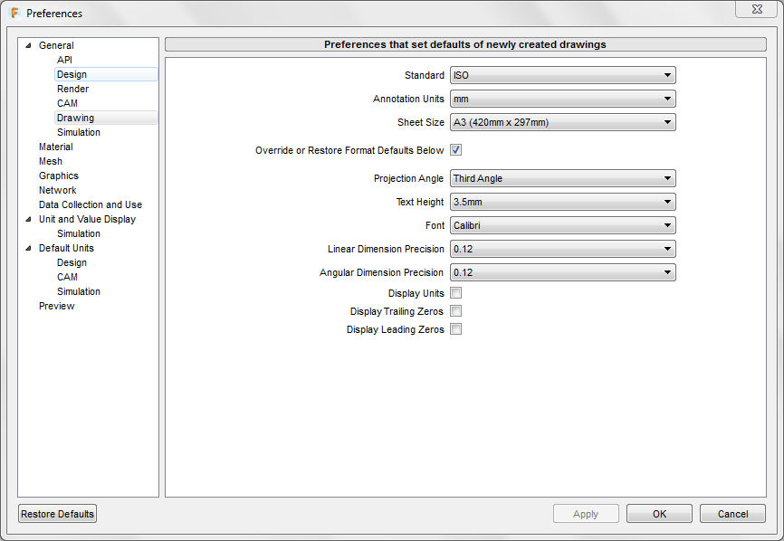
Welcome to Fusion 360, lets just quickly take a tour around the workspace.
Top left are your general options, you can find any work you have saved previously under top left icon. You can create a new document, save and when you’re working on a model, undo/redo any steps.
Top right you can find notifications and messages from users/admin as well as find your account details.
If you select your name you can also see the preferences for the program where you can customise the program to your personal style.
If you select preferences, the following box will open, select the drawing tab and change the following settings to they replicate the settings in the picture.

Slide 3
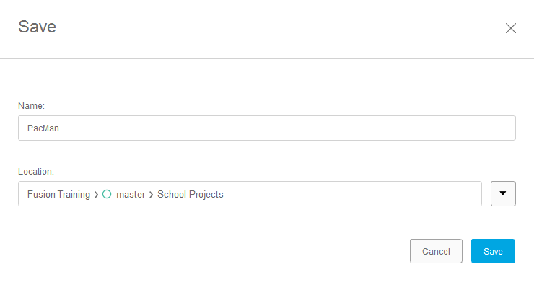
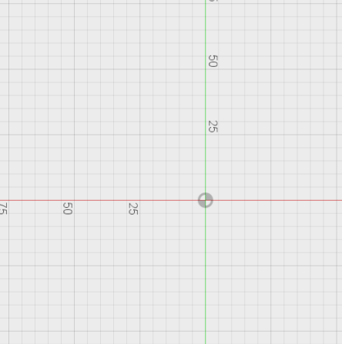
3. Click Sketch and then Create Sketch. 3 orange squares will appear, these are the planes that we can draw on. Click on the plane between the blue and red axis, it will turn grey when your mouse is over it. When you click on the plane, the view will change to a birds eye view of the work space.
1. Lets get started, create a new design. You can do this either two ways. You can click on File and then New Design or you can click on the + symbol.
2. Save your new design straight away. Give is a suitable name and save it in a suitable location.
4. Click on Sketch, Circle and then Center-Diameter Circle or click C on your keyboard. From the origin point draw a circle measuring 80mm.

Slide 4
5. Click on Sketch and then Line or L on your keyboard. This will bring up the Line tool, click on the origin and drag up and out to the right. Two text boxes will appear, in the distance one type in 40mm and in the angle one type in 45deg. By clicking tab on your keyboard it will alternate between each text box. Finally click enter on your keyboard to fix those measurements.
6. Use the line tool again or L on your keyboard, click on the origin point and drag down and out to the right. In the distance text box type in 40mm and in the angle text box type in 45deg. Click enter on your keyboard.
8. Click on the red lines highlighted in the pictures.
7. Click on Sketch and select Trim or by clicking T on your keyboard.

Slide 5
9. Using the Center Diameter Circle tool draw a circle somewhere along the green centre line above the origin point. Set the diameter as 6mm.
10. Click Create and select Extrude. Your PacMan shape will change to a Isometric view and an Extrude menu will appear. For the profile click within the Pacman shape, it should turn blue. For the distance enter 3mm and click Enter.
11. Click on Model and select Render. Click on the Appearance option. Click on the Wood folder to open it up, then open the Unfinished folder and find a Pine. Click and drag the appearance onto the PacMan. Click Close.

Slide 6
12. Click on Render and then click on Model so we go back to the Model environment. Click on Modify and Physical Material. Open up the Wood folder and drag Plywood, Finish onto the model. Click close at the bottom of the Physical Material menu window.
13. Click Save.

Slide 7
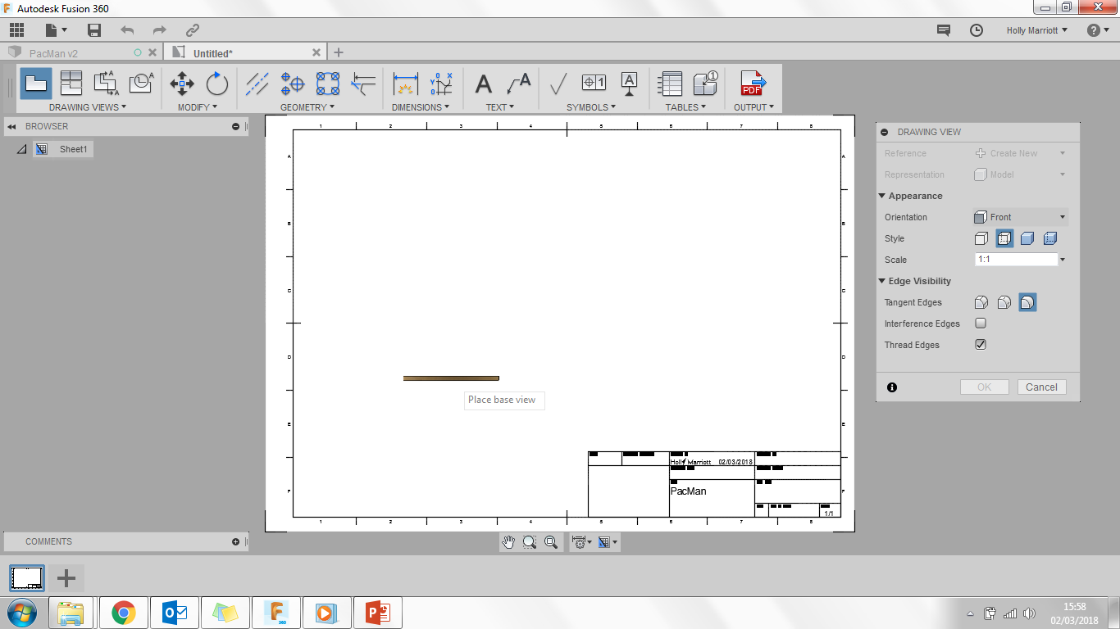
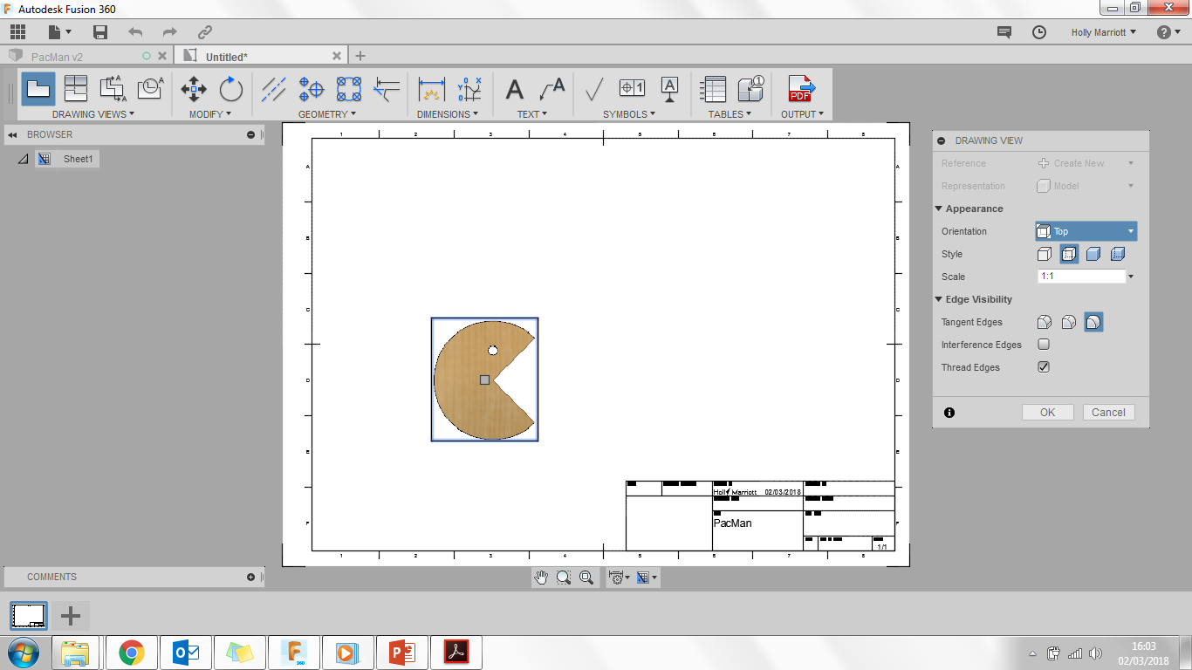
15. Your screen will now look something like the one in the picture. In the Drawing View menu change the orientation from Front to Top.
14. You are now going to create an engineering drawing that shows your PacMan from different angles and its measurements. Click on File, New Drawing and From Design, your Pacman will go a light blue colour and a menu box will appear. Ensure your menu box settings are the same as the picture below. Click ok.
16. Move your mouse so that the PacMan moves to the position in the below picture and click once. A blue box will appear around your PacMan. Click ok in the Drawing View Menu box.

Slide 8
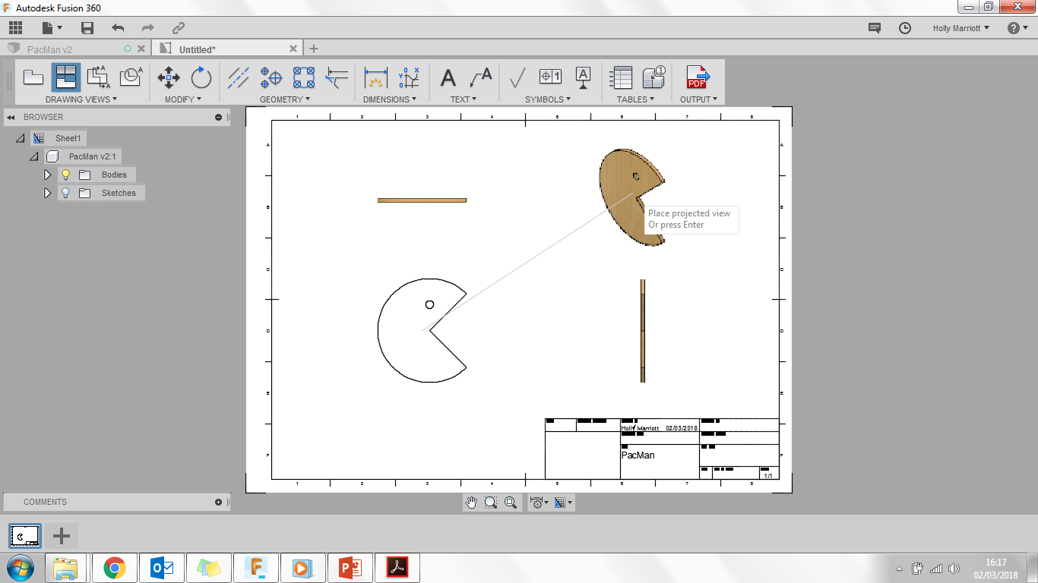
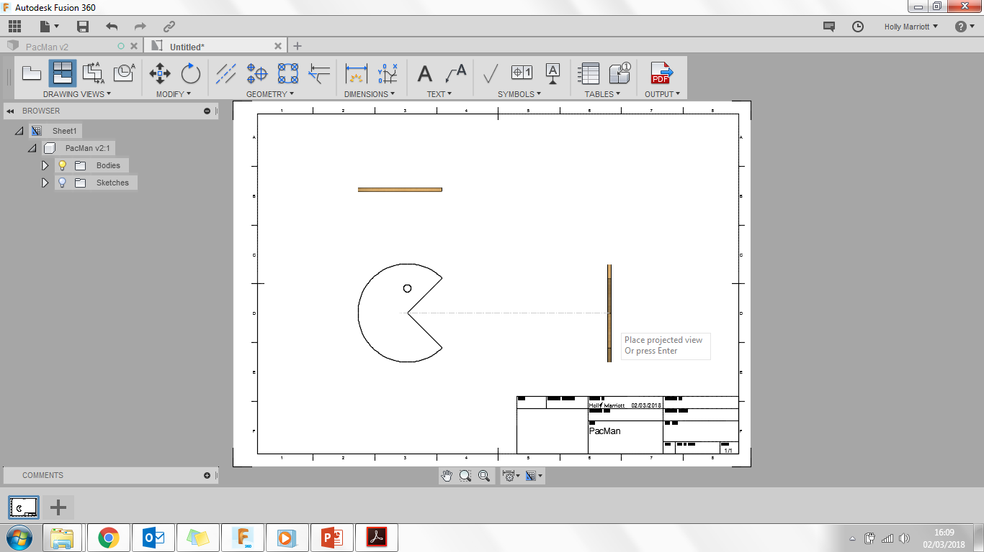
17. Click on Projected View and then click once on the PacMan you have just placed.
20. Now move your mouse above the side view you have just created and click once, this will give you an isometric view.
18. Move your mouse above the front view of your PacMan and in the space above click, this will show the top view.
21. Click on Projected View button to save those views in place.
22. You are now going to add some measurements. Click on the Dimension button
23. Zoom in on the top view and when you hover your mouse over the top view some green squares will appear. Click on the top left green square, then click on the bottom left green square and drag out to the left and click. This will add a dimension onto the drawing. Click Fit and the whole page will be in view now.
19. Now move your mouse to the right of the front view and click once, this will show the side view.

Slide 9
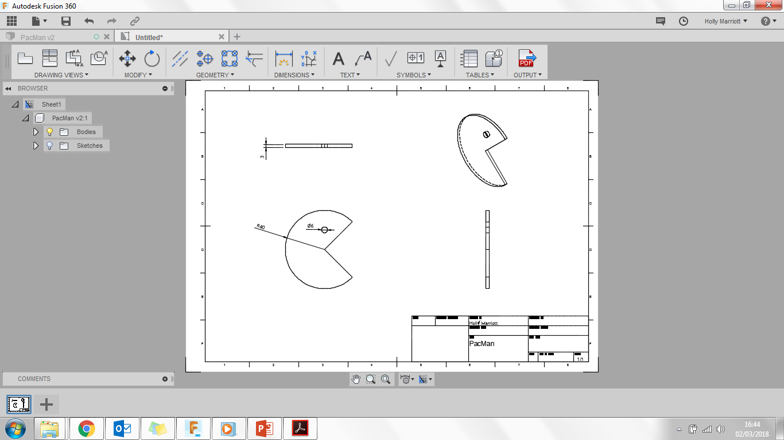
24. Hover over the circle of your front view.
25. Repeat Step 24 to add a dimension for the eye of the PacMan. You may need to zoom in a little to select the right parts. Remember to click Fit afterwards to see the whole engineering drawing.
Click Save. It will automatically put the work drawing after PacMan. Make sure you save it in a suitable place and click Save.
Click on the edge.
Drag out and click to place the dimension.

