Slide 1
Fusion 360 Lego Brick Tutorial

Slide 2
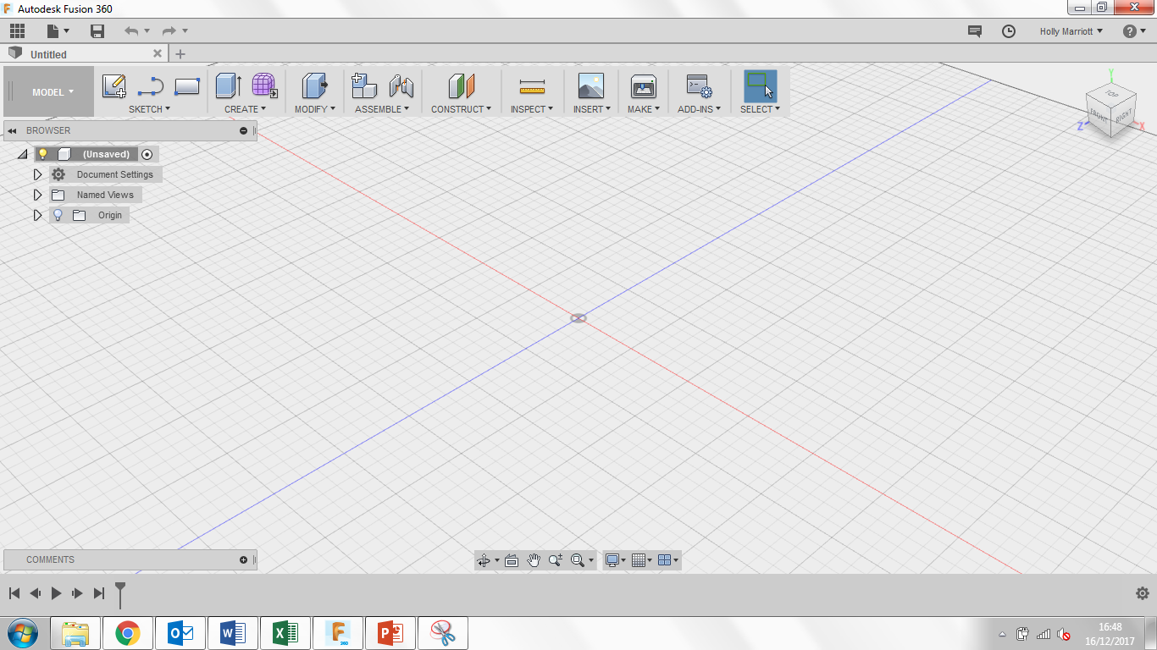
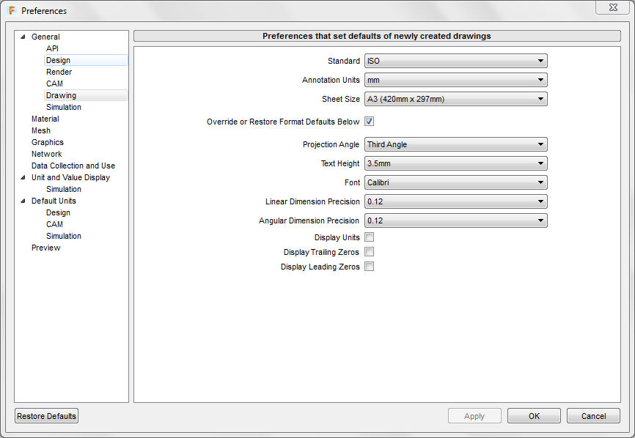
Welcome to Fusion 360, lets just quickly take a tour around the workspace.
Top left are your general options, you can find any work you have saved previously under top left icon. You can create a new document, save and when you’re working on a model, undo/redo any steps.
Top right you can find notifications and messages from users/admin as well as find your account details.
If you select your name you can also see the preferences for the program where you can customise the program to your personal style.
If you select preferences, the following box will open, select the drawing tab and change the following settings to they replicate the settings in the picture.

Slide 3
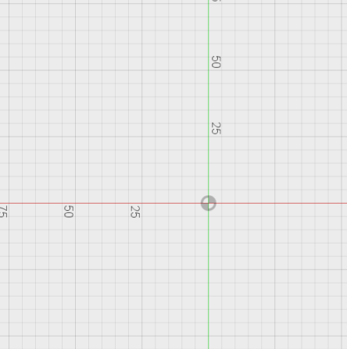
3. Click Sketch and then Create Sketch. 3 orange squares will appear, these are the planes that we can draw on. Click on the plane between the blue and red axis, it will turn grey when your mouse is over it. When you click on the plane, the view will change to a birds eye view of the work space.
1. Lets get started, create a new design. You can do this either two ways. You can click on File and then New Design or you can click on the + symbol.
2. Save your new design straight away. Give is a suitable name and save it in a suitable location.
4. Click on Sketch, Rectangle and then 2-Point Rectangle or click R on your keyboard. From the origin point draw a rectangle measuring 15.8mm by 31.8mm.

Slide 4
5. Click on Create and then Extrude or E on your keyboard. This will bring up the Extrude menu, click on the rectangle that you have just drawn and type in 9.6mm in the distance box and finally click ok.
6. Click on sketch, then circle and finally Center Diameter Circle or C on your keyboard. Next click on the top face of the cuboid you have just extruded. It will go a lighter shade of grey when the mouse is hovering over the face.
7. Draw a circle with a diameter of 4.8mm anywhere on the top of the cuboid.
8. Click on sketch and then Sketch Dimension. Click on the centre point of the circle and then click on the left edge of the rectangle, move your cursor up to reveal the dimension. Type in 3.9mm into the dimension box to set the distance at 3.9mm.

Slide 5
9. Using the Sketch Dimension tool again or shortcut D on your keyboard click on the centre point of the circle and then click on the top edge of the rectangle, move your cursor out to reveal the dimension. Type in 3.9mm into the dimension box to set the distance at 3.9mm.
10. Click Sketch, Rectangular Pattern. Within the Rectangular Pattern menu box under objects select the circle you drew earlier, under directions select the top and left edge.
Click on the arrow highlighted in blue in the below picture and 2 small text boxes will appear. In the distance box type in 8mm and in the quantity box type in 2.
11. Click on the arrow highlighted in blue in the picture below and 2 small text boxes will appear. In the distance box type in 8mm and in the quantity box type in 4. Change the Distance type to Spacing. Ensure that the distance has stayed as 8mm and click ok.

Slide 6
12. Click on Create and then Extrude or E on your keyboard, click on each circle individually and type in 1.8mm and click ok.
13. Click on the blue highlighted part of the view cube to show the underneath of the Lego Brick.
15. Click on Sketch and Create Sketch. Select the face of the underneath of the Lego Brick
14. Click Modify and then Shell. Click on the bottom of the Lego Brick and under Inside Thickness type in 1.2mm and ensure that the direction is set to Inside.

Slide 7
16. Click on Create, Circle and Center Circle Diameter. Draw a circle on the sketch you have just created measuring 4.8mm. Draw another circle with the same centre point measuring 6.5mm.
17. Click on Sketch and then Line. Draw a line from the inner top left corner to the inner bottom right corner and repeat this on the other side to form a cross. Right click and click ok. Select both lines by holding the shift button on your keyboard, right click and select Normal/Construction. Finally drag the centre origin of the circle onto the centre of the cross.
18. Click on Sketch and Rectangular Pattern. Click on both of the two circles then click on the blue arrow as highlighted in the picture on the left. In the menu under the 2nd quantity section type in 3. In the distance type in 8mm and change the Direction type to Symmetric, then click ok.

Slide 8
19. Click Sketch and Line on L on the keyboard and draw a line in the centre as shown. Right click and click Normal/ Construction.
20. Select the Line tool again and drawn anther line above the construction line like shown.
21. Click Sketch and Mirror. In the mirror menu for the objects select the line you have just drew and for the mirror line click the construction line and click ok. Drag the top line closer to the construction line to make the gap smaller.

Slide 9
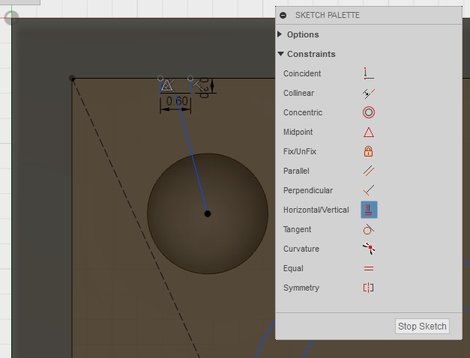
22. Click Sketch and Trim or click T on the keyboard. Click on the horizontal lines within the two circles so you are just left with the sets of lines on both sides of the circle.
23. Using the Line tool draw three connected lines on the edge like shown. Using the sketch dimension tool click on the horizontal line and make this measurement 0.6mm. Then click on one of the side lines and make this measurement 0.3mm.
24. Draw a line from the centre of the horizontal line to the centre of the circle.
25. In the Sketch Palette click on Horizontal/Vertical and then click on the line you have just drew.

Slide 10
26. Repeat steps 23-25 on the left side.
27. Click Sketch and Rectangular Pattern. Select on all three lines on the left hand side and click on the blue arrow shown in the picture. In the menu box find the 2nd Quantity and type in 4 and in the 2nd Distance box type in -8mm and click ok.
28. Click Sketch and Line, draw a vertical line from top to bottom in the middle. Right click and select Normal/ Construction.

Slide 11
29. Click on Sketch and Mirror and then click on the three connected lines at the top. Then click on the centre construction line as the mirror line and then click ok.
30. Click on Sketch and Mirror. In the Mirror menu you need to select the objects that are going to be mirrored, these are all the connected lines we have been working on. To make it easier to select them you can drag a box around them individually to select them. Select the mirror line as the centre construction line and click ok.
31. Click stop sketch.

Slide 12
32. Click on Create and Extrude or you can click E on your keyboard. Click on the 3 circles like shown below and then click on the small rectangle areas also shown below.
Then in the Extrude menu change the Extent to To Object and click on the outer rectangle. This area appears a lighter grey when the cursor is hovered over it.
33. Click on Extend Faces and click ok.
34. If you drag your view cube around you can see your Lego brick from all different angles.

Slide 13
35. In the Browser click on the arrow next to Sketches and click on the lightbulb next to Sketch 3. This will turn the last sketch you were working on.
36. Click Create and Extrude, select the two sections either side of the middle circle (shown in red) and in the distance box type in 7mm and click ok.
37. Turn off the sketch by click the lightbulb again.
38. You are now going to create the Lego words that go on each cylinder on the top of each Lego Brick. Click on Sketch and Text. Click on one of the top faces of the cylinders.

Slide 14
39. Click somewhere in the circle and type in LEGO in capital letters. In the Height box type in 2.3mm, in the Angle box type in 180 deg, change the Font to Agency FB and click the bold button. If you need to move the text to make it central in the circle then you can do using the blue circle shown in the picture.
40. Click on the text, then Right click and select explode text. This will make the text into an outline.
The Click ok.
41. Click Create and then Extrude, select all the letters and enter 0.1mm in the distance box then click ok.

Slide 15
42. Click on Create, Pattern and Rectangular Pattern. In the menu change Pattern type to features, click on the extrusion located in the timeline at the bottom (the extrusion is the last picture in the timeline).
44. Click Save.
43. For the directions select the vertical line on the left and the horizontal line at the bottom (both highlighted in blue in the picture). Change Distance Type to Spacing. In the 1st Quantity box type in 4, in the 1st Distance box type in 8mm, in the 2nd Quantity box type in 2, in the 2nd Distance box type in 8mm. Finally check that the preview of the rectangular pattern is correct. If it is Click ok, if it isn’t check with your teacher.
45. Click on Model and select Render.

Slide 16
46. Click on the Appearance option.
47. Click on the Plastic folder to open it up, then open the Opaque folder and find a Plastic – Glossy appearance in a colour of your choice. Click and drag the appearance onto the Lego Block.
48. Click on Render and then click on Model so we go back to the Model environment. Click on Modify and Physical Material.
Open up the Plastic folder and drag ABS Plastic onto the model. Click close at the bottom of the Physical Material menu window.

Slide 17
