Slide 1
Fusion 360 Lamp Tutorial

Slide 2
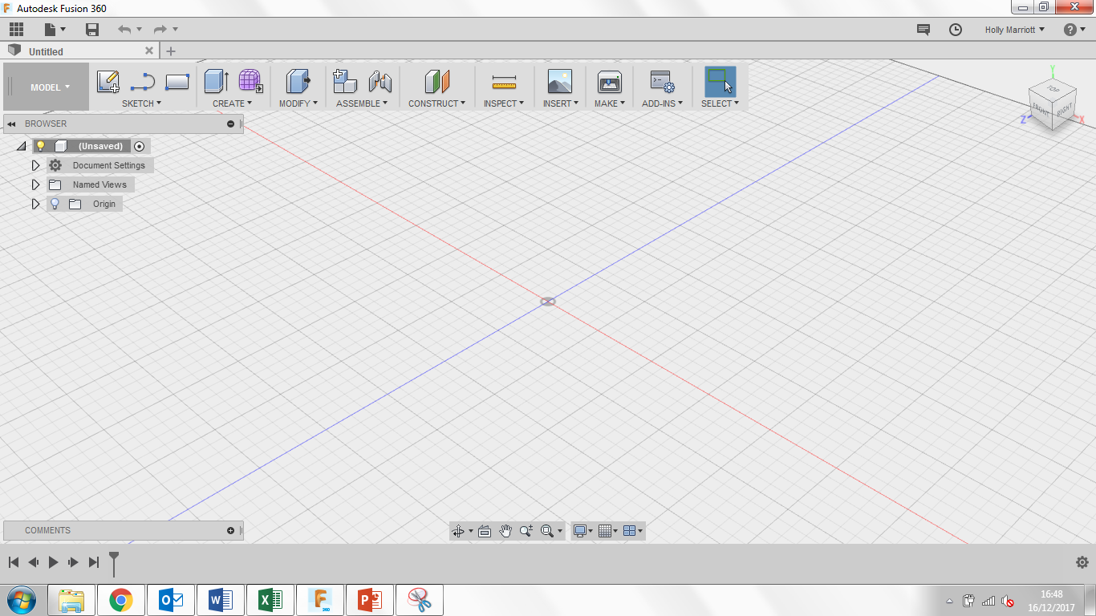
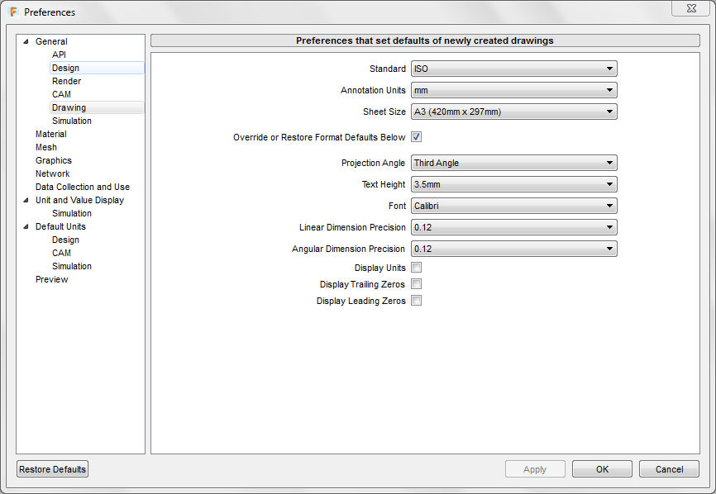
Welcome to Fusion 360, lets just quickly take a tour around the workspace.
Top left are your general options, you can find any work you have saved previously under top left icon. You can create a new document, save and when you’re working on a model, undo/redo any steps.
Top right you can find notifications and messages from users/admin as well as find your account details.
If you select your name you can also see the preferences for the program where you can customise the program to your personal style.
If you select preferences, the following box will open, select the drawing tab and change the following settings to they replicate the settings in the picture.

Slide 3
1. Click Create and then New Component. Rename from Component to Base and click ok.
3. Click on sketch, then circle and finally Center Diameter Circle. From the origin point create a circle with a diameter of 150mm.
2. Click Sketch and then Create Sketch. 3 orange squares will appear, these are the planes that we can draw on. When you hover over the planes they will turn a light grey cover. Click on the plane in-between the blue and red axis’.
4. Click on Create and then Extrude or E on your keyboard. An Extrude menu box will appear. For the Profile click on the circle you have just created and for the Distance type in 50mm. Click ok.

Slide 4
5. Click Modify and then Draft. A Draft menu window will appear. For the plane option click on the plane between the green and red axis’.
6. For the Faces option click on the top face of the cylinder.
8. In the Browser Menu, right click on Document Settings and click New Component. Change the name from Component2 to Neck.
7. For the Angle option type in 15deg and click ok.

Slide 5
9. Click Sketch and Create Sketch. Select the plane in-between the blue and green axis’.
10. Click Sketch and Line or L on your keyboard. Draw a line that is 120mm long and 15deg. This line put be on the top surface of the cylinder.
11. Draw a vertical line straight up from the end of the line you have just drew. It needs a measurement of 250mm.
12. From the end of the vertical line, draw a line that has is 120mm long and has a 165deg.

Slide 6
13. Click on sketch and Offset or O on your keyboard. An Offset menu box will appear. Click on the line you have just drew and in the Offset Position text box type in -5mm. Click ok.
14. Using the Line tool or L on your keyboard connect the lines you have drawn with the lines created by the Offset tool. Do this at the top and bottom. You may need to zoom in to see it more closely.
When you have connect both the area inside will turn a yellow/orange colour.

Slide 7
16. Click Assemble and then As-built Joint. A menu box will appear. For the components option click on the neck, it should turn a light blue colour, then click on the base, It should shake a little, this will show a preview of the joint. Leave the Joint Type as rigid and click ok.
15. Click on Create and Extrude or E on your keyboard. An Extrude menu box will appear. For the Profile click the shape you have just created (the profile shown in blue in the picture). Change Direction to Symmetric and in the Distance box type in 35mm. Click ok.
17. Click on the blue section highlighted on the view cube so that we can see the underneath of the neck.

Slide 8
19. Click sketch and Create Sketch. Click on the underneath rectangle of the neck component.
18. Right click on Document settings and click New Component. Rename it as shade.
20. Click Create Form – the purple cube like picture. A window will appear, click ok. You will now enter the Sculpt Environment. Your toolbar will look slightly different.
21. Click Create and then Cylinder. Click once on the underneath rectangle of the neck component that you made a new sketch on. Find the centre of the rectangle and click to start the centre point of the cylinder. Drag out and enter 100mm in the measurement text box. Click enter on your keyboard.

Slide 9
22. Click on Modify and then Edit Form. An Edit Form menu box will appear.
Double click on one of the top edge segments until the whole top edge turns yellow. Click on the centre circle highlighted in blue in the picture.
23. Drag inwards until the top edge looks something like the one in the picture.
Double click on one of the bottom edge segments until the whole bottom edge turns yellow. Click on the centre circle.
Drag outwards until the bottom edge looks something like the one in the picture. Click ok.

Slide 10
25. Now that you are back in the Model environment right click on the light shade and click Thicken. A Thicken menu window will appear. Type in 1mm in the thickness text box and click ok.
24. Click Finish Form at the end of the toolbar.
26. Click Assemble and then As-built Joint. A menu box will appear. For the components option click on the shade, it should turn a light blue colour, then click on the neck, It should shake a little, this will show a preview of the joint. Leave the Joint Type as rigid and click ok.
27. Right click on Document settings and click New Component. Rename it as Wire

Slide 11
28. Click Sketch and Create Sketch. 3 Orange squares will appear. Click on the square in-between the blue and red axis’. It will then change the view.
29. Click on Sketch, Circle and Center Diameter Circle or C on your keyboard. On the green centre line draw a 10mm circle behind the lamp you have created so far. Click Stop Sketch
30. Click Sketch and then Spline, 3 planes will appear, click on the plane in-between the blue and green axis’.
31. Find the centre/midpoint of the top of the neck component. Click once to start the spline, then create a spline like the one shown in the picture. It is important to connect the last point to the circle you just created.

Slide 12
32. From this view you can edit your spline if you wish by moving any of the black dots slightly until you are happy with your spline.
33. Once you are happy with your spline, click Stop Sketch.
Click Create and Sweep.
0
34. A Sweep window will appear. For the Profile option click on the circle drawn in step 29. For the Path option click on the spline you created. It will then give you a preview of the extrusion. Click ok.

Slide 13
35. Click on the home button on the view cube.
36. Click on Assemble and then As-built Joint. Click on the wire and then the neck and finally click ok.
37. In the Browser menu click the white circle next to Unsaved to Activate the component. This will now show all of the product.
39. Open the Glass folder, find the glass material and drag it onto the lamp shade.
38. Right click and the marking menu will appear, select Physical Materials

Slide 14
40. Open the Metal folder and drag Aluminium onto the neck component.
41. Open the Wood folder, find Pine and drag this onto the Base component.
43. Open the Glass folder, open the Smooth folder and select a Glass option. You can choose a colour of your choice. Drag it onto the lamp shade.
42. Click Model and select the Render environment.
Click the Appearance button.

Slide 15
44. Open the Leather and Cloth folder, open the Cloth folder and select a Fabric option. You can choose a colour of your choice. Drag it onto the wire.
45. Open the Metal folder, open the Aluminium folder and select an Aluminium option. You can choose a colour of your choice. Drag it onto the neck.
46. Open the Wood folder, open the Finished folder and select an Pine option. You can choose a finish of your choice. Drag it onto the base. Click close.

Slide 16
48. Click Modify and click Fillet or F on your keyboard. A Fillet menu window will appear. Click on the top edge of the base, type in 3mm in the Radius text box. Click ok.
47. Click Render and select Model.
49. Click save and give it a suitable name and save it in a suitable location within your data panel. You have now completed the Lamp tutorial.

