Slide 1
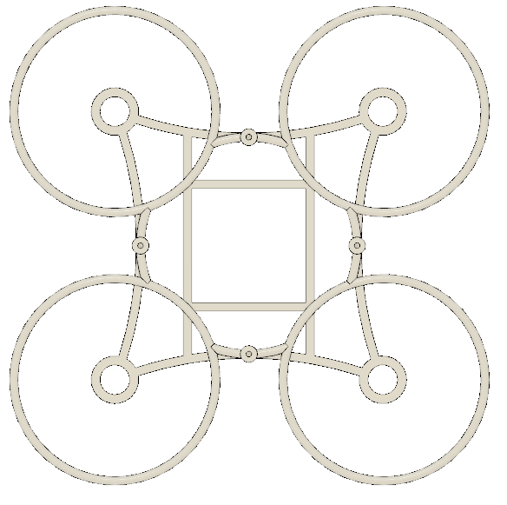
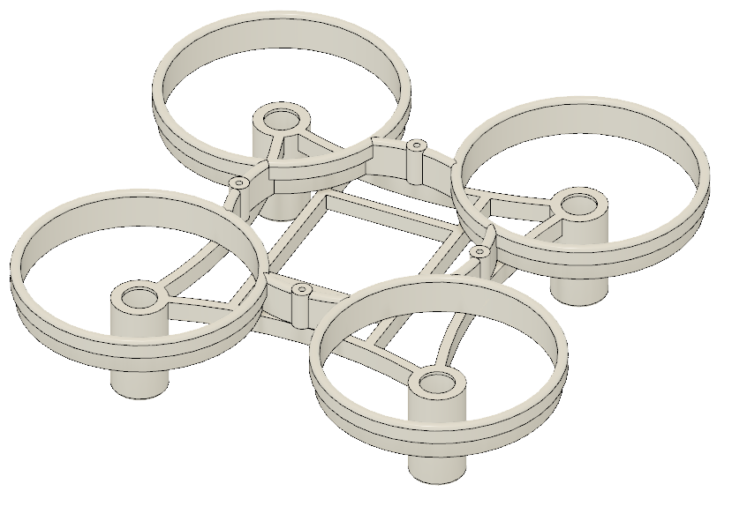
Fusion 360 Airgineers Drone Tutorial

Slide 2
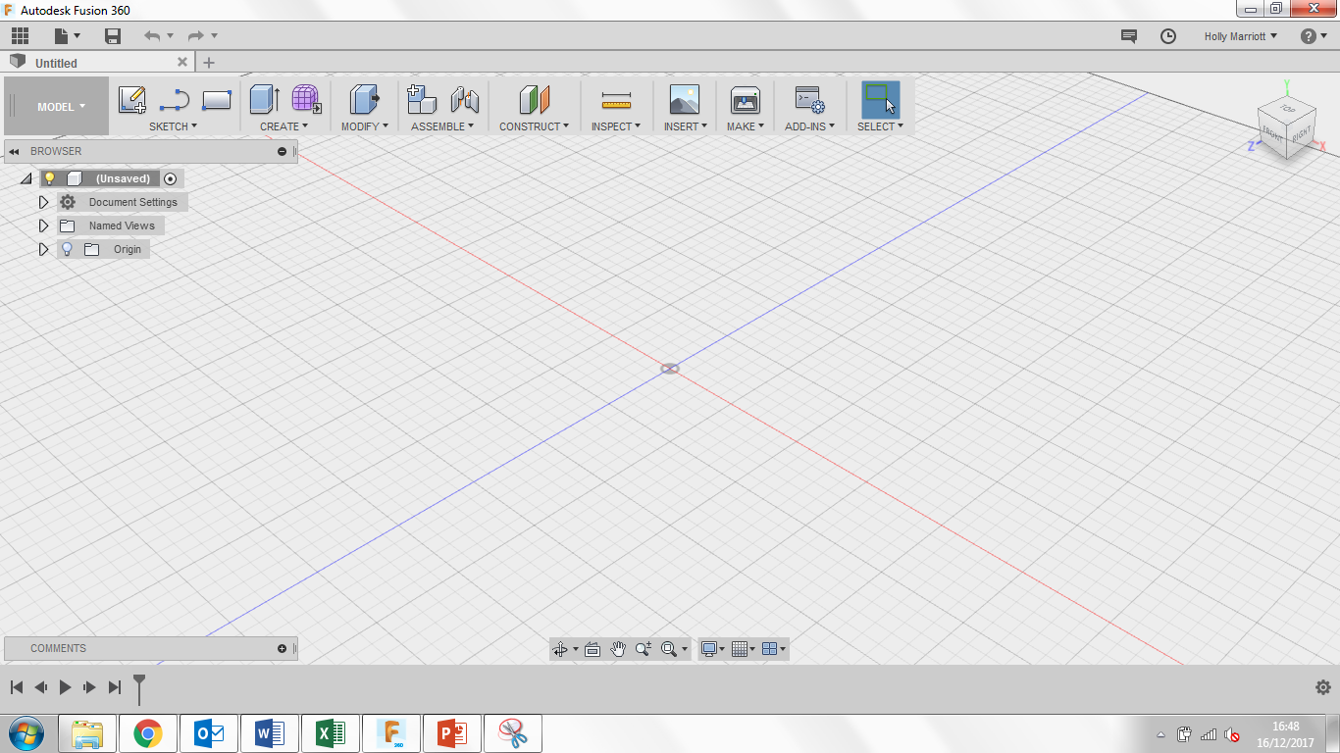
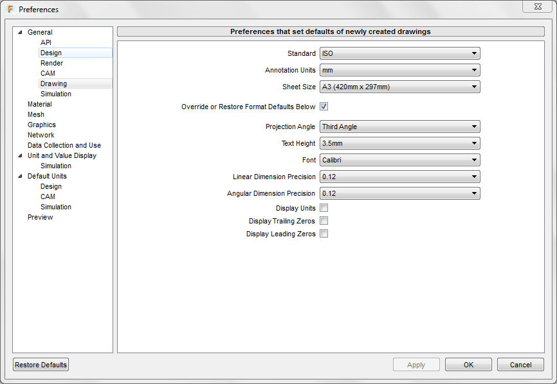
Welcome to Fusion 360, lets just quickly take a tour around the workspace.
Top left are your general options, you can find any work you have saved previously under top left icon. You can create a new document, save and when you’re working on a model, undo/redo any steps.
Top right you can find notifications and messages from users/admin as well as find your account details.
If you select your name you can also see the preferences for the program where you can customise the program to your personal style.
If you select preferences, the following box will open, select the drawing tab and change the following settings to they replicate the settings in the picture.

Slide 3
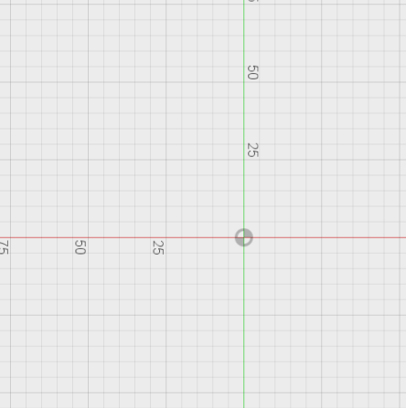
3. Click Create and then New Component. A small menu box should appear. Change the component name to Chassis. Click ok.
1. Lets get started, create a new design. You can do this either two ways. You can click on File and then New Design or you can click on the + symbol.
2. Save your new design straight away. Give is a suitable name and save it in a location suggested by your teacher.
4. Click Sketch and then Create Sketch. 3 orange squares will appear, these are the planes that we can draw on. Click on the plane between the blue and red axis, it will turn grey when your mouse is over it. When you click on the plane, the view will change to a birds eye view of the work space.

Slide 4
5. Click on Sketch, Rectangle and then Center Rectangle. From the origin point draw a square measuring 47mm by 47mm.
6. Select the square that you have just drawn by dragging a box around it so it selects all of it.
7. Click the construction icon located in your sketch palette. This will change your square from full lines to dashed lines.
8. Click Sketch, then Circle and finally Center Diameter Circle. Draw 3 circles from the top left corner of the square you created earlier. One circle measuring 5.2mm, the second circle measuring 6.4mm and the last circle measuring 8.4mm.

Slide 5
9. Click Create and then Extrude. Click the space in-between the 2nd circle and the outer circle as shown in the picture.
10. In the distance text box type in -15.5mm and click ok.
11. Click on the arrow to the left of the word Chassis. This will open up the Chassis folder.
12. Click on the arrow to the left of the word Sketches.
13. Click on the lightbulb to the left of Sketch1. This will show Sketch1.

Slide 6
14. Click on Create and the Extrude. Click on the inner circle as shown in the picture.
15. In the distance box type in -0.5mm and click ok.
17. Click on the bottom edge. This edge will then turn blue. Type in 0.5mm in the Radius box and click ok.
16. Click on Modify and then Fillet.

Slide 7
19. Change Pattern type to Bodies. Then click on the Motor Mounting that you have created so it turns blue.
18. Click on Create, then Pattern and finally Circular Pattern. A menu window will appear.
20. Click on Axis and then click on the green axis line. It will then show a preview of the circular pattern.
21. In the Quantity box, type in 4 and click ok.

Slide 8
22. Click on Sketch and then Create Sketch.
23. Three planes will appear. Click on the orange plane in between the blue and red axis’.
24. Click Sketch and Line.
26. Click on the line you have just drew and click on the construction icon located in the sketch palette.
25. Draw a line from the centre origin point measuring 19mm.
27. Click on Sketch, Arc and then 3-Point Arc.

Slide 9
29. Click on Sketch and then Offset. Click on the arc you have just created.
28. Click on the top left corner of the square to start the arc. Then click on the bottom left corner of the square to mark the end point of the arc. Finally click on the end of the construction line you have just made.
1
3
30. Type in 0.75mm in the offset position and click ok.
Click Sketch and offset again. Click on the original arc you made, type in 0.75mm again but make sure you click the flip icon so you have an offset line on both sides of the original arc.
2

Slide 10
31. Click Sketch, then Project/Include and finally Project.
Click on the outer circle of the top left motor mounting and the outer circle of the bottom left motor mounting.
Finally click ok.
32. Click Create and then Extrude.
Click on the 2 arc areas.
In the distance box type in -3mm.
Click ok.
It should put a purple line around both selected circles.

Slide 11
33. Click on Create, Pattern and then Circular Pattern.
34. Change the pattern type to Features.
Then click on the last icon on the timeline located at the bottom.
35. Click on select Axis and click on the green dashed line. It should give you a preview of the pattern.
37. Click Modify and then Combine.
36. Change the quantity to 4 and click ok.

Slide 12
38. Click on the motor mounting at the top for the target body.
41. Click on Sketch and then Create Sketch.
40. Click the lightbulb to the left of sketch1.
39. Click on the other 3 parts for the tool bodies. Click ok.
42. Three planes will appear. Click on the orange plane in between the blue and red axis’.
43. Click on sketch, rectangle and then center rectangle.

Slide 13
44. From the centre origin point draw a rectangle measuring 20mm wide and 40mm long.
46. Click sketch, click project/include and finally click project.
47. Click the inner arc line at the top and bottom.
These two lines will turn purple. Click ok.
45. Click sketch and offset. Click on the rectangle you have just created. In the offset position box type in 1.50mm. Make sure the red offset line is on the outside of the blue original rectangle before clicking ok.
48. Click Create and then Extrude.

Slide 14
49. Click on the 2 blue highlighted lengths.
50. In the distance box type in -3mm and then click ok.
53. Click on orange square in between the blue and green axis’. Click ok.
51. Underneath Chassis is Origin. Click the lightbulb to the left of Origin to turn it on.
52. Click on Inspect and then section analysis.

Slide 15
55. Click on Sketch and then Create Sketch.
54. Click the lightbulb next to Origin to turn the workplanes off.
56. Click on face that is pointed to.
57. Click on sketch, then rectangle and finally 2 point rectangle. Draw a rectangle measuring 1.5mm wide and 2.5mm high. Ensure that the top line of the rectangle lines up with the top of the drone chassis.
58. Click on Sketch and then Sketch Dimension.

Slide 16
59. Firstly click on the centre origin point and then click on the left line of your rectangle. Drag your cursor upwards. In the box type in 10mm and click enter on your keyboard.
62. Click the lightbulb next to the work analysis to turn off the section analysis. You will now be able to see all of your drone so far.
60. Click Create and then Extrude.
61. Click on the rectangle you have just drawn and in the distance box type in 20mm and click ok.

Slide 17
63. Click Create and then mirror. A menu box will appear.
Change pattern type to Features.
Click on the last icon on the timeline at the bottom.
65. Click the lightbulb next to Sketch1 to turn the sketch on.
66. Click on Sketch and Create Sketch.
64. Select the plane in between the red and green axis’. Click ok.
67. Click on orange square in between the green and he red axis’.

Slide 18
68. Click on Sketch, then Rectangle and finally 2-Point Rectangle.
69. Draw a rectangle above your drone so that the rectangle measures 6mm high and 1.5mm wide.
72. Click on the origin point and then click on left side of the 1st rectangle your drew. Drag your cursor upwards and type in 17mm to move your rectangles.
70. Draw another rectangle so that it measures 3mm high and 0.75mm wide.
Make sure your rectangles look exactly like the picture above.
71. Click on Sketch and then Sketch Dimension.

Slide 19
76. Click on axis and then click on the green axis line you can see coming from the centre origin point.
73. Click Stop Sketch.
74. Click Create and then Revolve.
77. Change Operation to New Body and click ok.
78. Right click on the Propeller housing you have just created and click Move/Copy.
75. Click on the area highlighted in blue for the profile you are going to revolve.

Slide 20
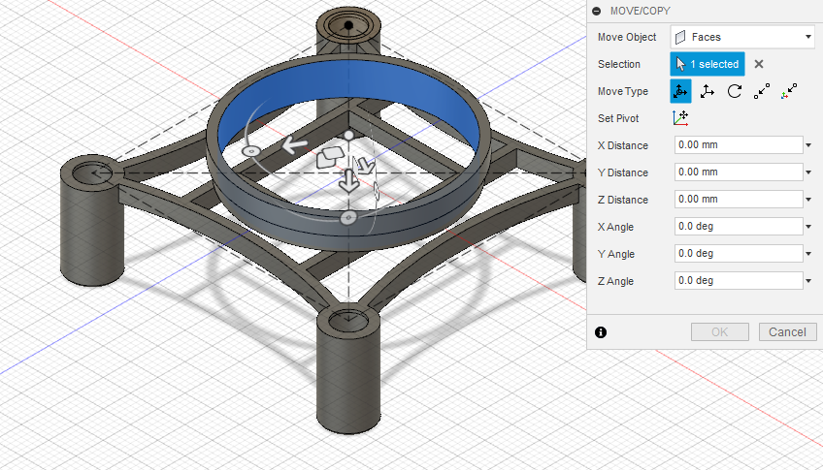
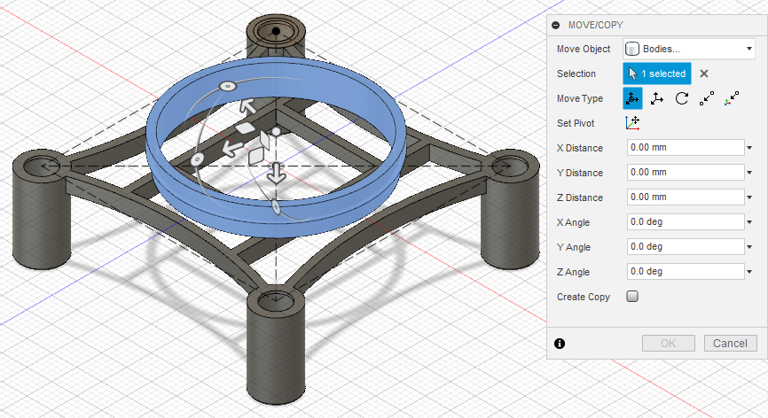
79. Change the move object to bodies and then click on the propeller housing you have just made.
80. Click on Point to Point
2
81. Click on the centre origin point. See number 1 in the picture.
82. Click on the centre point of the top motor housing. See number 2 in the picture.
83. Make sure your drone chassis looks like the one in the picture before clicking ok.
1

Slide 21
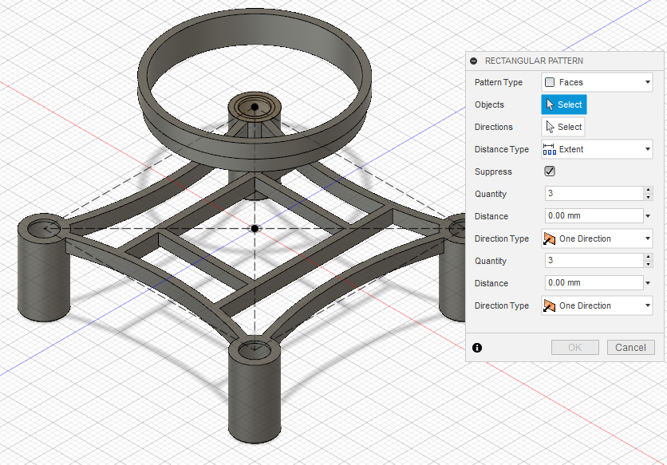
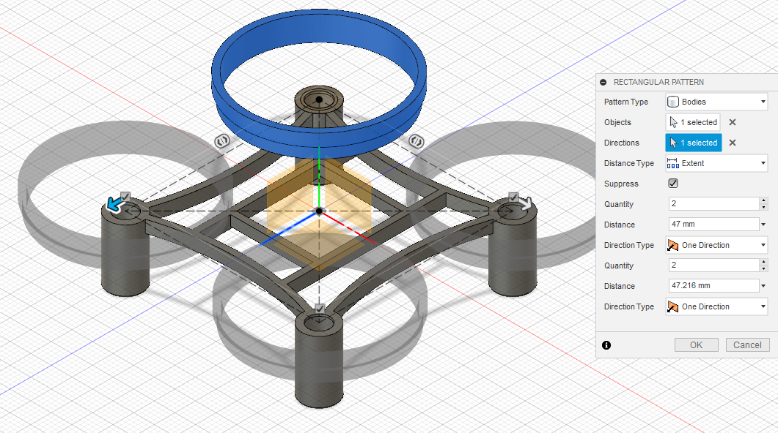
85. Change Pattern Type from Faces to Bodies.
86. Click on the propeller housing.
87. Click on Directions and then click on the blue axis.
88. Change both Quantity boxes to 2.
89. Change both Distance boxes to 47mm. Click ok.
84. Click on Create, then Pattern and Rectangular Pattern.
90. Click Save.

Slide 22
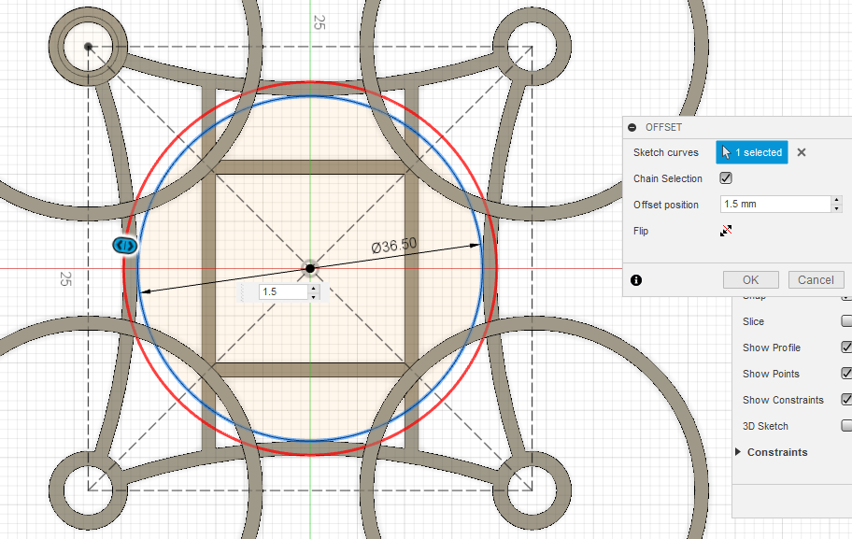
94. Draw a circle from the centre origin point measuring 36.5mm.
91. Click on Sketch and Create Sketch.
92. Click on orange square in between the blue and red axis’.
95. Click on Sketch and then offset. Click on the circle drawn in step 94. Type in the offset position box 1.5mm. Make sure the red circle is on the outside of the blue circle. Click ok.
93. Click on Sketch, circle and then Center Diameter Circle.

Slide 23
97. Click on the 4 inside circles shown in bold. Click Ok.
96. Click on Sketch, Project/Include and then Project.

Slide 24
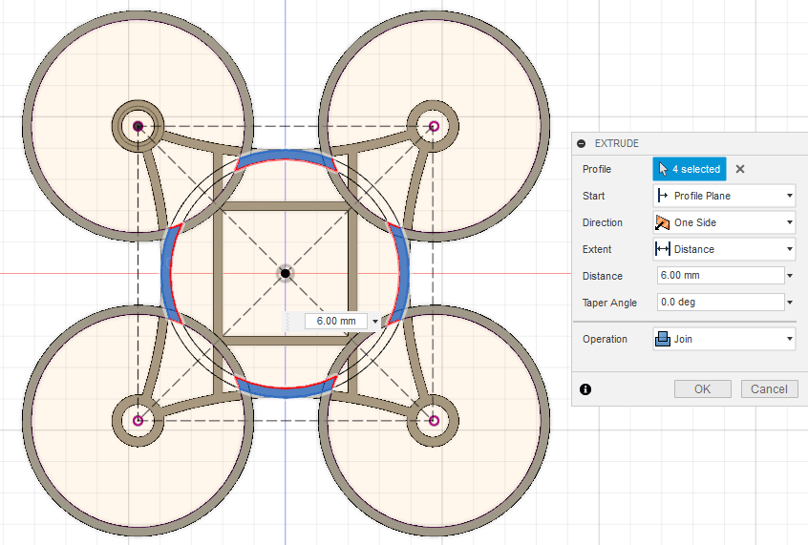
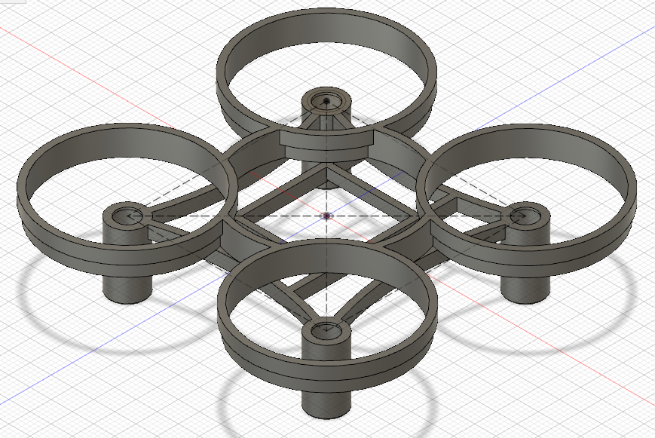
98. Click Create and then Extrude.
99. Click on the 4 blue parts shown in the picture.
100. In the distance box type in 6mm.
101. Change Operation from Cut to Join. Click ok.
102. Click Modify and then Rule Fillet.
103. Click on the top surface of the drone chassis (blue highlighted part in the picture).
104. Type in the radius box 0.75mm and click ok.

Slide 25
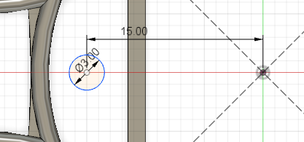
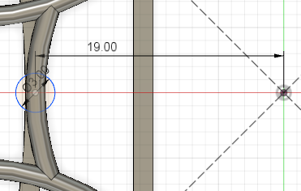
105. Click on Sketch and Create Sketch.
108. Draw a circle measuring 3mm. Make sure its on the red axis line and to the left of the origin point.
106. Click on orange square in between the blue and red axis’.
109. Using the sketch dimension tool (Sketch, Sketch Dimension).
Click on the origin point and then the centre of the circle.
Drag the dimension up and type in 19mm.
107. Click on Sketch, circle and then Center Diameter Circle.

Slide 26
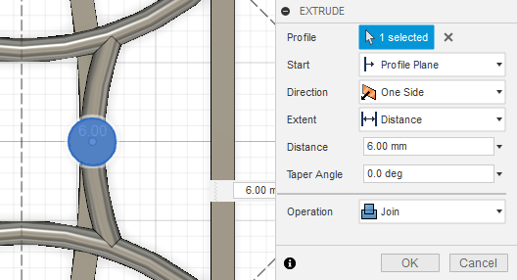
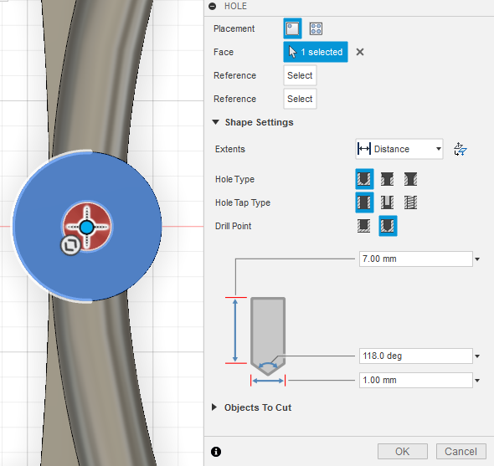
110. Click Create and then Extrude.
111. Select the circle you have just created
Type in 6mm in the distance box.
Change the Operation from Cut to Join.
Click ok.
113. Click on the circle that you have just extruded.
Move the red circle so it snaps to the centre of the clue circle.
Change the height of the hole to 7mm and click ok.
112. Click Create and then Hole.

Slide 27
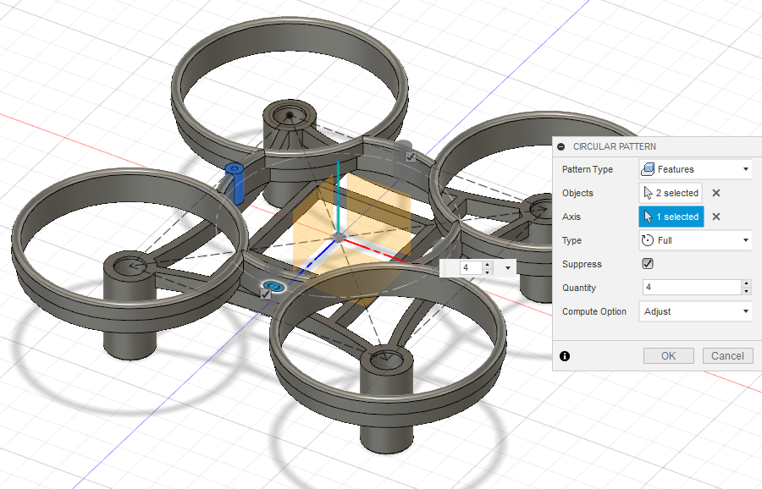
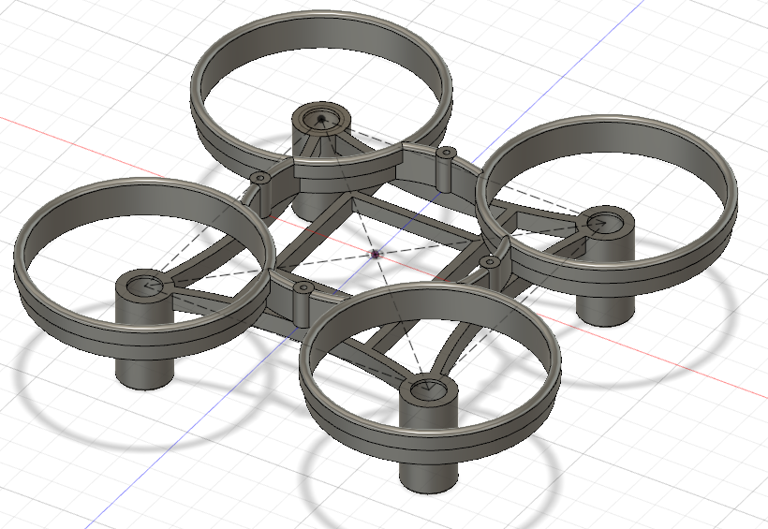
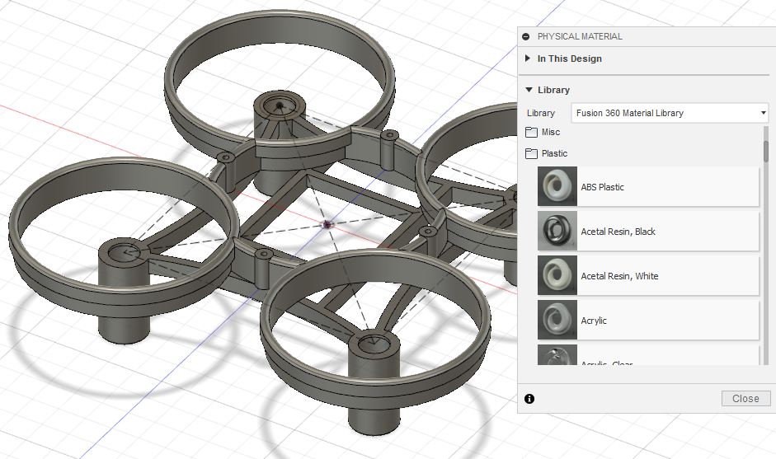
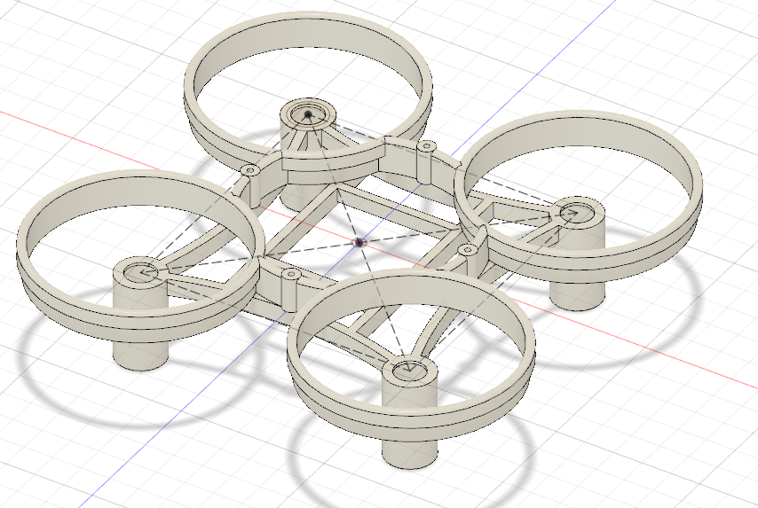
114. Click on Create, Pattern and then Circular Pattern.
115. Make sure the Pattern type is Features.
Click on the last 2 icons on the timeline located at the bottom of the screen.
Select axis and click on the green axis line.
Type 4 in the quantity box.
Make sure your drone chassis looks like the picture on the right before clicking ok.
117. Open up the plastic folder by clicking on the little folder icon.
Drag the ABS Plastic icon onto you drone chassis.
116. Click on Modify and then Physical Material.

Slide 28
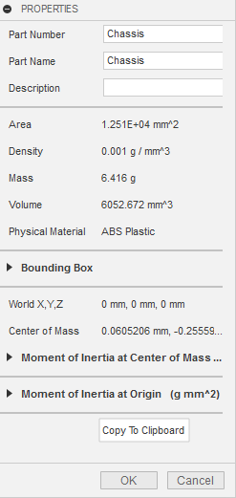
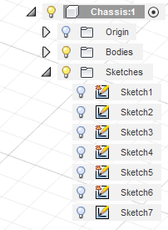
118. Turn Sketch 1 off by clicking the lightbulb.
119. Right click on Chassis and click on Properties.
120. A box will appear showing information about your Drone Chassis.
The piece of information you need to keep checking is the mass.
You now need to edit your drone chassis to lower the overall mass. Your aim is to get the mass around 4 grams.
You must think:
Do you make your drone as light as possible but will it be too light it cant be controlled easily?
OR
Do you keep your drone slightly heavier so it is easier to control when flying?

