Slide 1
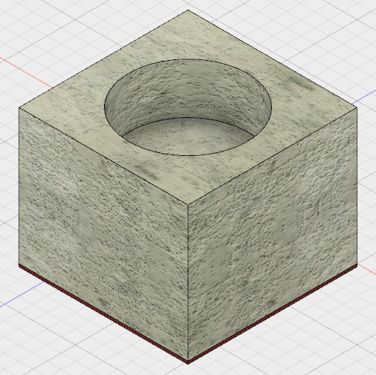
Fusion 360 Concrete Tea light Holder Tutorial

Slide 2
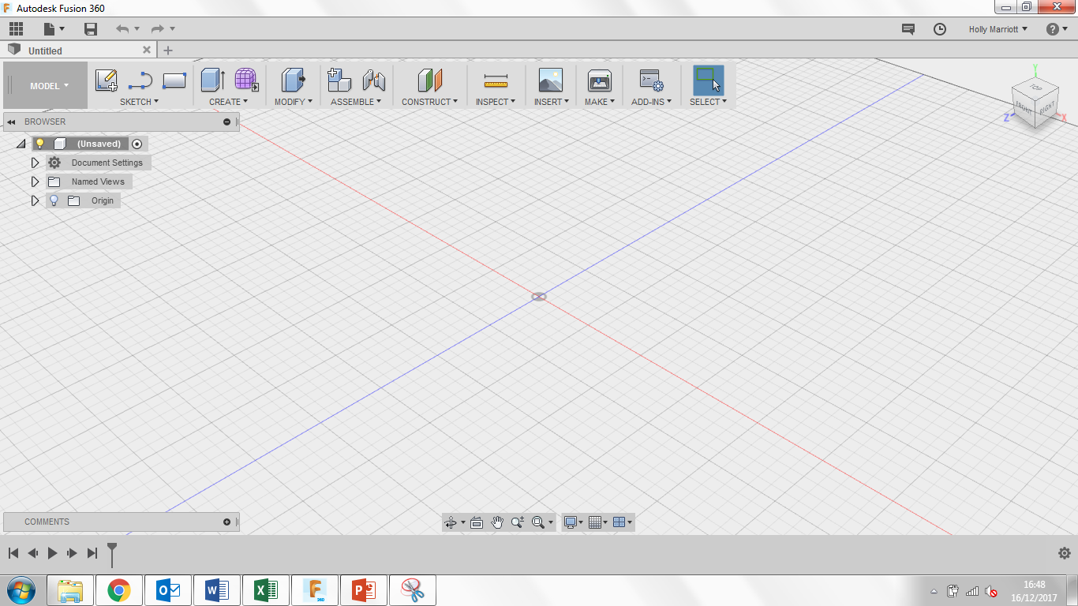
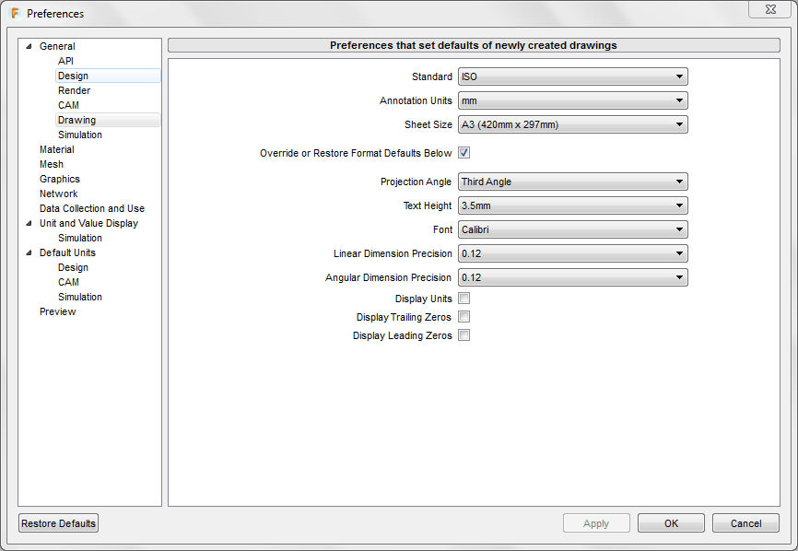
Welcome to Fusion 360, lets just quickly take a tour around the workspace.
Top left are your general options, you can find any work you have saved previously under top left icon. You can create a new document, save and when you’re working on a model, undo/redo any steps.
Top right you can find notifications and messages from users/admin as well as find your account details.
If you select your name you can also see the preferences for the program where you can customise the program to your personal style.
If you select preferences, the following box will open, select the drawing tab and change the following settings to they replicate the settings in the picture.

Slide 3
1. Lets get started, we’re going to begin by making the felt part of our concrete tea light holder.
First of all click Sketch and then Create Sketch. 3 orange squares will appear, these are the planes that we can draw on.
2. You will have 3 planes to draw on, depending on your design each one will provide a use, for now we’re going to select the plane between the blue and red axis, it will turn grey when your mouse is over it.
3. When you click on the plane, the view will change to a birds eye view of the work space.
4. Select sketch again, then rectangle and then finally center rectangle
Click on the middle circle where the red and green lines cross and drag your mouse away from the centre.

Slide 4
5. Draw out a rectangle that is 60mmx60mm, you can use the mouse to do this or you can manually type in the measurements.
6. You can modify dimensions at any time, this can be done by going to sketch, then sketch dimension (2nd option from the bottom) you can click on a side of your shape, drag a dimension bar away from the edge and then click the mouse again, this should allow you to type in a new dimension.
7. We’re going to make our shape 3d by extruding it. Click create and then extrude, the camera will change to the original view.
8. Hover your mouse over the square, it should turn blue, this means it can be manipulated in some way. Click on it and the box should appear, you can add material thickness by either typing in the thickness or dragging the blue arrow up and down. For now just type in 2.

Slide 5
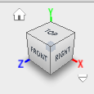
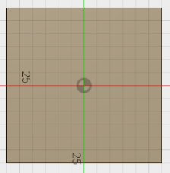
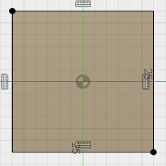
9. On the top right you have the view cube, you can change the view you see at any point by using this. You can return to its original view by clicking on the home icon.
10. This is what you should have.
11. Click on Sketch and create sketch and then click on the top face of the shape we have just created. It should highlight a lighter shade of grey.
12. Once clicked it should take you to the following view. Then click on the 3rd icon on the sketch toolbar and draw a square exactly the same size as before.

Slide 6
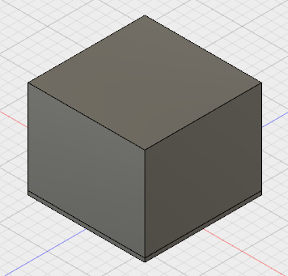
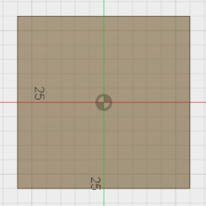
13. We’re going to make our shape 3d by extruding it. Click create and then extrude, the camera will change to the original view.
14. Hover your mouse over the square, it should turn blue, this means it can be manipulated in some way. Click on it and the box should appear, you can add material thickness by either typing in the thickness or dragging the blue arrow up and down. For now just type in 48. Finally change the operation to New Body.
15. You should now have the following:
16. Click on Sketch and create sketch and then click on the top face of the shape we have just created. It should highlight a lighter shade of grey.

Slide 7
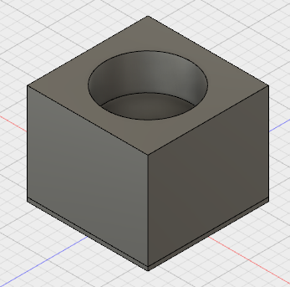
17. Click on Sketch, Circle, then Centre Diameter Circle and draw a circle from the middle of the square. Your circle needs a diameter of 42mm.
19. You have now made a CAD (Computer Aided Design) version of the Concrete Tea Light Holder you made.
20. We are now going to render it. Click on the model tab and find Render. This will take you to a new window.
18. Now click on Create, then Extrude. Click on the circle you have just drawn and type in the dimension box -18mm. Notice that this changes the operation type to cut because we are removing material.
21. We can select a wide range of materials to finishes to make our designs look more realistic. Select appearance on the setup icons. The appearance toolbar should appear.

Slide 8
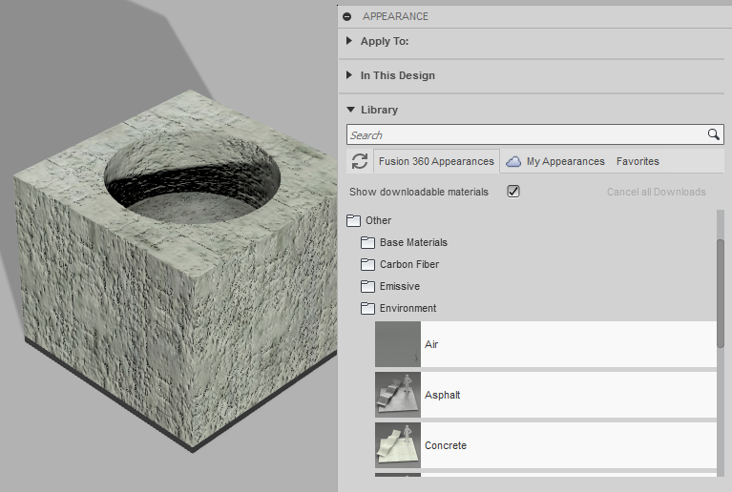
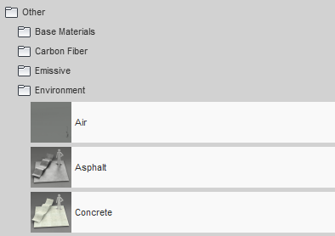
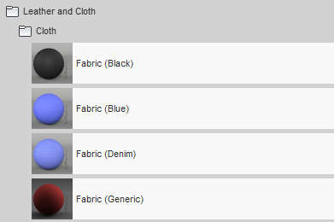
22. On the appearance box, press the + symbol to open it up and then under library find the other folder. Under the other folder, select environment and then find Concrete.
23. Once you have found Concrete left click and hold down and drag the material onto the main part of your concrete tea light holder. Release your mouse button and the model should to a concrete colour.
24. Under the Leather and Cloth folder find a fabric with a colour of your choice and drag and drop that onto the bottom part underneath the concrete.
25. Well Done you have completed this tutorial. Save your work into your online cloud area.

