Slide 1

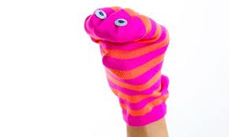

5 August, 2018
Analysing Skills
Starter
Complete a quick PMI analysis of
your tie using the mini white
board and pen.

Slide 2
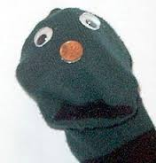

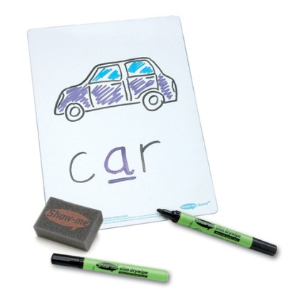
Starter
Plus
Minus
Interesting
You have
3 minutes
Be prepared to share your answers

Slide 3
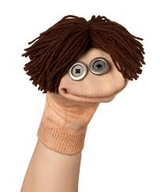

Learning Objectives
Lesson Objectives:
To demonstrate understanding of evaluating skills, through evaluation of a 20 minute make task.

Slide 4

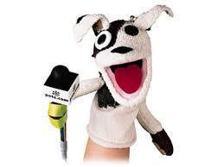
Learning Outcomes
Evaluate a textiles product using several techniques.
Apply design & making skills to textiles products.
Remember how to use different
types of evaluation
techniques.

Slide 5


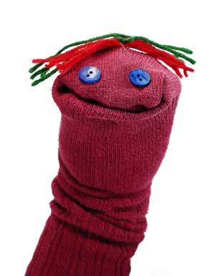


Design Brief:
Design and make a sock puppet that can be used to promote the social issue of 3-5 years olds starting school.
Specification for Sock Puppet:
Appeals to children aged 3-5 years.
Uses a range of materials.
Promotes a spiritual, moral, social or cultural issue.

Slide 6
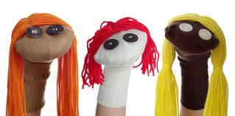
Social Issue – how to make friend when starting at a new school.
Your target audience is 3-5 year old children, which will be starting at a new
primary school. The puppet needs to help them make friends.
http://www.youtube.com/watch?v=1q_TuDxY5pI
2:20

Slide 7
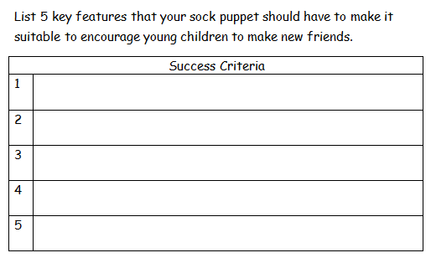

Slide 8
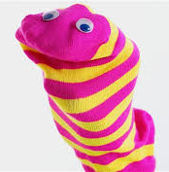
You need to produce your design ideas, look at the materials available and back in your book for ideas on the type of labels and annotation you need to add.
Idea 1 | Idea 2 | Idea 3
You have
15 minutes

Slide 9
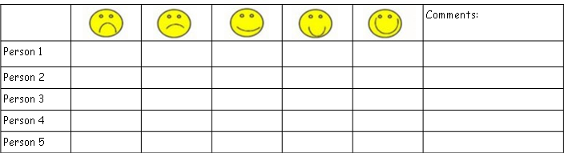
Ask 5 other students what their opinion of your chosen design idea is.
Explain how you will change your design.
You have
15 minutes

Slide 10
Evaluate a textiles product using several techniques.
Apply design & making skills to textiles products.
Remember how to use different
types of evaluation
techniques.

Slide 11
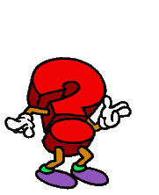
Who have you been today?
Teamworker?
Independent Enquirer?
Self Manager?
Effective Participator?
Creative Thinker?
Reflective Learner?
Plenary

