Slide 1
Course Objective:.
To learn how to navigate and use AutoCAD to build the foundations for 2D drawing.
@TrinityHighEng

Slide 2
Lesson1: Starter
In 1957, Dr Patrick Hanratty became the 'Father of CAD' by inventing a machine, controlled by numbers (CNC), that was able to draw a simple line.
1. What does CAD stand for?
2. What does CNC stand for?
@TrinityHighEng

Slide 3
Objectives
Be able to name the main features of the AutoCAD interface
Use the zoom, pan and select commands to interact with a given drawing.
@TrinityHighEng

Slide 4
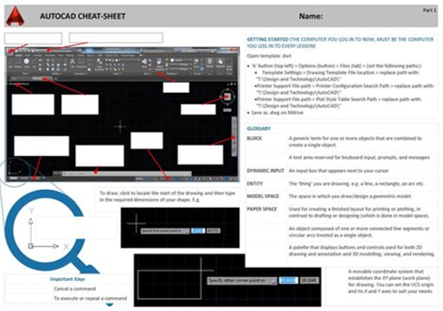
Task 1
Complete the Cheat Sheet, part 1.
@TrinityHighEng
Notes:
Explain 3 labels at a time – use recall – write them on the board – ask the students to label the three they have just learnt. Move on to the next 3.

Slide 5
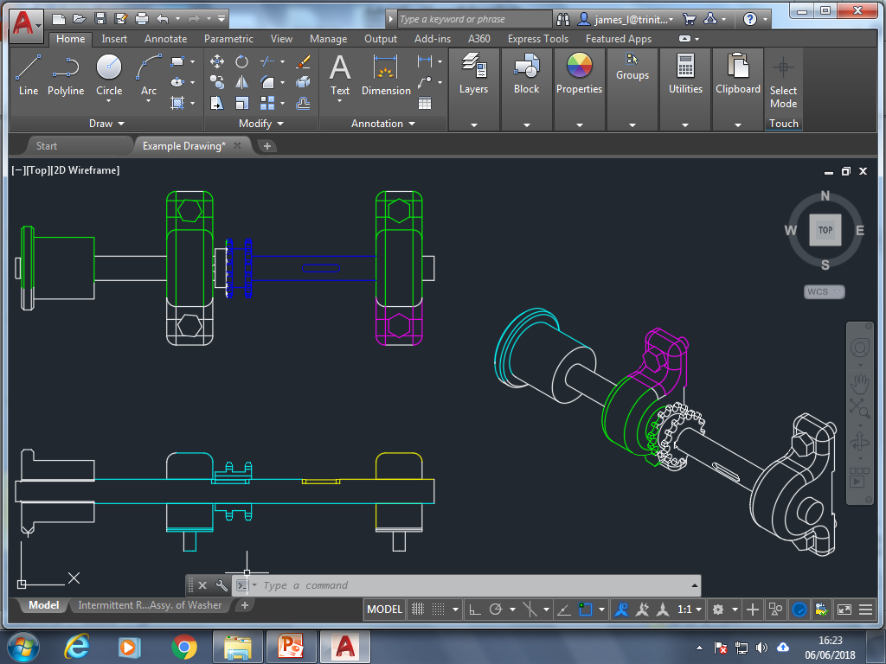
Task 2
Use the ‘select all’ and ‘select crossing’ tools to highlight parts of the drawing. Change the colours of your selected parts to result in a multi-coloured drawing.
@TrinityHighEng

Slide 6
Plenary
Name 3 parts of the AutoCAD interface.
Does ‘select crossing’ show as a blue or green shape?
If I want to select just the stepped line, would I move my mouse ‘left to right’ or ‘right to left’?
@TrinityHighEng

Slide 7
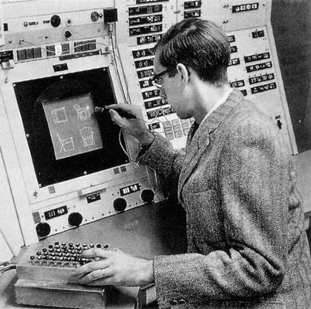
Lesson 2: Starter
5 years after Dr Patrick Hanratty's success, Ivan Sutherland invented Sketchpad.
This was the first computer program to allow human-computer interaction and enabled humans to draw simples lines and circles on a computer.
Sketchpad is the ancestor of modern CAD programs.
Task: Study the CAD Cheat Sheet
you created last lesson
@TrinityHighEng

Slide 8
Objectives
Know what the layer functions are for
Be able to manipulate the layers
Draw a simple shape
@TrinityHighEng

Slide 9
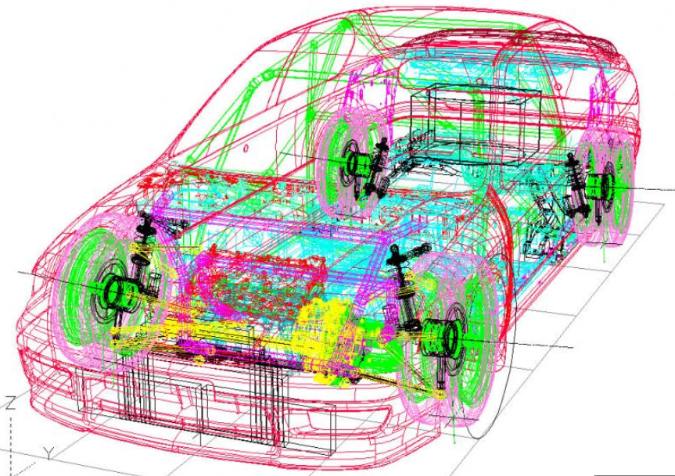
Why so many layers?

Slide 10
Task 1
Practise turning layers on and off to see the affects on the drawing
@TrinityHighEng

Slide 11
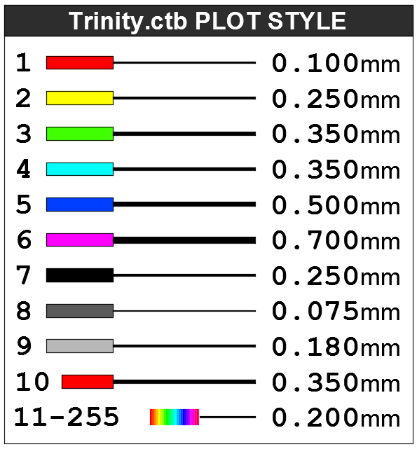
Task 2
Change the colours of the layers to be in line with the PLOT STYLE Table
PLOT STYLE The colours are code for the line thickness when printing.
@TrinityHighEng

Slide 12
Task 3
Use construction lines to add a rectangle to represent the LEDs on the front of the torch.
@TrinityHighEng

Slide 13
Plenary
Write down:
3 things you’ve done today
2 new skills that you have learnt today
1 reason why learning these skills is important
@TrinityHighEng

Slide 14
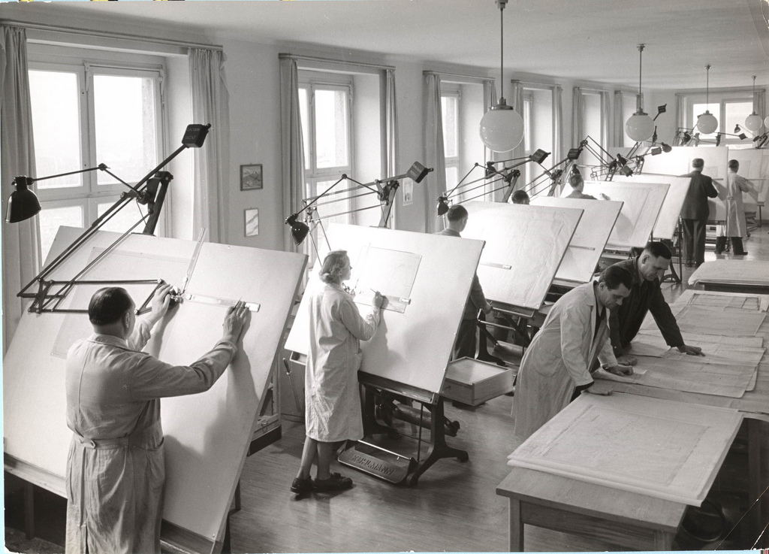
Lesson 3: Starter
Did you know, before the development of CAD programmes in the 1980's, design engineers used to work in drafting offices like this...
@TrinityHighEng

Slide 15
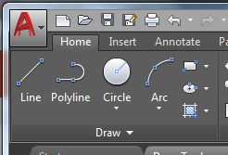
Objectives
To learn AutoCAD shortcuts
To learn how to use the ‘Draw’ tools
@TrinityHighEng

Slide 16
Task 1
Fill in the missing blanks – use AutoCAD’s command line to help you work out the Multi-Key Commands
Hint: Start typing the word in the command line and the shortcut will appear (ensure F12 is on),
e.g. Copy's shortcut is CO.
@TrinityHighEng

Slide 17
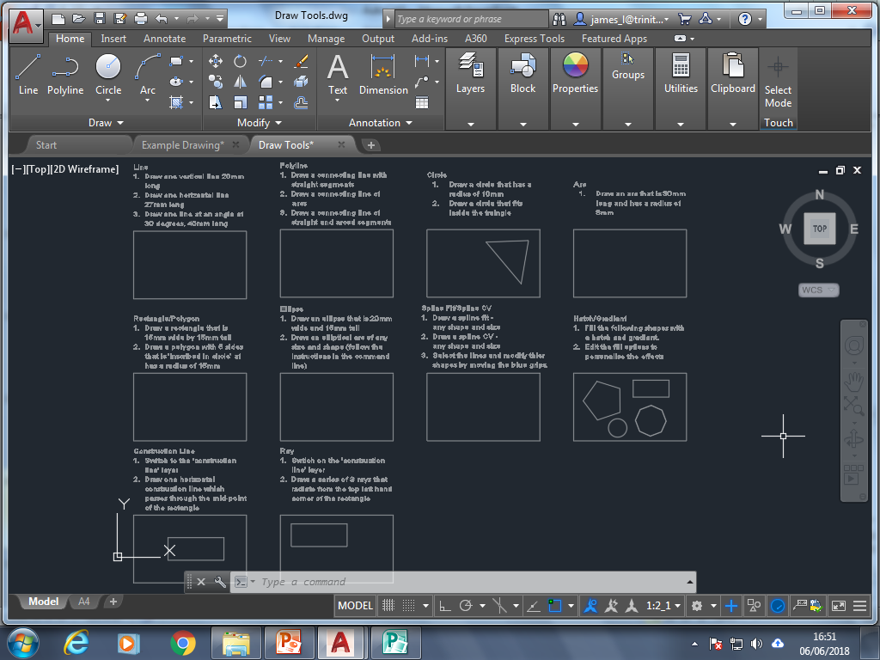
Task 2
Complete the ‘Draw Tools’ worksheet in AutoCAD
@TrinityHighEng
Notes:
Give a demo on line and rec boxes to show using the tab button.

Slide 18
Plenary
Describe the activities completed during the lesson without using the keywords or topic of the lesson.
@TrinityHighEng

Slide 19
Lesson 4: Starter
3 minutes to write down as many keywords from the previous lessons.
@TrinityHighEng

Slide 20
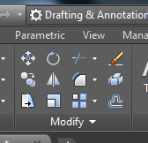
Objectives
To learn how to use the ‘Modify’ tools
@TrinityHighEng

Slide 21
Plenary
Expand this sentence to summarise what you have learnt today.
"During today's lesson, I have
learnt how to use the modify tools"
@TrinityHighEng

Slide 22
Lesson 5: Starter
Can you find the 2 key terms?
COM | IGN | ED | TER | AID
PU | CON | PU | COM | NUM
CAL | TER | ERI | TROL | DES
@TrinityHighEng

Slide 23
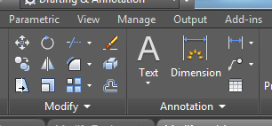
Objectives
Continue to learn how to use the ‘Modify’ tools and learn how to annotate your drawing.
@TrinityHighEng

Slide 24
Plenary
Split the class in to 2 teams to play a game of blockbusters.
@TrinityHighEng

