Slide 1
Sculpt Fundamentals Racing Seat Tutorial
©STEM Learning Limited. All rights reserved.
Notes:
This area of the PowerPoint is to be used to provide tutor notes for facilitators to help them run the session and achieve the stated outcomes. The aim is to provide guidance as to the lengths of various activities, as well as notes on how to contextualise the learning and ideas of how the materials can be adapted for different audiences.
The structure of these notes should be as follows:
Time needed
Contextualisation
Tasks
Guidance for how to write the information in each section:
Time needed: up to XX minutes
Contextualisation
Provide guidance that will help the facilitator understand the main points of the slide and any information needed to be thought about or shared before or after revealing points within it.
Examples of this type of contextualisation could be:
- In order for improvements to teaching and learning to be driven forward and a vision established it is essential that all stakeholders are involved in the process. It is good practice to engage with different evidences which can stimulate discussions and influence thinking and that is why a number of perspectives are used. The group may wish to draw on other evidences to add to the discussions at a later date including: feedback from technicians; work samples; learning walks etc.
- This is a key activity of the session as all members of the team are able to influence and shape their collective vision
Task <NUMBER OF TASK WITHIN THE PDE>
Task Title – e.g. Developing Characteristics for Our Team for Outstanding Teaching and Learning in Science
Task instructions or ideas of how to adapt it – e.g.
- Go through task instructions and the support materials for the discussions, slides 5-8 and Handout 1-3
- Slides 3-5 can be revealed one at a time with key points discussed after each or participants could spend time in groups looking at Handout 1 which relates to these slides and feedback their learning around their discussions.

Slide 2
Seat Example:
https://a360.co/2HrBrtO

Slide 3
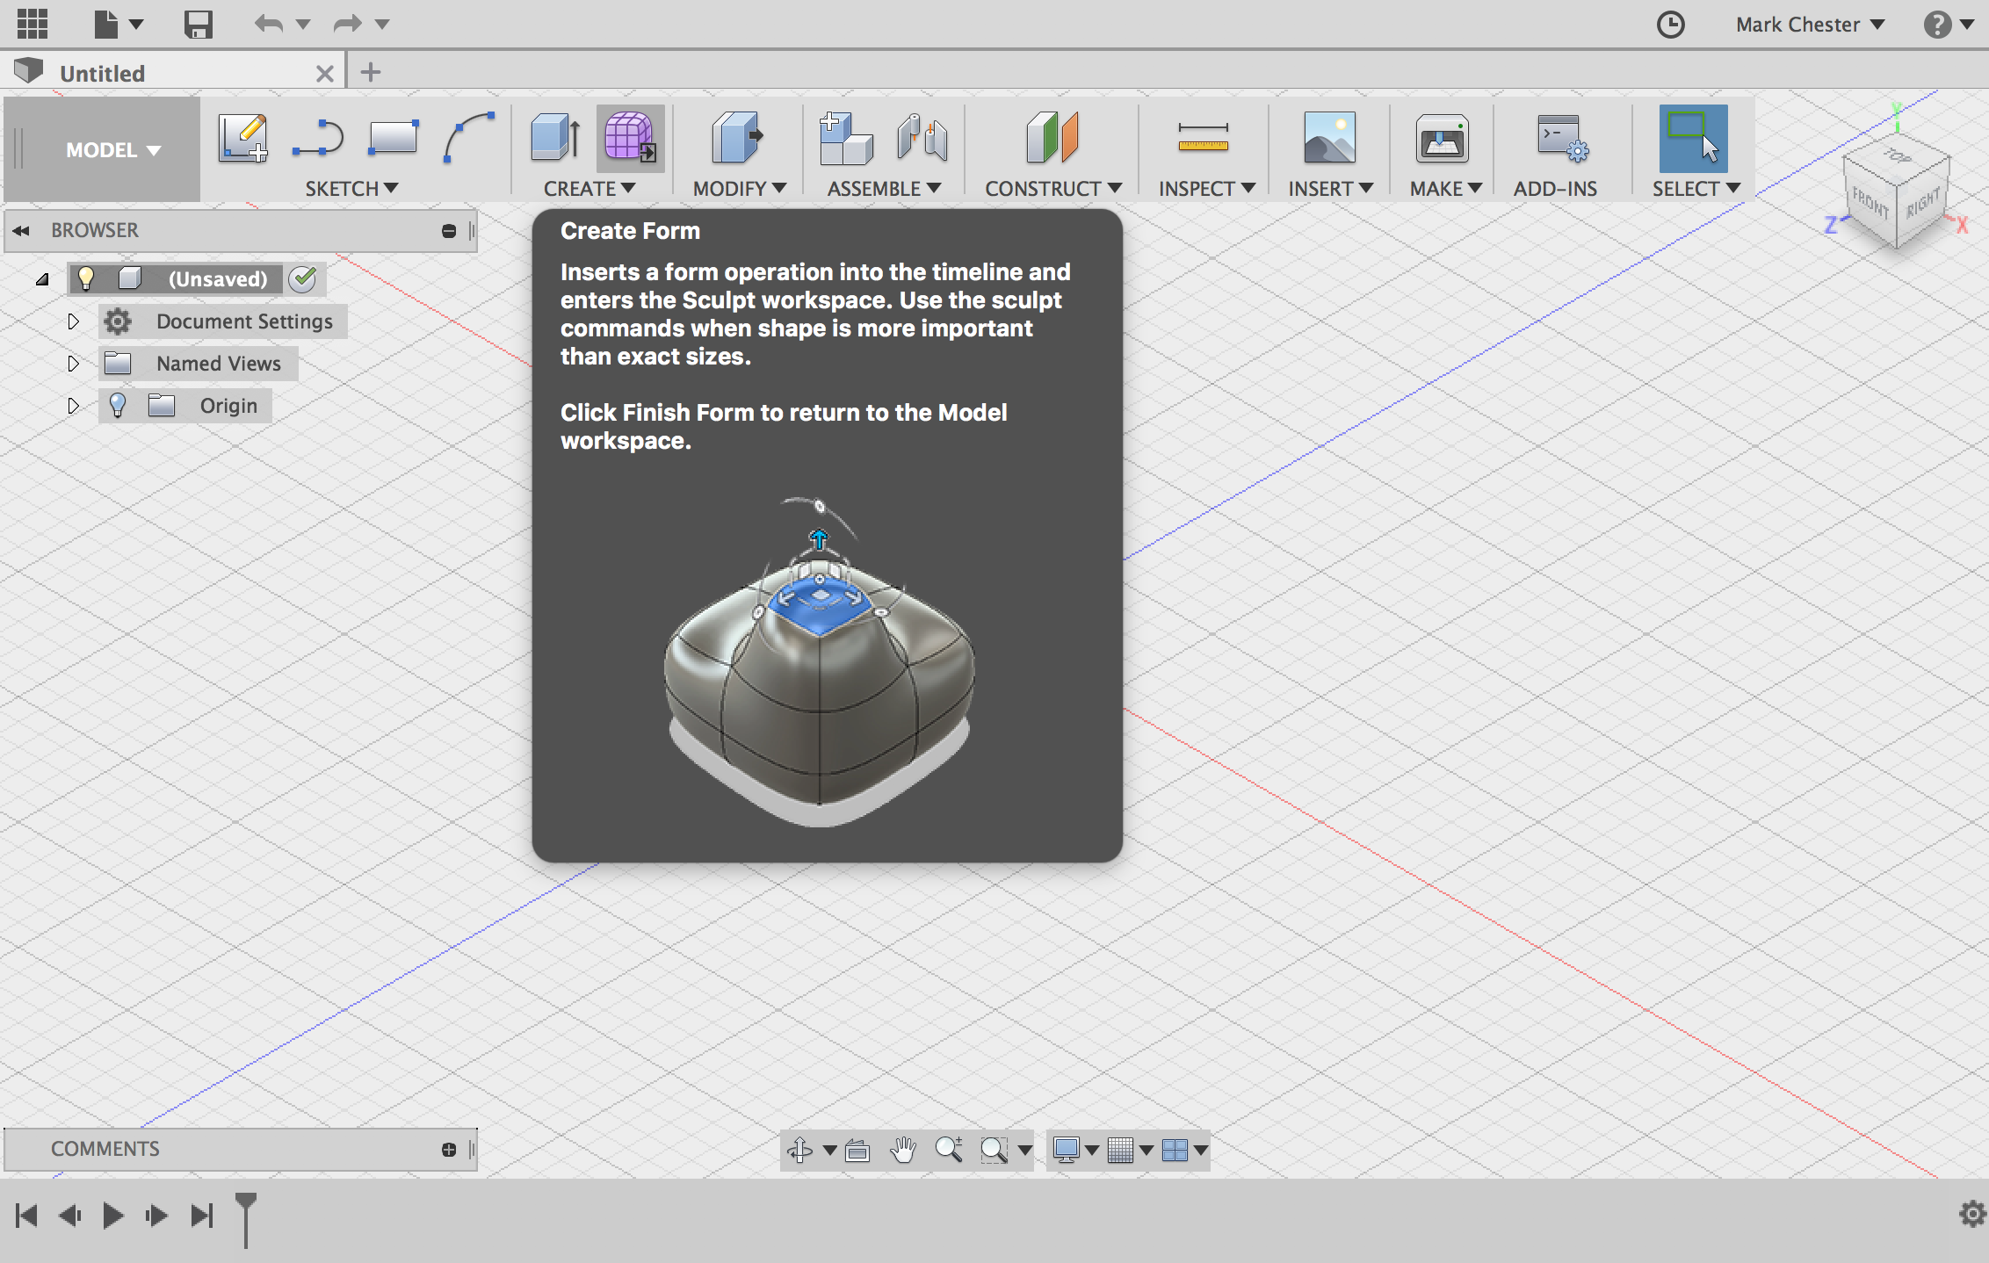
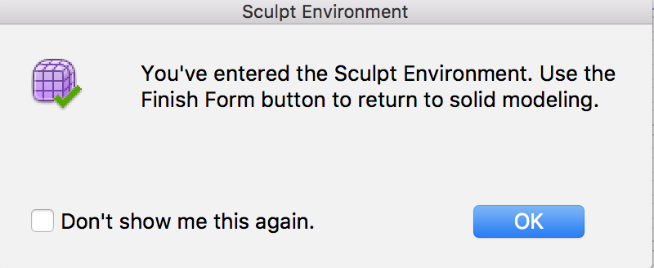
Change to the Sculpt Workspace:
Click on Create Form (purple box)
Press Ok and continue into the sculpt environment
Notice the toolbar in the top of the workspace has changed.

Slide 4
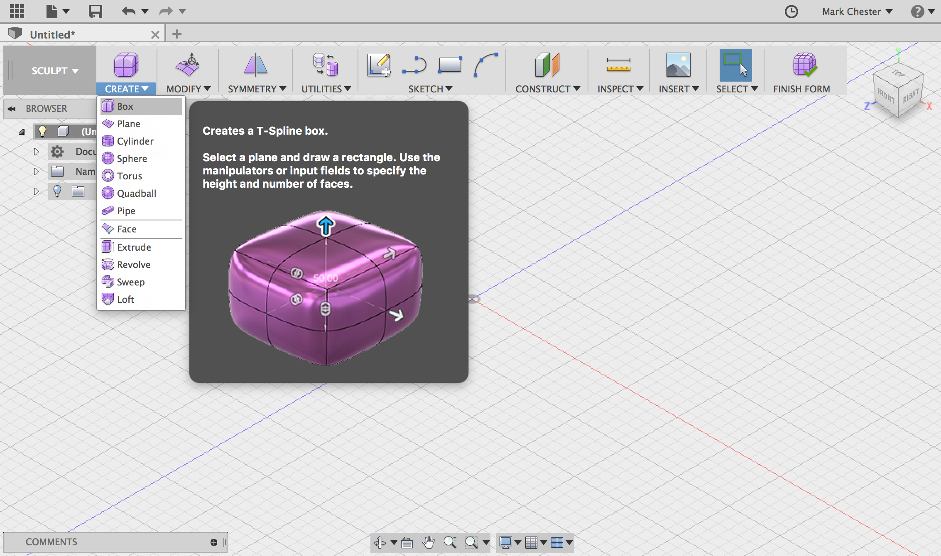
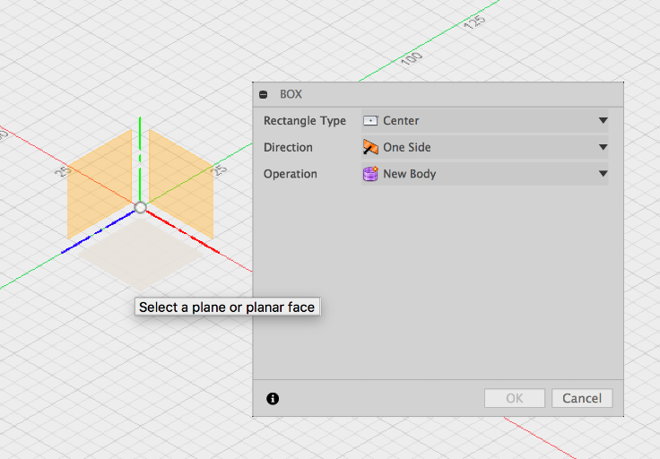
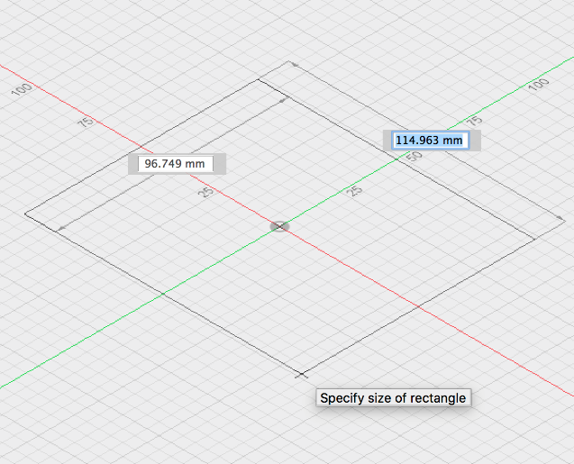
Create a Box
Create a box on the bottom plane. Then start creating a rectangle. Move your cursor outwards then click, don’t worry about stating dimensions yet.
Click on Create,
Box

Slide 5
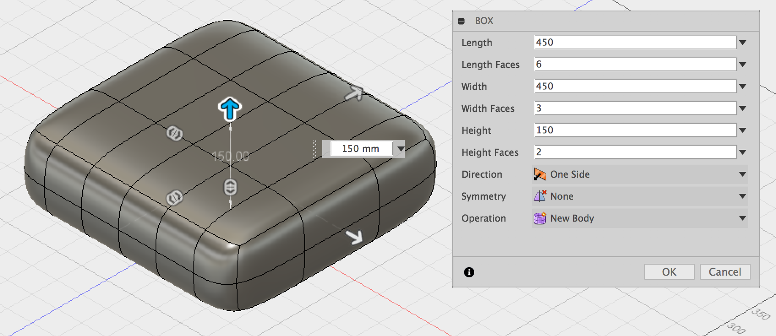
Create a Box
Change the dimensions of the box to 450 x 450 x 150 mm
Change length faces to 6 and width faces to 3

Slide 6
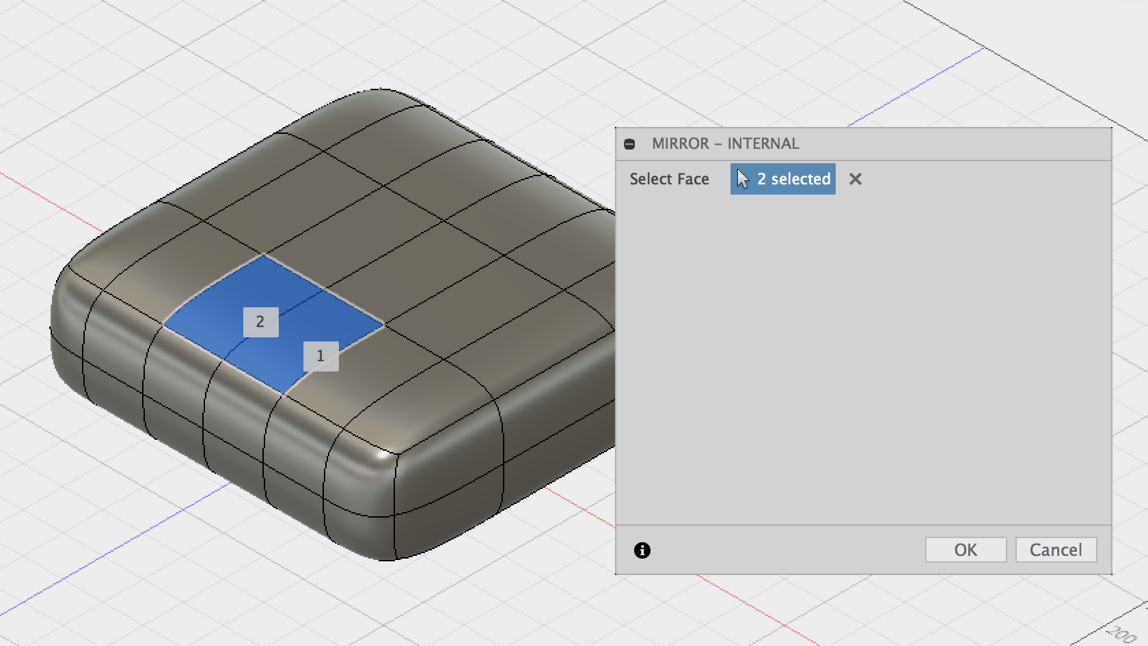
Create Symmetry – Mirror Internal
Click on Symmetry, Mirror - Internal
Click on the two faces shown above to create a line of symmetry

Slide 7
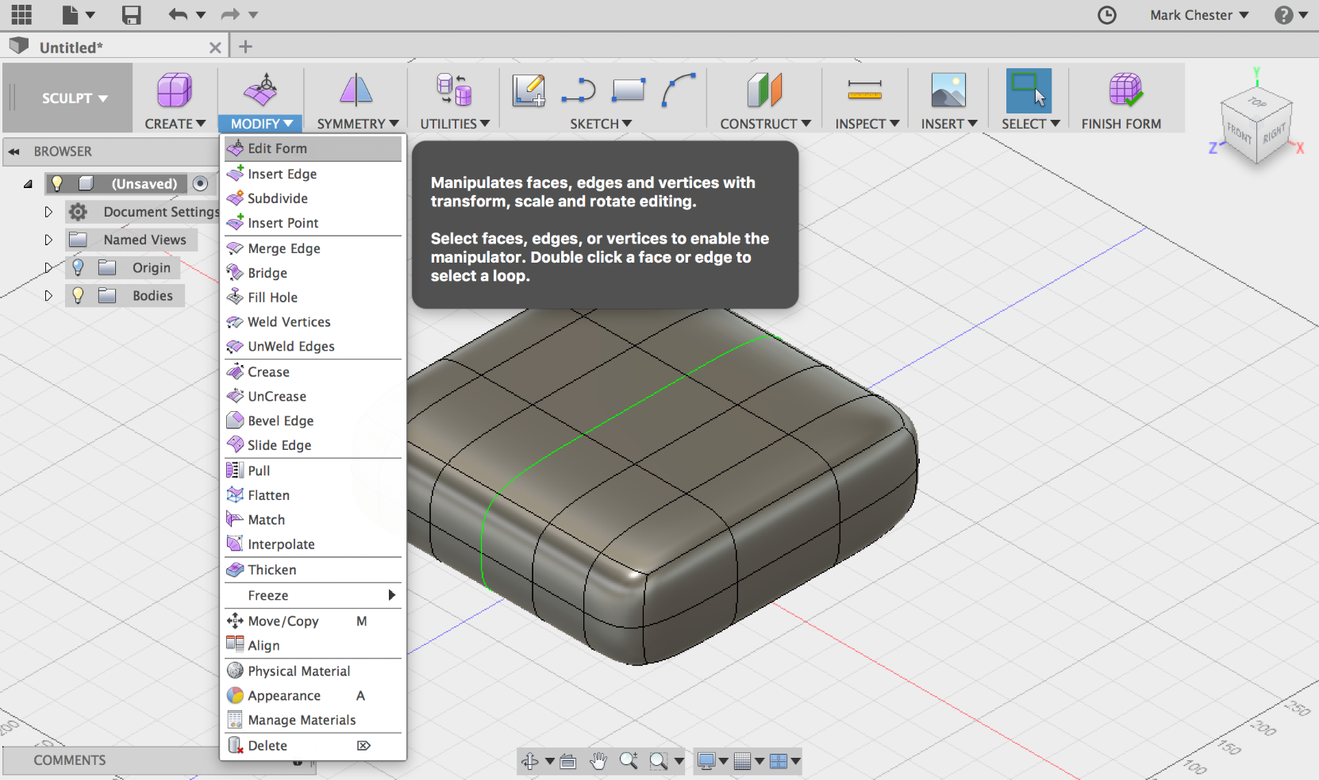
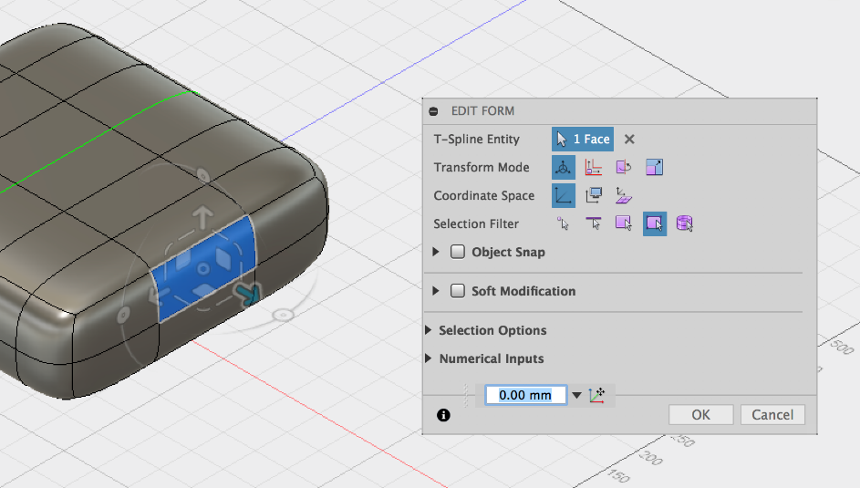
Edit Form -
Click on the faces shown below, use the arrows or squares to edit the form
Click on Modify, Edit Form

Slide 8
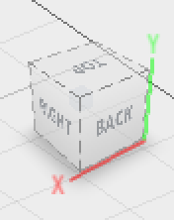
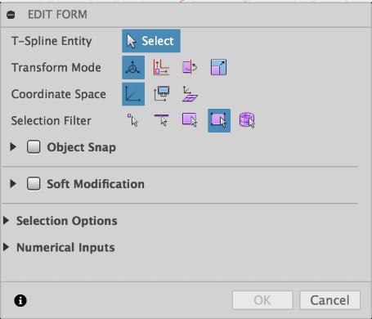
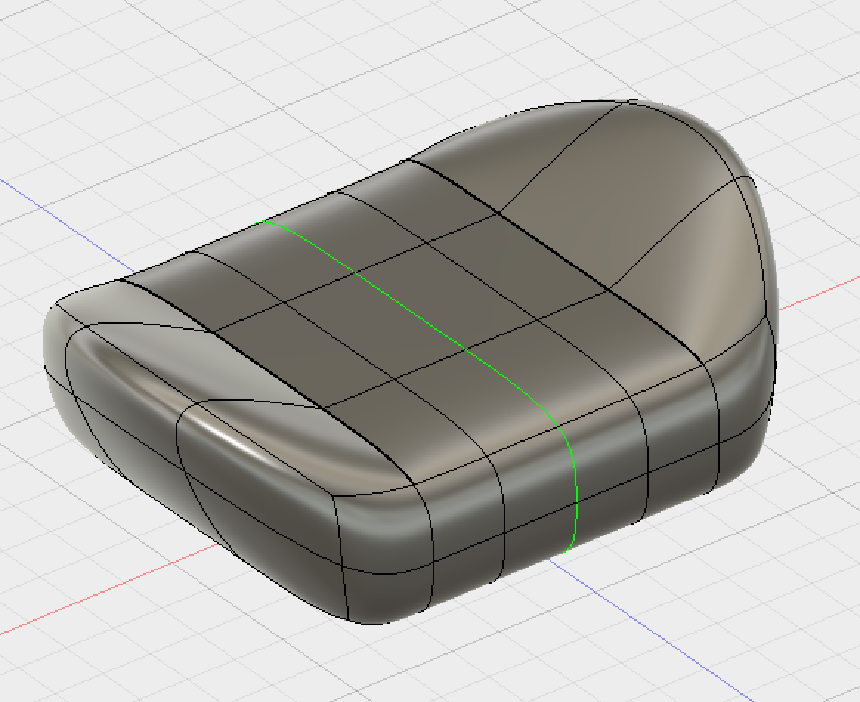
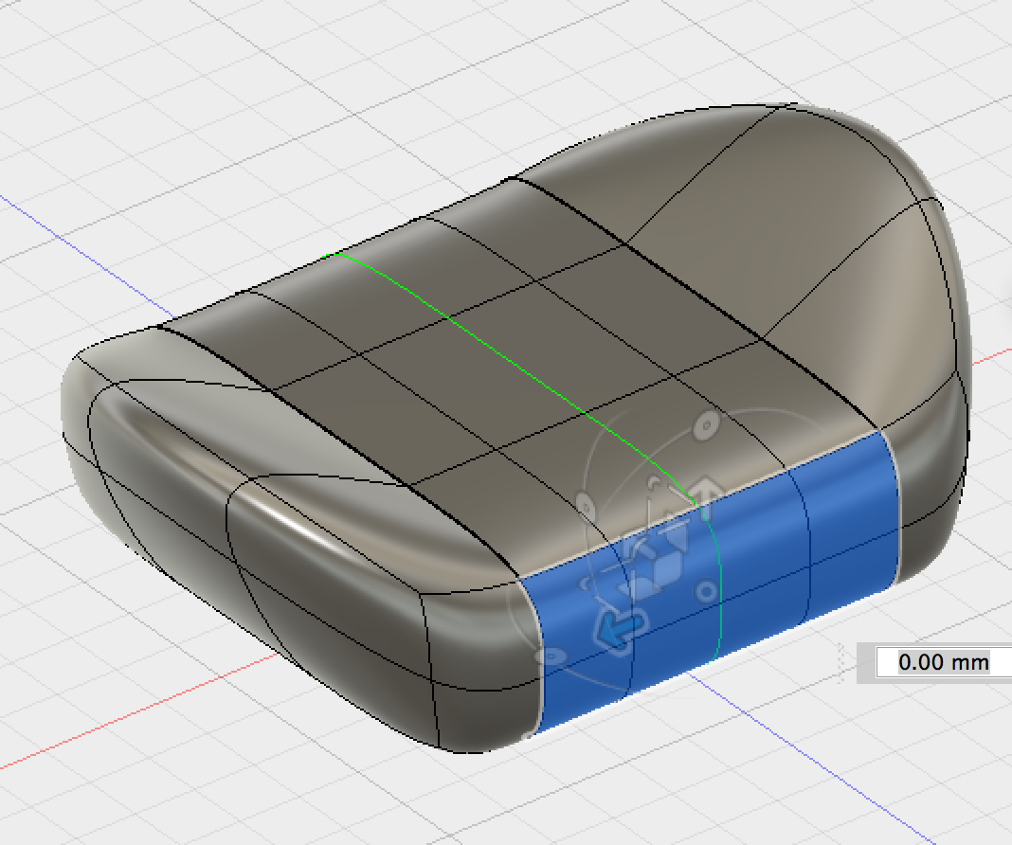
Adding Faces -
Navigate to the back of the seat
Click on Modify, Edit form
Select the back 8 faces of the seat as shown above

Slide 9
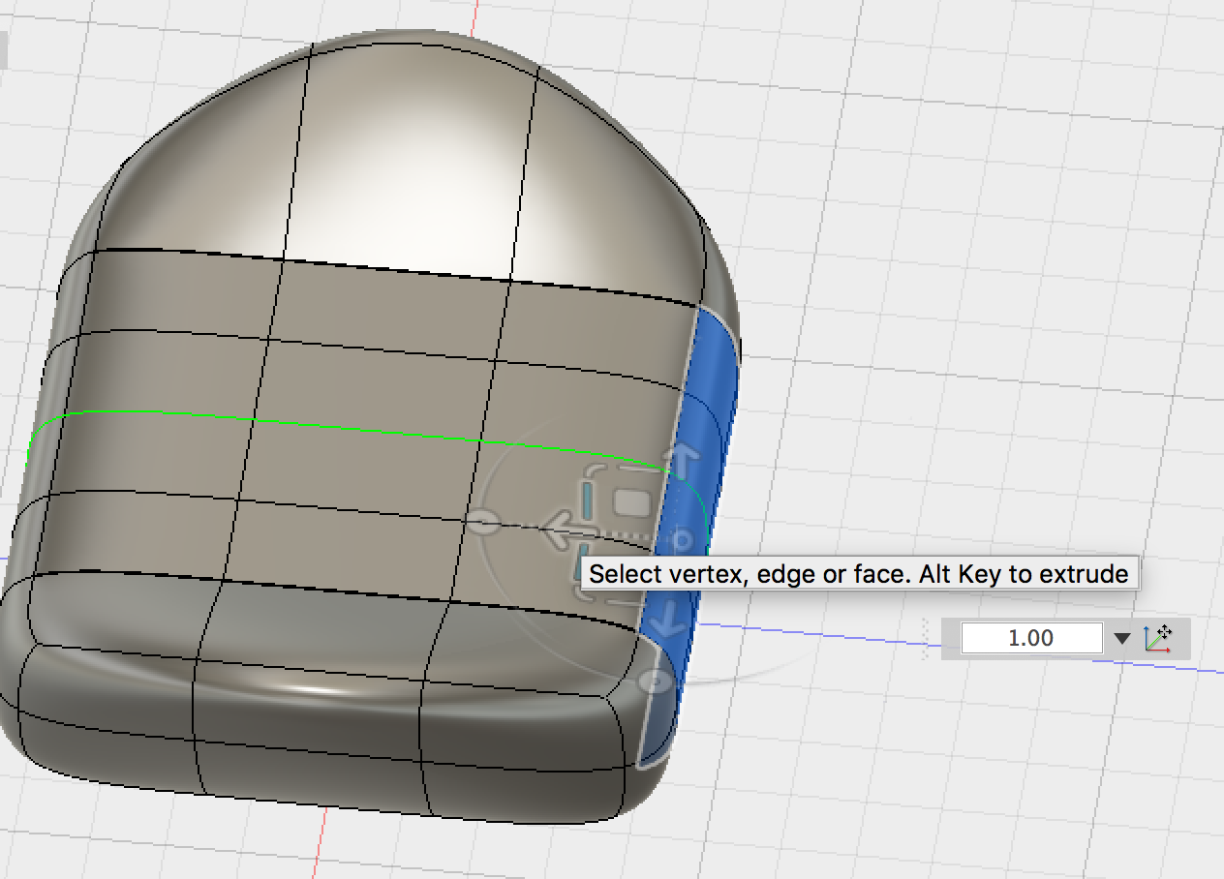
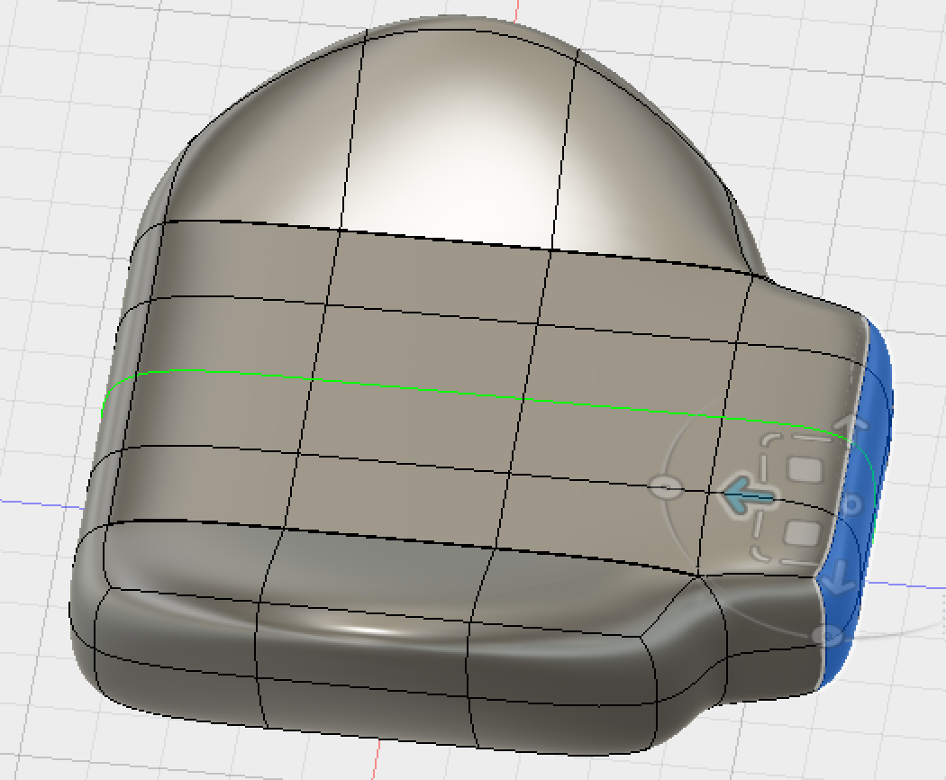
Adding Faces -
Press and Hold the ALT Key then use the arrow to add more faces
Notice a new set of faces has been added to the back

Slide 10
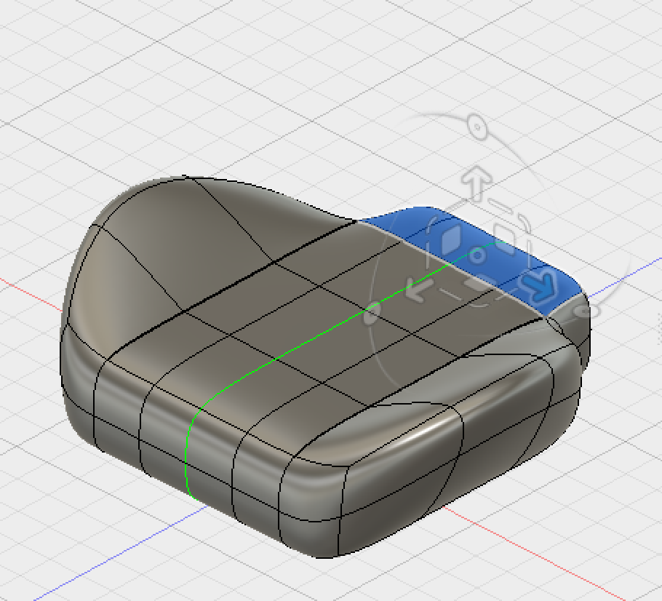
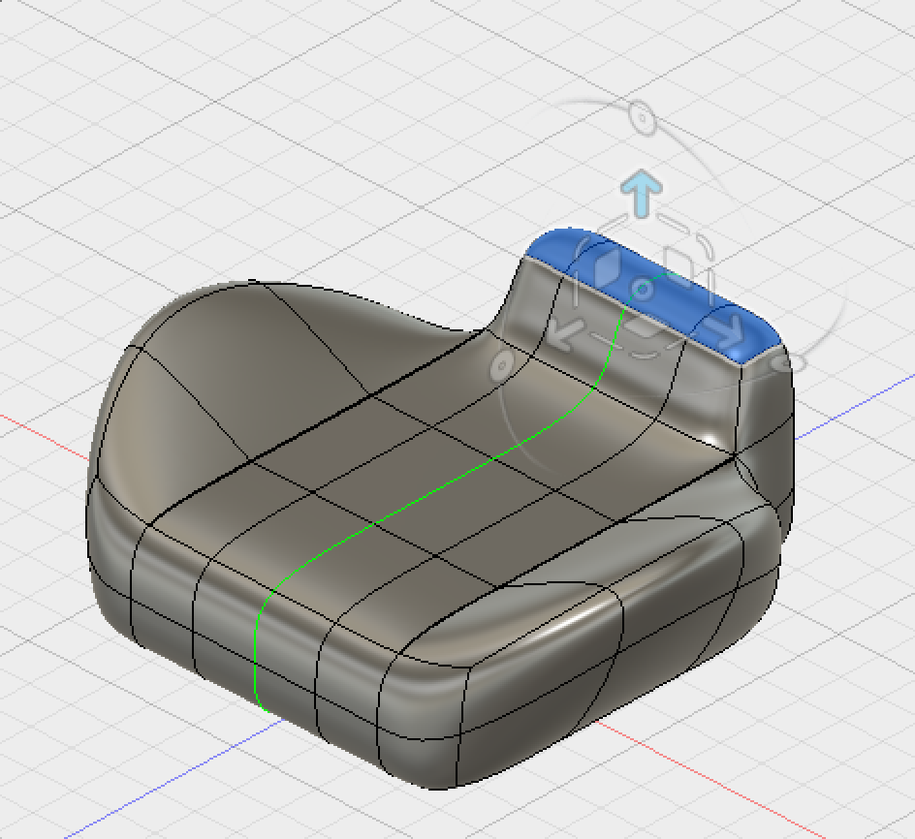
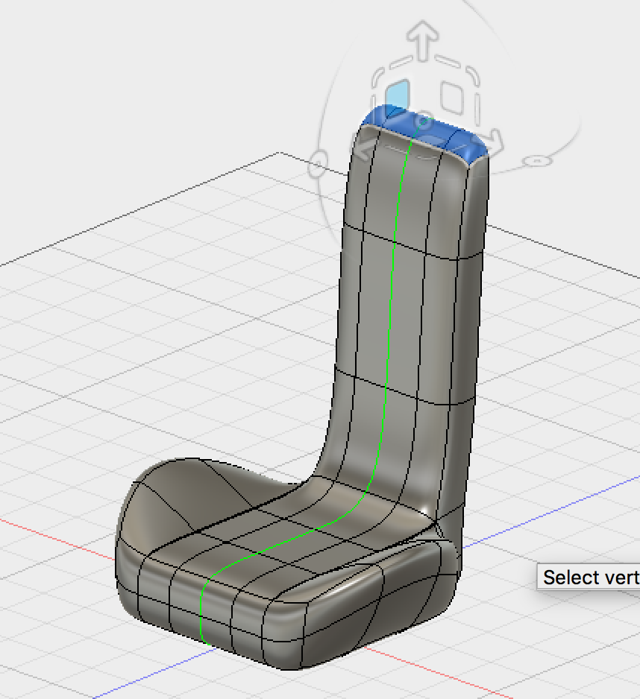
Adding Faces -
Click on,
Modify,
Edit Form
Use the view cube view the back of the torch
Select the back 4 faces of the seat. Then using edit form, press and hold the alt key and add three faces to the back of the seat

Slide 11
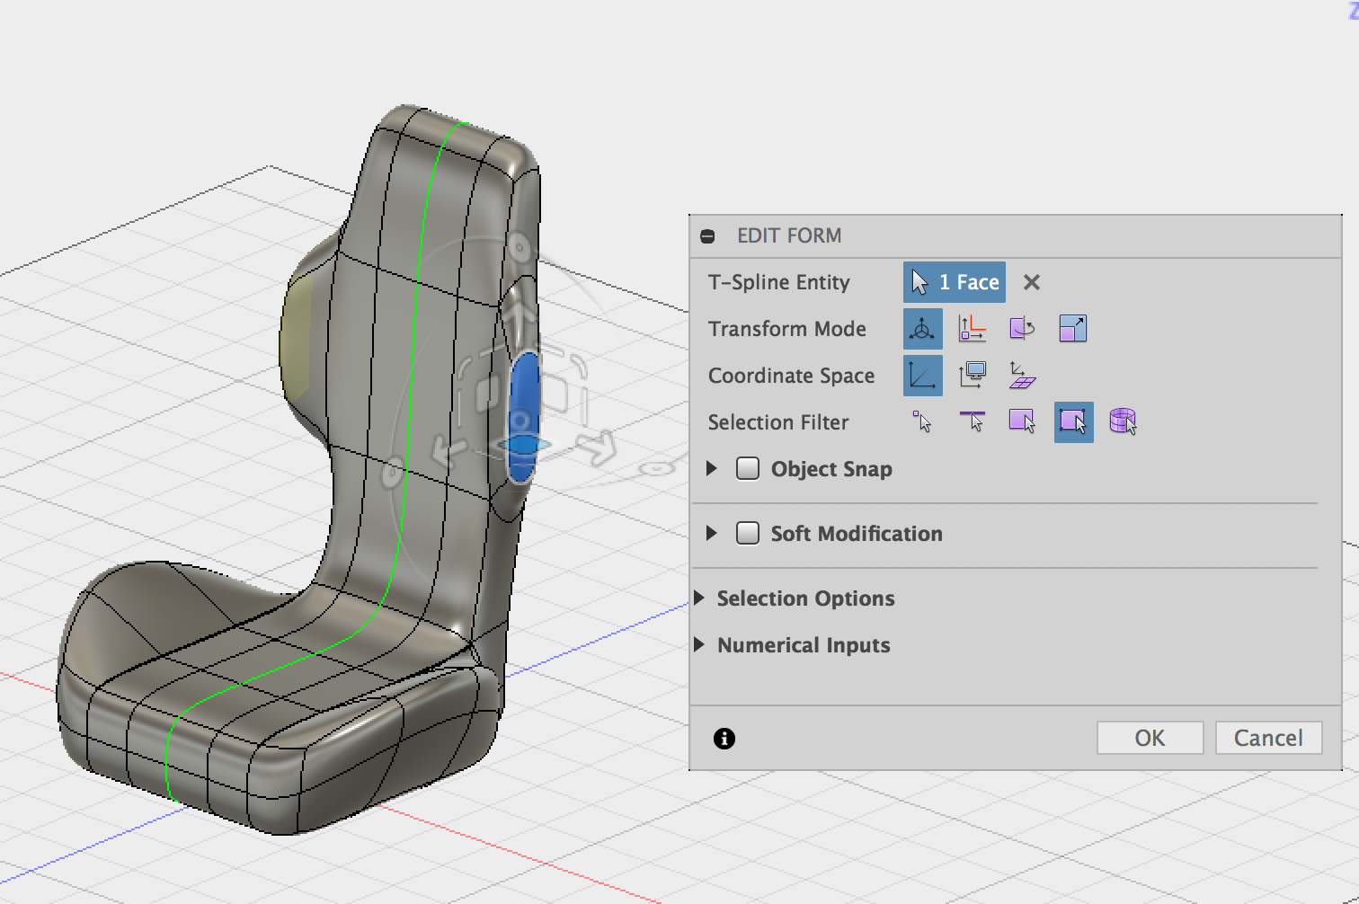
Adding Faces -
Click on,
Modify,
Edit form
Select the face shown below, then using edit form, press and hold the alt key and add a face

Slide 12
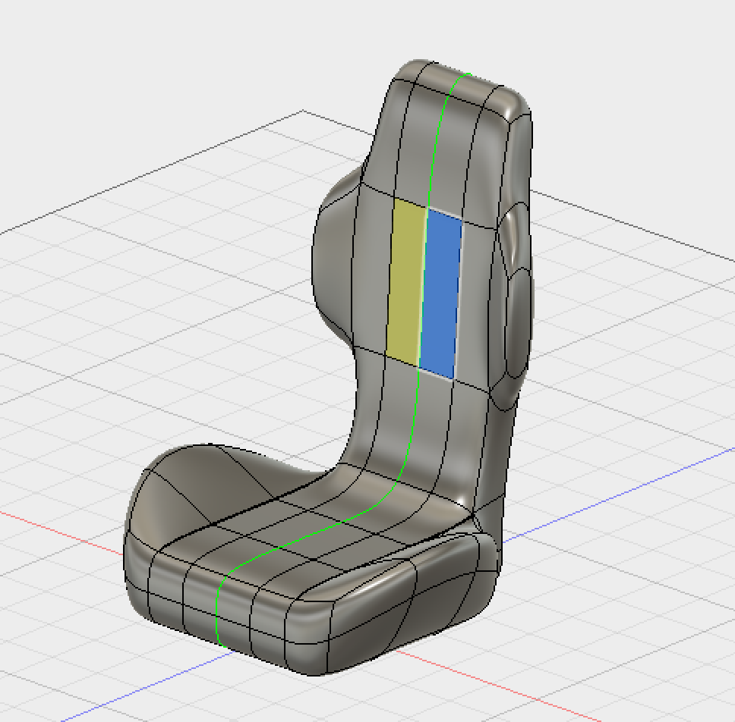
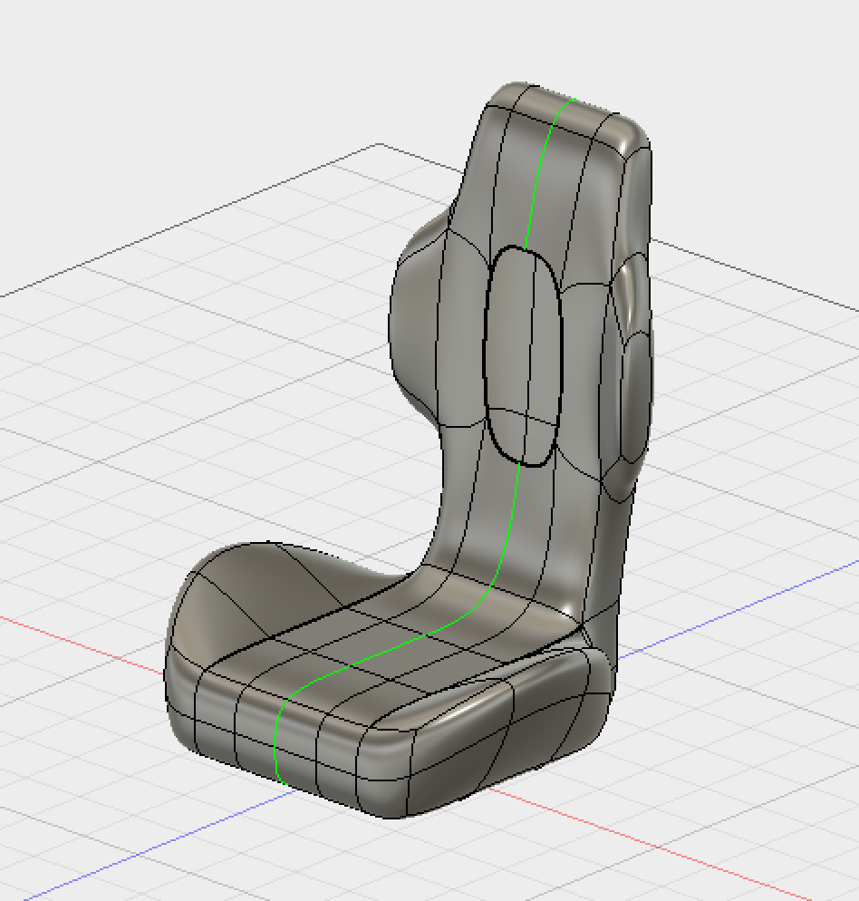
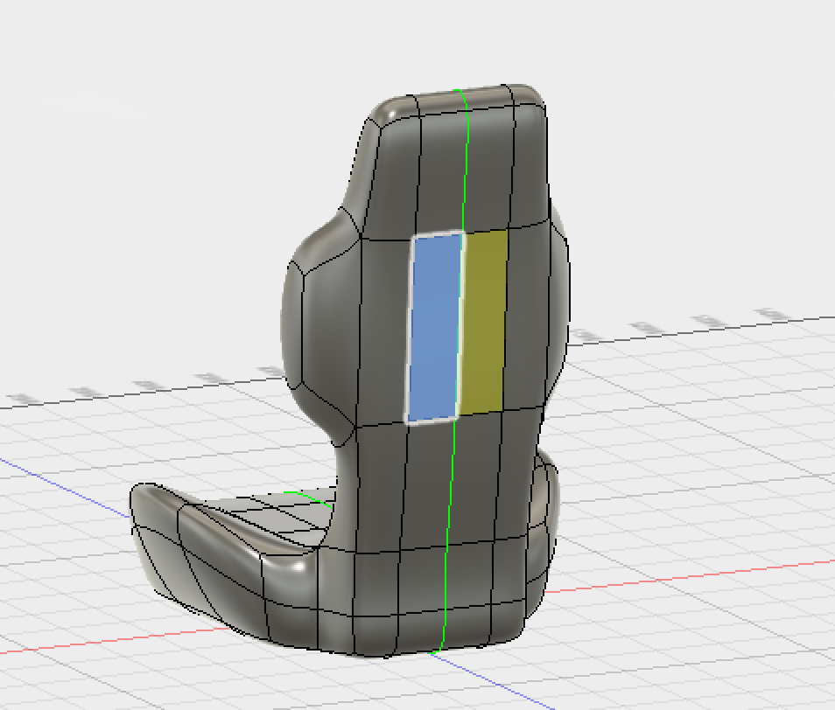
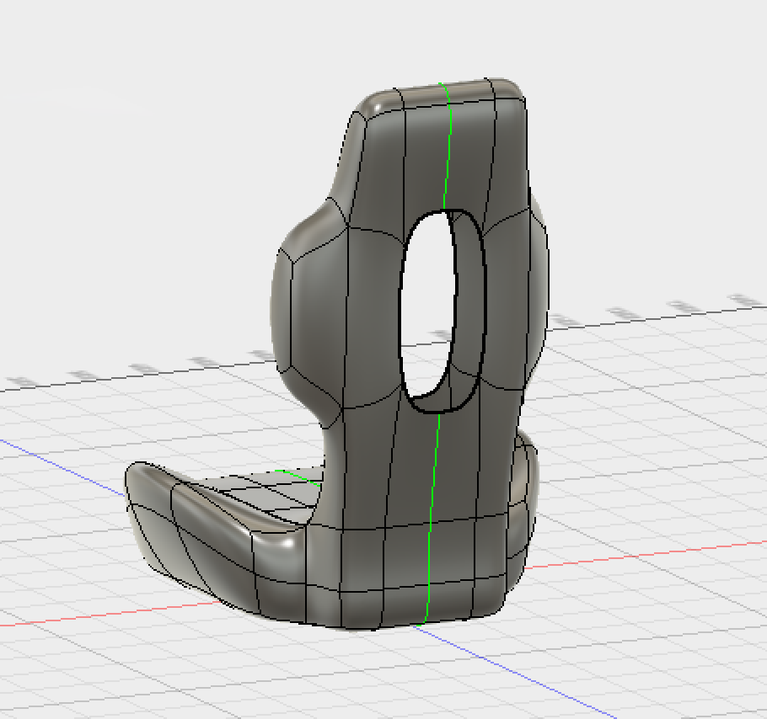
Deleting Faces -
Select the following faces and delete them by pressing backspace or delete on your keyboard.

Slide 13
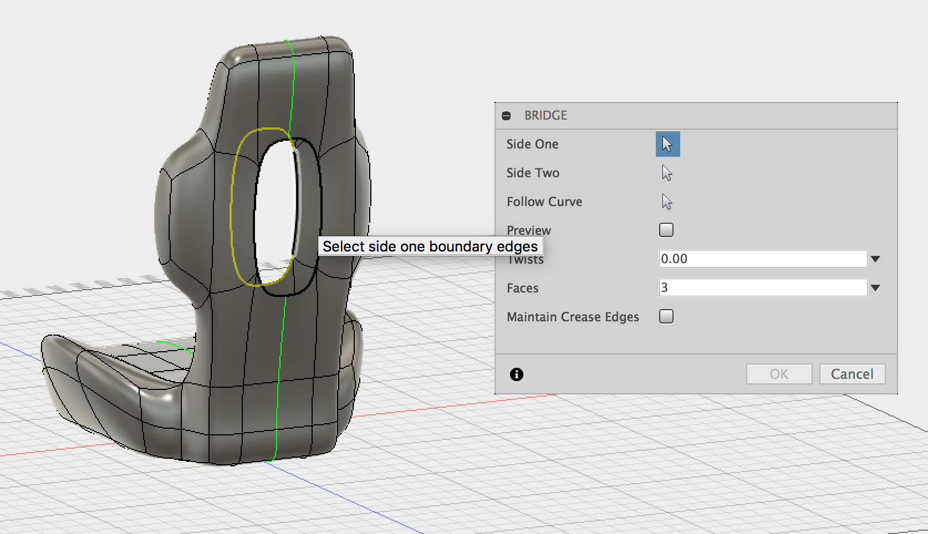
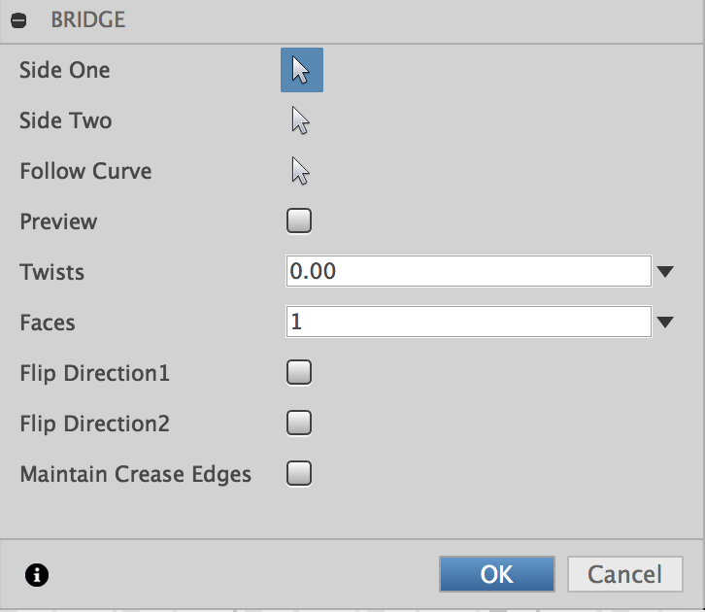
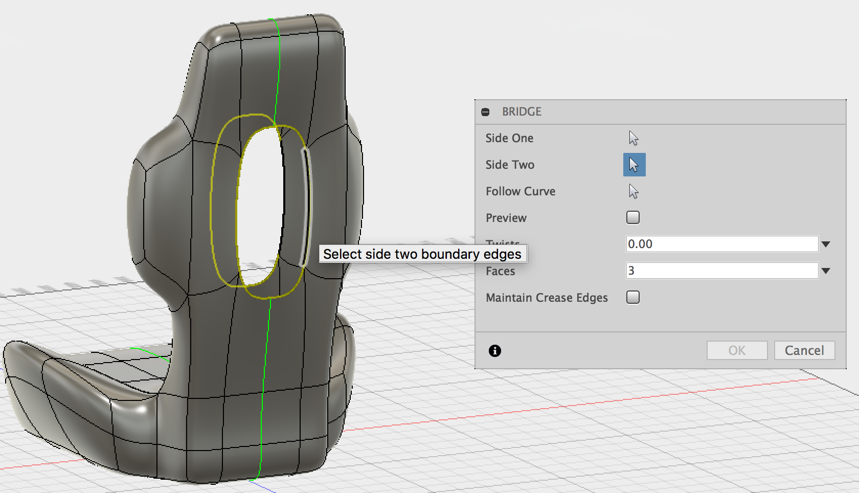
Create a Bridge
Double Click on the edge below to select the hole
Side 1
Click on, Modify,
Bridge
Side 2
Change the faces to 1 and press okay, notice the two holes have been bridged
Double Click on the edge below to select the hole

Slide 14
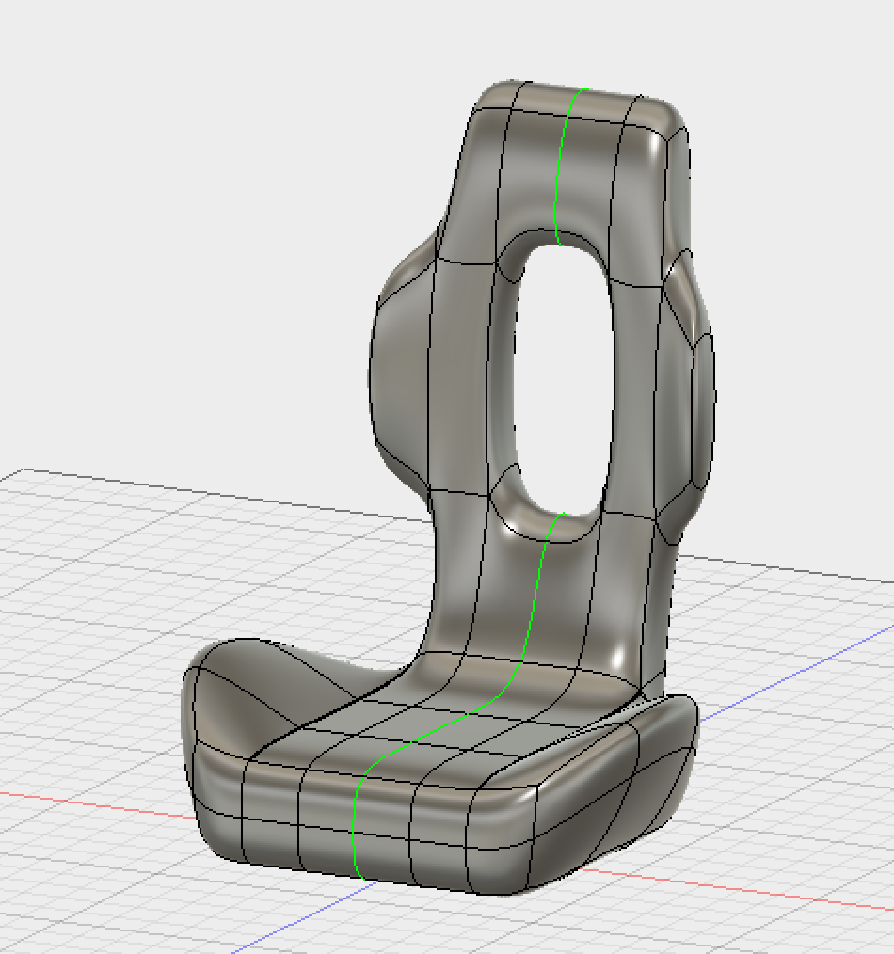
Tutorial Finished
Now try adding appearances and rendering your seat.

