Slide 1
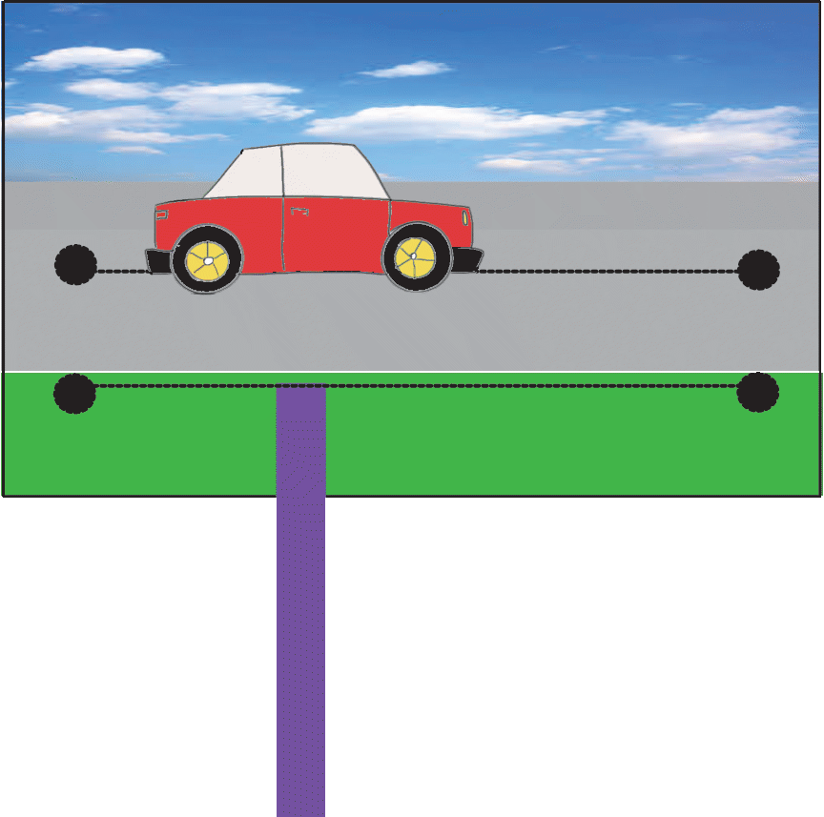
Moving Pictures
Sliders and Levers

Slide 2
Simple Slider
Cut two slots in the base card
If you can, make round holes at the end of each slot to stop them tearing
Slide the slider through the two slots
Stick the top piece on the end
This slider allows side-to-side movement

Slide 3
Alternative Slider – Rabbit from a Hat
This slider allows up-and-down movement
Using sticky tape over the ends, attach the guide for the slider to the back of the hat
Slide the slider under the bar
Stick the rabbit on the end
BACK VIEW
guide

Slide 4
Simple Lever
This lever creates a rocking movement
Cut the slot in the base card
Slide the lever through the slot
Push the metal fastener through the card and lever
Stick the top piece on the end
Fastener (pivot)

Slide 5
Now Try This…
Design a page for a story book.
This could be about a journey, a voyage, magic, a surprise…
It must include either a lever or a slide.

Slide 6
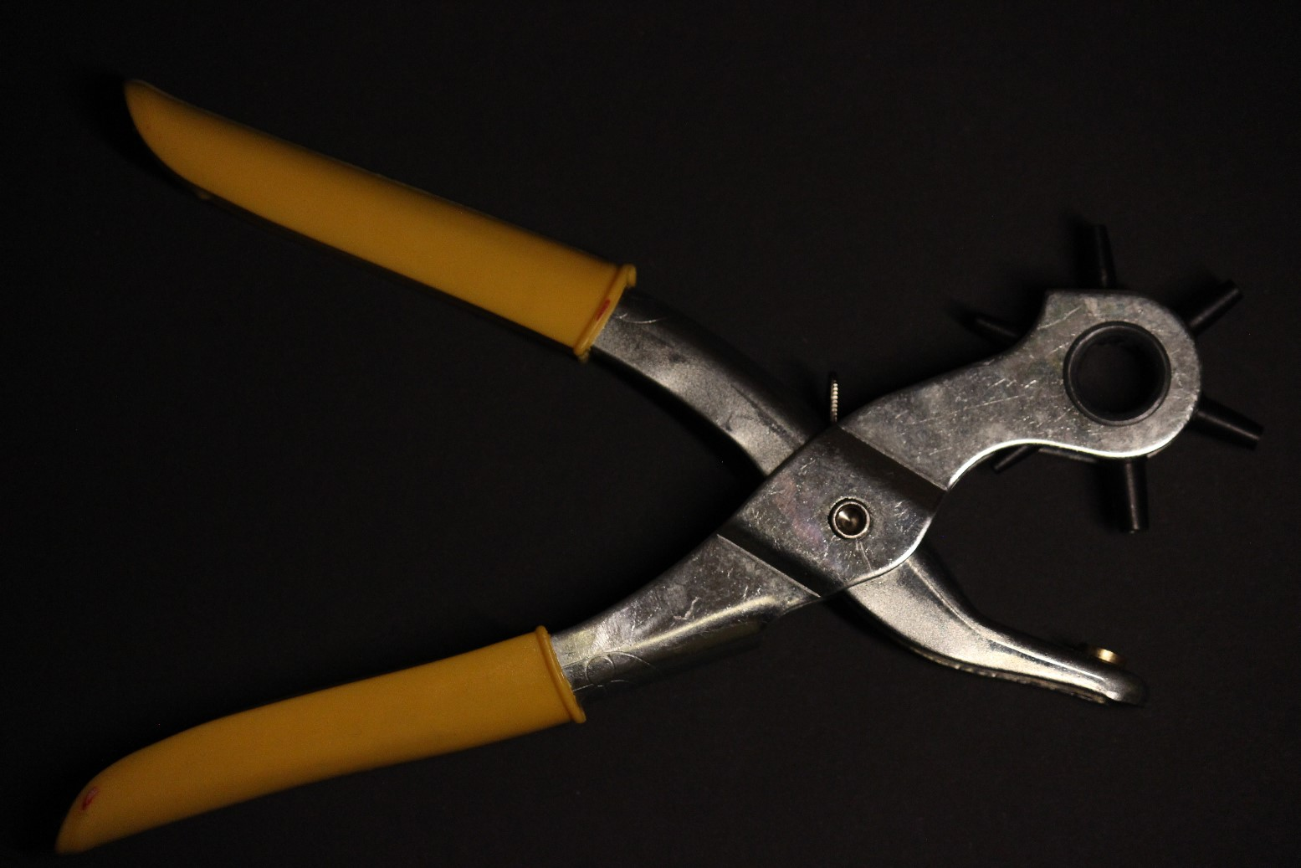
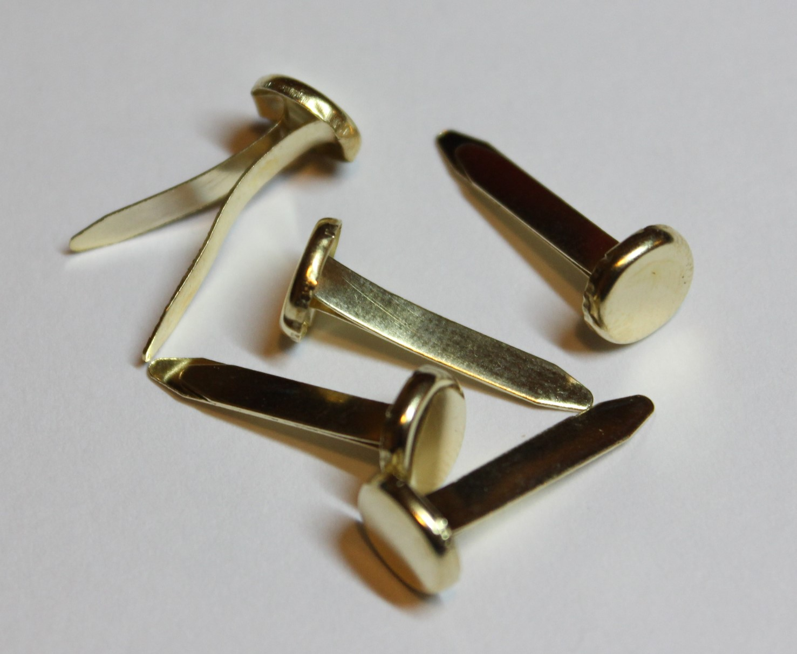
Additional Images for Reference
Single hole punch
Fasteners

