Slide 1
Fire detection with the Internet of Things
Exploring the properties of polygons

Slide 2
Making fire detection more connected
The Internet of Things (IoT) connects the unconnected.
The IoT is improving fire detection, helping to save lives through more intelligent, faster and efficient systems.
‘Smart’ fire detectors can now communicate with other detectors, alert the fire service and warn people at risk of fire…

Slide 3
Making fire detection more connected
Your challenge:
You work in a company specialising in fire detection. The company are often asked to fit alarms in buildings with unusual designs. You have been asked to help decide where to place the fire detectors.

Slide 4
Infrared cannot travel through walls
Your challenge:
The company uses just one type of detector. Passive Infrared (PIR) sensors provide a signal when they sense an increase in the overall amount of infrared (heat) from any direction. Infrared is similar to visible light.

Slide 5
Making fire detection more connected
Just like visible light, infrared travels in straight lines and cannot travel through walls.

Slide 6
Your challenge…
For each room you will have to decide where to place fire detectors so that the entire room is covered, using the smallest number of detectors.
Rules:
Detectors can only be placed at the vertex (corner) of each room
Detectors cannot sense fire through walls!

Slide 7
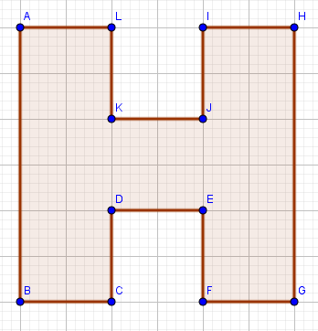
Where to place the detectors?
This is the plan of an area you have been asked to protect from fire.
Remember detectors can only be placed at the vertex of each room, they can sense fire 360º at any distance but they can’t detect fire through walls!
Using the fewest detectors possible, where should the fire detectors be placed so that the entire room is covered?

Slide 8
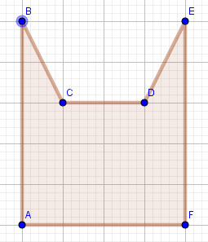
Where to place the detectors?
Use the fewest detectors possible, and remember fire detectors can only be placed at the vertex of each room, and they can’t sense fire through walls!

Slide 9
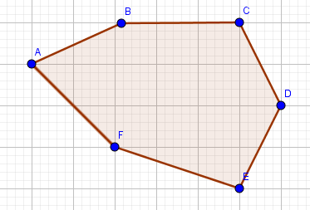
Where to place the detectors?
Use the fewest detectors possible, and remember fire detectors can only be placed at the vertex of each room, and they can’t sense fire through walls!

Slide 10
Where to place the detectors?
Your turn!
For each of the rooms on the worksheet, what is the smallest number of detectors required so that the entire room is covered? Use the fewest detectors possible. Remember they can only be placed at the vertex of each room, and they can’t sense fire through walls!

Slide 11
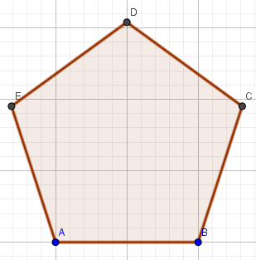
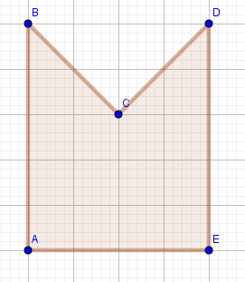
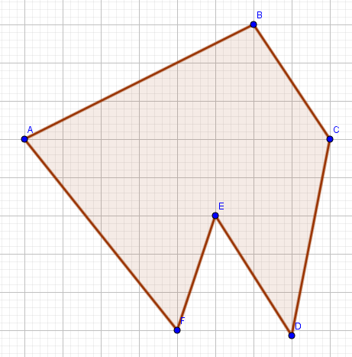
Where to place the detectors?
Notes:
Answers: 1 1 1
2 2 1

Slide 12
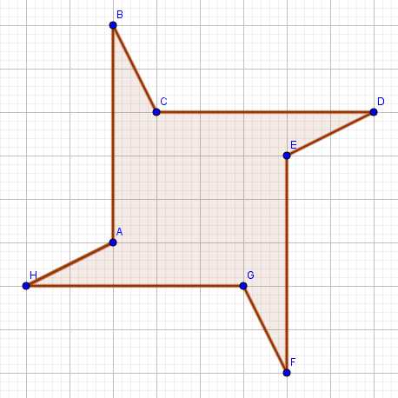
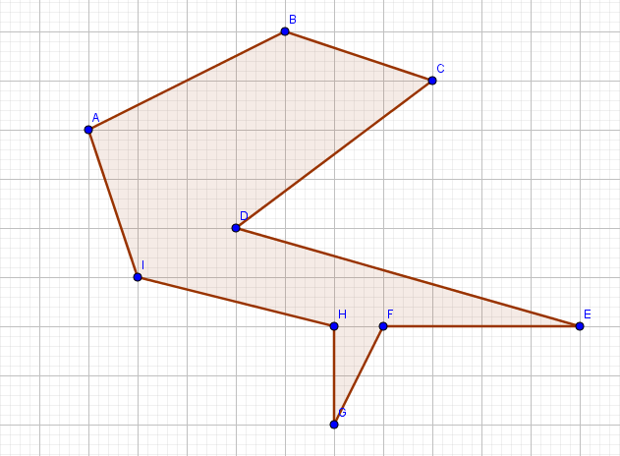
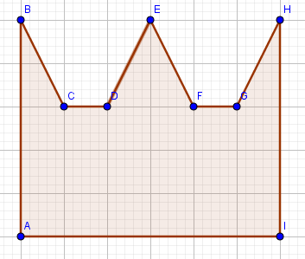
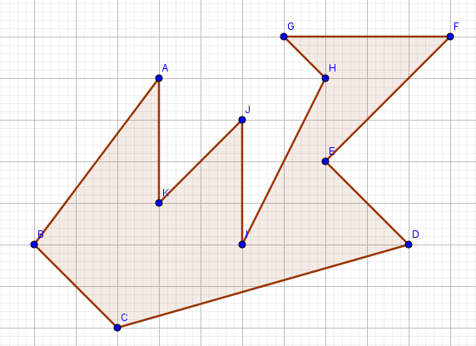
Where to place the detectors?
Notes:
Answers: 2 2
3 3

Slide 13
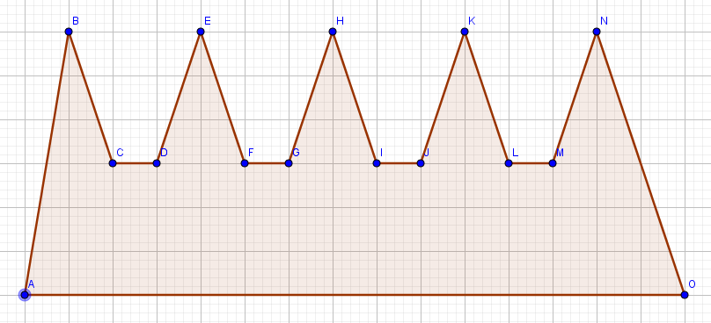
Where to place the detectors?
Challenge: The fire detector company think this room required 5 detectors - do you agree? How many distinct ways can the detectors be placed?
Notes:
Answers: 5

Slide 14
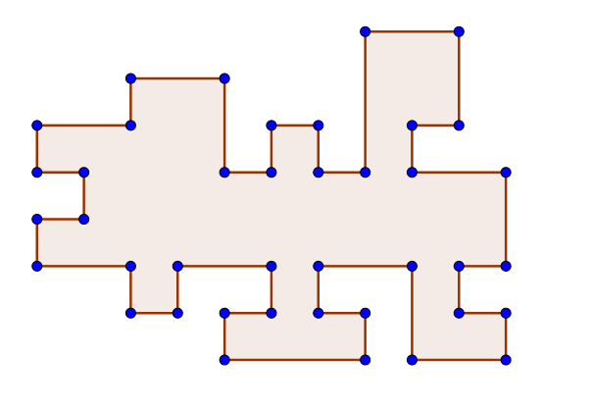
How many detectors are required?

Slide 15
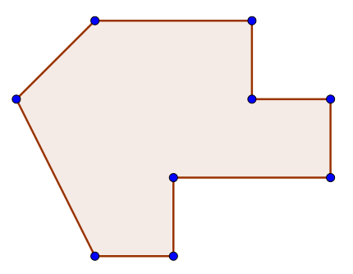
How many detectors are required?
This room has nine vertices.
How many fire detectors are required?
Can you design a room with nine vertices that requires more? What is the maximum number of detectors?
Challenge: Investigate the maximum number of detectors for rooms with a different number of vertices

Slide 16
The ‘floor function’
It turns out, the number of detectors required is connected to the number of vertices.
If there are n vertices, the maximum number of detectors required is:
The floor function rounds down to the nearest integer. Does this fits with your maximum suggestion findings?
Click here to see the proof.

Slide 17
Cisco Little Big Futures
Image credits:
IOT drawing: By Wilgengebroed on Flickr [CC BY 2.0], via Wikimedia Commons
Flames
Fire detector

