Slide 1
Introduction to Fixing

Slide 2
Notes:
This presentation is used to introduce students to the many aspects of the term FIX. Use each image as a trigger for students response: What do they see? How do they think it relates to Fixing? Can they think of similar examples?

Slide 3
FIX
Notes:
What does this word make you think of?

Slide 4
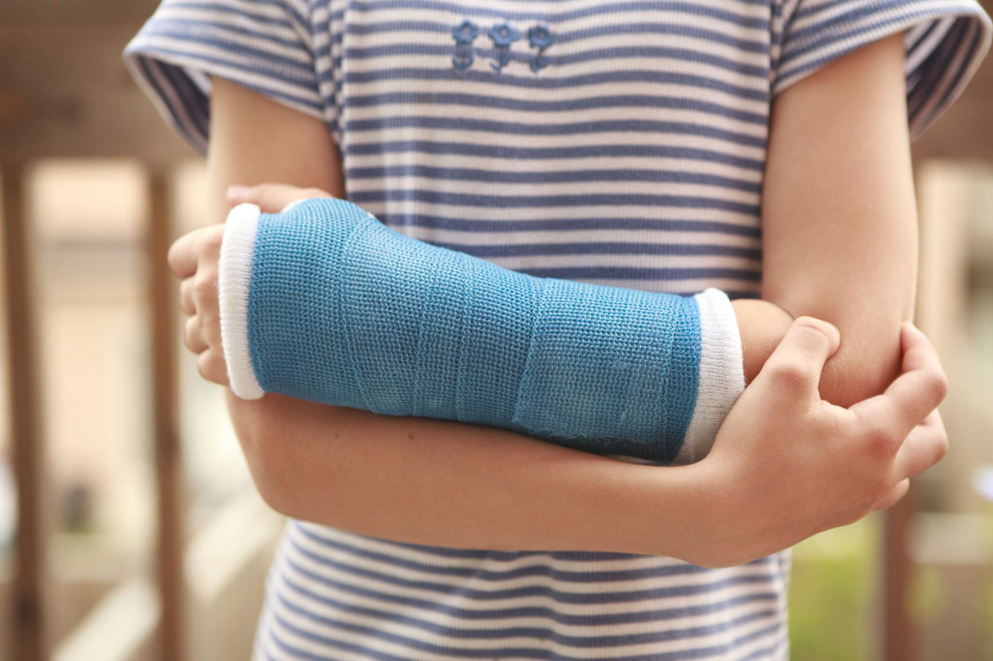
Fix = Repair something broken
Notes:
Anyone fixed something recently? What?
Image: https://www.verywell.com/treatment-of-broken-bones-2549211

Slide 5
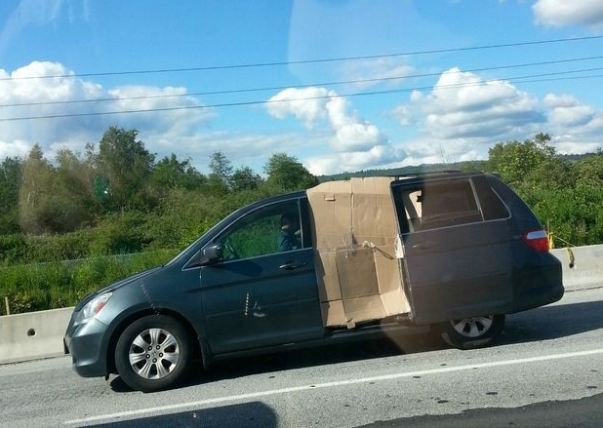
Notes:
Temporary fixes, improvised fixes…
Image: http://www.thqafawe3lom.com/2013/08/blog-post_6348.html

Slide 6
Fix = Solve a problem
Notes:
Fixing often involves solving a problem.
Ketchup in traditional glass bottles got stuck and was difficult to shake out. This plastic bottle not only allows us to squeeze the ketchup out, it is also designed to stand upside down to help the ketchup pour fluidly.
Image: http://ecx.images-amazon.com/images/I/41qjTI7JBOL.jpg

Slide 7
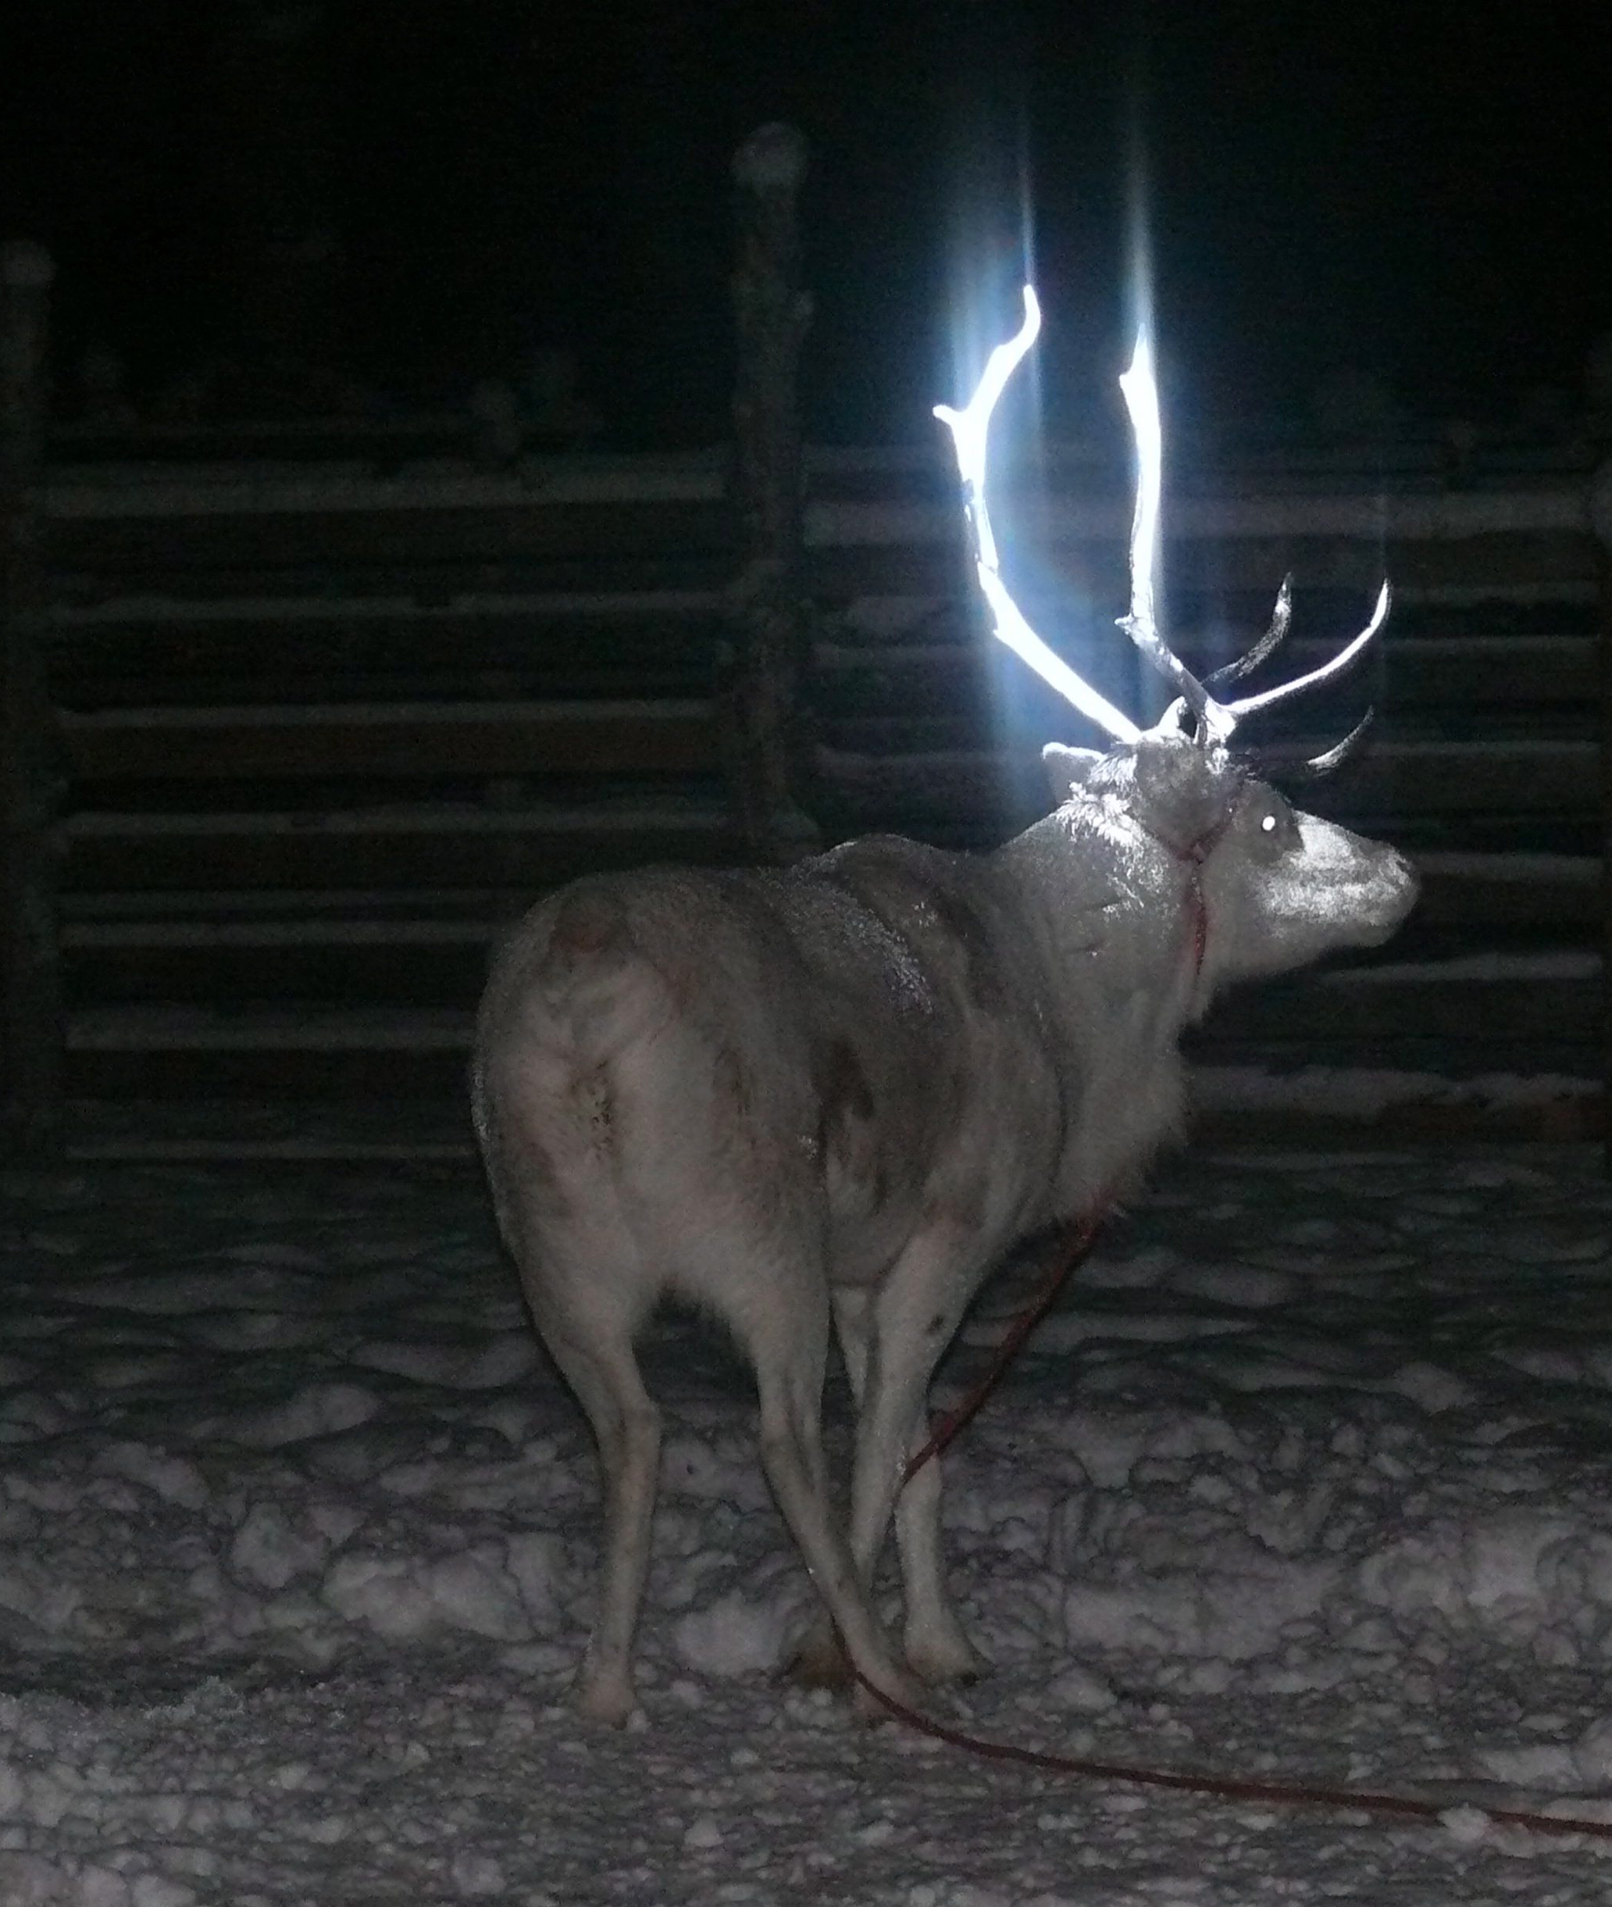
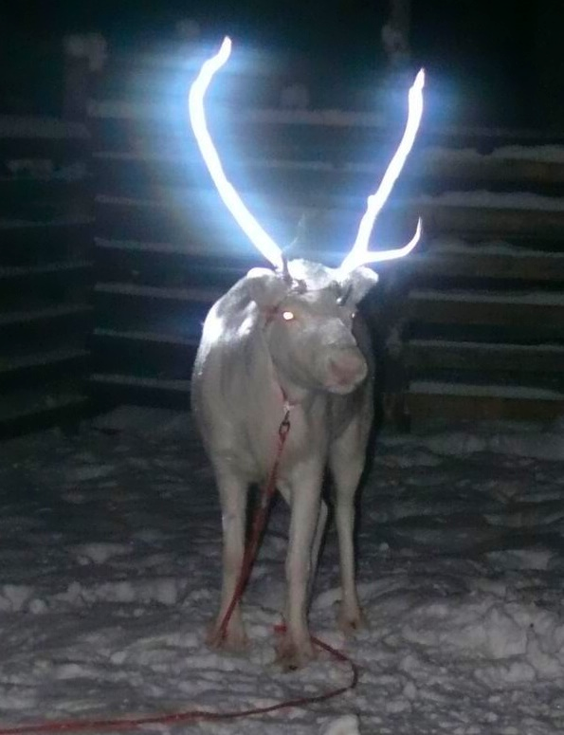
Notes:
Reflective spray applied to reindeer antlers to increase visibility and reduce incidents of car accidents (over 3500 reindeer were killed in car accidents in Finland in 2013).
Image credits: Photo: Anne Ollila, Reindeer Herders' Association.
http://i.imgur.com/BCTPuD5.jpg

Slide 8
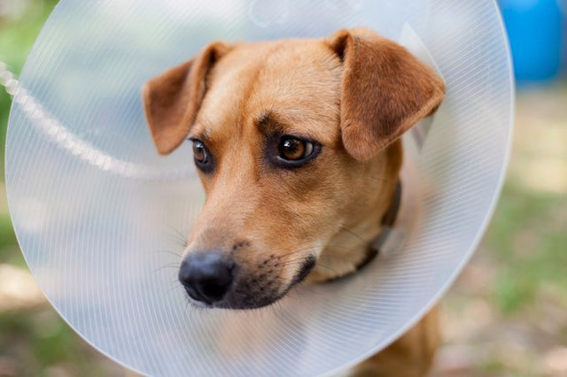
Notes:
What problem has this solved?
Often solutions are incredibly simple, yet fit for purpose – they simply do the job!
Image: Royalty Free
https://www.cuteness.com/blog/content/how-to-help-a-dog-cope-with-a-cone

Slide 9
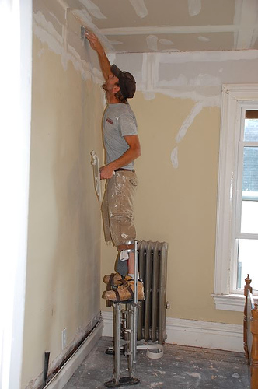
Fix = Make something work better
Notes:
What has this fix improved?
Painters on stilts work faster than those using ladders
Image credits: https://worksthatwork.com/artefacts/higher-productivity
https://farm2.static.flickr.com/1415/688897479_d129cd7550.jpg

Slide 10
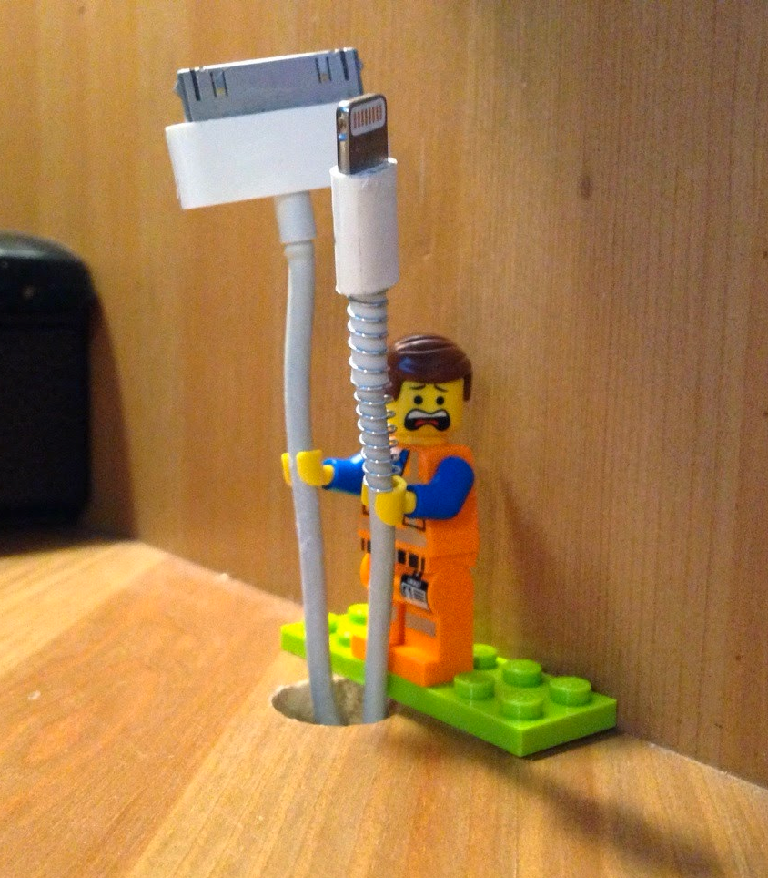
Notes:
Sugru (sugru.com) is a rubber compound that sticks permanently to lots of stuff and is used to repair, customise and build things. After 24 hours it harden and is water and heat resistant.
This person used sugru to ‘fix’ the mess his cables were in, when he discovered that Lego figures’ hands are exactly the right diameter to fit around an Apple cable!
Images: sugru.com
https://sugru.com/tech-gadget/how-to-organise-your-cables-with-lego-minifigures
https://macgyverisms.wonderhowto.com/how-to/organize-your-cable-clutter-with-sugru-mini-lego-people-0156162/

Slide 11
Fix = Change how we behave
Notes:
London Transport is always looking for ways to help ease congestions in underground stations. Simple graphic language is used to communicate standing on the right, walking on the left.
Do you think this is more effective than a sign instructing you to Stand Right, Walk left?
Image credit: Yoni Alter

Slide 12
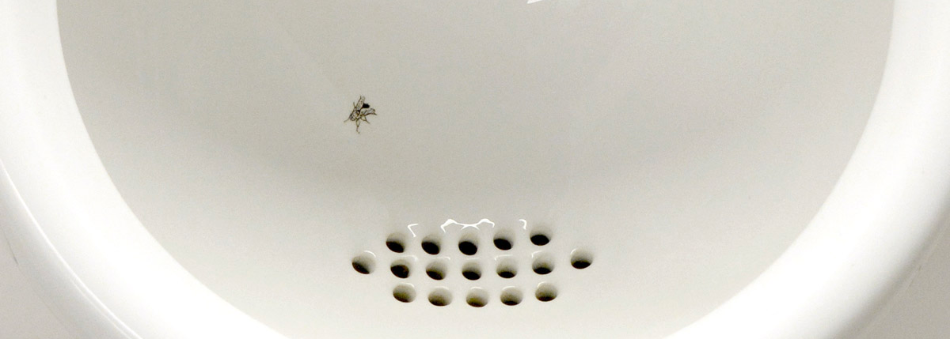
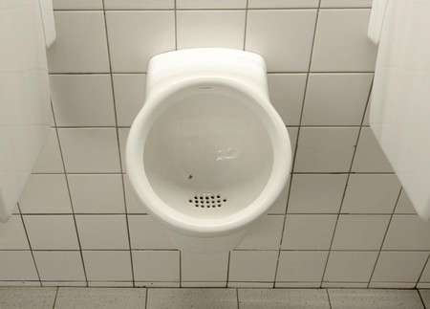
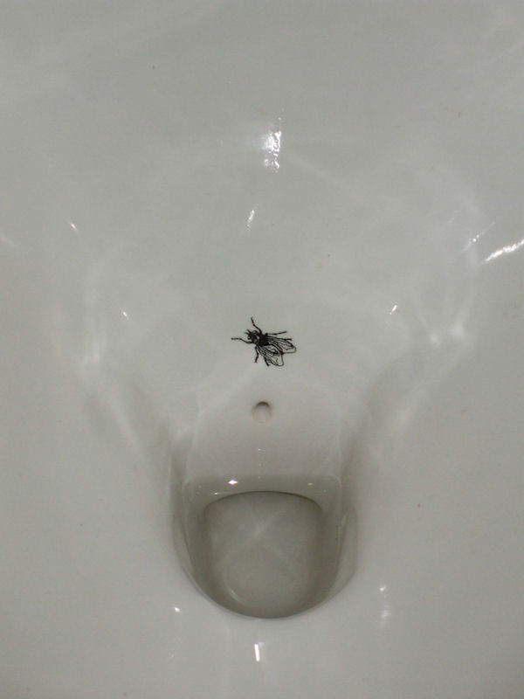
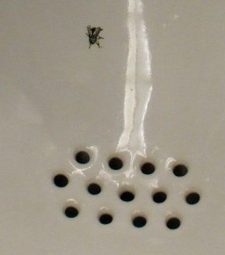
Notes:
Why is there a fly in this urinal?
The management at Schipol Airport in Amsterdam employed a design team to help them think of ways to reduce cleaning costs of the Men’s toilets. Unofficial data says since introducing the flies ‘spillage’ has reduced by anything from 20-50%.
Image credits:
Droog Design,
Photos: Peter Biľak,
http://englishcoffeedrinker.blogspot.co.uk/2010/01/fly-in-urinal.html
http://toilet-guru.com/netherlands.php

Slide 13
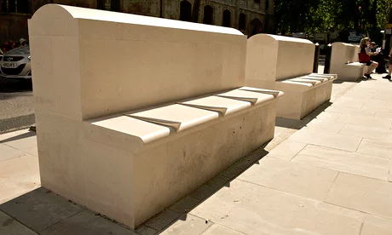
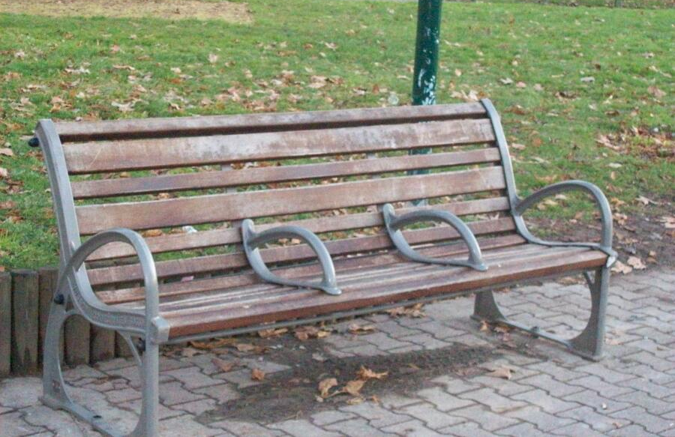
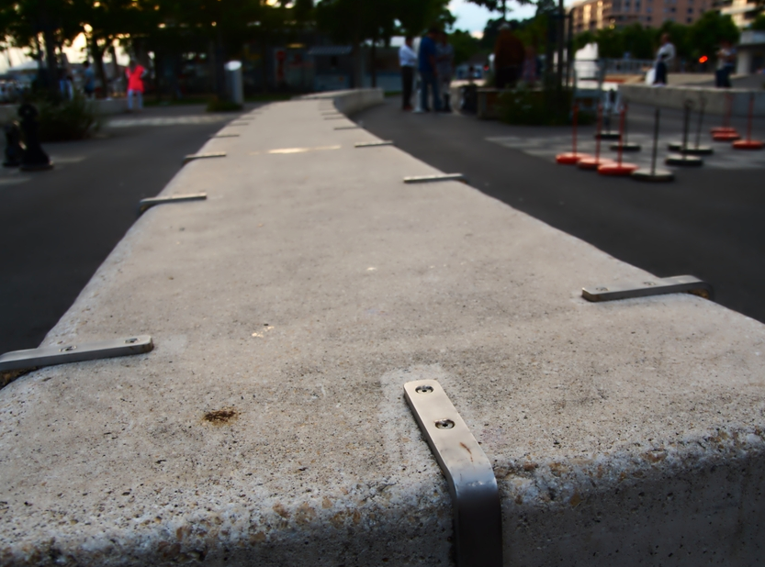
Notes:
What’s the problem? What needs ‘fixing’? Is Fixing always a positive thing?
Benches commissioned by local councils to deter skateboarders from using street furniture for skating; public benches designed to prevent homeless people from lying down.
Image credits:
Top right: http://embed.wistia.com/deliveries/d85dd1e98696eaa594058c2c8fb0f551a99363a3.jpg
Top Left: Photograph: Linda Nylind for the Guardian
Top right: http://unpleasant.pravi.me/wp-content/uploads/2012/10/anti-scate-01.jpg
Bottom left: https://imgur.com/gallery/NDQ5D

Slide 14
Notes:
Introduce Fixperts – (See Introduction to Fixperts for teachers document)
Fixperts is a creative social campaign and design education programme that connects people through the act of ‘fixing’
A Fixperts project offers designers and communicators the opportunity to collaborate with a real person and identify real needs in the world around them. They then work in teams to research and develop solutions, sketch out ideas, model prototypes and make a final product to gift to the Fix Partner.

Slide 15
Notes:
The story is captured in a short video and shared with others in the form of a Fix Film, like this story of Edna and her Sockhorn.
(Show one Fixperts film to the class.)

Slide 16
Let’s fix the future…
Copyright © Fixperts Ltd 2017 and protected under UK and international law.
This presentation is intended for the purposes of teaching exclusively. It is an introduction to ideas and concepts only. It should not be treated as a definitive guide, nor be regarded as advice. Permission is granted to use and reproduce for personal and educational use only. Commercial copying or redistribution is prohibited.
It may contain copyrighted material the use of which has not been specifically authorised by the copyright owner. These materials remain the property of their copyright holders. In accordance with Copyright, Designs and Patents Act 1988 (as amended) they are included under an exception to copyright law - as we are distributing them without profit for teaching and educational purposes. For more information go to: https://www.gov.uk/guidance/exceptions-to-copyright
If you wish to use copyrighted material from this presentation for purposes of your own that go beyond ‘fair dealing’ or teaching purposes, you must obtain permission from the copyright owner.

