Slide 1
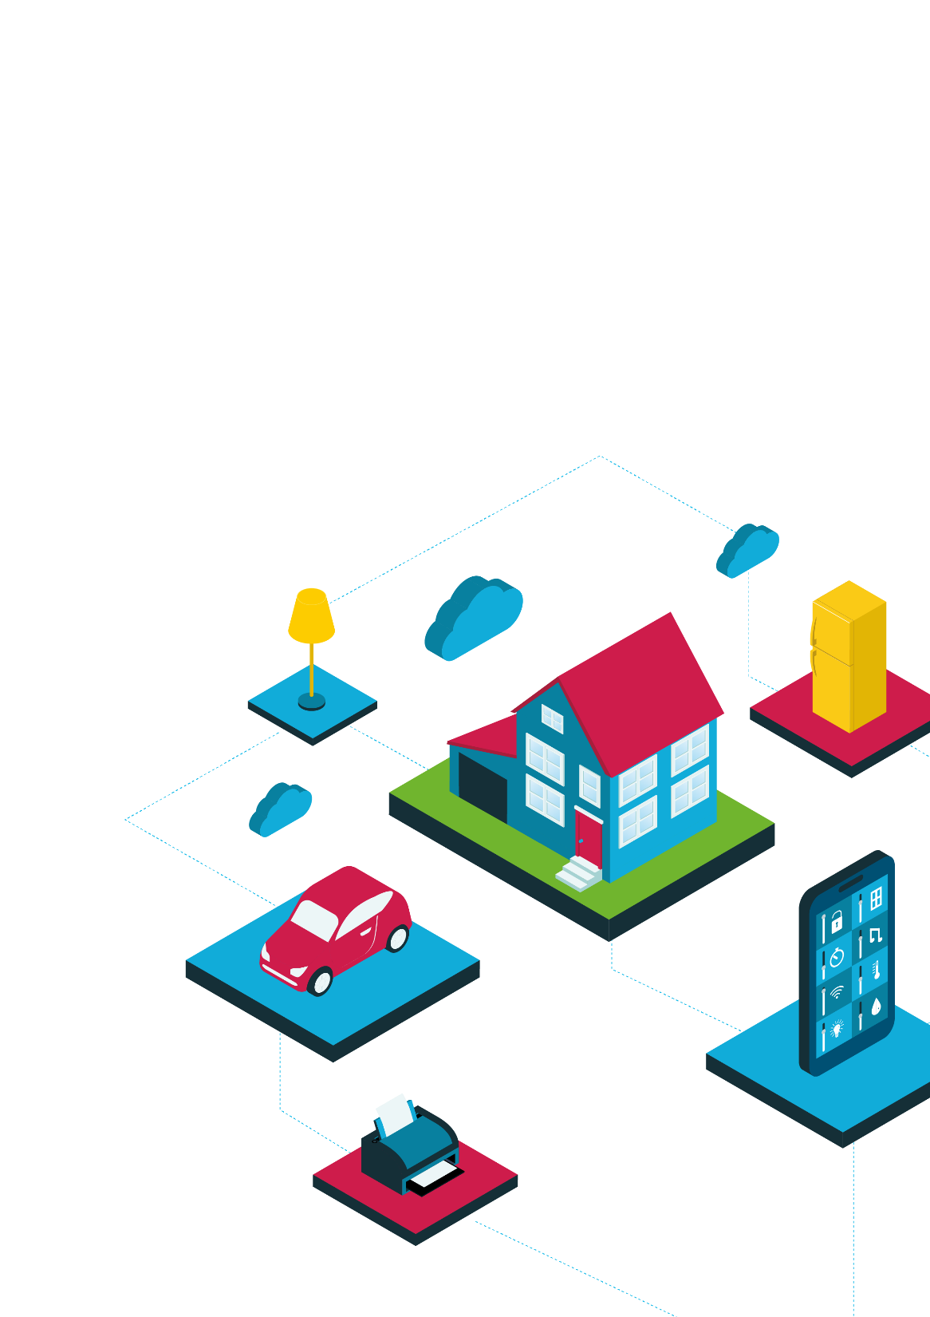
Buildings and fire safety
Making human habitats safer

Slide 2
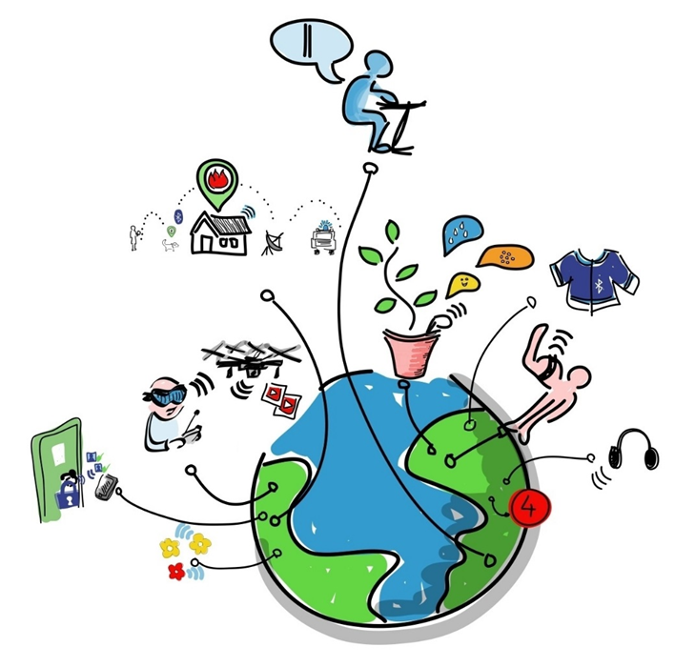
What is the Internet of Things?
The Internet of Things (IoT) links objects in the real world to the internet, enabling data and insights never available before.

Slide 3
Where do we live, work and play?
Before we think about how the designs and features of buildings we might use, we need to think about what types of buildings there are.
On your own think off as many types of buildings that we might live in, work in, study in or play in, as you can.
Then in pairs write down your thoughts.
Finally in a group collate and group those buildings together (this can be in anyway).

Slide 4
What fire risks do different types of buildings have?
Looking at the groups of buildings you have, what do you think are the issues in terms of fire safety?
What are the fire risks you could control? And how would you do it?
Think about:
hazards
design
technology
people

Slide 5
Making buildings safer
In your teams pick one of the building groups you’ve created.
You’ve been asked by the local council to improve fire safety in this type of building, this includes prevention and what happens when there is a fire.
How can you include the Internet Of Things?
In your teams create a poster of what you would do to make this type of building safer for the public. Be prepared to feedback to the class.

Slide 6
Cisco Little Big Futures
Image credits:
IOT drawing: By Wilgengebroed on Flickr [CC BY 2.0 (http://creativecommons.org/licenses/by/2.0)], via Wikimedia Commons

