Slide 1
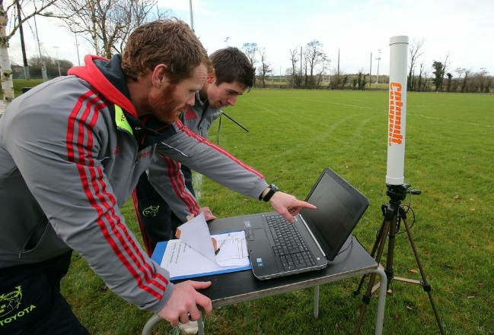
Techniques for Analysis of Sports and Exercise
National STEM Learning Centre and Network

Slide 2
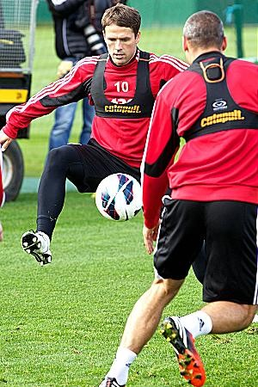
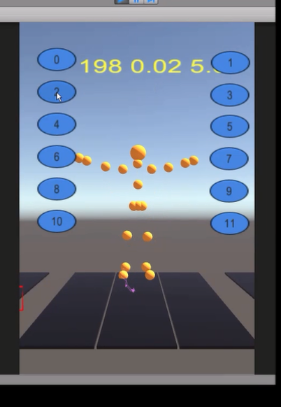
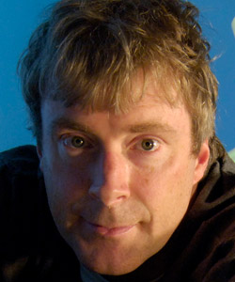

Combining sport and technology
EPSRC Digital Economy Research Project

Slide 3
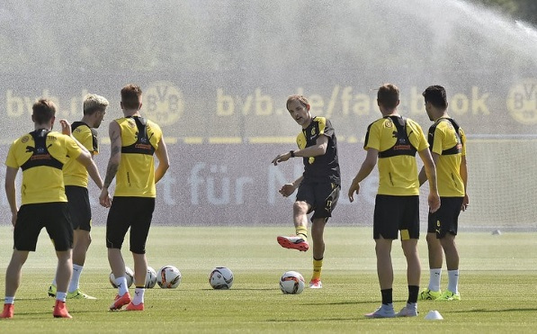
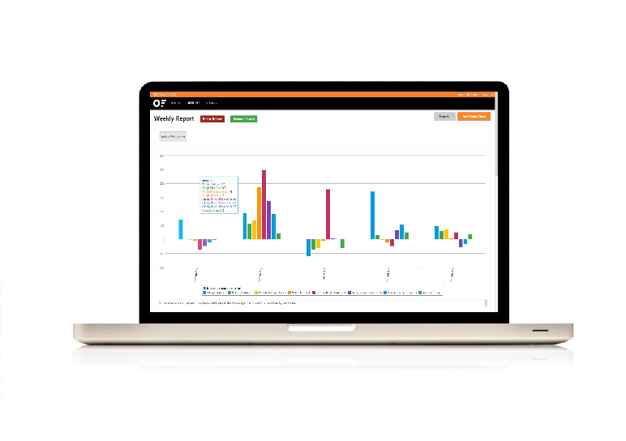
Use of technology in sports
Obtaining data
    Physical data
    (speed, distance etc)
    Technical data
    (game technique)
    Tactical data

Slide 4
Benefits of collecting data in sport
Match analysis of own team / opponents
Scouting for new players
Monitoring physical activity of players
  - Potential for injury

Slide 5
Injury prevention – Activity 1
Give some reasons why this is important for people who are involved in sports
Why are clubs willing to spend money on this?

Slide 6
Injury Prevention - Reasons
Unable to do sports – loss of income
Medical costs
Long term impact on health – arthritis
Any others?

Slide 7
Knee injury
    Click here for NHS article about knee injury
Anterior cruciate ligament
Femur
Patella
Meniscus
Tibia
Knee joint: Front View Side view

Slide 8
ACL Injury and causes
Anterior cruciate ligament (ACL) injury
  Video explanation of ACL
  important in stabilising the knee joint
  can be injured when overstretched: contact /non-contact
  In sports where there is a turning and twisting motion (football, rugby, basketball and alpine skiing)

Slide 9
Famous sufferers of ACL injury
  Paul Gascoigne
  Michael Owen
  Tiger Woods
  Click here for article about Theo Walcott
  Click here for article about professional footballer injuries

Slide 10
Knee Joint Angle & force on knee
a) Normal stance b) Varus c) Valgus
Normal stance:
No torque force on the knee joint
Varus/Valgus: Torque force on knee

Slide 11
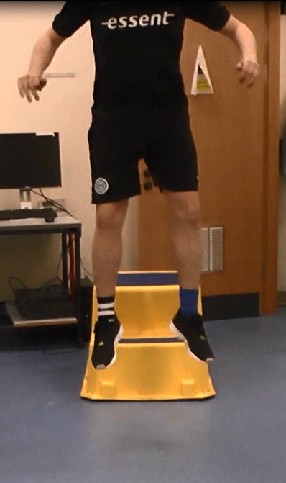
Research investigation
Researchers and medical doctors have observed that ACL injuries are caused by:
  jumping technique
  Turning/twisting movement technique
  Sudden deceleration
  Plan an investigation using an exercise movement to assessing whether athlete likely to be injured?

Slide 12
Research investigation planning
What would you need to consider?
  Type of experiment: jump, hop…
  Variables: independent, dependent, control (what to keep the same)
  How to record results: chart, graph
  Hazards: What could go wrong?
  Control measures: reduce risk to acceptable level
  Measurements: repeatable, reproducible

Slide 13
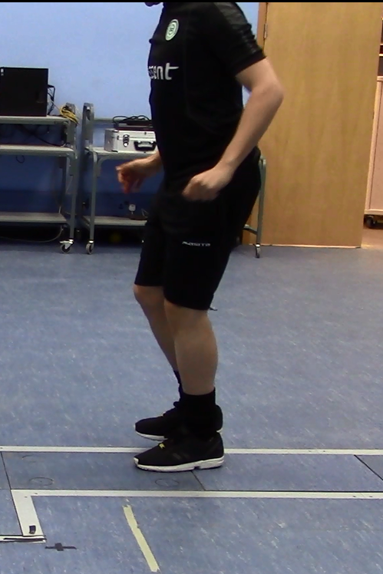
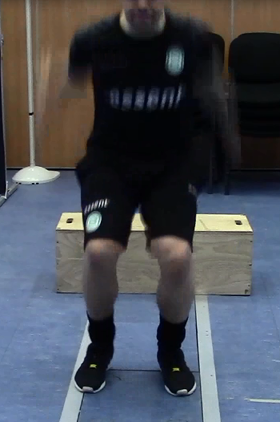
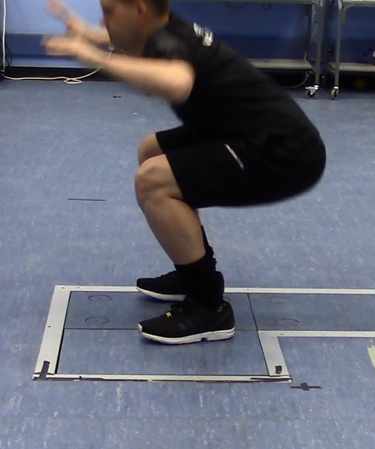
Experiments
Movements performed in research into ACL injuries
  One and two footed jumps (landing technique)
  Different movements involving change of direction

Slide 14
Measurements in this research
Variables:
  Flexion (bend) in the knee and hip after landing
  Knee valgus angle (knees bend towards each other)
  Knee rotation (foot not pointing forwards)
  Landing on front or back of the foot

Slide 15
Factors to consider: ethics/safety
Medical ethical committee must approve research study before it can conducted
  Risk of injury to study participants so precautions taken:
  warming up
  time between jumps to recover
  conduct in a controlled environment

Slide 16
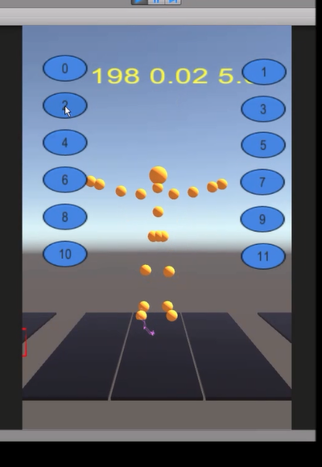
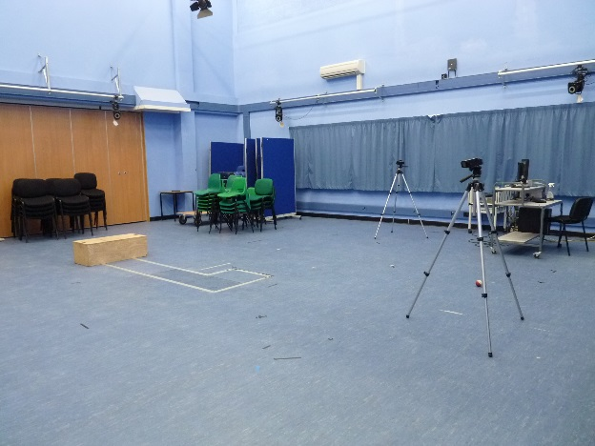
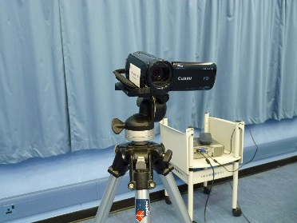
Biomechanics research
Video techniques and markers are used
  (Student Information Sheet 2)
  Video results analysed by person or computer programme

Slide 17
Video set up – control variables
Length of jump is half athlete’s height
Jump box
(fixed height)
50% athlete height
Camera 1
Fixed lens to floor height
& distance from force plate
Force plate
Camera 2
Fixed lens to floor height
& distance from force plate

Slide 18
Measurements
Typical scoring system used in research
  “LESS” – requires expertise (Student Information Sheet 3)
Can you suggest a scoring system for your investigation
  - For example: Risk of injury: Yes/No , Reason

Slide 19
Analysis of results – Activity 3
Use information about cause of ACL injuries (Information Sheet 1) to evaluate likelihood of injury
  Make your own videos or use the video clips of jumps provided (see next slide)
  Share results, how could you investigate further?

Slide 20
Analyse research data
View videos
  - Record comments
  - Compare with researcher analysis (Information Sheet 4)

Slide 21
Researcher analysis of movements
Vertical drop jump
Video 000 | Good, although more knee flexion would have been better
Video 001 | Knee valgus angle: injury risk
Video 002 | External knee rotation: injury risk
Single leg hop
Video 003 | Error, hopped from one leg onto the other leg
Video 004 | Good
Video 005 | Error, jump was diagonal instead of straight forward, and knee valgus
Video 006 | Good
Video 007 | Good
Video 008 | Good
Squats
Video 009 | Good
Video 010 | Knee external rotation: injury risk
Video 011 | Knee valgus: injury risk

Slide 22

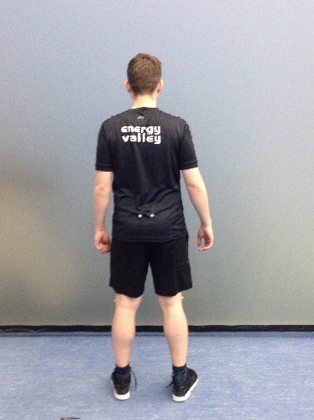
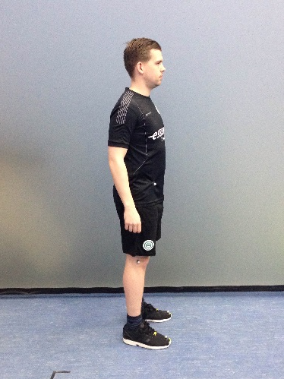
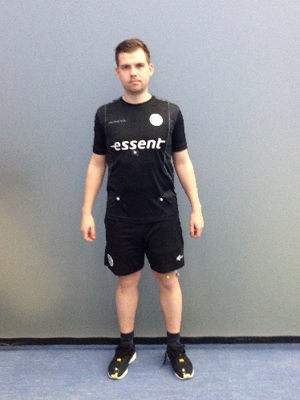
Computer analysis
  Researcher analysis of movement is time consuming and potentially subjective
  In this research markers are attached to athlete’s clothing and images analysed by computer

Slide 23
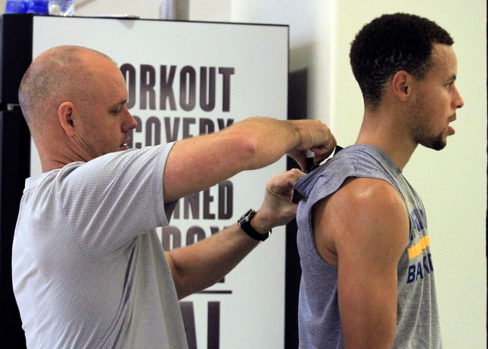
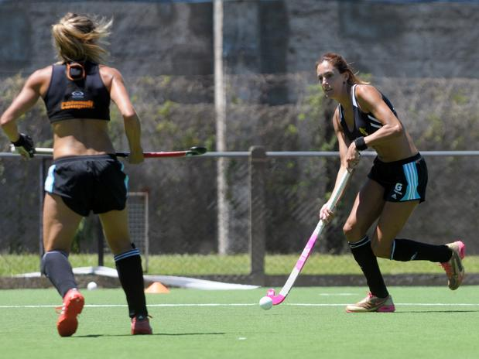
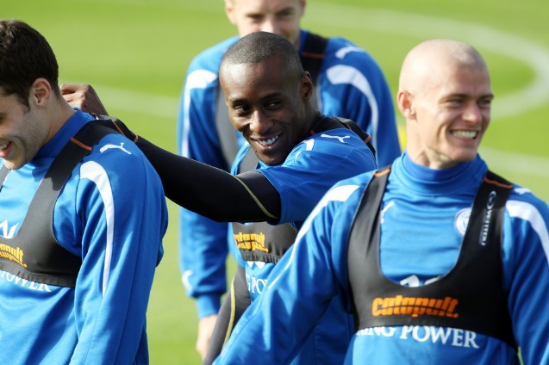
Use of Wearable GPS Devices
  GPS vests/chips in shirts measure position of player throughout training or match
    Video of typical GPS athlete tracking system
    Video about GPS monitoring at Newcastle United
    BBC: "wearable tech giving sports teams winning ways"

Slide 24
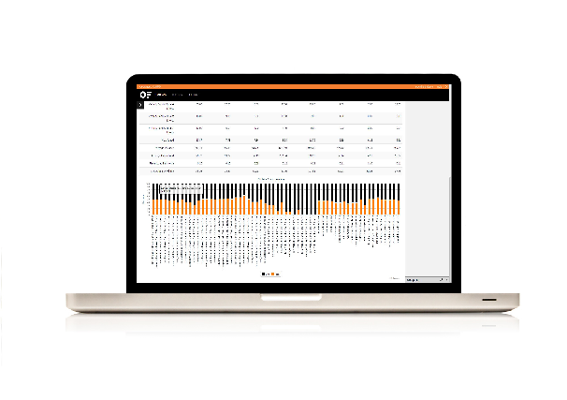

Use of Wearable GPS Devices
  Data transferred to laptop computer
  Analysed using computer programme/spreadsheet
  Gives statistics about athlete performance
  Not yet sufficiently accurate to assess injury potential

Slide 25
Collect own performance data
  You could also use GPS data to measure and evaluate sports performance using:
  “sports watch” with GPS
  Smart Phone with accelerometers
  Smartphone App (for example “Runkeeper”, “Runtastic”)
  Measurements could be:
  Acceleration/Deceleration
  Average Speed
  Distance covered

Slide 26
Wearable Tech: Boxing Game
  A boxing computer game was tested by University of Teesside researchers on 50 unhealthy men from Teesside
  gamers played against a virtual boxer who reacts to their punches
  research showed that the exercise gained from the game could improve people's health
  Link to Newspaper article , BBC News Website

Slide 27
Career Profiles of Researchers
Many routes to become a researcher
  People involved in biomechanics research include:
  Computer programmers, medical doctors, sports scientists, engineers, physical therapists
  Normally move into research after BSc or Masters degree at university
  Some enter research with experience of working with professional athletes

Slide 28
Professor Iain Spears
Career
  Research Degree (PhD), Liverpool University
  Dept of Human Anatomy and Cell Biology
  Currently: Professor of Sport and Exercise, University of Teesside
  Professor Spears’ background is engineering, specialising in computational biomechanics in the areas of sport and exercise. Prior to sport and exercise, he worked in dental and orthopaedic research.

Slide 29
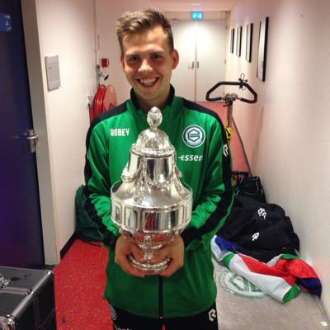
Mark Wijnbergen
Career
  BSc – University of Groningen
    Human Movement Science
  MSc – University of Groningen
    Sports Science & Human Movement Science
  Video and data analyst at FC Groningen
  PhD Student Teesside University
  “Development and evaluation of a performance analysis system for use in elite football”

Slide 30
Acknowledgements
Professor Iain Spears / Mark Wijnbergen
  For supplying information about the research and videos
Catapult Sports
  - For supplying and giving permission to use images

