Slide 1
Classification

Slide 2
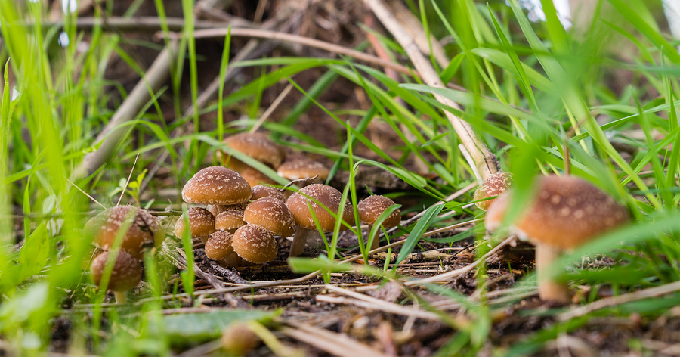
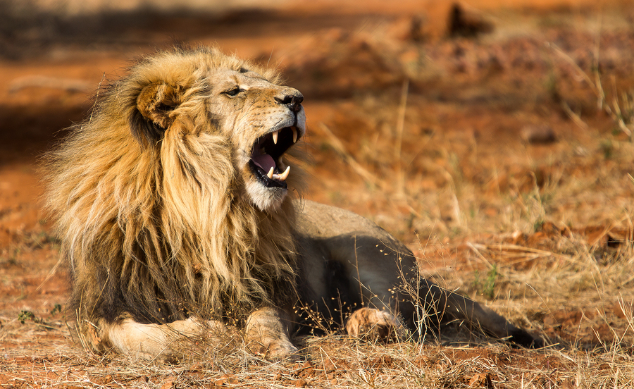
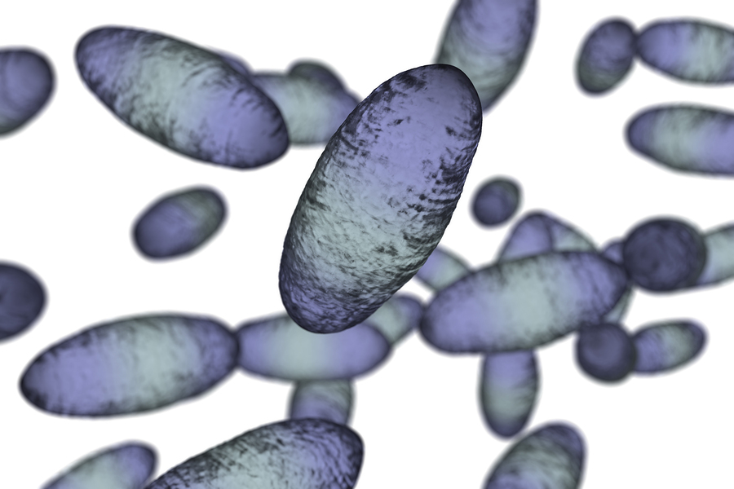
Kingdoms

Slide 3
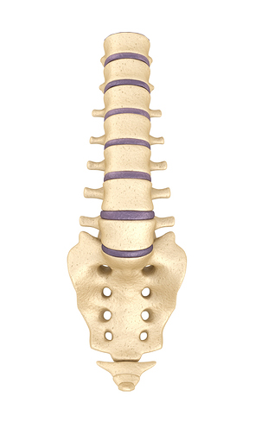
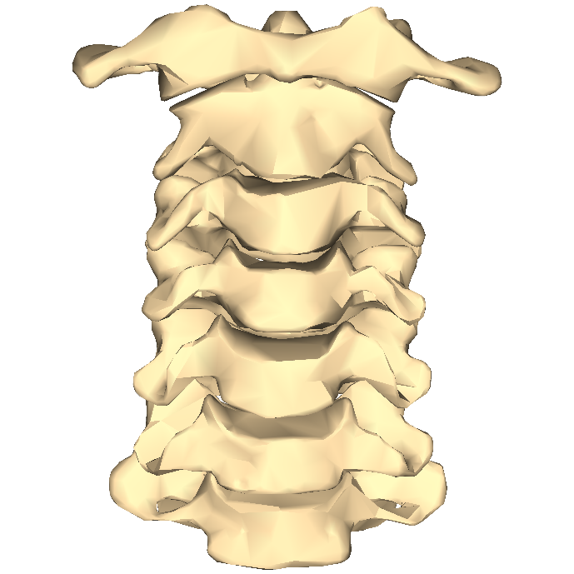
Phylum
Does the animal have a back bone?
If yes - it is a vertebrate.
If not - it is an invertebrate.

Slide 4
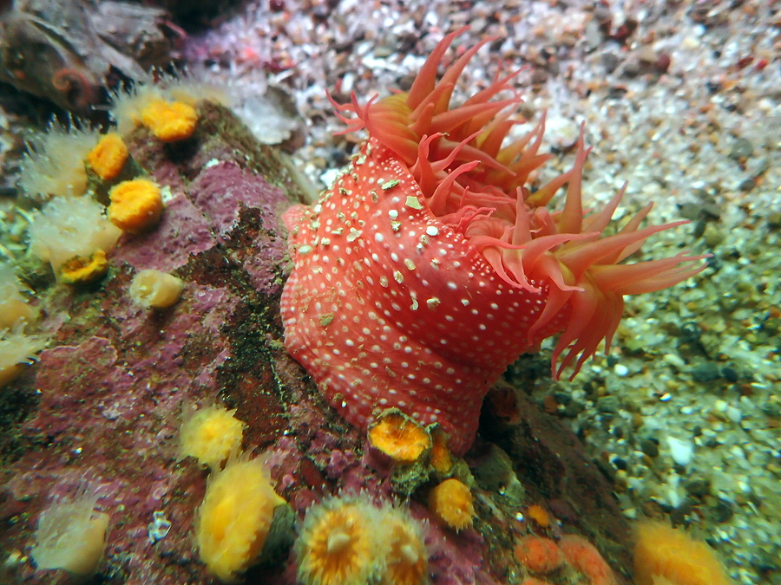
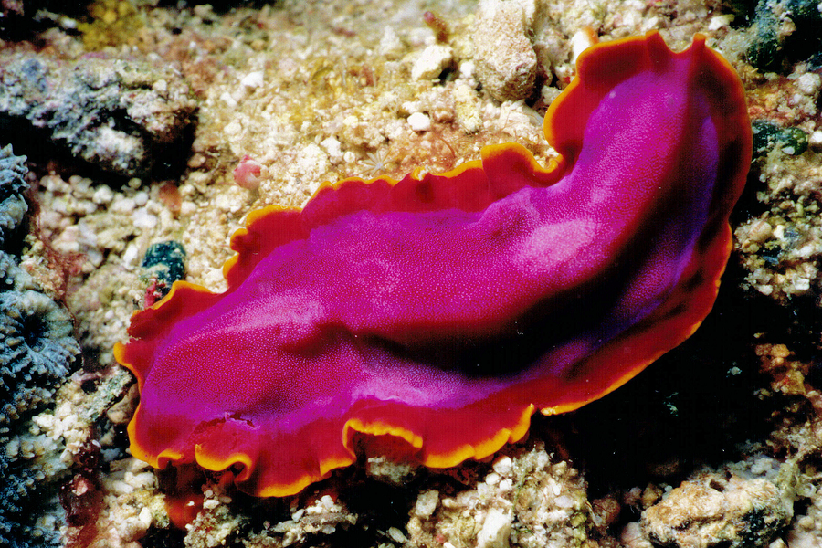
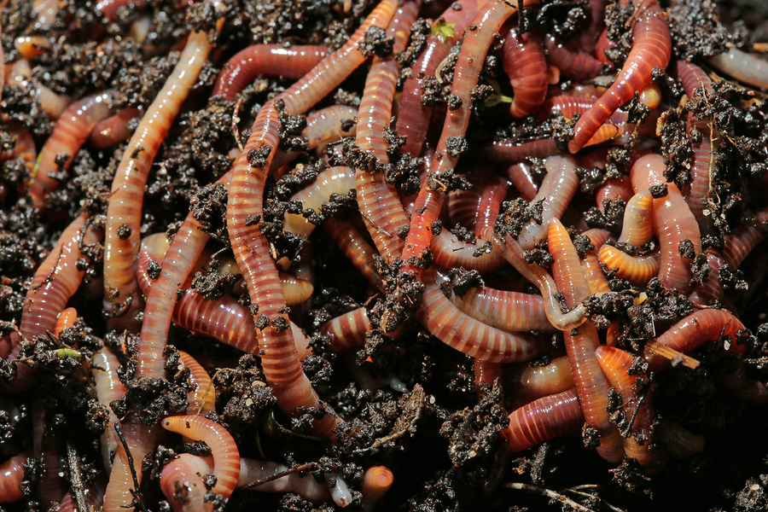
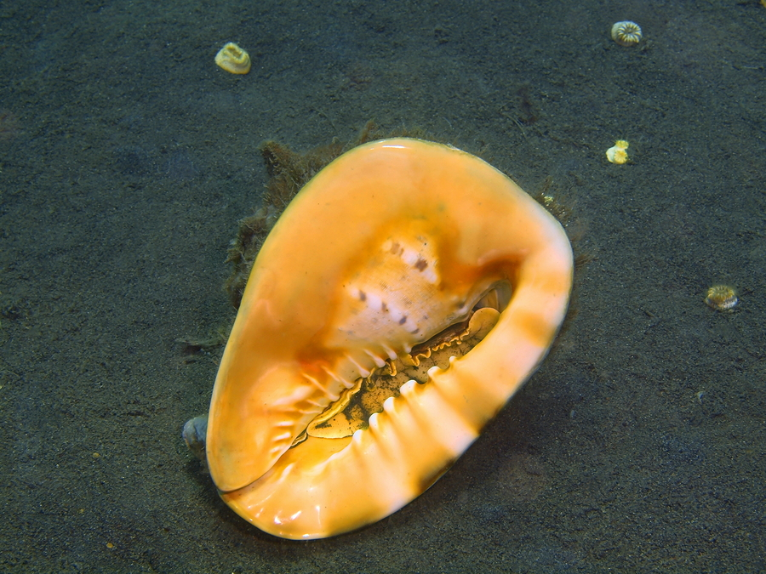
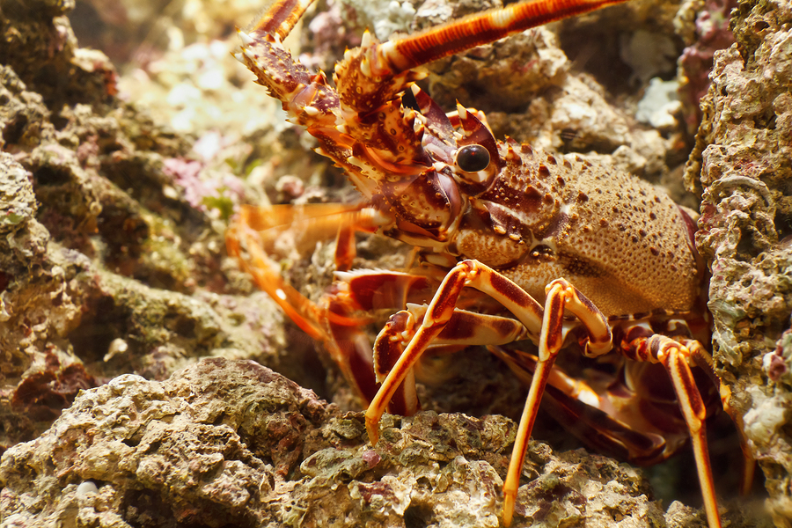
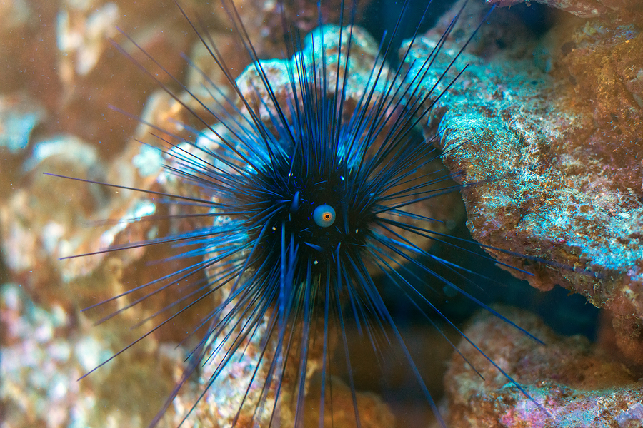
Class
We know it is an invertebrate- the classes are:
Protozoa - single celled organisms
Coelenterates - soft bodies, stinging cells
Flatworms - simple and soft bodies
Annelid worm - segmented bodies
Molluscs - soft bodies, most have shells
Arthropods - hard external skeleton and jointed limbs
Echinoderms - spiny sea creatures

Slide 5
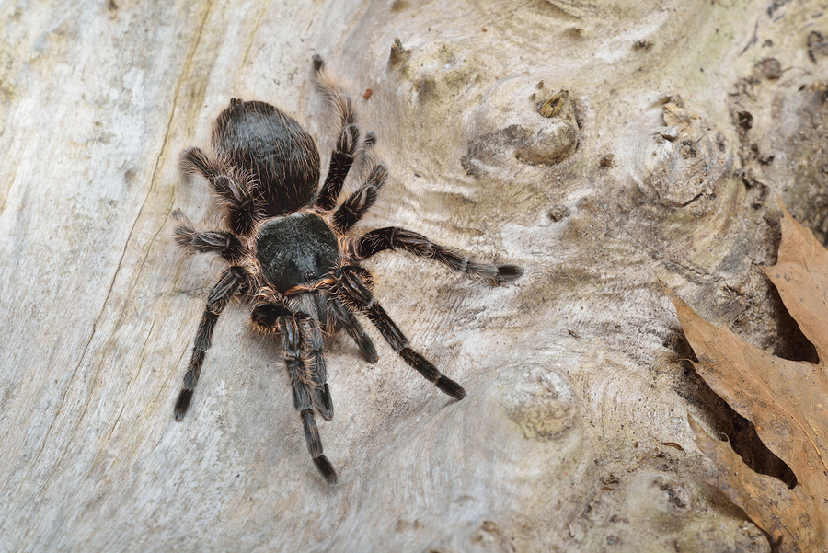
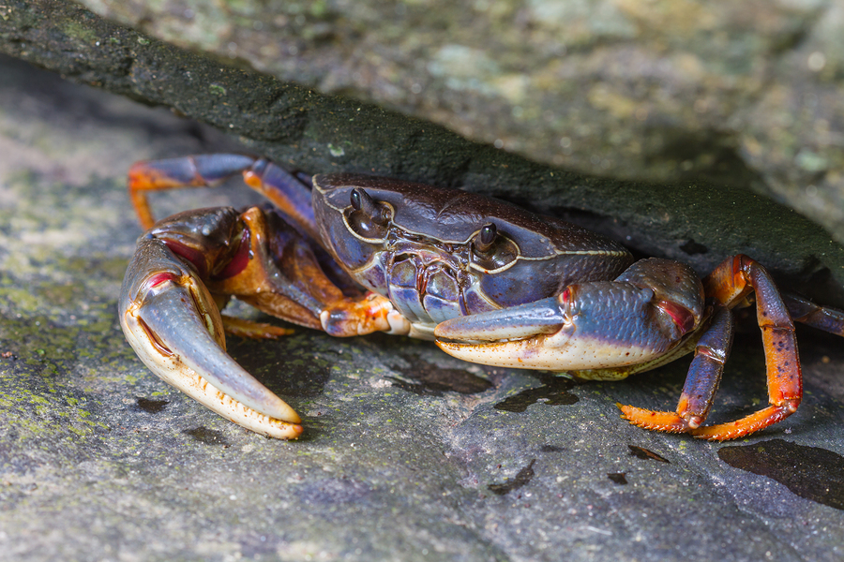
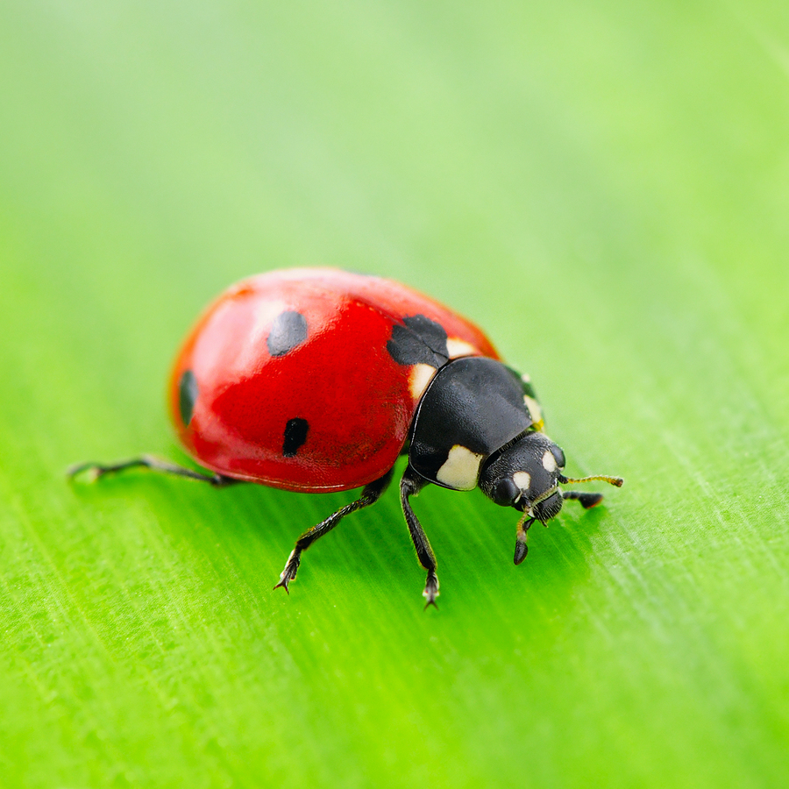
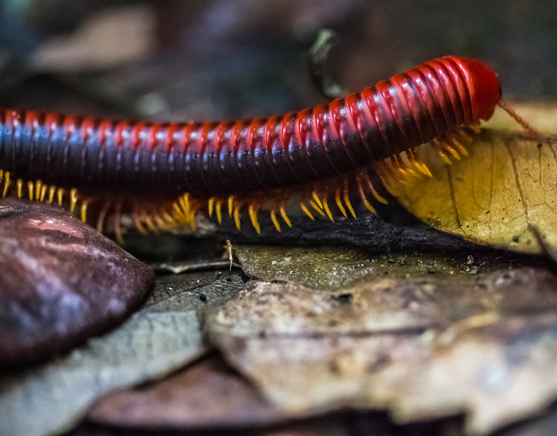
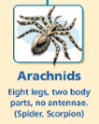
Order
We have identified our animal as an arthropod. Which order is it from?

Slide 6
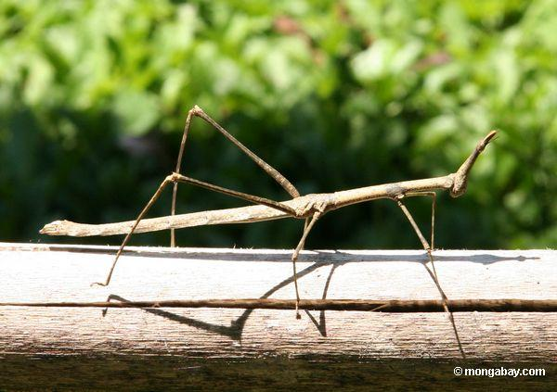
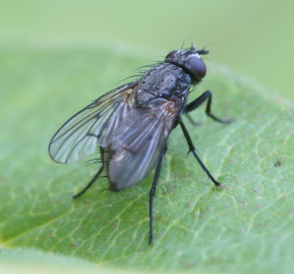
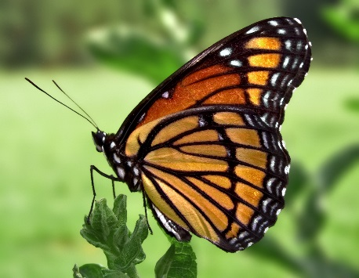
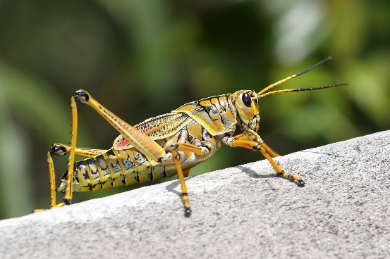
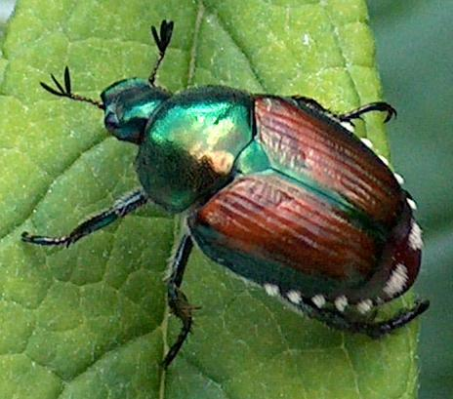
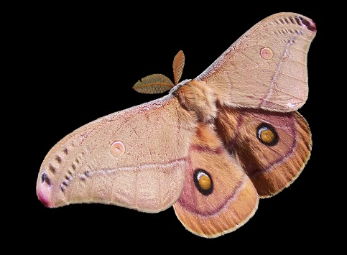
Family
Within the insect order there are lots of different families.
These include flies, butterflies and moths, stick insects and grasshoppers and beetles.
A beetle is described as an insect that has forewings which are typically modified into hard wing cases that cover and protect the hindwings and abdomen.

Slide 7
