Slide 1
Flying Fruit
Age 4–5

Slide 2
Lesson 1: Fantastic Fruit
Learning outcomes:
I know my food comes from different places around the world.
I know that fruit can be part of a healthy diet.

Slide 3
Lesson 1: Fantastic Fruit
Big Question:
Why does my fruit come from different places?

Slide 4
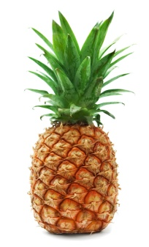
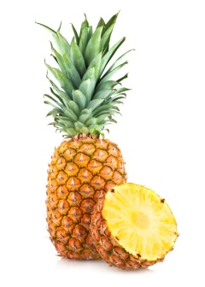
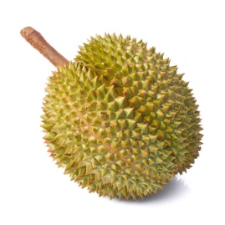
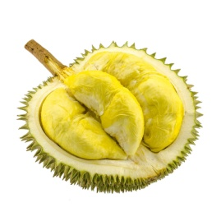
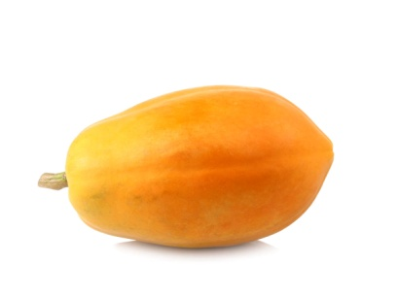
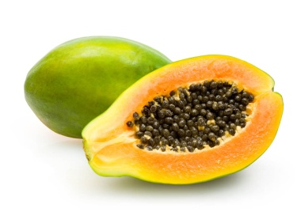
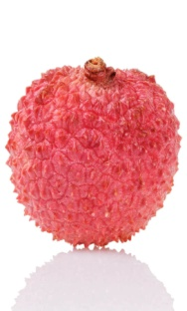
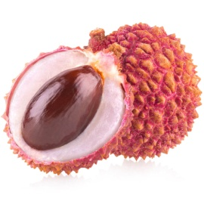
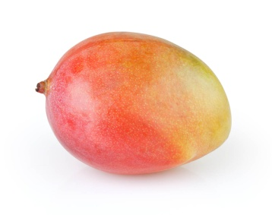
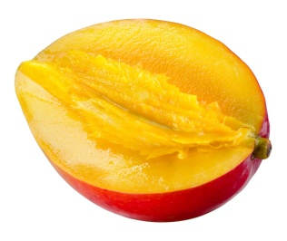
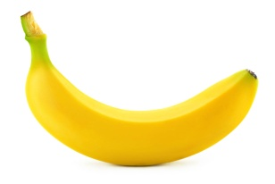
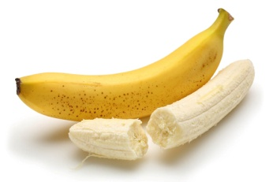
Lesson 1: Fantastic Fruit
Fruit pictures 1:
pineapple
durian fruit
papaya
lychee
banana
mango

Slide 5
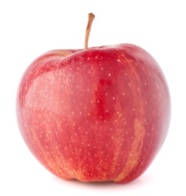
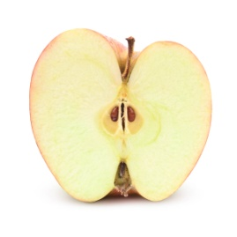
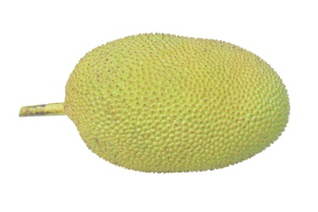
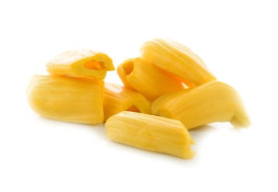
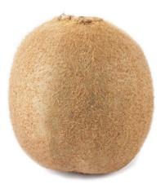
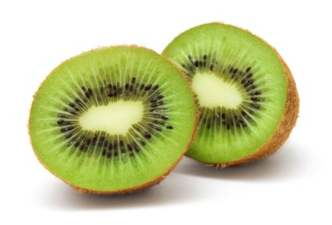
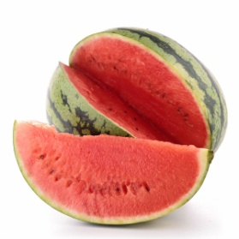
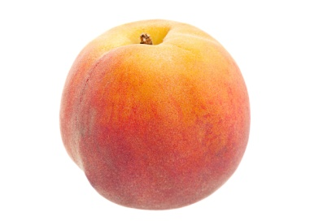
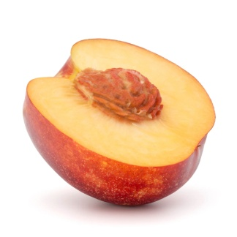
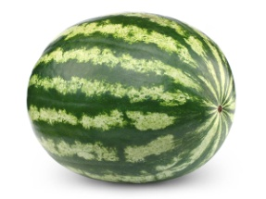
Lesson 1: Fantastic Fruit
Fruit pictures 2:
apple
jack fruit
kiwi fruit
watermelon
peach

Slide 6
Lesson 1: Fantastic Fruit

Slide 7


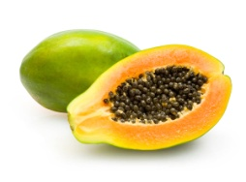

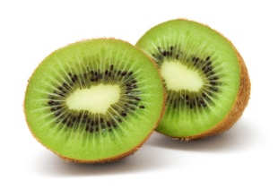






Lesson 1: Fantastic Fruit
List of countries:
durian fruit
Thailand
watermelon
Brazil
papaya
Indonesia
banana
Bolivia
kiwi fruit
New Zealand
mango
Algeria
pineapple
The Philippines
jack fruit
Bangladesh
apple
France
peach
United States of America
lychee
China

Slide 8
Lesson 2: What’s Inside?
Learning outcomes:
I recognise the similarities and differences between fruit.

Slide 9
Lesson 2: What’s Inside?
Big Questions:
Where are the seeds in each fruit?
Are seeds the same in each fruit?
Why do we need seeds?

Slide 10











Lesson 2: What’s Inside?
The insides of fruits:

Slide 11
Lesson 3: Watch It Grow
Learning outcomes:
I can observe how a seed grows into a plant.

Slide 12
Lesson 3: Watch It Grow
Big Question:
What does a seed need to grow?

Slide 13
Unit Key Vocabulary
fruit
healthy
seasonal
vitamins
seeds
stone
flesh
skin
seed
grow
light
food
water
germinate

Slide 14
Photo Credits:
Flying Fruit, Age 4–5
apple (whole) - Shutterstock.com / Nattika; apple (inside) - Shutterstock.com / Anna Sedneva; banana (whole) - Shutterstock.com / Maks Narodenko; banana (inside) - Fotolia.com / mates; durian fruit (whole) - Shutterstock.com / panda3800; durian fruit (inside) - Fotolia.com / pongpatpic; jack fruit (whole) - Fotolia.com / foto76; jack fruit (inside) - Fotolia.com / yodaswaj; kiwi fruit (whole) - Shutterstock.com / freedomnaruk; kiwi fruit (inside) - Shutterstock.com / Alex Staroseltsev; lychee (whole) - Fotolia.com / goodween123; lychee (inside) - Fotolia.com / Malyshchyts Viktar; mango (whole) - Shutterstock.com / Svetlana Kuznetsova; mango (inside) - Fotolia.com / Tim UR; papaya (whole) - Fotolia.com / artphotoclub; papaya (inside) - Shutterstock.com / Viktar Malyshchyts; peach (whole) - Fotolia.com / Leonid Nyshko; peach (inside) - Shutterstock.com / Nattika; pineapple (whole) - Shutterstock.com / Alex Staroseltsev; pineapple (inside) - Fotolia.com / Malyshchyts Viktar; watermelon (whole) - Shutterstock.com / Maks Narodenko; watermelon (inside) - Shutterstock.com / margouillat photo

