Slide 1
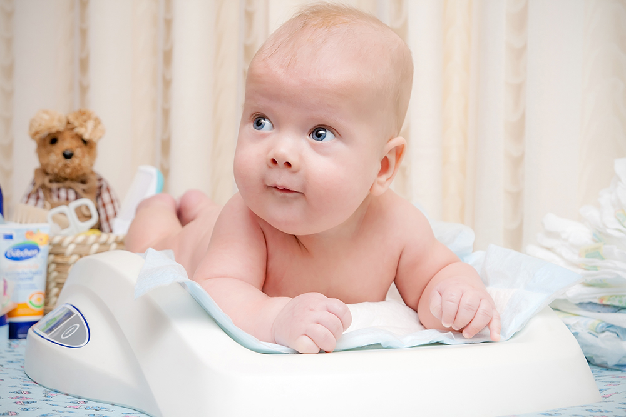
Statistics 2 – Activity 3
Baby boom

Slide 2
Baby boom yesterday
It was a very busy day at the Royal Hospital yesterday, when 12 babies were born – a record for one day. One of the babies, Jake, son of Jasmine and Jeremy Whitehouse, weighed in at a whopping 10.8lbs – the heaviest baby born at the hospital for over five years.
But was Jake really exceptionally heavy?

Slide 3
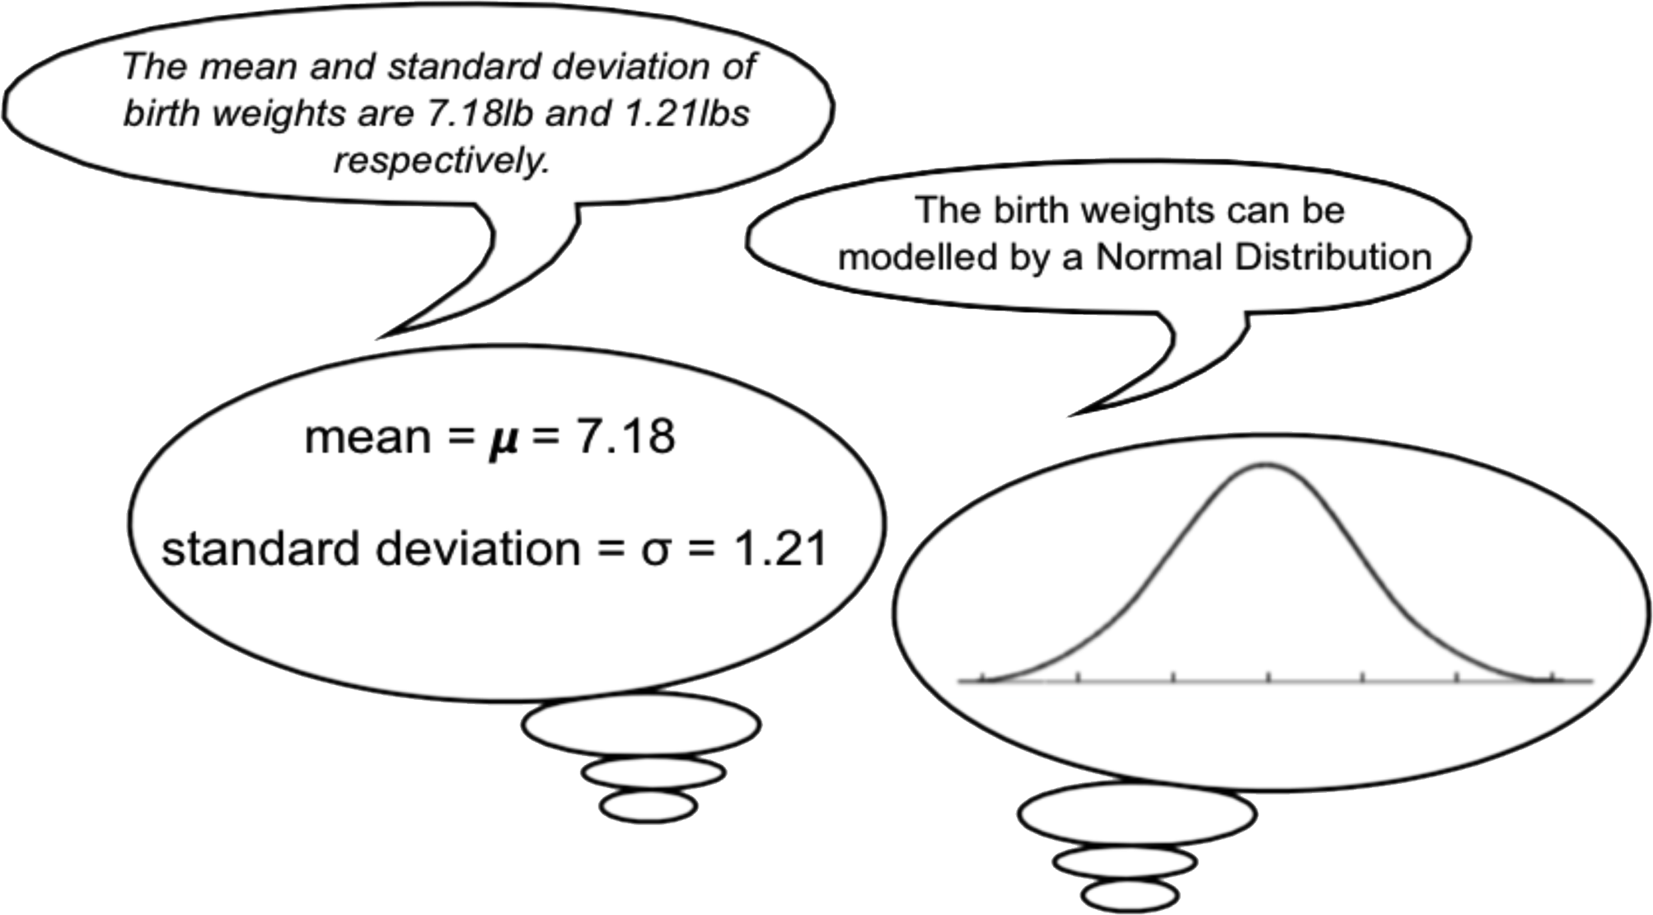
When asked, a data analyst from the National Statistics Office stated that…
and that…

Slide 4
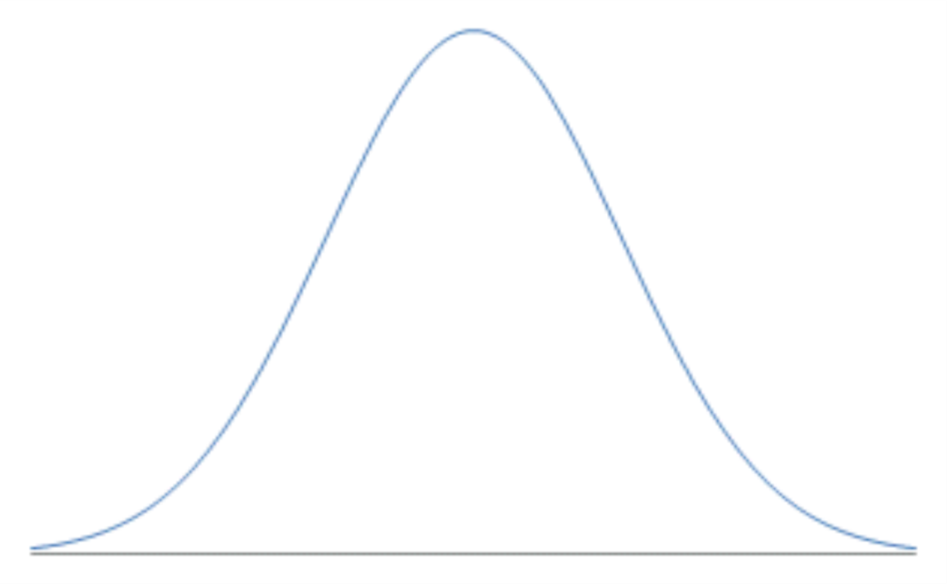
A normal distribution: what does it look like?
Characteristics of a normal distribution:
Bell shaped, symmetrical about its middle, with scores concentrated more in the middle than at the end.
The mean, mode and median are the same.
The curve is continuous and is used for continuous data.

Slide 5
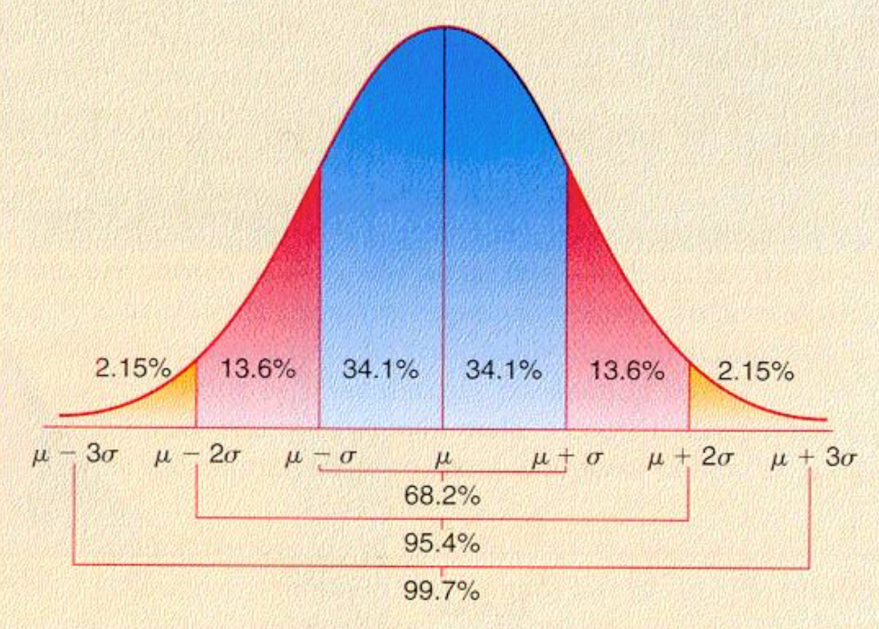
What else do we know?
About 68% of values drawn from a normal distribution are within one standard deviation σ away from the mean; about 95% of the values lie within two standard deviations; and about 99.7% are within three standard deviations. This fact is known as the 68-95-99.7 (empirical) rule, or the 3-sigma rule.

Slide 6
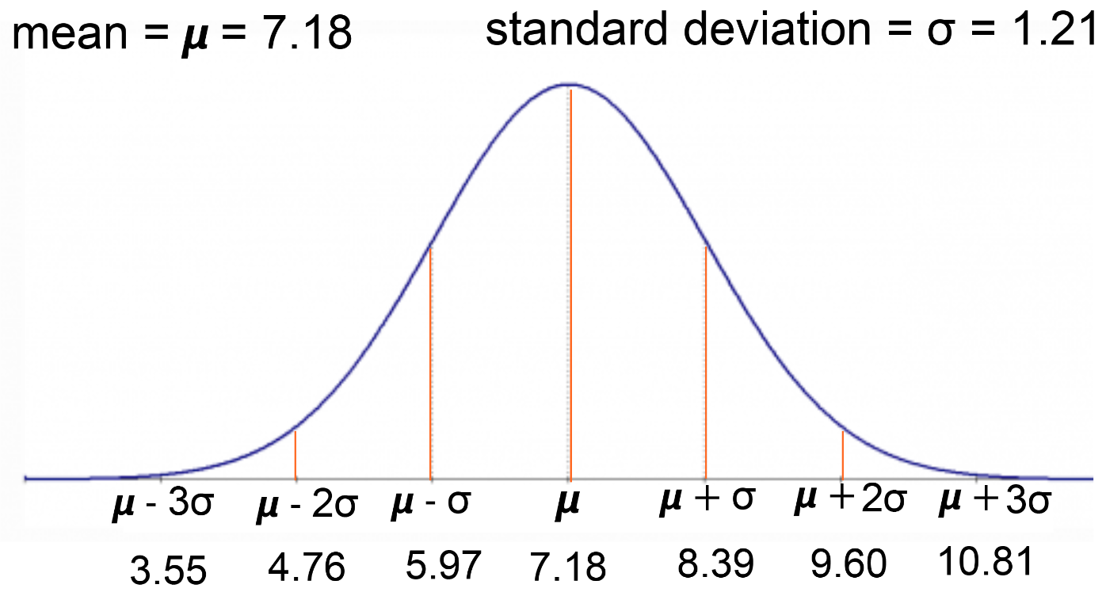
So what do we know in this case?
This means that 68% of babies should be between ............ and ............ and 95% should be between ................ and ................ and 99.7% should be between ............... and ................
So baby Jake – at 10.8Ib – is very rare!

Slide 7
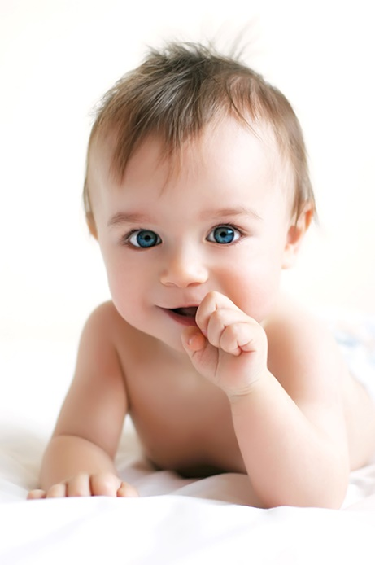
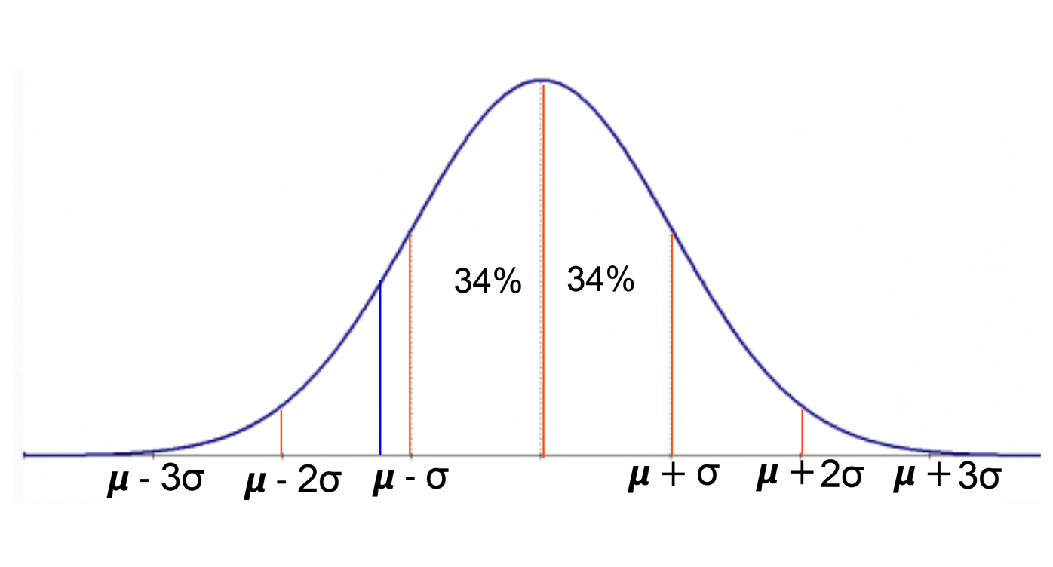
On the same day, baby Josie Allchurch weighed in at 5.8Ibs. Was this exceptionally light?
So baby Josie, at 5.8lb, is not in the middle 68%, but she is in the bottom 16%. She is definitely quite small but does not appear to be exceptionally so.
Clearly we do need a better way of working this out!

Slide 8
Some new notation
Let X be the distribution of the weights in lbs of the babies born across the country.
Then, because we are told that these weights form a normal distribution, we write:
X~N(7.18, 1.21²)
Name of the distribution
This number (1.21²) is the variance
Indicates it is a normal distribution
The standard deviation is 1.21lbs
The mean is 7.18Ibs

Slide 9
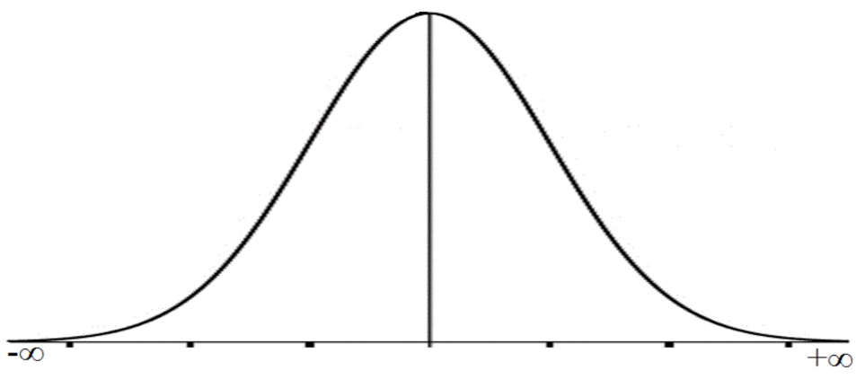
Practice time
In each of the following questions, write down the mean, variance and standard deviation of the given distribution.
In each case draw the x-axis of the distribution, clearly labelling the seven key measures.
Let X be the distribution of IQ scores across Wales, then X ~ N(100, 15²)
Let X be the length of eggs in cms laid by a particular species of chicken then X ~ (6, 1.4²)
Let X be the rainfall measured in mm over a given area of land, then X ~ N(850,100²)
Let X be the width of bolts in mm made by a certain factory, then X ~ N(4, 0.09). Note in this question you are given the variance as a number – be careful!

Slide 10
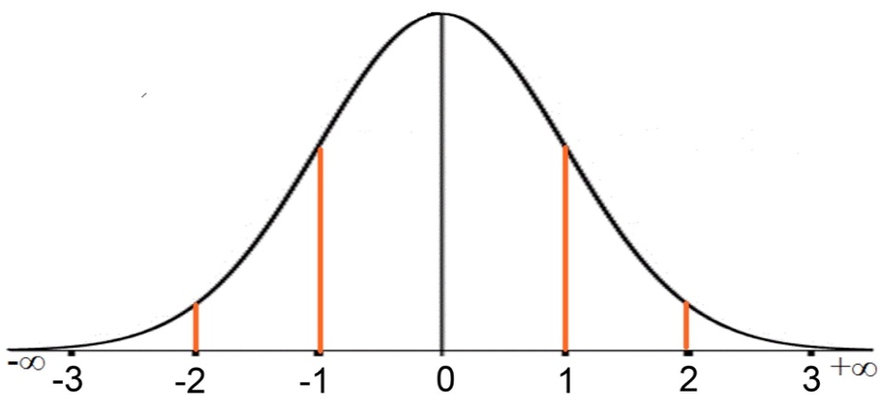
A very special normal distribution
A very useful normal distribution that has a mean of 0 and a standard deviation of 1 is known as the standardised normal distribution. It follows that the variance is also 1.
It it traditionally written as
Z ~ (0, 1)
and it can then be represented pictorially as shown here.
The area under this curve and above the x-axis is 1, which links this curve very nicely to probability.
If we only work in whole numbers of standard deviations, this limits the number of questions we can tackle.
Fortunately this very special distribution is supported by tables – which enables us to extend our range of questions.

Slide 11
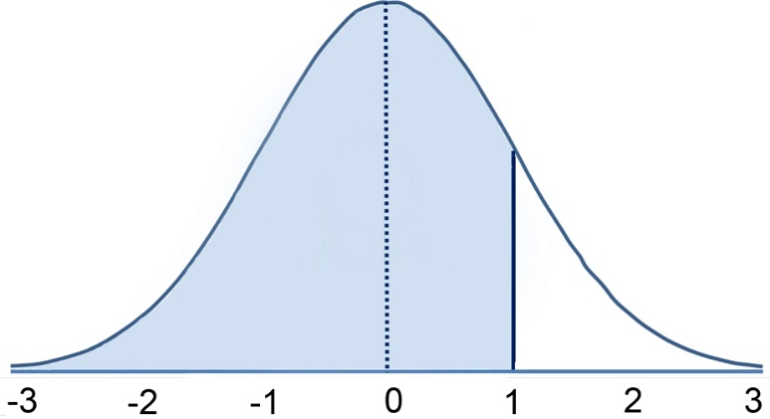
A new range of problems
If Z is a standardised normal distribution, then Z ~ (0, 1)
Suppose we want to find the probability that a randomly chosen value of Z is less than 1.
Then it can be represented by the shaded area on this diagram.
We write this as P(Z<1)
Based on your current understanding, you should be able to give a fairly accurate answer to this question
P(Z<1) =

Slide 12
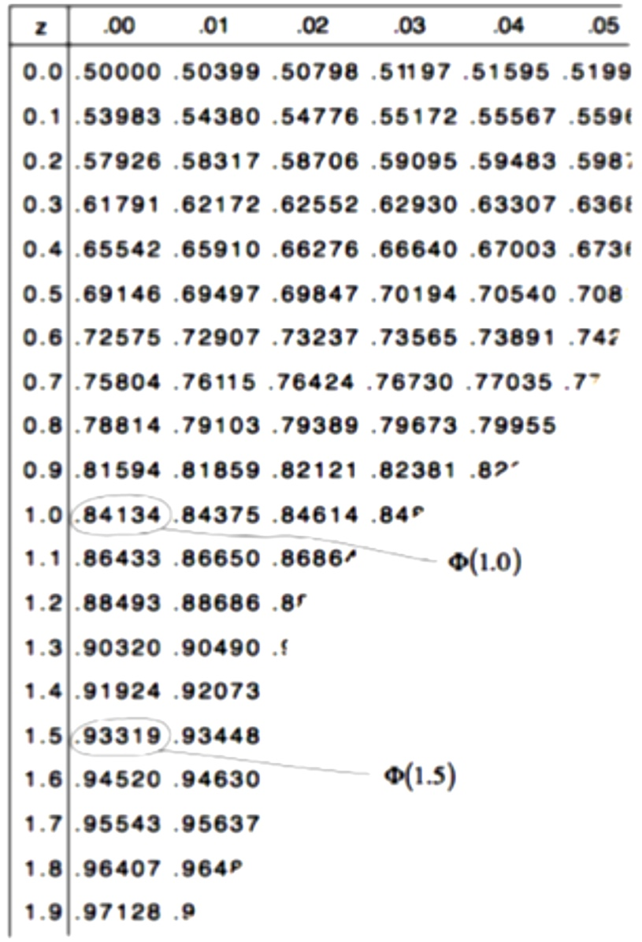
Using tables
If Z is a standardised normal distribution, then Z ~ (0, 1), then we can use tables to find P(Z<1).
This is also written as Φ(1)
We can see from the tables that Φ(1) = 0.84134 and so P(Z<1) = 0.84134 or there is an 84.1% chance that a randomly chosen value of Z is less than 1.
It follows that P(Z>1) = 1 –0.84134 = 0.15866 or 15.9%

Slide 13
Practice time – using tables
In all of these questions Z ~ N(0,1)
1. Find P(Z < 1.5)
2. Find P(Z > 1.5)
3. Find P(Z < 0.6)
4. Find P(Z > 0.6)
5. Find P(Z > 0)
6. Find P(Z < 0)
7. Find P(Z < -0.6)
8. Find P(Z > -0.6)

Slide 14
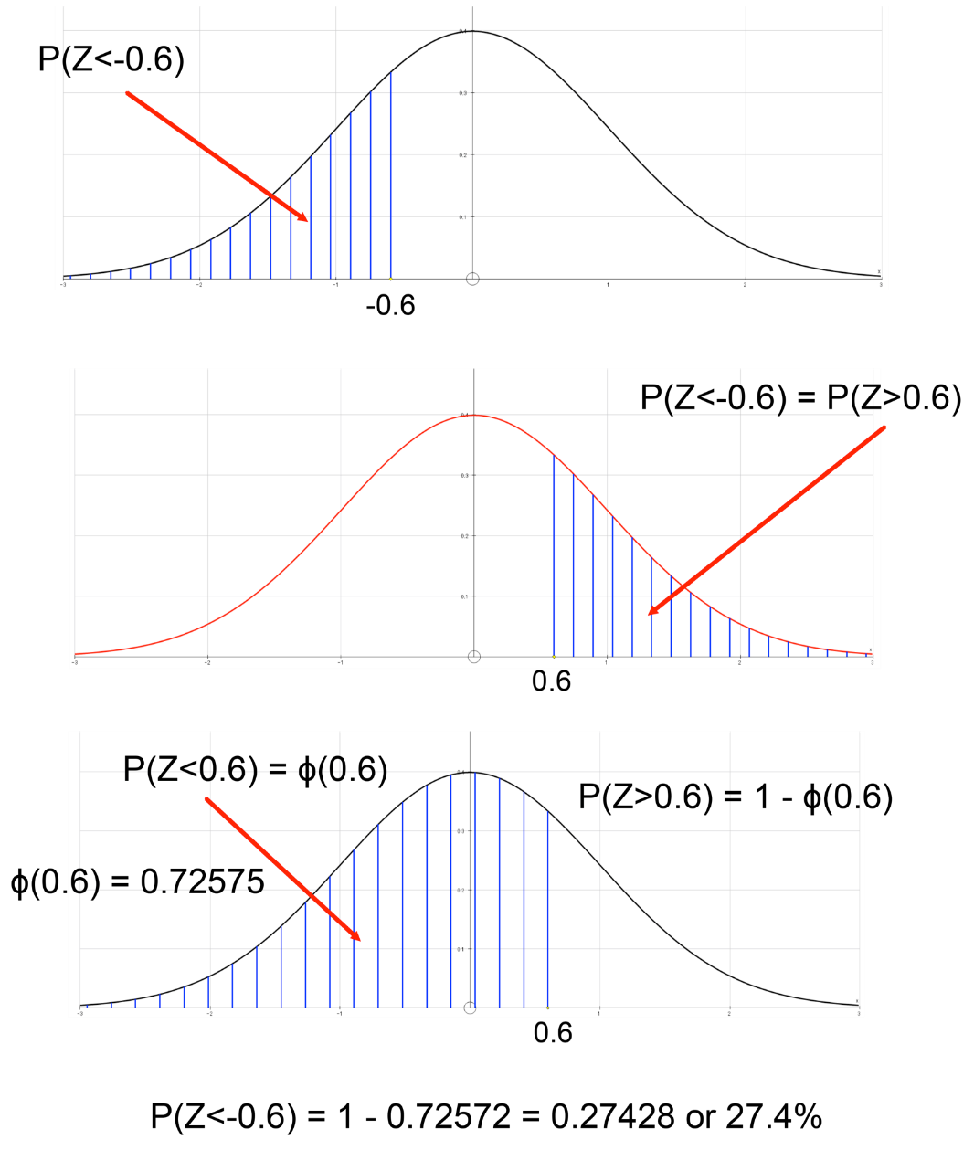
Find P(Z < -0.6)

Slide 15
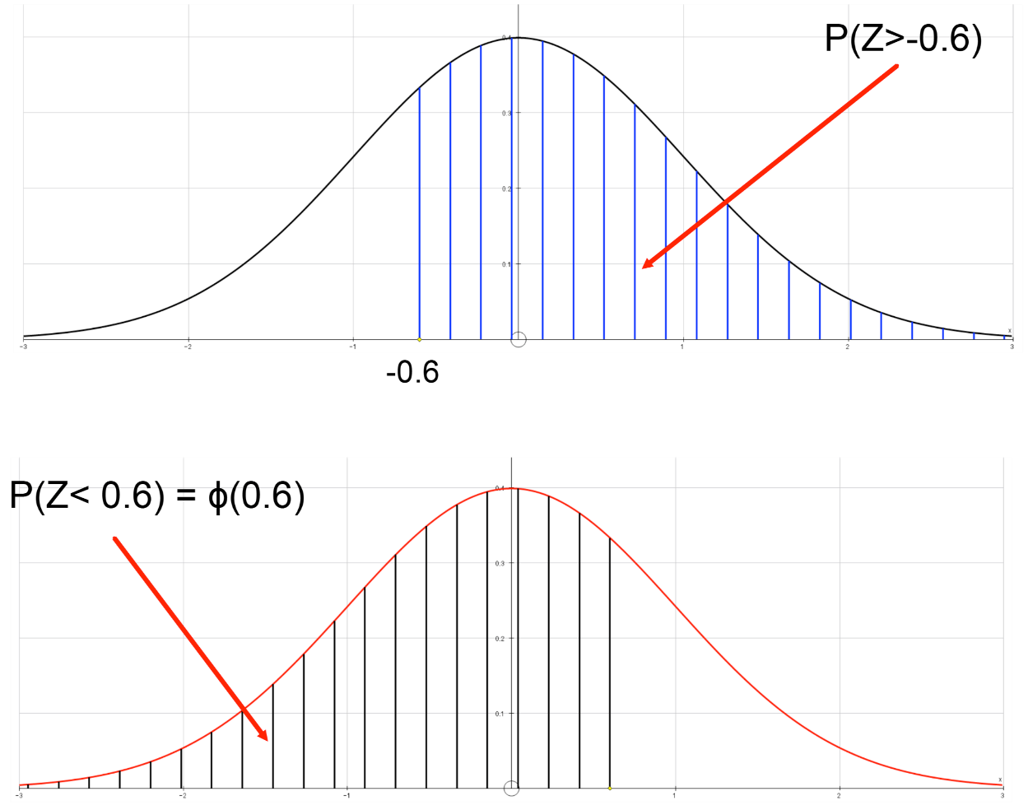
Find P(Z > -0.6)
P(Z>-0.6) = P(Z<0.6) = Φ(0.6) = 0.72575
(This is an alternative approach if you are not asked to find P(Z<-0.6)

Slide 16
Practice time
In all of these questions Z ~ N(0,1)
1. Find P(Z < -1.5)
2. Find P(Z > -1.5)
3. Find P(Z < -0.4)
4. Find P(Z > -0.4)
5. Find P(0.6 < Z < 1.8)
6. Find P(-0.6 < Z < 1.8)

Slide 17
Suggestion
Now try ‘The chicken and the egg’

