Slide 1
Codebreakers

Slide 2
Decrypting
There 6 different numbers, represented with 5 different scripts.
Can you work out which symbols represent which numbers?
Smile Mathematics 1931 “Which Scripts?”

Slide 3
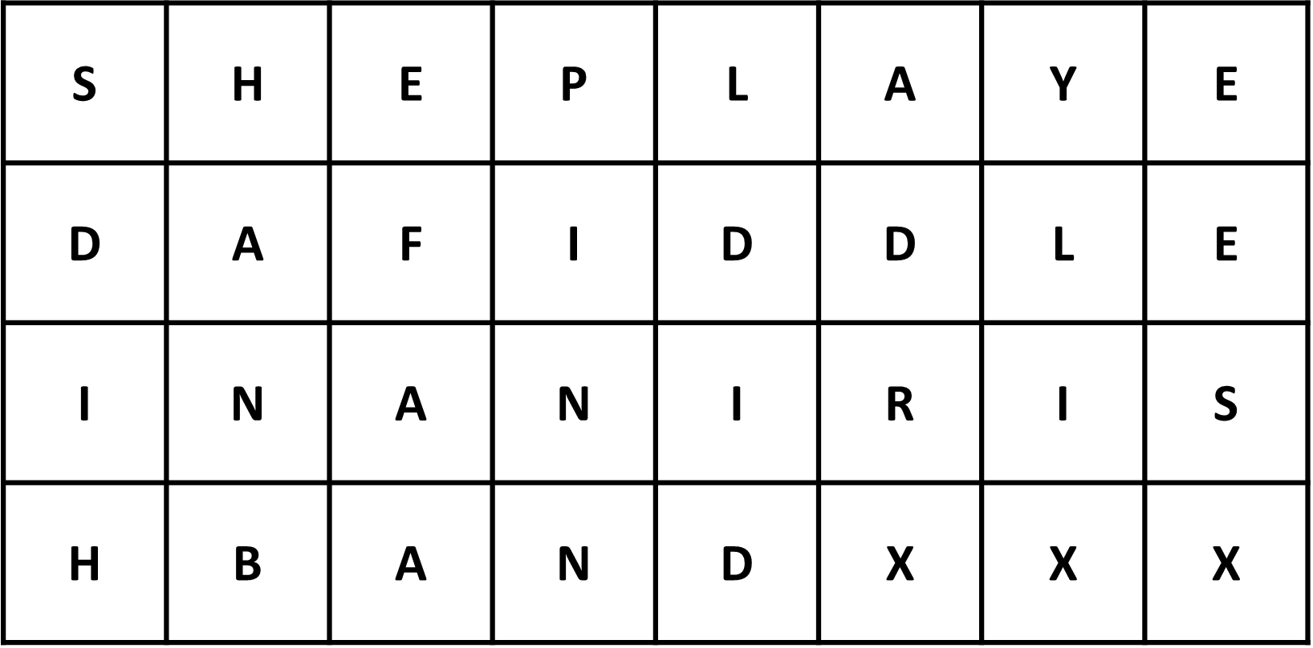
Encrypting
She played a fiddle in an Irish band.
A transposition cipher
SDIH-HANB-EFAA-PINN-LDID-ADRX-YLIX-EESX

