Slide 1
Scottish Regional Network Meeting, Stirling 17th April 2013
Raising the Profile of Technical Staff in your Institution
Val Gordon
An interactive session developed by Helen Charlwood & Jenny Harman, University of Hertfordshire.

Slide 2
Scottish Regional Network Meeting, Stirling 17th April 2013 Why do we need to raise the profile of Technical Staff? Occupational profile is associated with image, social status, esteem, value and worth. The profile of Technical Staff MUST be an accurate representation of what is a highly skilled, highly qualified, highly experience workforce. To achieve an optimal profile, Technical staff NEED high visibility, a strong voice, a clear sense of identity and formal, professional recognition of skills levels.

Slide 3
Scottish Regional Network Meeting, Stirling 17th April 2013
Using pictures and conversation it is hoped that you will leave the session with at least one personal action which will impact the profile of Technical Staff in a positive way within your specific area or institution.

Slide 4
Scottish Regional Network Meeting, Stirling 17th April 2013
Raising the Profile of Technical Staff in your Institution
Choose a picture that represents how you feel Technical Staff are perceived within your institution by:
Students
Academic staff
Senior management
Consider:
Does one card cover all 3 groups?
If not, what are the differences in perception?
What are the positives?
What are the issues and problems?
What are the common themes across institutions?
What are the themes across technical disciplines?
Now – choose a new picture that represents how you would like to be seen (think BIG! imagine a new picture of the future!)
Consider:
What are the good things about your 1st picture?
what are the issues and problems it raises?
Why is your new (2nd) picture important?
What benefits would this bring to you, your colleagues, the students, the institution?
Please avoid getting into HOW to achieve it at this stage – focus on the picture

Slide 5
Scottish Regional Network Meeting, Stirling 17th April 2013
Raising the Profile of Technical Staff in your Institution
Now – choose a new picture that represents how you would like to be seen.
Think BIG, your Utopian outcome, technician Nirvana!
Consider:
Ideally, how would you want technical staff to be perceived by the 3 groups (Students, Academics, Senior management)
Why is your new (2nd) picture important?
What benefits would this bring to you, your colleagues, the students, the institution?
Please avoid getting into HOW to achieve it at this stage – focus on the picture

Slide 7
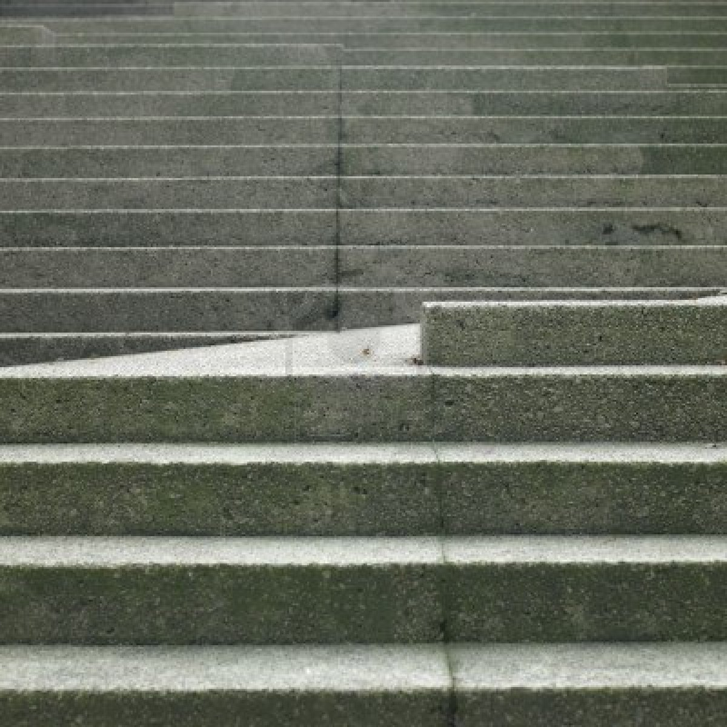
Scottish Regional Network Meeting, Stirling 17th April 2013
Raising the Profile of Technical Staff in your Institution
Consider a scale of 1 – 10, where 10 is your ‘new picture’ for the profile of technical staff?
1-—2—-3—-4—-5—-6—-7—-8—-9----10
What would one step closer be like and what actions will you take get there?
S pecific Specific aim?
T ime By when?
E lements What actions do you need to take?
P rogress How will progress be tracked?
S uccess How will you know it’s a success?

Slide 8
Scottish Regional Network Meeting, Stirling 17th April 2013
Raising the Profile of Technical Staff in your Institution
What can you do to move one step closer to a “10” profile?
Ensure a Technical presence on committees
Post profiles of Technical staff on departmental website alongside Academics
Talk to other technical managers
Pursue Professional Registration
Regular coffee mornings
Technicians notice board
Twitter – 2 way communication
Nominate Technicians for awards
Try to get a senior management “champion”
Technician training programme and succession planning
“Big yourself up” – nobody else will!
Information sessions for Technical staff e.g. HoS on resources
Include a Technical Showcase in Open Days/Induction/Freshers week
Set up a cross discipline Technicians forum within your Institute

Slide 9
Scottish Regional Network Meeting, Stirling 17th April 2013
Raising the Profile of Technical Staff in your Institution
Now that everyone has a personal action plan, let’s commit to encouraging progress by posting on the online community.
Rachel has talked us through how to do it!
Also, we can check how everyone’s plan is coming along when we meet at the next HEaTED Regional Event.

